Slide 1

ESE535:
Electronic Design Automation
Day 17: March 30, 2015
High Level Synthesis II
Dataflow Graph Sharing

Slide 2
Today
Behavioral
(C, MATLAB, …)
Sharing
Arch. Select
Schedule
Sharing
Dataflow subgraph
  Pattern identification
  Pattern selection
RTL
FSM assign
Two-level,
Multilevel opt.
Covering
Retiming
Gate Netlist
Placement
Routing
Layout
Masks

Slide 3
Flow Review

Slide 4
Additional Concerns?
What are we still not satisfied with?
Parallelism in hyperblock
  Especially if memory sequentialized
    Disambiguate memories?
    Allow multiple memory banks?
Only one hyperblock active at a time
  Share hardware between blocks?
Data only used from one side of mux
  Share hardware between sides?
Most logic in hyperblock idle?
  Couldn’t we pipeline execution?

Slide 5
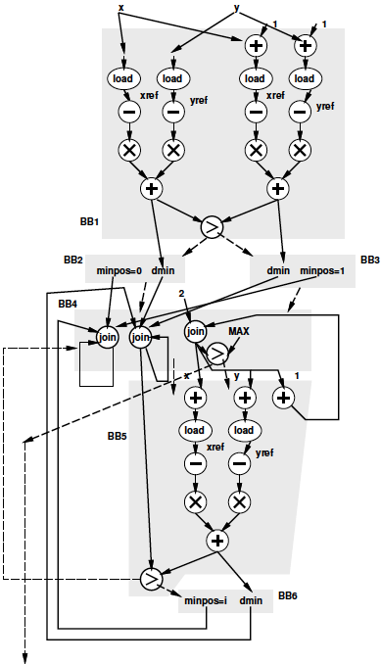
Preclass
Common subgraphs?
How would we like to
share?
  If trying to avoid slowdown
  If willing to make area-time
  tradeoffs?

Slide 6
Subgraph Sharing
Can potentially share identical subgraphs
Can share similar subgraphs

Slide 7
Evaluating Subgraph Sharing
What do we have to do to share subgraphs?
When is it worthwhile?
  How big does graph need to be?
  How much overhead to share?

Slide 8
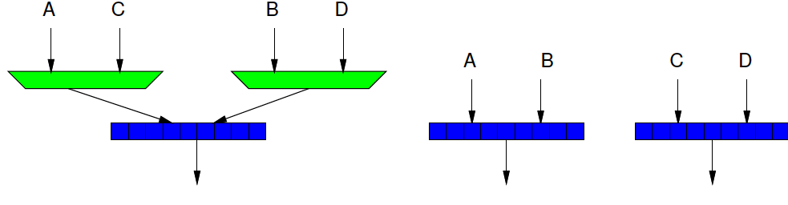
Example
Muxes on inputs to an adder
  Probably bigger than just having two adders
  2(Amux) + Aadd > 2(Aadd)
  On FPGA:
    ~LUT per Adder bit
    ~LUT per Mux bit

Slide 9
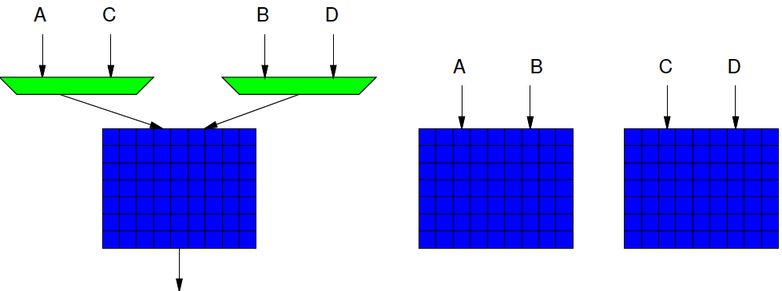
Example
Muxes on input to mulitipler
  Probably smaller than two multipliers
  2(Amux)+Ampy < 2(Ampy)
  General
    Area(Amux) ~ O(N)
    Area(Ampy) ~ O(N²)

Slide 10
Extreme Case
If ignored multiplexing overhead,
what would we get?
  What would we select at the resources and how connected?

Slide 11
VLIW Extreme
Sketch
  Each basic block requires a set of operators to achieve minimum path length
  Union sets over all basic blocks
    Keep track of max number of each operator type
  Build VLIW with that operator set
Why unsatisfying?
X
X
+

Slide 12
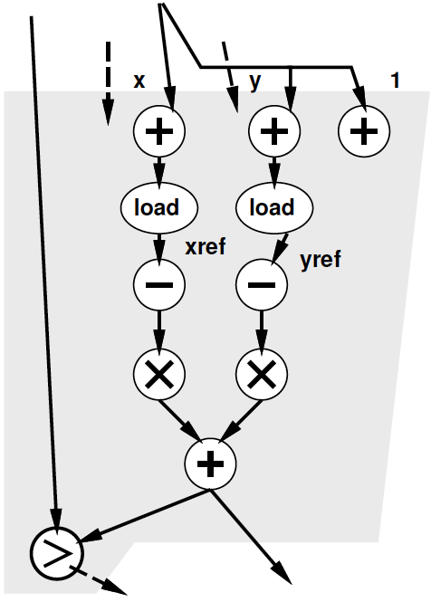
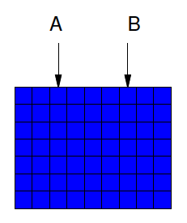
Favorable Subgraphs
Particularly beneficial when I/O into subgraph small
  Overhead for muxing
  proportional to inputs

Slide 13
Approach
Find candidate, reusable subgraphs→patterns
Select a cover set of patterns
Assign original graph to patterns
  Assess benefits of sharing
Patch together pattern cover with
control and multiplexing

Slide 14
Terms
Subgraph
  A piece of original computational graph
Pattern
  Common (resuable) subgraph
Want to find small set of patterns that can efficiently cover the original graph

Slide 15
Approach
Find patterns
Select a cover set of patterns
Assign original graph to patterns
  Assess benefits of sharing
Patch together pattern cover with
control and multiplexing

Slide 16
Find Recurring Patterns
How might we identify the set of candidate patterns?

Slide 17
Finding Subgraphs
Keep set of subgraphs of size k
Create subgraphs of size k+1 from subgraphs of size k
  By adding a neighboring node
    Maybe several such expansions for each k-subgraph
Careful: can end up with exponential subgraphs

Slide 18
Optimization
Compute candidate graph patterns during subgraph generation
  Each subgraph may become a candidate
  Keep track of subgraphs that might match with candidate patterns
  As add subgraph, compare it with candidate patterns and add to list if “close” enough
  At end of a given graph size, prune out patterns with too few potential matches

Slide 19
Close enough?
Conceptually: not too expensive to use the candidate pattern
Concretely: compute a distance metric between graph and pattern
  Minimum cost of edits to morph one graph into another
    E.g. relabel nodes, remove nodes
  Want to capture potential cost of adding muxes and control

Slide 20
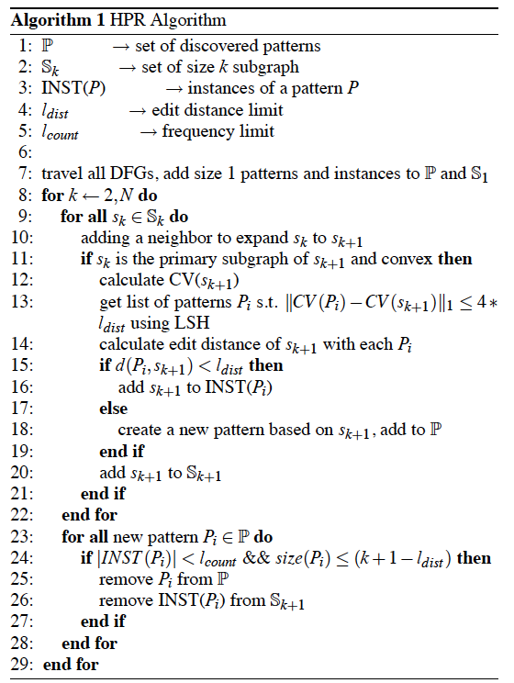
[Cong & Jiang / FPGA 2008]

Slide 21
Potential Optimization
Canonicalize subgraphs so recognize when encounter same subgraph again
  Keep set of subgraphs small
How might we identify/match subgraphs?

Slide 22
Subgraph Canonicalization
(similar to Common Subexpression)
In topological order (inputs to outputs)
Give name for single operator
Each node, need name for subgraph rooted at this node
  Since named/canonicalize all predecessors
    Looking for name for a pattern with same operator at the output, and the same subgraph on inputs
    Compare existing patterns end with output operator
      Hash operator+inputs → only check things that match hash
      Match → use that name, else allocate name

Slide 23
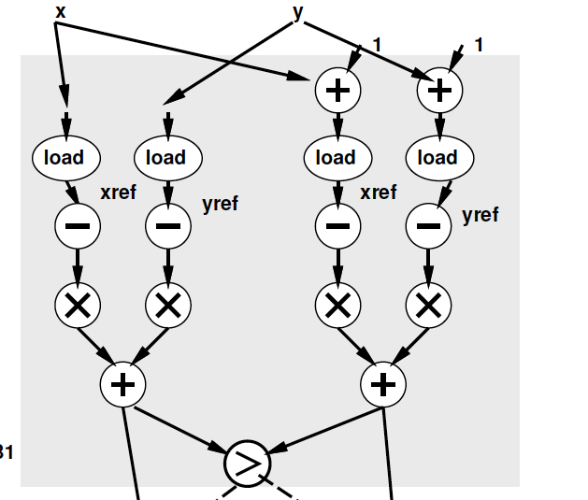
Subgraph Canonicalization
Problem
  Matches partial patterns from inputs
  Not match partial pattern omit part of inputs

Slide 24
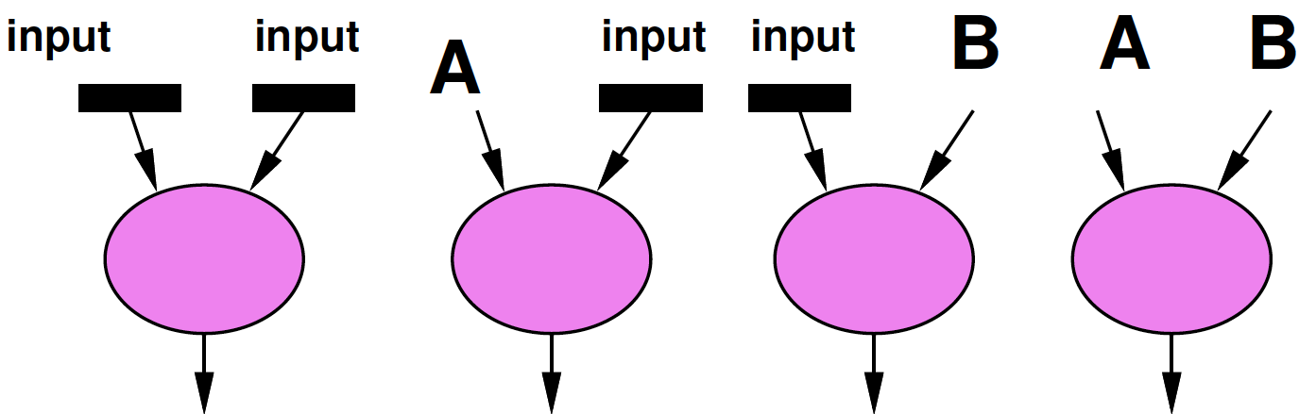
Subgraph Canonicalization
Problem
  Matches partial patterns from inputs
  Not match partial pattern omit part of inputs
Approach
  Also create/name patterns at each node with a subset of the inputs
  Means each node has multiple pattern candidates (could explode here)

Slide 25
Cover Subgraphs
One have candidate patterns, need to cover the original graph.
What’s our goal?
  (cost function)

Slide 26
Cover Goal
Minimize area
Minimum added latency
  Delay of BB covered by p in P
Minimize energy?

Slide 27
Cover Subgraph
Given a proposed set of pattern graphs,
how can we cover?

Slide 28
Cover Subgraph
How many sets if we explored them all?

Slide 29
Greedy Cover Subgraph
How might we cover greedily?

Slide 30
Greedy Cover Subgraph
Select “most beneficial” pattern
Assign it to the stuff it covers
  Add logic to share accommodate
  Remove those as things that need to be covered
Repeat until all covered or no benefit

Slide 31
Most Beneficial Pattern
How would we define pattern benefit?

Slide 32
Beneficial Pattern
N – number of patterns can apply to
Area: save muxes inside pattern
Latency: prefer parallel (low depth)
[Cong & Jiang / FPGA 2008]

Slide 33
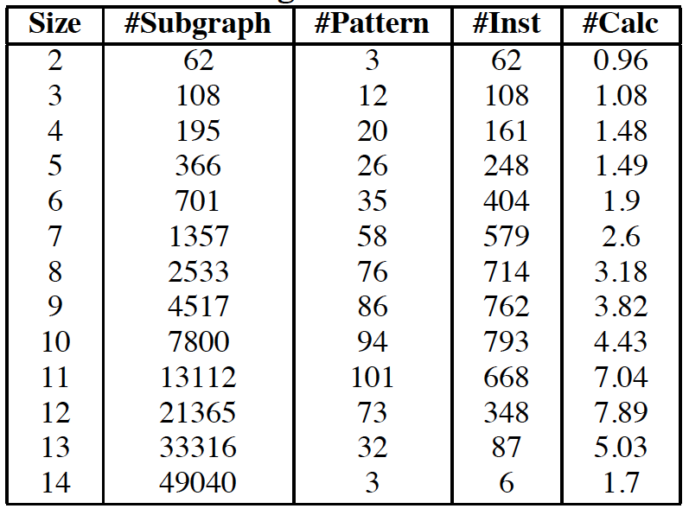
Pattern and Graph Statistics
#Calc –
Average
number of
edit-distance
calculations
per subgraph
match
[Cong & Jiang / FPGA 2008]

Slide 34
Energy Impact?
What are the energy impacts of sharing?

Slide 35
Big Ideas:
Sharing
Estimation
Techniques
  Graph Matching
  Covering
  Greedy

Slide 36
Admin
Project Formulation Proposal Due Thursday
  Office Hours or schedule time if want to discuss
Reading for Wednesday online

