Slide 1

ESE535:
Electronic Design Automation
Day 18: April 1, 2015
Modern SAT Solvers
({z}Chaff, GRASP, miniSAT)

Slide 2
Today
Behavioral
(C, MATLAB, …)
Arch. Select
Schedule
RTL
FSM assign
SAT
Pruning Search
Davis-Putnam
Data Structures
Optimizations
  Watch2
  VSIDS
  ?restarts
Learning (time permit)
Two-level,
Multilevel opt.
Covering
Retiming
Gate Netlist
Placement
Routing
Layout
Masks

Slide 3
Problem (almost)
SAT: Boolean Satisfiability
Given: logical formula g
Find a set of variable assignments that makes g true
Or conclude no such assignment exists

Slide 4
Example Uses
Can I find an assignment that causes this output to become true, false?
  Automatic Test Pattern Generation (ATPG)
  Static Timing Analysis (false paths)
Verification
  Is this optimized logic the same as the specification logic?
Provisioning/Scheduling
Partitioning, Placement, Routing
FSM Encoding

Slide 5
Preclass
Satisfying assignment for 1?
Satisfying assignment for 2?

Slide 6
Problem (more precise)
SAT: Boolean Satisfiability
Given: logical formula g in CNF
Find a set of variable assignments that makes g true
Or conclude no such assignment exists

Slide 7
CNF
Conjunctive Normal Form
Logical AND of a set of clauses
  Product of sums
Clauses: logical OR of a set of literals
Literal: a variable or its complement
E.g.
  (A+B+/C)*(/B+D)*(C+/A+/E)

Slide 8
CNF
Conjunctive Normal Form
Logical AND of a set of clauses
To be satisfied:
  Every clause must be made true
(A+B+/C)*(/B+D)*(C+/A+/E)
  If know D=false
    ➔ B must be false

Slide 9
3-SAT Universal
Can express any set of boolean constraints in CNF with at most 3 literals per clause
Canonical NP-complete problem

Slide 10
Convert to 3-SAT
A=/B*/C=/(B+C) → universal primitive
  We know can build any logic expression from nor2
3-CNF for A=/B*/C
  (A+B+C)*(/A+/B)*(/A+/C)
    If (B==0 && C==0) then A=1
    If (B==1 || C==1) then A=0
To convert any boolean formula to 3-CNF:
  Convert to nor2’s
    Or norX if not limited to 3-CNF formulas
  Then use above to convert nor2 expressions to set of clauses
  Combine (conjunct=AND) the clauses resulting from all the nor’s

Slide 11
3-SAT Universal
Point of conversion to 3-SAT
  simply to show that the problem hardness doesn’t change for clauses of any size larger than 3-SAT
  (2-SAT is an easier problem)
We will work directly with larger clauses

Slide 12
Brute Force Exhaustive
How could we find satisfying assignment?
How long would it take?
  With N binary variables

Slide 13
Search Formulation
A
Think of as search tree on variables
Each variable can be true or false
  Branch on values
All variables determined at leaves of tree
0
1
B
B
0
1
C
C
C
C
0
1

Slide 14
Key Trick
A
Avoid searching down to leaf on all subtrees
“Prune” away branches of tree
0
1
B
B
0
1
C
C
C
C
0
1

Slide 15
Key Trick
A
(A+B+C)*(/A+/B)*(/A+/C)
Consider A=1
0
1
B
B
0
1
C
C
C
C
0
1

Slide 16
Key Trick
A
(A+B+C)*(/A+/B)*(/A+/C)
Consider A=1
In this subtree becomes
  /B*/C
0
1
B
B
0
1
C
C
C
C
0
1

Slide 17
Key Trick
A
(A+B+C)*(/A+/B)*(/A+/C)
Consider A=1
In this subtree becomes
  /B*/C
Consider B=1
0
1
B
B
0
1
C
C
C
C
0
1

Slide 18
Key Trick
A
(A+B+C)*(/A+/B)*(/A+/C)
Consider A=1
In this subtree becomes
  /B*/C
Consider B=1
  Becomes false
  Regardless of C
  Don’t need to explore tree further
0
1
B
B
0
1
C
C
C
C
0
1

Slide 19
Key Trick
(A+B+C)*(/A+/B)*(/A+/C)
Consider A=1
In this subtree becomes
  /B*/C
Implication
  When there is only one literal left in a clause
  Can conclude it must be true
  → Select it and prune other branch
A
0
1
B
B
0
1
C
C
C
C
0
1

Slide 20
Key Trick
(…)*B*/B*(…)
Contradiction
  If implications lead to a conflicting assignments
  Can conclude this subtree is unsatisfiable
  Prune branch
A
0
1
B
B
0
1
C
C
C
C
0
1

Slide 21
Prospect
Use implications and contradictions to prune subtrees and avoid visiting full space
A
0
1
B
B
0
1
C
C
C
C
0
1

Slide 22
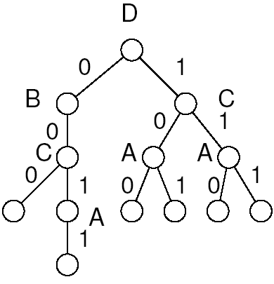
Pruning Search
(A+B+/C)*(/B+D)*(C+/A+/E)
Solve with pruning search
  Pick an unassigned variable
  Branch on true/false
  Compute implications

Slide 23
Davis-Putnam
while (true) {
if (!decide()) // no unassigned vars
return(satisfiable);
while ( !bcp()) { // constraint propagation
if (!resolveConflict()) // backtrack
return(not satisfiable);
}
}

Slide 24
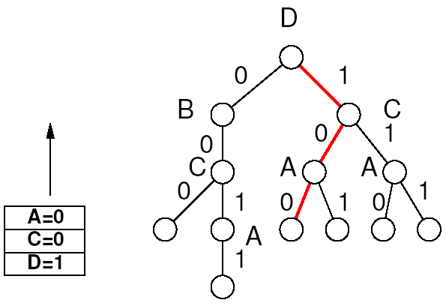
decide()
Picks an unassigned variable
Gives it a value
Push on decision stack
  Efficient structure for depth-first search tree
(A+B+/C)*(/B+D)*(C+/A+/E)

Slide 25
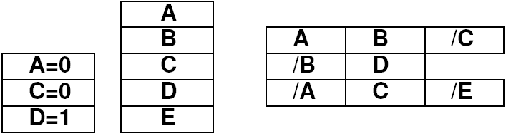
Data Structures
(A+B+/C)*(/B+D)*(C+/A+/E)
Decision “stack”
Variable “array”
Clause “DB”
  Each clause is a set of variables

Slide 26
bcp
(boolean constraint propagation)
What do we need to do on each variable assignment?
  Find implications
    Implication when all other literals in a clause are false
    Look through all clauses this assignment effects
    See if any now have all false and one unassigned
  Assign implied values
  Propagate that assignment
  Conflict if get implications for true and false

Slide 27
bcp()
Q=new queue();
Q.insert(top of decision stack);
while (!Q.empty())
  V=Q.pop();
  For each clause C in DB with V
    If C now satisfied, mark as such (remove from DB)
    If C has one unassigned literal, rest false
      Vnew=unassigned literal in C
      val=value Vnew must take
      If (Vnew assigned to value other than val)
        return (false); // conflict
      Q.add(Vnew=val);
return(true)

Slide 28
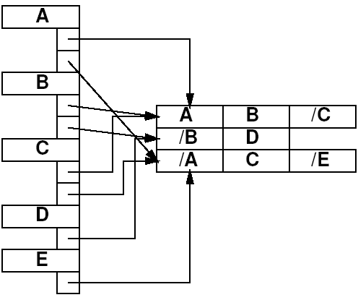
Variable Array
Each variable has a list pointing to all clauses in which it appears?
  Avoid need to look at every clause
(A+B+/C)*(/B+D)*(C+/A+/E)

Slide 29
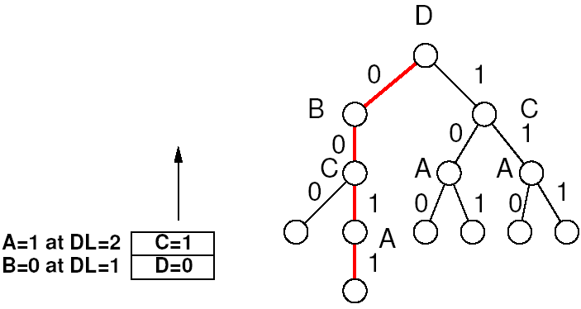
Tracking Implications
(A+B+/C)*(/B+D)*(C+/A+/E)
Each implication made at some tree level
  Associated with some entry on decision stack
  Has associated decision stack height
On backtrack
  Unassign implications above changed decision level

Slide 30
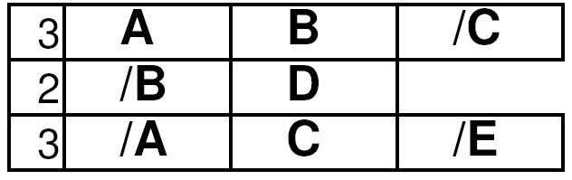
Track Variable Assignment
Each clause has counter
  Count number of unassigned literals
  Decrement when assign false literal
  Mark clause as satisfied when assign true literal (remove from clause database?)

Slide 31
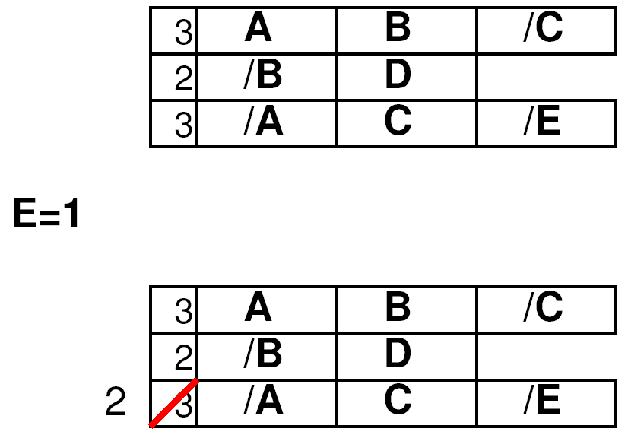
Track Variable Assignment
Each clause has counter
  Count number of unassigned literals
  Decrement when assign false literal
  Mark clause as satisfied when assign true literal (remove from clause database?)

Slide 32
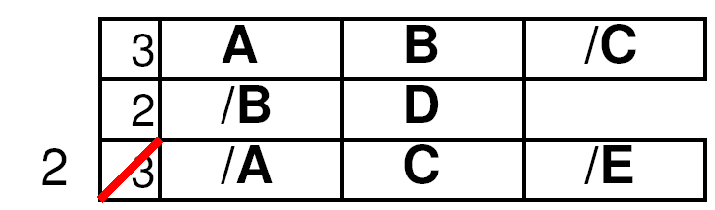
Track Variable Assignment
Each clause has counter
  Count number of unassigned literals
  Decrement when assign false literal
  Mark clause as satisfied when assign true literal
  Counter avoids need to check all variable assignments in clause on every assignment
  Watch for counter decrement 2→1
    That’s when a literal is implied.

Slide 33
resolveConflict()
What does resolveConflict need to do?
  Look at most recent decision
  If can go other way, switch value
    (clear implications to this depth)
  Else pop and recurse on previous decision
  If pop top decision,
    Unsatisfiable
Alternates:
  Treat literals separately
    Unassign and pick another literal
  Learning (later in lecture)
    May allow more direct backtracking

Slide 34
Chaff Optimizations

Slide 35
How will this perform?
10,000’s of variables
100,000’s of clauses (millions)
Every assignment walks to the clause database
Cache performance?
How big is L1 cache? L2 cache?
Ratio of main-memory speed to L1 cache speed?

Slide 36
Challenge 1
Currently, visit every clause on each assignment
  Clause with K variables
  Visited K-1 times
  K-2 of which just to discover it’s not the last
Can we avoid visiting every clause on every assignment?
  Every clause in which a variable appears?

Slide 37
Avoiding Clause Visits
Idea: watch only 2 variables in each clause
Only care about final set of next to last variable
If set other k-2, won’t force an implication
When set one of these (and everything else set)
  Then we have an implication

Slide 38
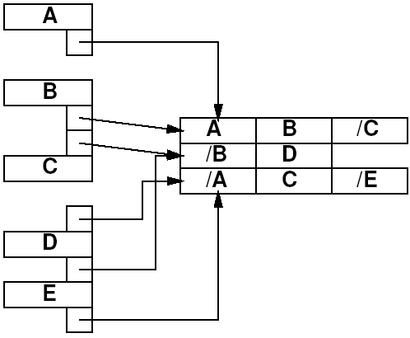
Watch 2 Data Structure

Slide 39
Avoiding Clause Visits
Idea: watch only 2 variables in each clause
Only care about final set of next to last variable
What if we set one of these two “watched” variables?
  If not last, change the watch to one of the unset variables

Slide 40
Watch 2
If watched literal becomes false
  Check if any non-watched true
  Check if all non-watched are set
    if so, set implication on other watched
    else, update watch literal

Slide 41
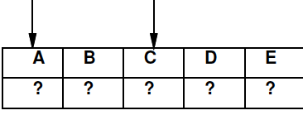
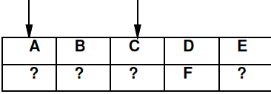
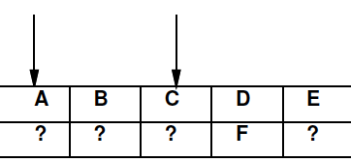
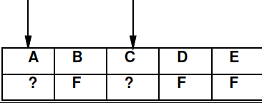
Review
Watch 2 Cases
What do in each case?
Set variable true (any)
Set variable false
  Non-watched
  Watched
    There is an undetermined,
    non-watched variable
    There is no undetermined,
    non-watched variable

Slide 42
Note
Watch pair is arbitrary
Unassigning a variable (during backtrack)
  Does not require reset of watch set
  Constant time to “unset” a variable

Slide 43
Challenge 2: Variable Ordering
How do we decide() which variable to use next?
  Want to pick one that facilitates lots of pruning

Slide 44
Variable Ordering
Old Ideas:
  Random
  (DLIS) Dynamic largest individual sum
    Used most frequently in unresolved clauses
    Potential weakness:
      Must re-sort with every variable assignment?
  …none clearly superior
    DLIS competitive
    Rand good on CAD benchmarks?

Slide 45
New: VSIDS
Variable State Independent Decaying Sum
  Each literal has a counter
  When clause added to DB, increment counter for each literal
  Select unassigned literal with highest count
  Periodically, all counters are divided by a constant

Slide 46
New: VSIDS
Variable State Independent Decaying Sum
  Each literal has a counter
  When clause added to DB, increment counter for each literal
    Remove clauses when satisfied?
    Reinsert on backtrack
  Select unassigned literal with highest count
  Periodically, all counters are divided by a constant

Slide 47
New: VSIDS
Variable State Independent Decaying Sum
  Each literal has a counter
  When clause added to DB, increment counter for each literal
  Select unassigned literal with highest count
    Don’t need to re-sort each selection
    Only re-sort on backtrack
    Maybe priority queue insert?
  Periodically, all counters are divided by a constant

Slide 48
VSIDS
Goal: satisfy recent conflict clauses
Decaying sum weights things being added
  Clauses not conflicting for a while, have values reduced
    (? Avoid walking through them by increasing weight on new stuff rather than decreasing all old?)
Impact: order of magnitude speedup

Slide 49
Restarts
Periodically restart
  Clearing the state of all variables
    i.e. clear decision stack
  Leave clauses in clause database
    ? Keep ordering based on recent costs
    ? Re-insert clauses must reinsert on restart?
  State of clause database drives variable ordering
    Benefit: new variable ordering based on lessons of previous search

Slide 50
Overall
Two orders of magnitude benefit on unsatisfiable instances
One order of magnitude on satisfiable instances

Slide 51
Learning
(time permitting)

Slide 52
Learning
When encounter a conflict
  Determine variable assignment contributing to conflict
  Add new clause to database
New clause allows pruning

Slide 53
Davis-Putnam w/ Learning
while (true) {
if (!decide()) // no unassigned vars
return(satisfiable);
while ( !bcp()) { // constraint propagation
analyzeConflicts(); // learning
if (!resolveConflict()) // backtrack
return(not satisfiable);
}
}

Slide 54
Implication Graph
As perform bcp propagation
  When set variable, insert back link to previous variable set forcing this variable set
  Graph captures what this implication depends upon
When encounter a conflict
  Identify what variable values caused

Slide 55
Example
Marques-Silva/Sakallah TRCOMP v48n5p506 1999

Slide 56
Conflict Resolution
x1 & /x9 & /x10 & /x11 lead to conflict
/(x1 & /x9 & /x10 & /x11)
/x1+x9+x10+x11 ⬅ new clause for DB

Slide 57
New Clause
New clause does not include x12, x13
May encounter this case again
/x1+x9+x10+x11 ⬅ new clause for DB

Slide 58
More Implications
x4 & /x10 & /x11 lead to conflict
/x4+x10+x11 ⬅ new clause for DB
Also (/x1+x9+x4) since x1*/x9 ➔ x4

Slide 59
New Clauses
/x4+x10+x11
  Doesn’t depend on x9
(/x1+x9+x4)
  x4 not in decision tree
Will be useful for later pruning

Slide 60
Unique Implication Point
UIP = vetext that dominates verticies leading to conflict
  x1 is UIP (decision variable causing is always a UIP)
  x4 is UIP

Slide 61
Clause Tradeoff
Adding clauses facilitates implications
  Increases pruning
  Must make less decisions
Adding clauses increases size of clause database
  Increases memory
  Could add exponential clauses
  Forces more work to push implications

Slide 62
Learned Clauses
Runtime = Decisions * ImplicationTime
  Decisions decreasing
  Implication Time increasing
Starting from 0 learned clauses,
  Net decrease in runtime
Eventually, Implication Time too large and slows down
Optimum with limited number of learned clauses

Slide 63
Limiting Learned Clauses
Filter out dominated clauses
Keep smaller clauses (fewer literals)
  Have most relevance
zChaff study suggest inserting only UIP closest to conflict [Zhang et al., ICCAD2001]
Treat like cache and evict learned clauses
  Use activity statistics as with variables so keep most useful clauses [minisat 1.2]

Slide 64
(Recall) Restarts
Periodically restart
  Clearing the state of all variables
    i.e. clear decision stack
  Leave clauses in clause database
  State of clause database drives variable ordering
    Benefit: new variable ordering based on lessons of previous search

Slide 65
Impact of Learning
zChaff [ICCAD2001] showed 2x improvement based on tuning the learning scheme
Learning can be orders of magnitude benefit

Slide 66
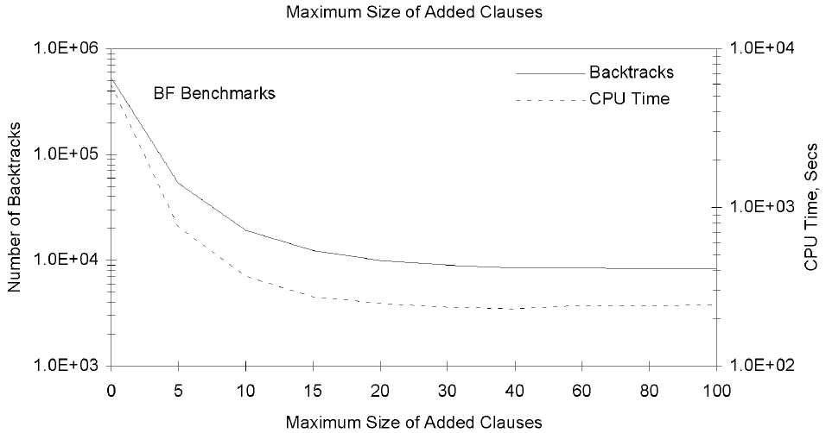
Impact of Learning
Marques-Silva/Sakallah TRCOMP v48n5p506 1999

Slide 67
Big Ideas
Technique: SAT
Exploit Structure
  Constraint propagation
  Pruning search technique
  Learning (discover structure)
Constants matter
  Exploit hierarchy in modern memory systems

Slide 68
Admin
Project Formulation Proposals – Thursday
Reading for Monday on Canvas

