Slide 1

ESE535:
Electronic Design Automation
Day 19: April 6, 2015
Two-Level Logic-Synthesis

Slide 2
Today
Behavioral
(C, MATLAB, …)
Arch. Select
Schedule
RTL
FSM assign
Two-Level Logic Optimization
  Problem
  Definitions
  Basic Algorithm: Quine-McCluskey
  Improvements
Two-level
Multilevel opt.
Covering
Retiming
Gate Netlist
Placement
Routing
Layout
Masks

Slide 3
Problem
Given: Expression in combinational logic
Find: Minimum (cost) sum-of-products expression
Ex.
  Y=a*b*c + a*b*/c + a*/b*c
  Y=a*b + a*c

Slide 4
EDA Use
Minimum size PLA, PAL, …
  Programmable Logic Array
  Programmable Array Logic
Minimum number of gates for two-level implementation
Starting point for multi-level optimization

Slide 5
Programmable Logic Arrays
(PLAs)

Slide 6
PLA
Directly implement flat (two-level) logic
  O=a*b*c*d + !a*b*!d + b*!c*d
Exploit substrate properties allow wired-OR

Slide 7
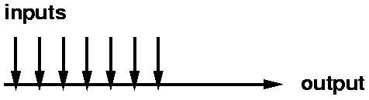
Wired-or
Connect series of inputs to wire
Any of the inputs can drive the wire high

Slide 8
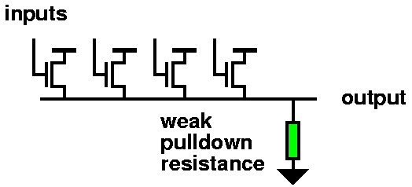
Wired-or
Obvious Implementation with Transistors

Slide 9
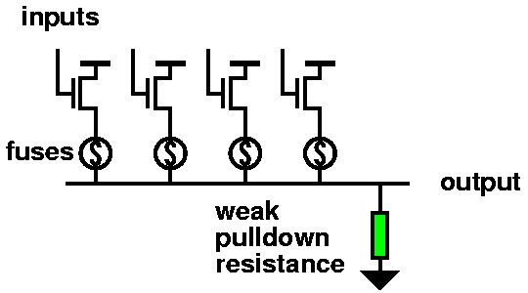
Programmable Wired-or
Use some memory function to programmable connect (disconnect) wires to OR
Fuse:

Slide 10
Programmable Wired-or
Memory configurable PLA model

Slide 11
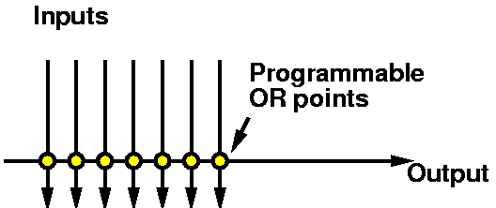
Diagram Wired-or

Slide 12
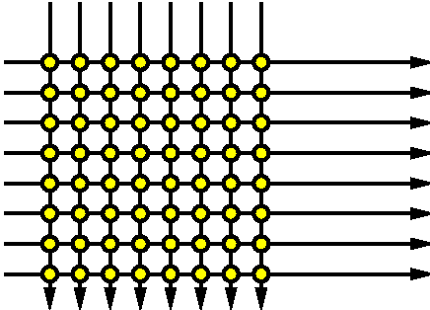
Wired-or array
Build into array
  Compute many different or functions from set of inputs

Slide 13
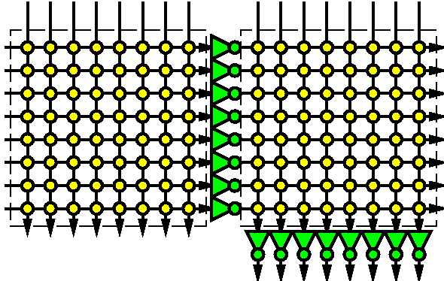
Combined or-arrays to PLA
Combine two or (nor) arrays to produce PLA (or-and / and-or array)

Slide 14
PLA
Can implement each and on single line in first array
Can implement each or on single line in second array
Strictly speaking:
or in first term and
in second,
but with both polarities
of inputs, can invert so
is and-or.

Slide 15
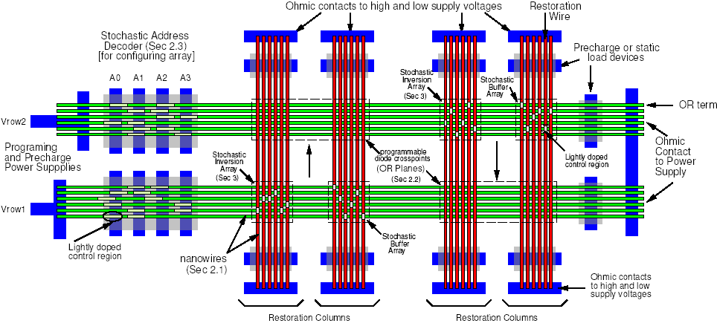
Nanowire PLA

Slide 16
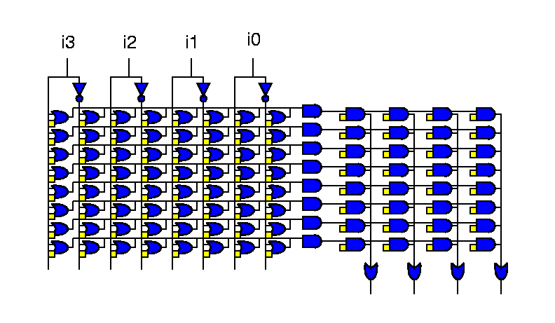
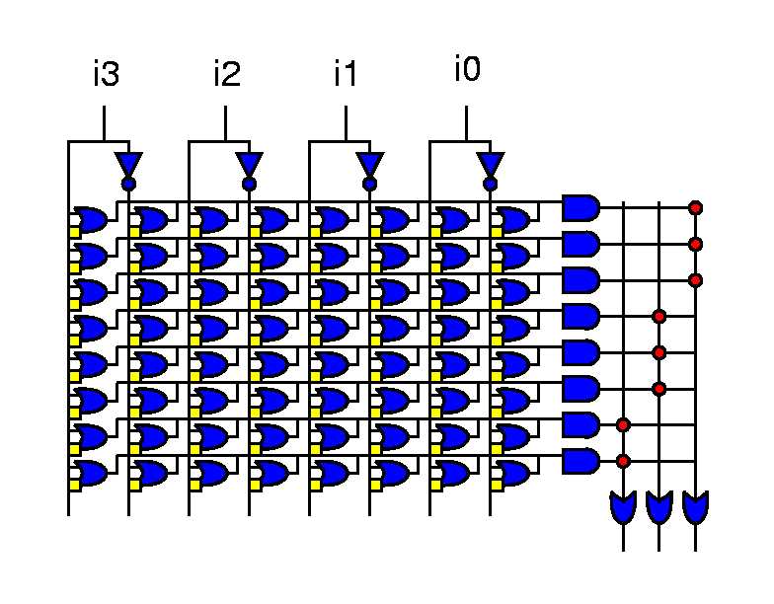
PLA and PAL
PAL = Programmable Array Logic
PAL has fixed OR plane.

Slide 17
…back to optimization…

Slide 18
EDA Use for 2-level Logic Min.
Minimum size PAL, PLA, …
  Programmable Logic Array
  Programmable Array Logic
Minimum number of gates for two-level implementation
Starting point for multi-level optimization

Slide 19
Complexity
Set covering problem
  NP-hard

Slide 20
Terminology (1)
Literals -- a, /a, b, /b, ….
  Qualified, single inputs
Minterms --
  full set of literals covering one input case
  in y=a*b+a*c
    a*b*c
    a*/b*c

Slide 21
Product Term
Each product = row in PLA is known as a Product Term or PTERM
With fixed number of inputs and outputs, area is determined by the number of PTERMs needed

Slide 22
Cost
PLA/PAL – to first order costs is:
  number of product terms
Abstract (mis, sis)
  {multilevel,sequential} interactive synthesis
  number of literals
    cost(y=a*b+a*/c )=4
General (simple, multi-level)
  ∑cost(product-term)
    e.g. nand2=4, nand3=5,nand4=6…

Slide 23
Terminology (2)
Cube:
  product covering one or more minterms
  Y=a*b+a*c
  cubes:
    a*b*c abc
    a*b ab
    a*c ac

Slide 24
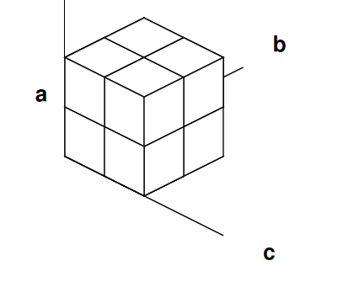
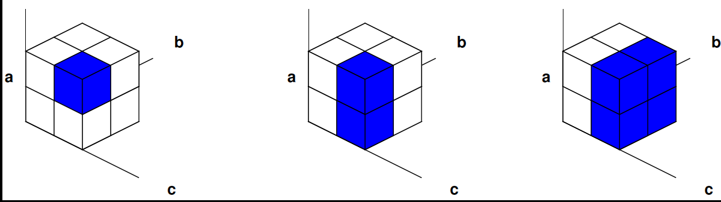
Terminology (2)
Cube:
  product covering one or more minterms
  Think of as n-dimensional space
  Looking for a k<=n cube

Slide 25
Terminology (3)
Cover:
  set of cubes
  sum products
  {abc, a/bc, ab/c}
  {ab,ac}

Slide 26
Truth Table
Also represent function
Specify on-set only
a b c y
0 0 0 0
0 0 1 0
0 1 0 0
0 1 1 0
1 0 0 0
1 0 1 1
1 1 0 1
1 1 1 1
a b c y
1 0 1 1
1 1 0 1
1 1 1 1

Slide 27
Cube/Logic Specification
Canonical order for variables
Use {0,1,-} to indicate input appearance in cube
  0 ≡ inverted abc 111
  1 ≡ not inverted a/bc 101
  - ≡ not present ac 1-1
a b c y
1 0 1 1
1 1 0 1
1 1 1 1
1 0 1 1
1 1 0 1
1 1 1 1
1 - 1 1
1 1 - 1
1 - 1
1 1 -

Slide 28
In General
Three sets:
  on-set (must be set to one by cover)
  off-set (must be set to zero by cover)
  don’t care set (can be zero or one)
Don’t Cares
  allow freedom in covering (reduce cost)
  arise from cases where value doesn’t matter
    e.g. outputs in non-existent FSM state
    data bus value when not driving bus

Slide 29
Multiple Outputs
Truth Table:
Convert to
single-output
problem
On-set
for result
a b y x
0 0 1 1
0 1 0 0
1 0 0 0
1 1 0 1
a b y x o
0 0 1 - 1
0 0 - 1 1
0 1 0 - 1
0 1 - 0 1
1 0 0 - 1
1 0 - 0 1
1 1 0 - 1
1 1 - 1 1
001-
00-1
010 -
01- 0
100 -
10- 0
110 -
11- 1

Slide 30
Multiple Outputs
Can reduce to single output case
  write equations on inputs and each output
    with onset for relation being true
  after cover
    remove literals associated with outputs

Slide 31
Multiple Outputs
Could Optimize separately
By optimizing together
  Maximize sharing of cubes/product-terms

Slide 32
Multiple Outputs
Consider:
  X=/a/b+ab+ac
  Y=/bc
Trivial solution has 4 product terms
000 10
001 11
010 00
011 00
100 00
101 11
110 10
111 10
000 10
-01 11
01- 00
100 00
11- 10

Slide 33
Multiple Outputs
Consider:
  X=/a/b+ab+ac
  Y=/bc
Now read off cover:
  Y=/bc
  A=/a/b/c+/bc+ab
  =/a/b+/bc+ab
000 10
001 11
010 00
011 00
100 00
101 11
110 10
111 10
000 10
-01 11
01- 00
100 00
11- 10
Only need 3 product terms
(versus 4 w/ no sharing)

Slide 34
Prime Implicants
Implicant -- cube in on-set
  (not entirely in don’t-care set)
Prime Implicant -- implicant, not contained in any other cube
  for y=a*b+a*c
    a*b is a prime implicant
    a*b*c is not a prime implicant (contained in ab, ac)
  I.e. largest cube still in on-set (on+dc-sets)

Slide 35
Prime Implicants
Minimum cover will be made up of primes
  fewer products if cover more
  fewer literals in prime than contained cubes
Necessary but not sufficient that minimum cover contain only primes
  y=ab+ac+b/c
  y=ac+b/c
Number of PI’s can be exponential in input size
  more than minterms, even!
  Not all PI’s will be in optimum cover

Slide 36
Restate Goal
Goal in terms of PIs
  Find minimum size set of PIs that cover the on-set.

Slide 37
Essential Prime Implicants
Prime Implicant which contains a minterm not covered by any other PI
  Essential PI must occur in any cover
  y=ab+ac+b/c
  ab 11- 110 111
  ac 1-1 101 111
  b/c -10 110 010
* essential (only 101)
* essential (only 010)

Slide 38
Computing Primes
Start with minterms
  for on-set and dc-set
merge pairs (distance one apart)
for each pair merged,
  mark source cubes as covered
repeat merging for resulting cube set
  until no more merging possible
retain all unmarked cubes which aren’t entirely in dc-set

Slide 39
Compute Prime Example
0 0000
5 0101
7 0111
8 1000
9 1001
10 1010
11 1011
14 1110
15 1111
Note this is preclass 3.
(in-class assignments, back of preclass sheet;
record solutions on board.)

Slide 40
Compute Prime Example
0, 8 -000
5, 7 01-1
7,15 -111
8, 9 100-
8,10 10-0
9,11 10-1
10,11 101-
10,14 1-10
11,15 1-11
14,15 111-
0 0000
5 0101
7 0111
8 1000
9 1001
10 1010
11 1011
14 1110
15 1111

Slide 41
Compute Prime Example
/b/c/d
/abd
bcd
a/b
ac
0 0000
5 0101
7 0111
8 1000
9 1001
10 1010
11 1011
14 1110
15 1111
0, 8 -000
5, 7 01-1
7,15 -111
8, 9 100-
8,10 10-0
9,11 10-1
10,11 101-
10,14 1-10
11,15 1-11
14,15 111-
0, 8 -000
5, 7 01-1
7,15 -111
8, 9 100-
8,10 10-0
9,11 10-1
10,11 101-
10,14 1-10
11,15 1-11
14,15 111-
8, 9,10,11 10--
10,11,14,15 1-1-

Slide 42
Covering Matrix
Minterms × Prime Implicants
Goal:
minimum
cover
/b/c/d /abd bcd a/b ac
0000 X
0101 X
0111 X X
1000 X X
1001 X
1010 X X
1011 X X
1110 X
1111 X X

Slide 43
Essential Reduction
Must pick essential PI
  pick and eliminate row and column
Which essential?
/b/c/d /abd bcd a/b ac
0000 X
0101 X
0111 X X
1000 X X
1001 X
1010 X X
1011 X X
1110 X
1111 X X

Slide 44
Essential Reduction
This case:
  Cover determined by essentials
  Preclass 3: ac+a/b+/abd+/b/c/d
General case:
  Reduces size of problem

Slide 45
Dominators: Column
If a column (PI) covers the same or strictly more than another column
  can remove dominated column
C dominates B
B C D E F G H
0101 X X
0111 X X
1000 X X
1010 X X
1110 X X
1111 X X
Any others?
G dominates H

Slide 46
Dominators: Column
If a column (PI) covers the same or strictly more than another column
  can remove dominated column
C D E F G
0101 X
0111 X X
1000 X
1010 X X
1110 X X
1111 X X
B C D E F G H
0101 X X
0111 X X
1000 X X
1010 X X
1110 X X
1111 X X

Slide 47
New Essentials
Dominance reduction may yield new Essential PIs
What’s essential?
C D E F G
0101 X
0111 X X
1000 X
1010 X X
1110 X X
1111 X X
C,G now essential
C D E F G
1110 X X
1111 X X
What now?
E dominates D and F
Cover = {C,E,G}

Slide 48
Dominators: Row
If a row has the same (or strictly more) PIs than another row, the larger row dominantes
  we can remove the dominating row
    (NOTE OPPOSITE OF COLUMN CASE)
C D E F G
0101 X
0111 X X
1000 X
1010 X X
1110 X X
1111 X X
0111 dominates 0101
remove 0111
Others?
1010 dominates 1000
remove 1010

Slide 49
Cyclic Core
After applying reductions
  essential
  column dominators
  row dominators
May still have a non-trivial covering matrix
How do we move forward from here?

Slide 50
Example
A B C D E F G H
0000 X X
0001 X X
0101 X X
0111 X X
1000 X X
1010 X X
1110 X X
1111 X X

Slide 51
Cyclic Core
Cannot select (e.g. essential) or exclude (e.g. dominated) a PI definitively.
Make a guess
  A in cover
  A not in cover
Proceed from there

Slide 52
Example
A B C D E F G H
0000 X X
0001 X X
0101 X X
0111 X X
1000 X X
1010 X X
1110 X X
1111 X X
A in Cover:
What now?
B C D E F G H
0101 X X
0111 X X
1000 X X
1010 X X
1110 X X
1111 X X

Slide 53
Example
A B C D E F G H
0000 X X
0001 X X
0101 X X
0111 X X
1000 X X
1010 X X
1110 X X
1111 X X
A in Cover:
B C D E F G H
0101 X X
0111 X X
1000 X X
1010 X X
1110 X X
1111 X X
C dominates B
G dominates H

Slide 54
Example
A B C D E F G H
0000 X X
0001 X X
0101 X X
0111 X X
1000 X X
1010 X X
1110 X X
1111 X X
What now?
A not in Cover:
B C D E F G H
0000 X
0001 X
0101 X X
0111 X X
1000 X X
1010 X X
1110 X X
1111 X X

Slide 55
Basic Two-Level Minimization
(espresso-exact)
Generate Prime Implicants
Reduce (essential, dominators)
If not done,
  pick a cube
  branch (back to reduce) on selected/not
    i.e. search tree … branch and bound
Save smallest

Slide 56
Branching Search
A in cover
A not in cover
{A,B}
{A,/B}
A and B not in cover
{A,B,C}
{/A,/B,/C}

Slide 57
Branching Search w/ Implications
A in cover
A not in cover
/B
B
{A,/B, C}
{/A,B,/C}
Implications Prune Tree
(like BCP in SAT)
Only exponential in decision
where must branch

Slide 58
Covering Technique?
Possibly useful for dataflow subgraph selection? (Day 17)
  Treat application components as rows (minterms)
  Treat patterns as columns (PIs)
But, more general (complicated) cost model

Slide 59
Optimization
Summarize Minterms (signature cubes)
  rows represent collection of minterms with same primes
Avoid generating full set of PIs
  pre-combining dominators during generation
Branch-and-bound pruning
  get lower bound on remaining cost of a cover by computing independent set of primes
    (not necessarily maximal, that would be NP-hard)

Slide 60
Heuristic Variant
Don’t backtrack when select prime for inclusion/exclusion
  pick cover large set of minterms/signatures
  weight to select “hard” to cover signatures
Generate reduced set of PIs
Iterative improvement

Slide 61
Canonical Form
Can start with any form of logical expression
Get unique truth-table/minterms
Problem not sensitive to input statement
  compare covering (decomposition)
  compare sequential programming languages
Cost: potentially exponential explosion in minterms/PIs

Slide 62
Summary
Formulate as covering problem
Solution space restricted to PIs
Essentials must be in solution
Use dominators to further reduce space
Then branching/pruning to explore rest of PIs
Ways to reduce work
  group minterms/PIs together early
  mostly fall into this general scheme

Slide 63
Big Ideas
Canonical Form
  eliminate bias of input specification
Technique:
  branch-and-bound
  pruning search – exploit structure
  Dominators

Slide 64
Admin
Reading for Wednesday online (web)

