Slide 1

ESE535:
Electronic Design Automation
Day 20: April 8, 2015
Sequential Optimization
(FSM Encoding)

Slide 2
Today
Behavioral
(C, MATLAB, …)
Arch. Select
Schedule
RTL
FSM assign
Encoding
  Input
  Output
State Encoding
  “exact” two-level
    …at least input constraints
    Flavor of output
  Energy-oriented
Two-level
Multilevel opt.
Covering
Retiming
Gate Netlist
Placement
Routing
Layout
Masks

Slide 3
Input Encoding
Pick codes for input cases to simplify logic
E.g. Instruction Decoding
  ADD, SUB, MUL, OR
Have freedom in code assigned
Pick code to minimize logic
  E.g. number of product terms

Slide 4
Output Encoding
Opposite problem
Pick codes for output symbols
E.g. allocation selection
  Prefer N, Prefer S, Prefer E, Prefer W, No Preference
Again, freedom in coding
Use to maximize sharing
  Common product terms, CSE

Slide 5
FSM Reminder

Slide 6
Finite-State Machine
What’s a FSM?
  Or DFA = Deterministic Finite Automata?

Slide 7
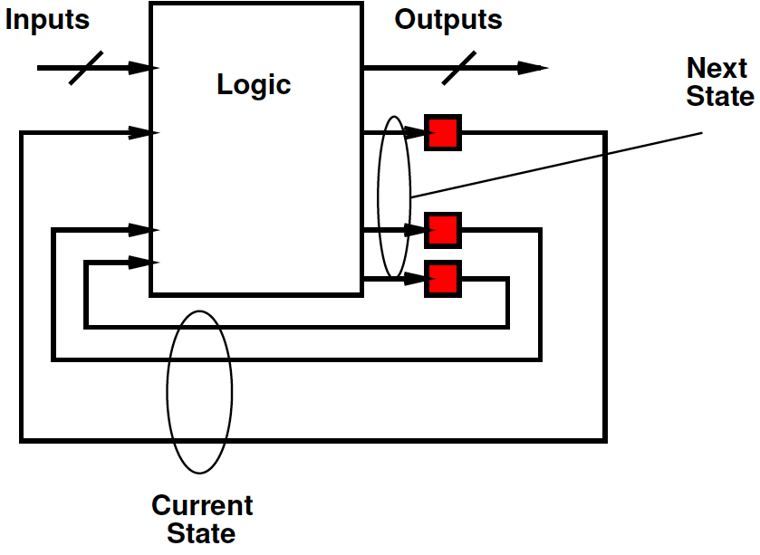
FSM
Logic depends on past inputs
Behaves differently based on state
Logic selects outputs and next state
  Based on inputs and current state

Slide 8
FSM Examples
What are examples where need an FSM rather than just combination logic?

Slide 9
FSM Examples
What are examples where need an FSM rather than just combination logic?
  Parsing
  Protocols
  Datapath control
  Data dependent branching

Slide 10
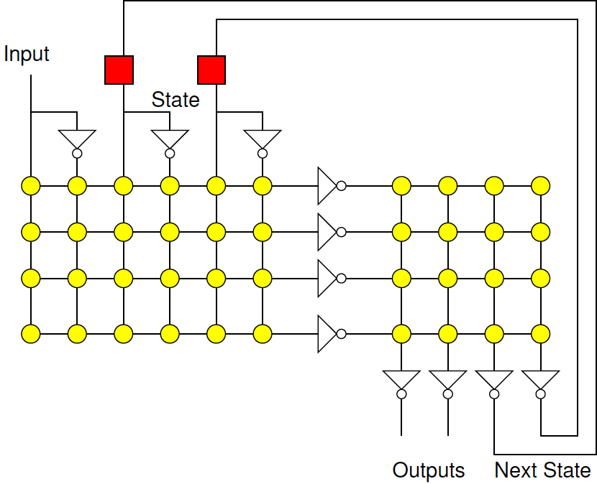
Two-Level FSM

Slide 11
Finite-State Machine
Logical behavior depends on state
In response to inputs, may change state
0/1
1/0
-/1
1/0
0/0

Slide 12
State Encoding
State encoding is a logical entity
No a priori reason any particular state has any particular encoding
Use freedom to simply logic

Slide 13
Finite State Machine
0/1
1/0
-/1
1/0
0/0
0 S1 S1 1
1 S1 S2 0
1 S2 S2 0
0 S2 S3 0
1 S3 S3 1
0 S3 S3 1

Slide 14
Motivating Example

Slide 15
Preclass 1—3
How many PTERMs after optimization?
What caused savings?
01010
01111
10010
10101
11011
11101

Slide 16
Preclass 4—5
How many PTERMs after optimization?
What caused savings?
000--
001--
01010
01111
10010
10101
11011
11101
00010
00101
01010
01111
10010
10101
11011
11101

Slide 17
Preclass 6
Anyone get smaller? Encoding?

Slide 18
Two Issues
Input Coding
  Use a single input cube to select an output
  Capture the union of things that behave similarly on a single cube
Output Coding
  Only need to cover the 1’s
  Share logic producing 1’s between states

Slide 19
Preclass
Current State | Input | Next State
ST1 | 0 | ST2
ST1 | 1 | ST3
ST2 | 0 | ST2
ST2 | 1 | ST1
ST3 | 0 | ST3
ST3 | 1 | ST1
What input cases produce
same output?

Slide 20
Preclass
Current State | Input | Next State
ST1 | 0 | ST2
ST1 | 1 | ST3
ST2 | 0 | ST2
ST2 | 1 | ST1
ST3 | 0 | ST3
ST3 | 1 | ST1
Produce same output?

Slide 21
Preclass
Current State | Input | Next State
ST1+ST2 | 0 | ST2
ST1 | 1 | ST3
ST2 | 0 | ST2
ST2+ST3 | 1 | ST1
ST3 | 0 | ST3
ST3 | 1 | ST1
Current State | Input | Next State
ST1 | 0 | ST2
ST1 | 1 | ST3
ST2 | 0 | ST2
ST2 | 1 | ST1
ST3 | 0 | ST3
ST3 | 1 | ST1

Slide 22
Preclass
Current State | Input | Next State
ST1+ST2 | 0 | ST2
ST1 | 1 | ST3
ST2 | 0 | ST2
ST2+ST3 | 1 | ST1
ST3 | 0 | ST3
ST3 | 1 | ST1
If we can code ST1+ST2 and ST2+ST3 as cubes, we can save due to input encodings.
How could we make these cubes?
  3b state code?
  2b state code?

Slide 23
Preclass
Current State | Input | Next State
ST1+ST2 | 0 | ST2
ST1 | 1 | ST3
ST2+ST3 | 1 | ST1
ST3 | 0 | ST3
Assume 2 bit state code
How many Pterms if ST3=00?
  (and assume get input groupings on cube)
How many if ST3=11?
What’s a good code?

Slide 24
Problem:
Real: pick state encodings (si’s) so as to minimize the implementation area
  two-level
  multi-level
Simplified variants
  minimize product terms
  achieving minimum product terms, minimize state size
  minimize literals

Slide 25
Two-Level
A_{pla} = (2*ins+outs)*prods+ flops*wflop
inputs = PIs + state_bits
outputs = state_bits+POs
products terms (prods)
  depend on state-bit encoding
  this is where we have leverage

Slide 26
Multilevel
More sharing → less implementation area
Pick encoding to increase sharing
  maximize common sub expressions
  maximize common cubes
Effects of multi-level minimization hard to characterize (not predictable)

Slide 27
Two-Level Optimization
Idea: do symbolic minimization of two-level form
  This represents effects of sharing
Generate encoding constraints from this
  Properties code must have to maximize sharing
Cover
  Like two-level (mostly…)
Select Codes

Slide 28
Kinds of Sharing
Input sharing:
encode inputs so
cover set to reduce
product terms
Output sharing:
share input cubes
to produce individual
output bits
10 inp1+inp2=01
11 inp2+inp3=01
Out1=11
Out2=01
Out3=10
Out4=00
10 inp1 01
01 inp1 10
1- inp2 01
01 inp2 01
11 inp3 01
01 inp3 10
1101 out1
1100 out2
1111 out3
0000 out4
0001 out4
10 1- 01
01 10 10
11 –1 01
01 11 01
01 01 10
Inp1=10
Inp2=11
Inp3=01
110- 01
11-1 10

Slide 29
Input Encoding

Slide 30
Two-Level Input Oriented
Minimize product rows
  by exploiting common-cube
  next-state expressions
  Does not account for possible sharing of terms to cover outputs
[DeMicheli+Brayton+SV/TR CAD v4n3p269]

Slide 31
Outline Two-Level Input
Represent states as one-hot codes
Minimize using two-level optimization
  Include: combine compatible next states
    1 S1 S2 0
    1 S2 S2 0 ➔ 1 {S1,S2} S2 0
Get disjunct on states deriving next state
Assuming no sharing due to outputs
  gives minimum number of product terms
Cover to achieve
  Try to do so with minimum number of state bits

Slide 32
Multiple Valued Input Set
Treat input states as a multi-valued (not just 0,1) input variable
Effectively encode in one-hot form
  One-hot: each state gets a bit, only one on
Use to merge together input state sets
0 S1 S1 1
1 S1 S2 0
1 S2 S2 0
0 S2 S3 0
1 S3 S3 1
0 S3 S3 1
0 100 S1 1
1 100 S2 0
1 010 S2 0
0 010 S3 0
1 001 S3 1
0 001 S3 1

Slide 33
One-hot Minimum
One-hot gives minimum number of product terms
i.e. Can always maximally combine input sets into single product term

Slide 34
One-Hot Example (preclass)
Single cube for ST1+ST2 ?
100 0 010
100 1 001
010 0 010
010 1 100
001 0 001
001 1 100
11- - ---
1-1 - ---
-11 - ---
000 - ---
100 0 010
100 1 001
010 0 010
010 1 100
001 0 001
001 1 100
11- - ---
1-1 - ---
-11 - ---
000 - ---
--0 0 010
100 1 001
0-- 1 100
001 0 001
ST1 0 ST2
ST1 1 ST3
ST2 0 ST2
ST2 1 ST1
ST3 0 ST3
ST3 1 ST1
One-hot:
ST1=100
ST2=010
ST3=001
Key: can define a cube to
cover any subset of states
--0 0 010 says (ST1+ST2) 0→ ST2

Slide 35
State Combining
Follows from standard 2-level optimization with don’t-care minimization
Effectively groups together common predecessor states as shown
(can define to combine directly)

Slide 36
Example
0 S s6 00
0 s2 s5 00
0 s3 s5 00
0 s4 s6 00
0 s5 S 10
0 s6 S 01
0 s7 s5 00
1 s6 s2 01
1 s5 s2 10
1 s4 s6 10
1 s7 s6 10
1 S s4 00
1 s2 s3 00
1 s3 s7 00
0 1000000 0000010 00
0 0100000 0000100 00
0 0010000 0000100 00
0 0001000 0000010 00
0 0000100 1000000 10
0 0000010 1000000 01
0 0000001 0000100 00
1 0000010 0100000 01
1 0000100 0100000 10
1 0001000 0000010 10
1 0000001 0000010 10
1 1000000 0001000 00
1 0100000 0010000 00
1 0010000 0000001 00
0 0110001 0000100 00
0 1001000 0000010 00
1 0001001 0000010 10
0 0000010 1000000 01
1 0000100 0100000 10
0 0000100 1000000 10
1 1000000 0001000 00
1 0000010 0100000 01
1 0100000 0010000 00
1 0010000 0000001 00

Slide 37
Two-Level Input
One-hot identifies multivalue minimum number of product terms
May be fewer product terms if get sharing (don’t cares) in generating the next state expressions
  (was not part of optimization)
Encoding places each disjunct on a unique cube face
  Can distinguish with a single cube
Can use fewer bits than one-hot
  this part typically heuristic
  Remember one-hot already minimized prod terms

Slide 38
Encoding Example
0 S s6 00
0 s2 s5 00
0 s3 s5 00
0 s4 s6 00
0 s5 S 10
0 s6 S 01
0 s7 s5 00
1 S s4 01
1 s2 s3 10
1 s3 s7 10
1 s4 s6 10
1 s5 s2 00
1 s6 s2 00
1 s7 s6 00
S 010
s2 110
s3 101
s4 000
s5 001
s6 011
s7 100
0 0110001 0000100 00
0 1001000 0000010 00
1 0001001 0000010 10
0 0000010 1000000 01
1 0000100 0100000 10
0 0000100 1000000 10
1 1000000 0001000 00
1 0000010 0100000 01
1 0100000 0010000 00
1 0010000 0000001 00
s2+s3+s7=1--
No 111 code

Slide 39
Encoding Example
S 010
s2 110
s3 101
s4 000
s5 001
s6 011
s7 100
0 0110001 0000100 00
0 1001000 0000010 00
1 0001001 0000010 10
0 0000010 1000000 01
1 0000100 0100000 10
0 0000100 1000000 10
1 1000000 0001000 00
1 0000010 0100000 01
1 0100000 0010000 00
1 0010000 0000001 00
0 1-- 001 00
0 0-0 011 00
1 -00 011 10
0 011 010 01
1 001 110 10
0 001 010 10
1 010 000 00
1 011 110 01
1 110 101 00
1 101 100 00
s4+s7=-00
S+s4=0-0
s2+s3+s7=1--
(no 111 code)

Slide 40
Input and Output
Concept

Slide 41
Idea
Input constraints → state sets can select with single cube
  (previous section)
Output constraints
  Track set of states encode together
  OR of asserted minterms is desired state
Encode constraints
Solve with SAT solver

Slide 42
Encoding Constraints
Minterm to symbolic state v
  should assert v
For all minterms m
  ∪all GPIs [(∩all symbolic tags) e(tag state)] = e(v)

Slide 43
Example: Output Constraints
  ∪all GPIs [(∩all symbolic tags) e(tag state)] = e(v)
Consider 1101 (out1)
covered by
110- (out1,out2)
11-1 (out1,out3)
1101 out1
1100 out2
1111 out3
0000 out4
0001 out4
110- (out1,out2)
11-1 (out1,out3)
000- (out4)
x
x
110- → e(out1) ∩ e(out2)
11-1 → e(out1) ∩ e(out3)
OR-plane gives me OR of these two
Want output to be e(out1)
1101 e(out1) ∩e(out2) ∪ e(out1) ∩e(out3)=e(out1)

Slide 44
Example: Output Constraints
  ∪all GPIs [(∩all symbolic tags) e(tag state)] = e(v)
Sample Solution:
out1=11
out2=01
out3=10
out4=00
Think about PLA
1101 out1
1100 out2
1111 out3
0000 out4
0001 out4
110- (out1,out2)
11-1 (out1,out3)
000- (out4)
110- 01
11-1 10
x
x
1101 e(out1) ∩e(out2) ∪ e(out1) ∩e(out3)=e(out1)
1100 e(out1) ∩e(out2)=e(out2)
1111 e(out1) ∩e(out3)=e(out3)
0000 e(out4)=e(out4)
0001 e(out4)=e(out4)

Slide 45
Idea
Input constraints → state sets can select with single cube
  (previous section)
Output constraints
  Track set of states encode together
  OR of asserted minterms is desired state
Encode constraints
Solve with SAT solver

Slide 46
Encoding for
Energy Minimization

Slide 47
Energy-Minimization
How would select encodings to minimize energy?

Slide 48
Energy-Minimization
Spend energy when state bits switch
  Driving outputs, driving inputs
Minimize distance
between states
  Esp. common state
  transitions

Slide 49
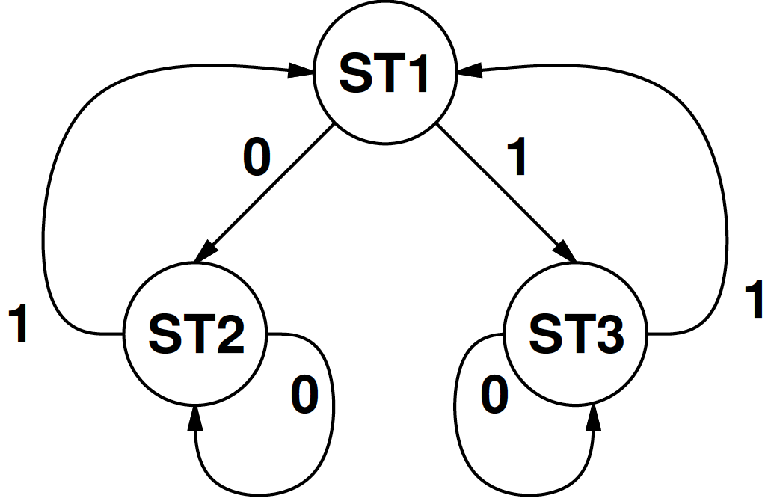
Energy Cost

Slide 50
Energy Encoding
How approach?
  Greedy
  Simulated Annealing
  ILP

Slide 51
Summary
Encoding can have a big effect on area, energy
Freedom in encoding allows us to maximize opportunities for sharing
Can do minimization around unencoded to understand structure in problem outside of encoding
Can adapt two-level covering to include and generate constraints
Multilevel limited by our understanding of structure we can find in expressions
  heuristics try to maximize expected structure

Slide 52
Today’s Big Ideas
Exploit freedom
Bounding solutions
Dominators
Formulation and Reduction
Technique:
  branch and bound
  SAT
  Understanding structure of problem
    Creating structure in the problem

Slide 53
Admin
Monday Reading on Web

Slide 54
Input and Output Details
Don’t expect to cover

Slide 55
General Problem
Track both input and output encoding constraints

Slide 56
General Two-Level Strategy
Generate “Generalized” Prime Implicants
Extract/identify encoding constraints
Cover with minimum number of GPIs that makes encodeable
Encode symbolic values
[Devadas+Newton/TR CAD v10n1p13]

Slide 57
Output Symbolic Sets
Maintain output state, PIs as a set
Represent inputs one-hot as before
0 S1 S1 1
1 S1 S2 0
1 S2 S2 0
0 S2 S3 0
1 S3 S3 1
0 S3 S3 1
0 100 S1 1
1 100 S2 0
1 010 S2 0
0 010 S3 0
1 001 S3 1
0 001 S3 1
0 100 (S1) (o1)
1 100 (S2) ()
1 010 (S2) ()
0 010 (S3) ()
1 001 (S3) (o1)
0 001 (S3) (o1)

Slide 58
Generate GPIs
Same basic idea as PI generation
  Quine-McKlusky
…but different

Slide 59
Merging
Cubes merge if
  distance one in input
    000 100
    001 100 ➔ 00- 100
  inputs same, differ in multi-valued input (state)
    000 100
    000 010 ➔ 000 110

Slide 60
Merging
When merge
  binary valued output contain outputs asserted in both (and)
    000 100 (foo) (o1,o2)
    001 100 (bar) (o1,o3) ➔ 00- 100 ? (o1)
  next state tag is union of states in merged cubes
    000 100 (foo) (o1,o2)
    001 100 (bar) (o1,o3) ➔ 00- 100 (foo,bar) (o1)

Slide 61
Merged Outputs
Merged outputs
  Set of things asserted by this input
  States would like to turn on together
    000 100 (foo) (o1,o2)
    001 100 (bar) (o1,o3) ➔ 00- 100 (foo,bar) (o1)

Slide 62
Cancellation
K+1 cube cancels k-cube only if
  multivalued input is identical
  AND next state and output identical
    000 100 (foo) (o1)
    001 100 (foo) (o1)
  Also cancel if multivalued input contains all inputs
    000 111 (foo) (o1)
Discard cube with next state containing all symbolic states and null output
  111 100 (foo,bar,baz…) () ➔ does nothing

Slide 63
Example
(copy to board…work;
Note inclass exercise, back of preclass)
0 100 (S1) (o1)
1 100 (S2) ()
1 010 (S2) ()
0 010 (S3) ()
1 001 (S3) (o1)
0 001 (S3) (o1)

Slide 64
Cancellation
K+1 cube cancels k-cube only if
  multivalued input is identical
  AND next state and output identical
    000 100 (foo) (o1) 00- 100 (foo) (o1)
    001 100 (foo) (o1)
  Also cancel if multivalued input contains all inputs
    000 111 (foo) (o1)
Discard cube with next state containing all symbolic states and null output
  111 100 (foo,bar,baz….) () ➔ does nothing

Slide 65
Example
0 100 (S1) (o1)
1 100 (S2) ()
1 010 (S2) ()
0 010 (S3) ()
1 001 (S3) (o1) x
0 001 (S3) (o1) x
- 100 (S1,S2) ()
0 110 (S1,S3) () x
0 101 (S1,S3) (o1)
1 110 (S2)
1 101 (S2,S3) () x
- 010 (S2,S3) ()
1 011 (S2,S3) () x
0 011 (S3) ()
- 001 (S3) (o1)
0 111 (S1,S3) ()
- 011 (S2,S3) ()
1 111 (S2,S3) ()
- 110 (S1,S2,S3) () x

Slide 66
Covering
Cover with branch-and-bound similar to two-level
  row dominance only if
    tags of two GPIs are identical
    OR tag of first is subset of second
Once cover, check encodeability
  [talk about next]
If fail, branch-and-bound again on additional GPIs to add to satisfy encodeability

Slide 67
Encoding Constraints
0 S1 S1 1
1 S1 S2 0
1 S2 S2 0
0 S2 S3 0
1 S3 S3 1
0 S3 S3 1
Minterm to symbolic state v
  should assert v
For all minterms m
  ∪all GPIs [(∩all symbolic tags) e(tag state)] = e(v)

Slide 68
Example
  ∪all GPIs [(∩all symbolic tags) e(tag state)] = e(v)
Consider 1101 (out1)
covered by
110- (out1,out2)
11-1 (out1,out3)
1101 out1
1100 out2
1111 out3
0000 out4
0001 out4
110- (out1,out2)
11-1 (out1,out3)
000- (out4)
x
x
110- → e(out1) ∩ e(out2)
11-1 → e(out1) ∩ e(out3)
OR-plane gives me OR of these two
Want output to be e(out1)
1101 e(out1) ∩e(out2) ∪ e(out1) ∩e(out3)=e(out1)

Slide 69
Example
  ∪all GPIs [(∩all symbolic tags) e(tag state)] = e(v)
Sample Solution:
out1=11
out2=01
out3=10
out4=00
Think about PLA
1101 out1
1100 out2
1111 out3
0000 out4
0001 out4
110- (out1,out2)
11-1 (out1,out3)
000- (out4)
110- 01
11-1 10
x
x
1101 e(out1) ∩e(out2) ∪ e(out1) ∩e(out3)=e(out1)
1100 e(out1) ∩e(out2)=e(out2)
1111 e(out1) ∩e(out3)=e(out3)
0000 e(out4)=e(out4)
0001 e(out4)=e(out4)

Slide 70
To Satisfy
Dominance and disjunctive relationships from encoding constraints
e.g.
  e(out1) ∩ e(out2) ∪ e(out1) ∩ e(out3)=e(out1)
  one of:
    e(out2)>e(out1) [i.e. e(out1) ∩e(out2)=e(out1)]
    e(out3)>e(out1) [i.e. e(out1) ∩e(out3)=e(out1)]
    e(out2)|e(out3)≥ e(out1)
> Means strictly
more bits on

Slide 71
Encodeability Graph
1100
    One of:
    e(out2)>e(out1)
    e(out3)>e(out1)
    e(out1)≤e(out2)|e(out3)
out1
out2
out4
1111
out3
1101 e(out1) ∩e(out2) ∪ e(out1) ∩e(out3)=e(out1)
1100 e(out1) ∩e(out2)=e(out2)
1111 e(out1) ∩e(out3)=e(out3)
0000 e(out4)=e(out4)
0001 e(out4)=e(out4)

Slide 72
Encoding Constraints
No directed cycles (proper dominance)
Siblings in disjunctive have no directed paths between
  (one cannot dominate other)
No two disjunctive equality can have exactly the same siblings for different parents
Parent of disjunctive should not dominate all sibling arcs

Slide 73
Encodeability Graph
1100
    One of:
    e(out2)>e(out1)
    e(out3)>e(out1)
    e(out1)≤e(out2)|e(out3)
cycle
out1
X
out2
cycle
1111
X
out4
No cycles → encodeable
out3
1101 e(out1) ∩e(out2) ∪ e(out1) ∩e(out3)=e(out1)
1100 e(out1) ∩e(out2)=e(out2)
1111 e(out1) ∩e(out3)=e(out3)
0000 e(out4)=e(out4)
0001 e(out4)=e(out4)

Slide 74
Determining Encoding
Can turn into boolean satisfiability problem for a target code length
All selected encoding constraints become boolean expressions
Also uniqueness constraints

Slide 75
What we’ve done
Define another problem
  Constrained coding
This identifies the necessary coding constraints
  Solve optimally with SAT solver
  Or attack heuristically

