Slide 1
ESE535: Electronic Design Automation
Day 21: April 13, 2015
FSM Equivalence Checking

Slide 2
Today
Behavioral
(C, MATLAB, …)
Arch. Select
Schedule
RTL
FSM assign
Sequential Verification
FSM equivalence
Issues
Extracting STG
Valid state reduction
Incomplete Specification
Two-level
Multilevel opt.
Covering
Retiming
Gate Netlist
Placement
Routing
Layout
Masks

Slide 3
FSM Equivalence

Slide 4
Motivation
Write at two levels
Java prototype and VHDL implementation
VHDL specification and gate-level implementation
Write at high level and synthesize/optimize
Want to verify that synthesis/transforms did not introduce an error

Slide 5
Question
Given a state machine with N states:
How long of an input sequence do I need to visit any of the N states?
(i.e. if someone picks a state, how long of an input sequence might you need to select a path to that state?)

Slide 6
Cornerstone Result
Given two FSM’s, can test their equivalence in finite time
N.B.:
Can visit all states in a FSM with finite input strings
No longer than number of states
Any string longer must have visited some state more than once (by pigeon-hole principle)
Cannot distinguish any prefix longer than number of states from some shorter prefix which eliminates cycle (pumping lemma)

Slide 7
FSM Equivalence
Given same sequence of inputs
Returns same sequence of outputs
Observation means can reason about finite sequence prefixes and extend to infinite sequences which FSMs are defined over

Slide 8
Equivalence
Brute Force:
Generate all strings of length |state|
(for larger FSM = the one with the most states)
Feed to both FSMs with these strings
Observe any differences?
How many such strings?
|Alphabet|^{states}

Slide 9
Random Testing
What does this say about random testing?
P(generate string)=1/|alphabet|^{|states|}
P(generate string)=|alphabet|^{-|states|}
P(miss string) = 1-P(generate string)
P(miss string, n tests)=P(miss string)^{n}
P(gen str, n test)=1-(1-|alphabet|^{-|states|})^{n}

Slide 10
Random Testing
Instance of “Coupon Collector” Problem
If there are C unique “Coupons” that can be selected uniformly at random
How many coupons will a collector need to get to have a full set of C?
Need C ln (C) to have a 50% chance of a full set

Slide 11
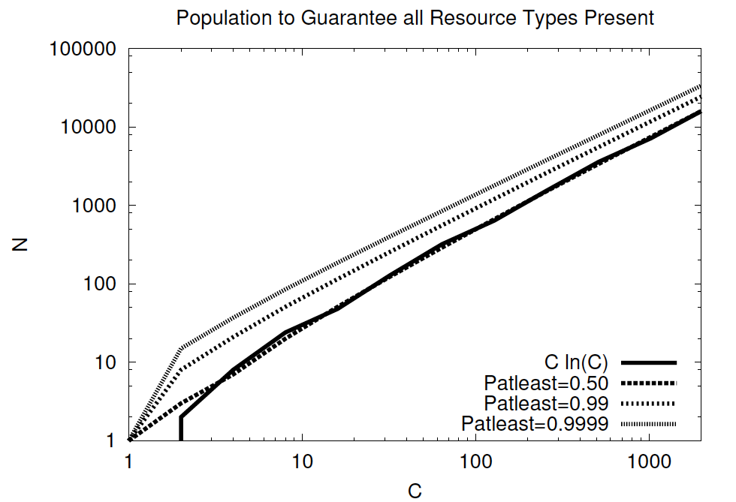
Random Testing
[DeHon, LLNSD Chapter, Kluwer 2004]

Slide 12
Random Testing
Random testing
Powerful
Not an efficient way to guarantee finds all behaviors
How can we do better?

Slide 13
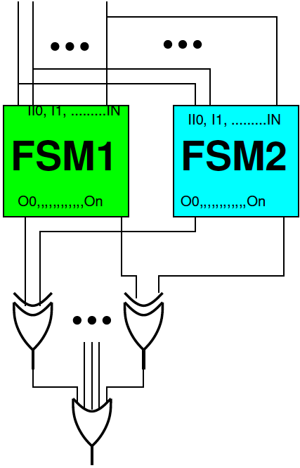
Smarter
Create composite FSM
Start with both FSMs
Connect common inputs together (Feed both FSMs)
XOR together outputs of two FSMs
Xor’s will be 1 if they disagree, 0 otherwise

Slide 14
Smarter
Create composite FSM
Start with both FSMs
Connect common inputs together (Feed both FSMs)
XOR together outputs of two FSMs
Xor’s will be 1 if they disagree, 0 otherwise
Ask if the new machine ever generate a 1 on an xor output (signal disagreement)
Any 1 is a proof of non-equivalence
Never produce a 1 → equivalent

Slide 15
Creating Composite FSM
Assume know start state for each FSM
Each state in composite is labeled by the pair {S1_{i}, S2_{j}}
How many such states?
Compare to number of strings of length #states?
Start in {S1₀, S2₀}
For each symbol a, create a new edge:
T(a,{S1₀, S2₀})→ {S1_{i}, S2_{j}}
If T₁(a, S1₀)→ S1_{i,} and T₂(a, S2₀)→ S2_{j}
Repeat for each composite state reached

Slide 16
Composite FSM
How much work?
At most |alphabet|*|State1|*|State2| edges == work
Can group together original edges
i.e. in each state compute intersections of outgoing edges
Really at most |E₁|*|E₂|

Slide 17
Non-Equivalence
State {S1_{i}, S2_{j}} demonstrates non-equivalence iff
{S1_{i}, S2_{j}} reachable
On some input, State S1_{i} and S2_{j} produce different outputs
If S1_{i} and S2_{j} have the same outputs for all composite states, it is impossible to distinguish the machines
They are equivalent
A reachable state with differing outputs
Implies the machines are not identical

Slide 18
Empty Language
Now that we have a composite state machine, with this construction
Question: does this composite state machine ever produce a 1?
Is there a reachable state that has differing outputs?

Slide 19
Answering Empty Language
Start at composite start state {S1₀, S2₀}
Search for path to a differing state
Use any search (BFS, DFS)
End when find differing state
Not equivalent
OR when have explored entire reachable graph w/out finding
Are equivalent

Slide 20
Reachability Search
Worst: explore all edges at most once
O(|E|)=O(|E₁|*|E₂|)
When we know the start states, we can combine composition construction and search
i.e. only follow edges which fill-in as search
(way described)

Slide 21
Example
s0
q0
1/0
-/0
0/0
-/1
s1
q1
q2
-/1
-/1
-/1
-/0
s2
q3

Slide 22
Creating Composite FSM
Assume know start state for each FSM
Each state in composite is labeled by the pair {S1_{i}, S2_{j}}
Start in {S1₀, S2₀}
For each symbol a, create a new edge:
T(a,{S1₀, S2₀})→ {S1_{i}, S2_{j}}
If T₁(a, S1₀)→ S1_{i,} and T₂(a, S2₀)→ S2_{j}
Check that both state machines produce same outputs on input symbol a
Repeat for each composite state reached

Slide 23
Example
s0
0/0
1/0
q0
0/0
1/0
s1
s2
1/0
0/0
0/1
1/1
0/1
q1
q2
1/1
0/1
1/1
s3
s4
1/0
0/0
0/0
1/0

Slide 24
Issues to Address
Obtaining State Transition Graph from Logic
Incompletely specified FSM?
Know valid (possible) states?
Know start state?

Slide 25
Getting STG from Logic
Brute Force
For each state
For each input minterm
Simulate/compute output
Add edges
Compute set of states will transition to
Smarter
Exploit cube grouping, search pruning
Cover sets of inputs together
Coming attraction: PODEM

Slide 26
Incomplete State Specification
Add edge for unspecified transition to
Single, new, terminal state
Reachability of this state may indicate problem
Actually, if both transition to this new state for same cases
Might say are equivalent
Just need to distinguish one machine in this state and other not

Slide 27
Valid States
Composite state construction and reachability further show what’s reachable
So, end up finding set of valid states
Not all possible states from state bits

Slide 28
Start State?
Worst-case:
Try verifying for all possible start state pairs
Identify start state pairs that lead to equivalence
Candidate start pairs
More likely have one (specification) where know start state
Only need to test with all possible start states for the other FSM

Slide 29
Summary
Finite state means
Can test with finite input strings
Composition
Turn it into a question about a single FSM
Reachability
Allows us to use poly-time search on FSM to prove equivalence
Or find differentiating input sequence

Slide 30
Big Ideas
Equivalence
Same observable behavior
Internal implementation irrelevant
Number/organization of states, encoding of state bits…
Exploit structure
Finite States … necessity of reconvergent paths
Structured Search – group together cubes
Limit to valid/reachable states
Proving invariants vs. empirical verification

Slide 31
Admin
Reading for next two lectures on blackboard

