Slide 1

ESE535:
Electronic Design Automation
Day 23: April 20, 2015
Static Timing Analysis
and Multi-Level Speedup

Slide 2
Delay of Preclass
Delay?
What transition causes?

Slide 3
Today
Behavioral
(C, MATLAB, …)
Arch. Select
Schedule
RTL
FSM assign
Topological Worst Case
  not adequate (too conservative)
Sensitization Conditions
Timed Calculus
Delay-justified paths
  Timed-PODEM
Speedup
Two-level
Multilevel opt.
Covering
Retiming
Gate Netlist
Placement
Routing
Layout
Masks

Slide 4
Topological Worst-Case Delay
Compute ASAP schedule
  Take max of arrival times
  Apply node Delay

Slide 5
Topological Worst-Case Delay
Node Delays
1
3
1
2
2
1
2

Slide 6
Topological Worst-Case Delay
7
Compute Delays
1
6
4
3
1
2
3
3
2
2
2
1
1
2
0
0
0
0
0
0

Slide 7
False Paths
Once consider logic for nodes
  There are logical constraints on data values
There are paths that cannot logically occur
  Call them false paths

Slide 8
What can we do?
Need to assess what paths are real
Brute force
  for every pair of inputs
  compute delay in outputs from in1→in2 input transition
  take worst case
How many such delay traces?
  2^{2n} delay traces

Slide 9
Alternately
Look at single vector and determine what controls delay of circuit
  I.e. look at values on path and determine path sensitized to change with input

Slide 10
Controlling Inputs
Controlling input to a gate:
  input whose value will determine gate output
  e.g.
    0 on a AND gate
    1 on a OR gate

Slide 11
Static Sensitization
A path is statically sensitized
  if all the side (non-path) inputs are non-controlling
  I.e. this path value flips with the input

Slide 12
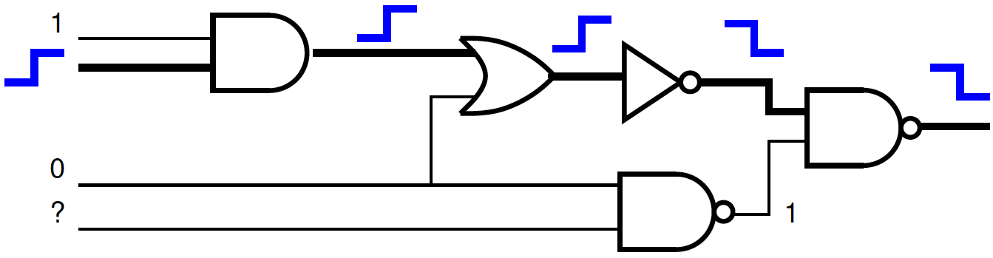
Statically Sensitized Path

Slide 13
Sufficiency
Static Sensitization is sufficient for a path to be a true path in circuit

Slide 14
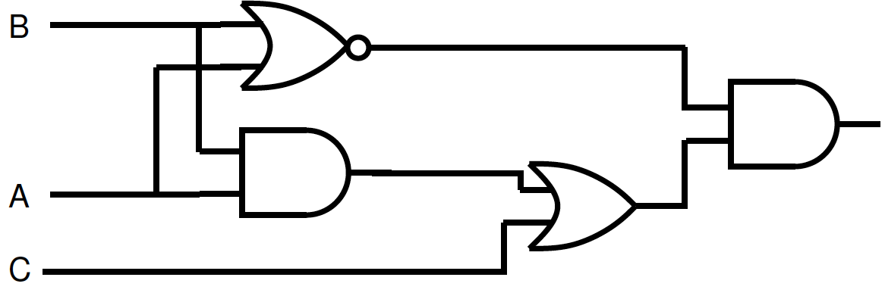
Static Sensitization not Necessary

Slide 15
Static Sensitization not Necessary
Possible path of length 3

Slide 16
Static Sensitization not Necessary
How do we sensitize this path?
Possible path of length 3

Slide 17
Static Sensitization not Necessary
0
Non-controlling = 1
Non-controlling = 1
Non-controlling = 0
Paths of length 3 not statically sensitizable.

Slide 18
Static Sensitization not Necessary
Any way to activate this path?
Possible path of length 3

Slide 19
Static Sensitization not Necessary
True Path of Delay 3 (simulate)
1→0 @0
0→1 @ 1
0→1 @ 2
1→0 @ 3
1→0 @ 1
1→0 @0
0
1→0 @ 2

Slide 20
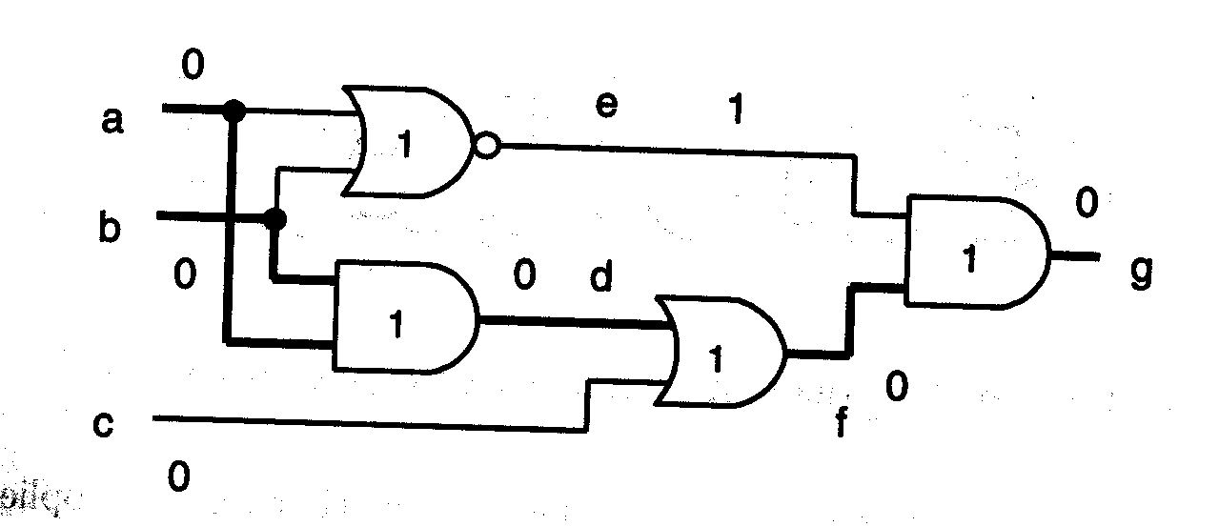
Static Co-sensitization
Each output with a controlled value
  has a controlling value as input on path
  (and vice-versa for non-controlled)
May trace multiple edges

Slide 21
Necessary
Static Co-sensitization is a necessary condition for a path to be true

Slide 22
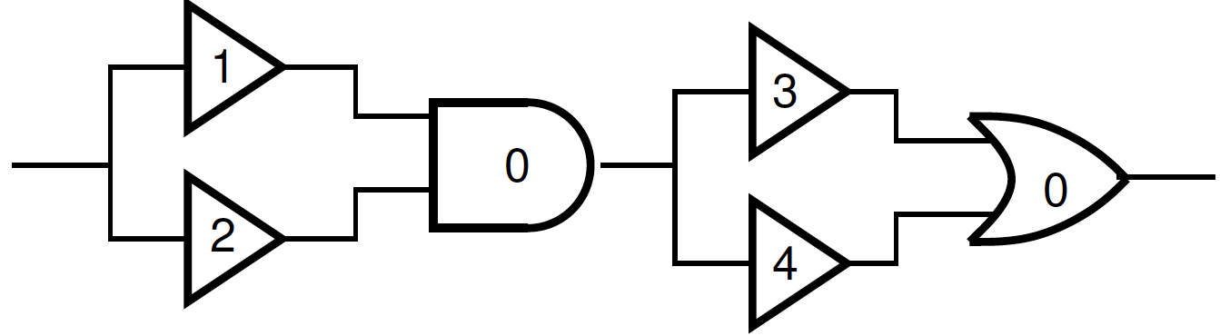
Static Co-sensitization
Each output with a controlled value
  has a controlling value as input on path
  (and vice-versa for non-controlled)
What is co-sensitization path length (0 output)?

Slide 23
Static Co-sensitization
Each output with a controlled value
  has a controlling value as input on path
  (and vice-versa for non-controlled)
What is co-sensitization path length (1 output)?

Slide 24
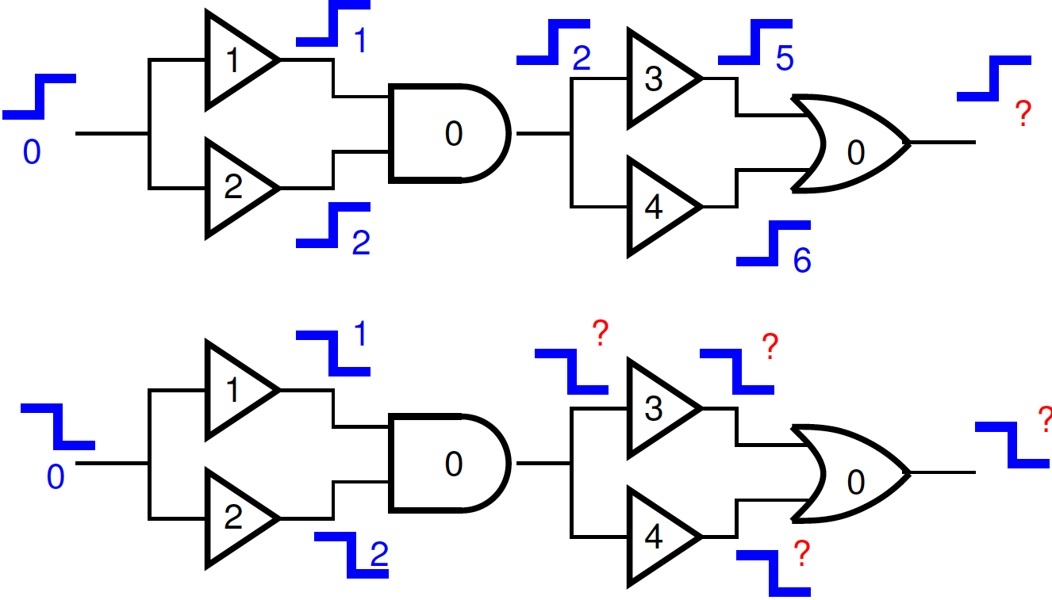
Transitions

Slide 25
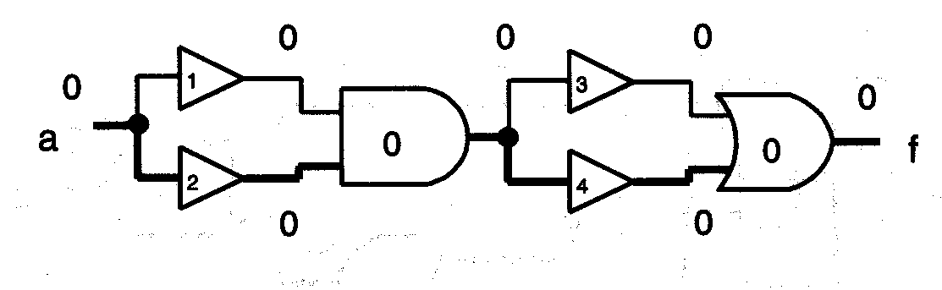
Cosensitization not Sufficient
Cosensitize path of length 6.
Real delay is 5.

Slide 26
Combining
Combine these ideas into a timed-calculus for computing delays for an input vector
True
delay
Static co-sensitization
Static sensitization

Slide 27
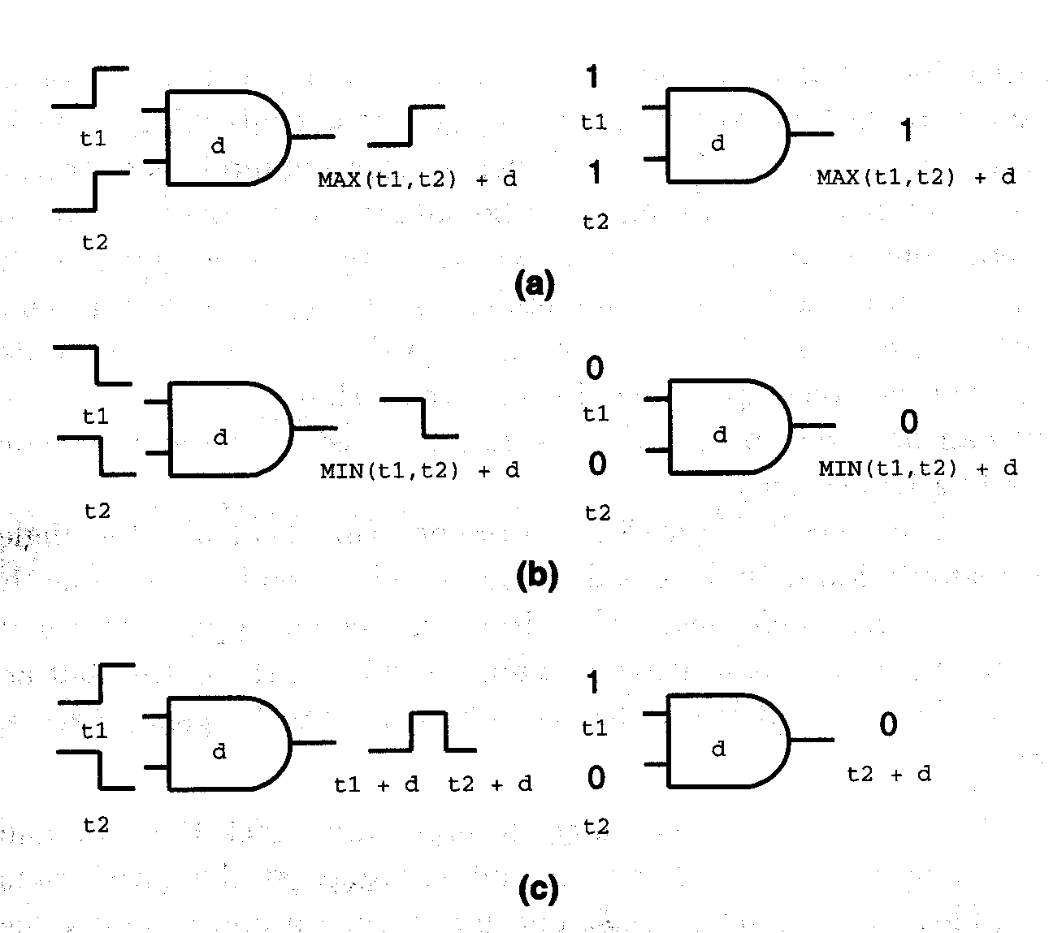
Computing Delays
AND
Timing
Calculus

Slide 28
Rules
If gate output is at a controlling value,
pick the minimum input and add gate delay
If gate output is at a non-controlling value, pick the maximum input and add gate delay

Slide 29
Example 1
0 @0
1 @1
0 @3
0 @1
0 @0
0 @2
0 @0

Slide 30
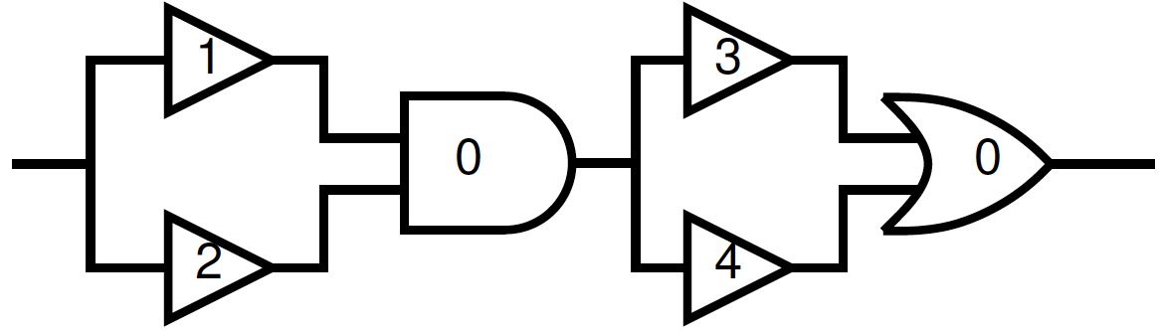
Example 2
0 @1
0 @4
0 @1
0 @0
0 @5
0 @2
0 @5

Slide 31
Example 2
1 @1
1 @5
1 @2
1 @0
1 @5
1 @2
1 @6

Slide 32
Now...
We know how to get the delay of a single input condition
Could:
  find “candidate” critical path
  search for an input vector to sensitize
  if fail, find next path
  …until find longest true path
May be O(2^{n})

Slide 33
Better Approach
Ask if can justify a delay greater than T
Search for satisfying vector
  …or demonstration that none exists
Binary search to find tightest delay

Slide 34
Delay Computation
Modification of a testing routine
  used to justify an output value for a circuit
  similar to SAT
PODEM (Path Oriented DEcision Making)
  backtracking search to find a suitable input vector associated with some target output
  branching search with implication pruning
    Heuristic for smart variable ordering

Slide 35
Search
Takes two lists
  outputs to set; inputs already set
Propagate values and implications
If all outputs satisfied → succeed
Pick next PI to set and set value
  Search (recursive call) with this value set
  If inconsistent
    If PI not implied
      Invert value of PI
      Search with this value set
      If inconsistent → fail
      Else succeed
    Else fail
  Else succeed

Slide 36
Picking next variable to set
Follow back gates w/ unknown values
  sometimes output dictate input must be
    (AND needing 1 output; with one input already assigned 1)
    Implication
  sometimes have to guess what to follow
    (OR with 1 output and no inputs set)
    Uses heuristics to decide what to follow

Slide 37
Example
d
g
e
f

Slide 38
Example (goal g=1)
?
d
?
g
?
e
?
?
?
f
?

Slide 39
Example (goal g=1)
Try B=1
0
d
1
g
?
e
?
0
?
f
?

Slide 40
Example (goal g=1)
Try B=0
?
d
0
g
0
e
?
?
?
f
?
Deduce any inputs?

Slide 41
Example (goal g=1)
Implied A=0
1
d
0
g
0
e
0
?
?
f
?
Deduce any inputs?

Slide 42
Example (goal g=1)
Implied C=1
1
d
0
g
0
e
0
1
1
f
1

Slide 43
For Timed Justification
Also want to compute delay
  on incompletely specified values
Compute bounds on timing
  upper bound, lower bound
  Again, use our timed calculus
    expanded to unknowns

Slide 44
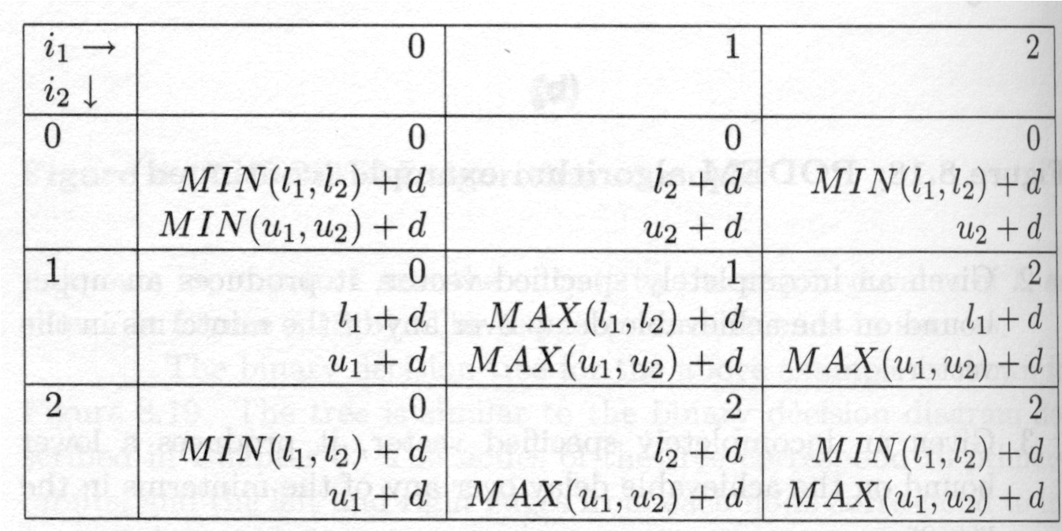
Delay Calculation
AND rules
?
?
Unknowns force us to represent upper/lower bound on delay.

Slide 45
Timed PODEM
Input: value to justify and delay T
Goal: find input vector which produces value and exceeds delay T
Algorithm
  similar
  implications check timing as well as logic

Slide 46
Example (goal g=1@3)
Work d, e, f g
d
?@(1,1)
?@0
g
e
?@(1,1)
?@0
?@(2,3)
f
?@(1,2)
?@0

Slide 47
Example (goal g=1@3)
Try B=1 (work d, g)
d
0@(1,1)
1@0
g
?@(1,1)
e
?@0
0@(2,2)
f
?@(1,2)
?@0

Slide 48
Example (goal g=1@3)
Try B=0 (work d, e, f, g)
d
?@(1,1)
0@0
g
0@(1,1)
e
?@0
?@(2,3)
f
?@(1,2)
?@0
Deduce any inputs?

Slide 49
Example
Imply A=0 (work d, g)
d
1@(1,1)
0@0
g
0@(1,1)
e
0@0
?@(2,3)
f
?@(1,2)
?@0
Deduce any inputs?

Slide 50
Example (goal g=1@3)
Imply C=1 (work f, g)
d
1@(1,1)
0@0
g
0@(1,1)
e
0@0
1@(2,2)
f
1@0
1@(1,1)
Failed to justify 1@3

Slide 51
Example (goal g=0@3)
Try C=0 (work f, g)
d
1@(1,1)
0@0
g
e
0@(1,1)
0@0
0@(3,3)
f
0@0
0@(2,2)

Slide 52
Search
Less than 2^{n}
  pruning due to implications
  here saw a must be 0
    no need to search 1xx subtree

Slide 53
Questions
Any questions on static timing analysis?

Slide 54
Speed Up
(sketch flavor)

Slide 55
Speed Up
Start with area optimized network
Know target arrival times
  Know delay from static analysis
Want to reduce delay of node

Slide 56
Basic Idea
Improve speed by:
  Collapsing node(s)
  Refactoring collapsed subgraph to reduce height

Slide 57
Timing Decomposition
Extract area saving kernels that do not include critical inputs to node
  f=abcd+abce+abef
  Kernels={cd+ce+ef,e+d,c+f} (last time)
  F=abe(c+f)+abcd, ab(cd+ce+ef), abc(e+d)+abef
  What decomposition use
  (and how finish decompose)?
    Critical input is e? f? d? {a,d}?
When decompose (e.g. into nand2’s) similarly balance with critical inputs closest to output

Slide 58
Delay Decompositions
f last:
  abc(e+d)+abef
  f*((ab)e)+((ab)(c(e+d)))
e last:
  abe(c+f)+abcd
  e*((*ab)(c+f))+((ab)(cd))

Slide 59
Delay Decompositions
d last:
  abe(c+f)+abcd
  d*((ab)c)+((ab)(e(c+f)))
{a,d} last:
  abe(c+f)+abcd
  a((be)(c+f)+d(bc))

Slide 60
Speed Up
While (delay decreasing, timing not met)
  Compute delay (slack)
    Static timing analysis
  Generate network close to critical path
    Within some delay ε, to some distance d
  Weight nodes in network
    Less weight = more potential to improve, prefer to cut
  Compute mincut of nodes on weighted network
  For each node in cutset
    Partial collapse
  For each node in cutset
    Timing redecompose

Slide 61
Weighted Cut
W=W_{t}+αW_{a} → α tuning parameter
Want to minimize area expansion (W_{a})
  Things in collapsed network may be duplicated
  E.g. W_{a}=literals in duplicated logic
Want to maximize likely benefit (W_{t})
  Prefer nodes with different input times to the “near critical path” network
    Quantify: large difference in arrival times
  Prefer nodes with critical path on longer paths

Slide 62
Weighing Benefit
Want to maximize likely benefit (W_{t})
  Prefer nodes with different input times to the “near critical path” network
3
1
2
4
2
2
2
2

Slide 63
Weighing Benefit
Want to maximize likely benefit (W_{t})
  Prefer nodes with critical path on longer paths
4
3
2
1
3
1
2
4

Slide 64
MinCut of Nodes
Cut nodes not edges
  Typically will need to transform to dual graph
    All edges become nodes, nodes become edges
  Then use maxflow/mincut

Slide 65
MinCut of Nodes
MinCut given this weighting?
4
2
3
3
5
5
5

Slide 66
Speed Up (review)
While (delay decreasing, timing not met)
  Compute delay (slack)
    Static timing analysis
  Generate network close to critical path
    w/in some delay ε, to some distance d
  Weight nodes in network
    Less weight = more potential to improve, prefer to cut
  Compute mincut of nodes on weighted network
  For each node in cutset
    Partial collapse
  For each node in cutset
    timing redecompose

Slide 67
Big Ideas
Topological Worst-case delays are conservative
  Once consider logical constraints
  may have false paths
Necessary and sufficient conditions on true paths
Search for paths by delay
  or demonstrate non existence
Search with implications
Iterative improvement

Slide 68
Admin
Reading Wednesday on web

