Slide 1

ESE535:
Electronic Design Automation
Day 24: April 22, 2015
Statistical Static Timing Analysis

Slide 2
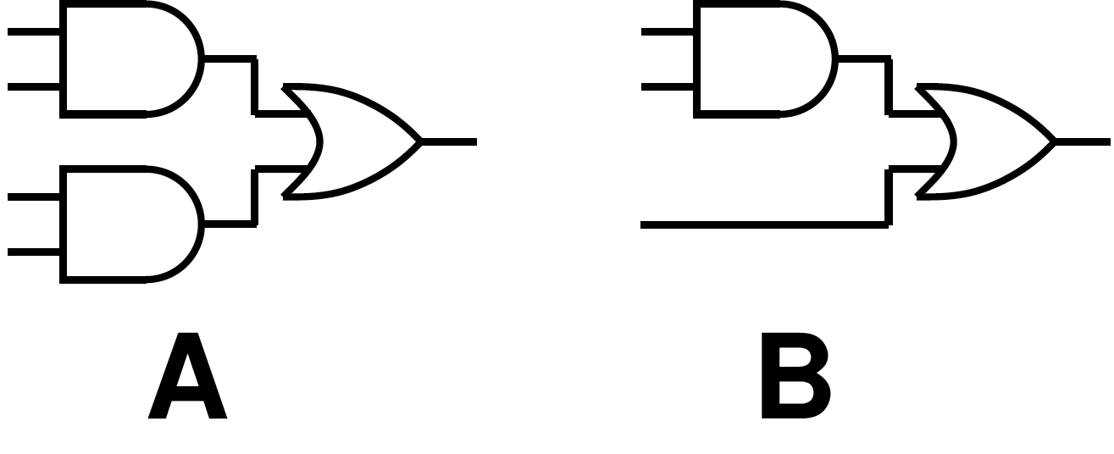
Delay PDFs? (2a)

Slide 3
Today
Behavioral
(C, MATLAB, …)
Arch. Select
Schedule
RTL
Sources of Variation
Limits of Worst Case
Optimization for Parametric Yield
Statistical Analysis
FSM assign
Two-level
Multilevel opt.
Covering
Retiming
Gate Netlist
Placement
Routing
Layout
Masks

Slide 4
Central Problem
As our devices approach the atomic scale, we must deal with statistical effects governing the placement and behavior of individual atoms and electrons.
10000
Transistor critical dimensions
  Atomic discreteness
  Subwavelength litho
  Etch/polish rates
  Focus
Number of dopants
Dopant Placement
1000
Mean Number of Dopant Atoms
100
10
1000
500
250
130
65
32
16
Technology Node (nm)

Slide 5
Oxide Thickness
[Asenov et al. TRED 2002]

Slide 6
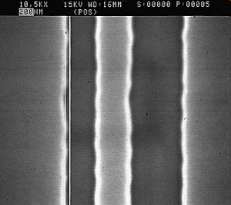
Line Edge Roughness
1.2μm and
2.4μm lines
From:
http://www.microtechweb.com/2d/lw_pict.htm

Slide 7
Light
What is wavelength of visible light?

Slide 8
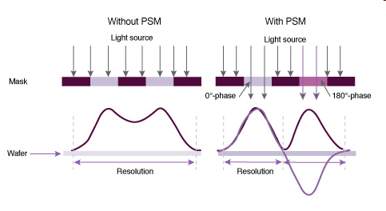
Phase Shift Masking
Source
http://www.synopsys.com/Tools/Manufacturing/MaskSynthesis/PSMCreate/Pages/default.aspx

Slide 9
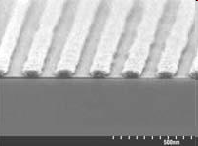
Line Edges (PSM)
Source:
http://www.solid-state.com/display_article/122066/5/none/none/Feat/Developments-in-materials-for-157nm-photoresists

Slide 10
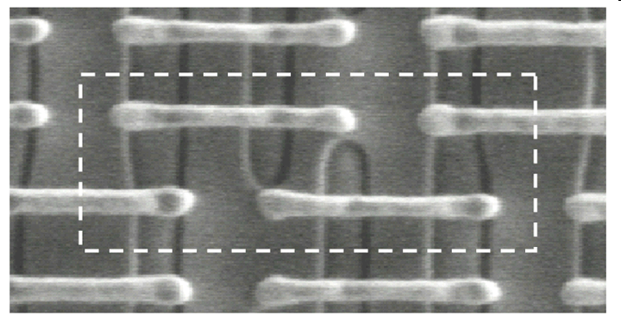
Intel 65nm SRAM (PSM)
Source:
http://www.intel.com/technology/itj/2008/v12i2/5-design/figures/Figure_5_lg.gif

Slide 11
Statistical Dopant Placement
[Bernstein et al, IBM JRD 2006]

Slide 12
V_{th} Variability @ 65nm
[Bernstein et al, IBM JRD 2006]

Slide 13

Gaussian Distribution
From: http://en.wikipedia.org/wiki/File:Standard_deviation_diagram.svg

Slide 14
ITRS 2011 Variation (3σ)
Table DESN10 Design for Manufacturability Technology Requirements
Year of Production | 2011 | 2012 | 2013 | 2014 | 2015 | 2016 | 2017 | 2018 | 2019 | 2020 | 2021 | 2022 | 2023 | 2024 | 2025 | 2026
Normalized mask cost from public and IDM data | 1.0 | 1.3 | 1.7 | 2.2 | 2.8 | 3.7 | 4.9 | 6.4 | 8.4 | 11.0 | 14.4 | 18.8 | 24.6 | 32.1 | ? | ?
% V_{dd} variability: % variability seen in on-chip circuits | 10% | 10% | 10% | 10% | 10% | 10% | 10% | 10% | 10% | 10% | 10% | 10% | 10% | 10% | 10% | 10%
% V_{th} variability: doping variability impact on V_{th}, (minimum size devices, memory) | 40% | 40% | 40% | 45% | 45% | 50% | 50% | 55% | 55% | 60% | 60% | 65% | 65% | 70% | 70% | 75%
% V_{th} variability: includes all sources | 42% | 42% | 42% | 47% | 47% | 53% | 53% | 58% | 58% | 63% | 63% | 68% | 68% | 74% | 74% | 79%
% V_{th} variability: typical size logic devices, all sources | 20% | 20% | 20% | 23% | 23% | 25% | 25% | 28% | 28% | 30% | 30% | 33% | 33% | 35% | 35% | 38%
% CD variability | 12% | 12% | 12% | 12% | 12% | 12% | 12% | 12% | 12% | 12% | 12% | 12% | 12% | 12% | 12% | 12%
% circuit performance variability circuit comprising gates and wires | 42% | 42% | 42% | 45% | 45% | 47% | 47% | 50% | 50% | 52% | 52% | 55% | 55% | 57% | 57% | 60%
% circuit total power variability circuit comprising gates and wires | 51% | 51% | 51% | 55% | 55% | 59% | 59% | 63% | 63% | 68% | 68% | 72% | 72% | 77% | 77% | 81%
% circuit leakage power variability circuit comprising gates and wires | 126% | 126% | 126% | 129% | 129% | 132% | 132% | 135% | 135% | 138% | 138% | 141% | 141% | 145% | 145% | 148%

Slide 15
Example: V_{th}
Many physical effects impact V_{th}
  Doping, dimensions, roughness
Behavior highly dependent on V_{th}

Slide 16
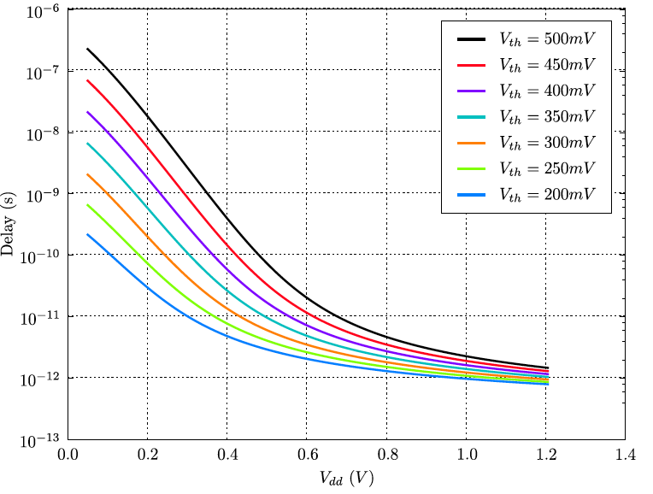
Impact Performance
V_{th} → I_{ds} → Delay (C_{load}/I_{ds})

Slide 17
Impact of V_{th} Variation

Slide 18
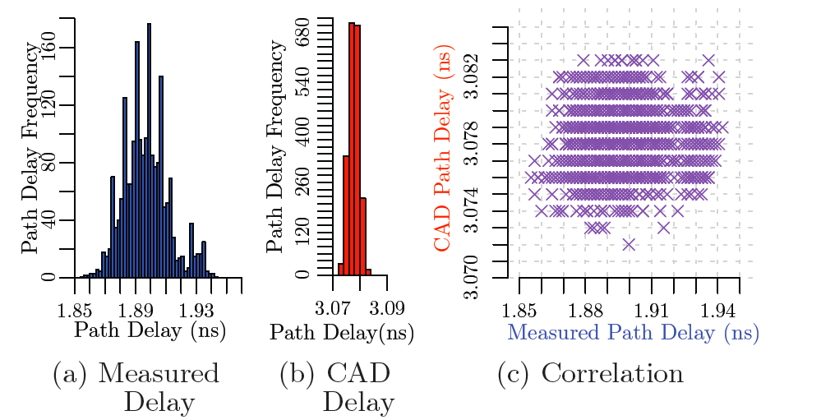
Variation in Current FPGAs
[Gojman et al., FPGA2013]

Slide 19
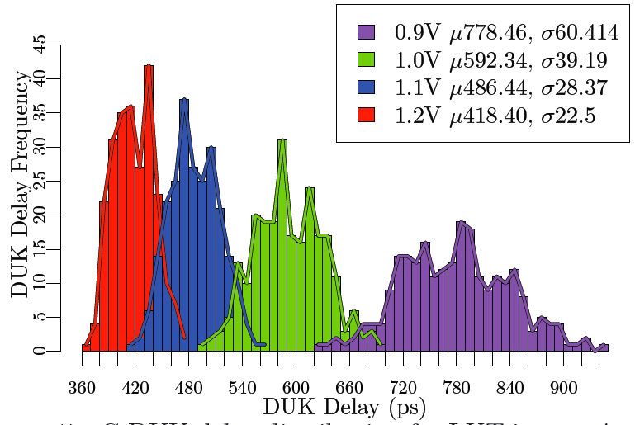
Reduce Vdd
(Cyclone IV 60nm LP)
[Gojman et al., FPGA2013]

Slide 20
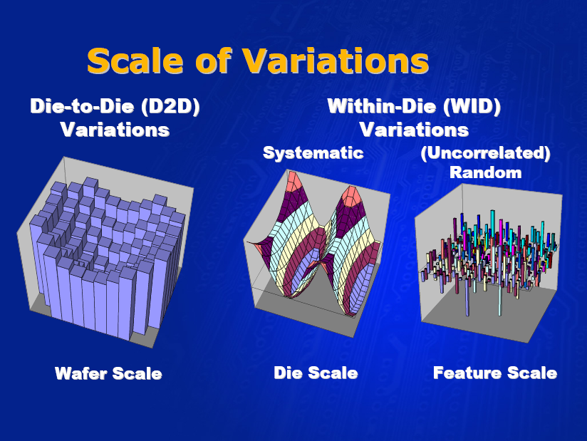
Source: Noel Menezes, Intel ISPD2007

Slide 21
Source: Noel Menezes, Intel ISPD2007

Slide 22
Old Way
Characterize gates by corner cases
  Fast, nominal, slow
Add up corners to estimate range
Preclass:
  Slow corner: 1.1
  Nominal: 1.0
  Fast corner: 0.9

Slide 23
Corners Misleading
[Orshansky+Keutzer DAC 2002]

Slide 24
Parameteric Yield
Sell
nominal
Sell
cheap
Sell
Premium
Discard
Probability Distribution
Delay

Slide 25
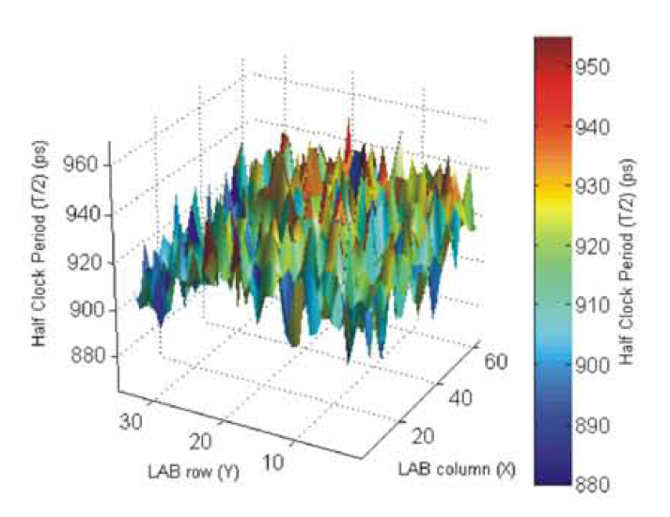
Phenomena 1: Path Averaging
T_{path} = t₀+t₁+t₂+t₃+…t_{(d-1)}
T_{i} – iid random variables
  Mean τ
  Variance σ
Tpath
  Mean d×τ
  Variance = √d × σ

Slide 26
Sequential Paths
T_{path} = t₀+t₁+t₂+t₃+…t_{(d-1)}
T_{path}
  Mean d×τ
  Variance = √d × σ
3 sigma delay on path: d×τ + 3√d × σ
  Worst case per component would be: d×(τ+3 σ)
  Overestimate d vs. √d

Slide 27
SSTA vs. Corner Models
STA with corners predicts 225ps
SSTA predicts 162ps at 3σ
SSTA reduces pessimism by 28%
[Slide composed
by Nikil Mehta]
Source: IBM, TRCAD 2006

Slide 28
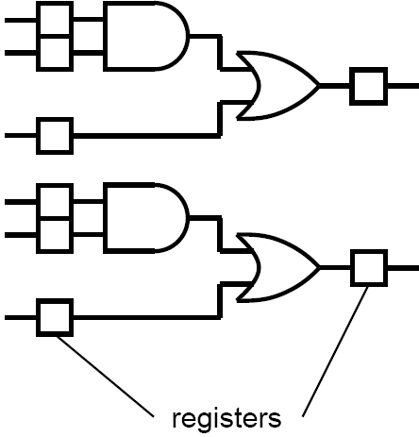
Phenomena 2: Parallel Paths
Cycle time limited by slowest path
T_{cycle} = max(T_{p0},T_{p1},T_{p2},…T_{p(n-1)})
P(T_{cycle}<T₀) = P(T_{p0}<T₀)×P(T_{p1}<T₀)…
= [P(T_{p}<T₀)]^{n}
0.5 = [P(T_{p}<T₅₀)]^{n}
P(T_{p}<T₅₀) = (0.5)^{(1/n)}

Slide 29
System Delay
Probability Distribution
P(T_{p}<T₅₀) = (0.5)^{(1/n)}
  N=10⁸ ➔ 0.999999993
    1-7×10⁻⁹
  N=10¹⁰ ➔ 0.99999999993
    1-7×10⁻¹¹
Delay

Slide 30
Gaussian Distribution
From: http://en.wikipedia.org/wiki/File:Standard_deviation_diagram.svg

Slide 31
System Delay
Probability Distribution
P(T_{p}<T₅₀) = (0.5)^{(1/n)}
  N=10⁸ ➔ 0.999999993
    1-7×10⁻⁹
  N=10¹⁰ ➔ 0.99999999993
    1-7×10⁻¹¹
For 50% yield want
  6 to 7 σ
  T₅₀=T_{mean}+7σ_{path}
Delay

Slide 32
System Delay

Slide 33
System Delay

Slide 34
Corners Misleading
Phenomena 2
Phenomena 1
[Orshansky+Keutzer DAC 2002]

Slide 35
Source: Noel Menezes, Intel ISPD2007

Slide 36
But does worst-case mislead?
STA with worst-case says these are equivalent:

Slide 37
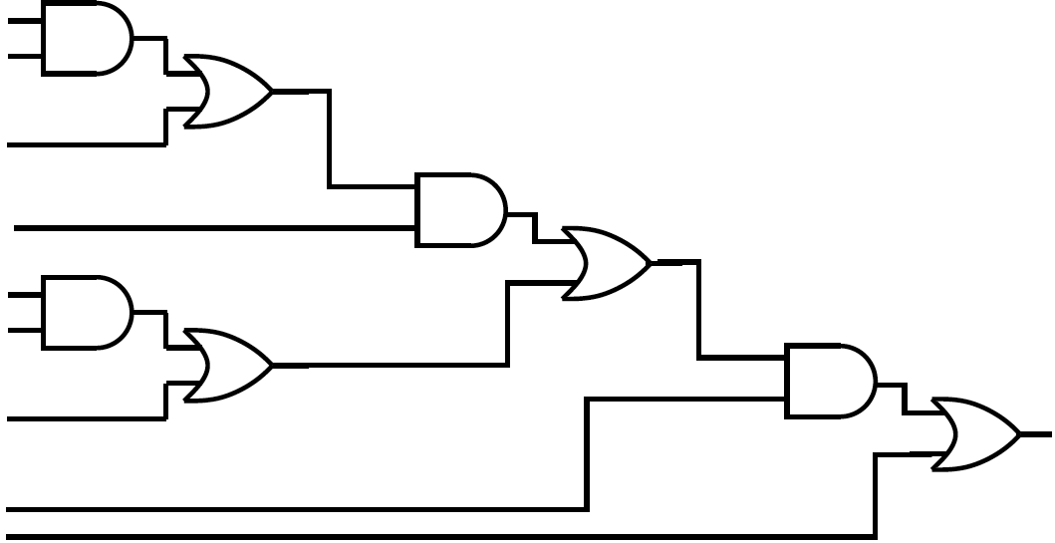
But does worst-case mislead?
STA Worst case delay for this?

Slide 38
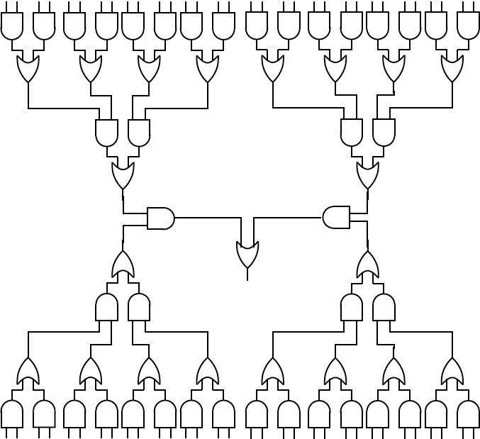
But does worst-case mislead?
STA Worst case delay for this?

Slide 39
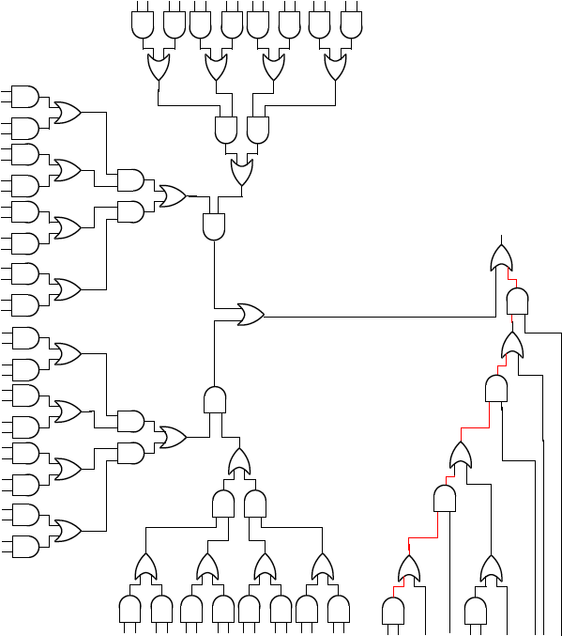
Does Worst-Case Mislead?
Delay of
off-critical path may matter
Best case delay of critical path?
Wost-case delay of non-critical path?

Slide 40
Probability of Path Being Critical
[Source: Intel DAC 2005]

Slide 41
What do we need to do?
Ideal:
  Compute PDF for delay at each gate
  Compute delay of a gate as a PDF from:
    PDF of inputs
    PDF of gate delay

Slide 42
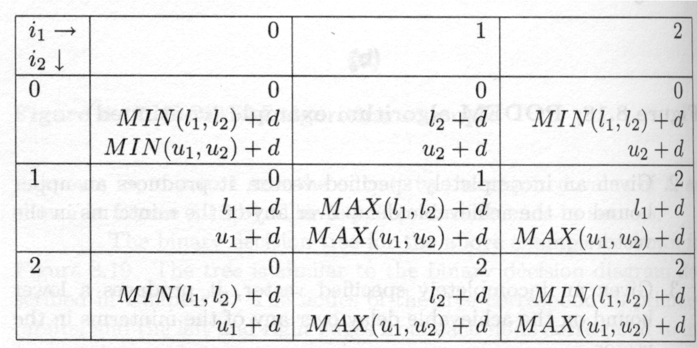
Delay Calculation
Day 23
AND rules

Slide 43
What do we need to do?
Ideal:
  compute PDF for delay at each gate
  Compute delay of a gate as a PDF from:
    PDF of inputs
    PDF of gate delay
  Need to compute for distributions
    SUM
    MAX (maybe MIN)

Slide 44
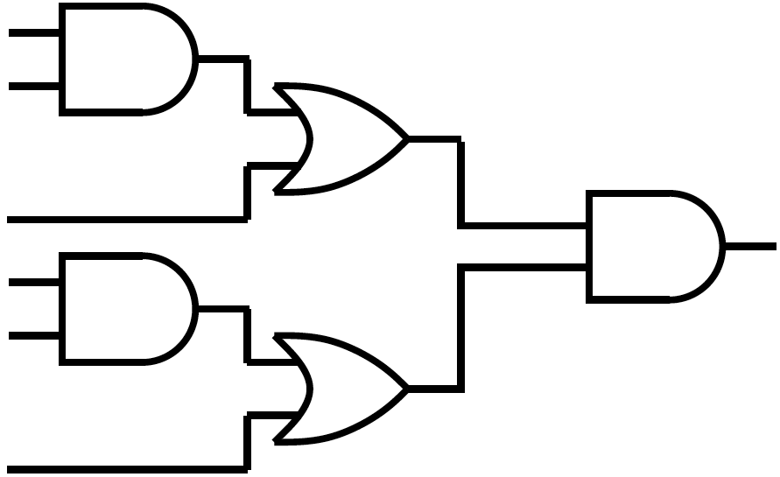
For Example
Consider entry:
  MAX(u₁,u₂)+d

Slide 45
MAX
Compute MAX of two input distributions
  Preclass 2(b)

Slide 46
SUM
Add that distribution to gate distribution.

Slide 47
Continuous
Can roughly carry through PDF calculations with Guassian distributions rather than discrete PDFs

Slide 48
Dealing with PDFs
Simple model assume all PDFs are Gaussian
  Model with mean, σ
  Imperfect
    Not all phenomena are Gaussian
    Sum of Gaussians is Gaussian
    Max of Gaussians is not a Gaussian

Slide 49
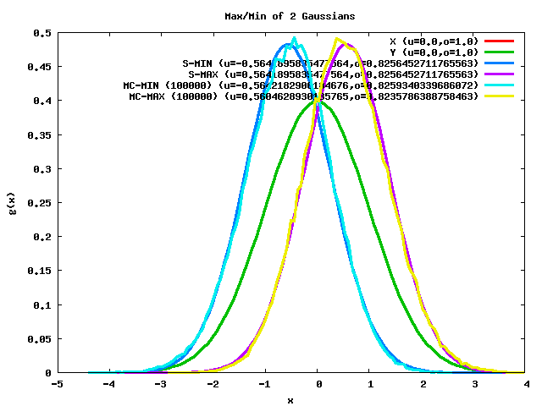
MAX of Two Identical Gaussians
Max of Gaussians is not a Gaussian
Can try to approximate as Guassian
Given two identical Gaussians A and B with μ and σ
Plug into equations
E[MAX(A,B)] = μ + σ/(π)^{1/2}
VAR[MAX(A,B)] = σ² – σ/π
[Source: Nikil Mehta]
Notes:
49

Slide 50
More Technicalities
Correlation
  Physical on die
  In path (reconvergent fanout)
    Makes result conservative
      Gives upper bound
      Can compute lower
2
1
4
3
Graphics from: Noel Menezes (top) and Nikil Mehta (bottom)

Slide 51
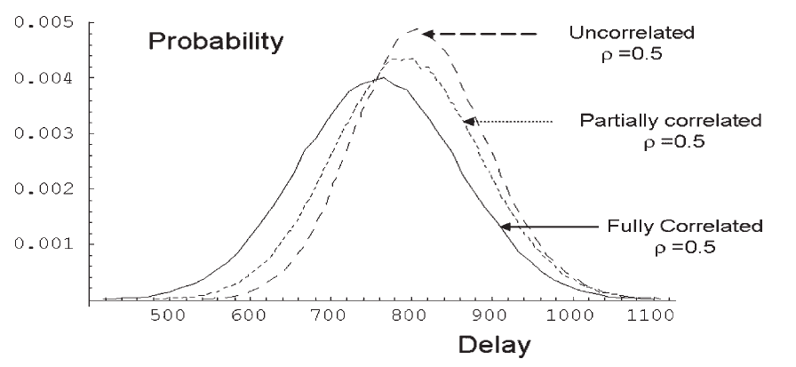
Max of Gaussians with Correlation
Max of identical Gaussians
[Blaauw et al. TRCAD v27n4p589]

Slide 52
MAX of Two Identical Gaussians
Given two identical Gaussians A and B with μ and σ
Plug into equations
E[MAX(A,B)] = μ + σ/(π)^{1/2}
VAR[MAX(A,B)] = σ² – σ/π
[Source: Nikil Mehta]
Extreme of correlated: is just the input Gaussian
Notes:
52

Slide 53
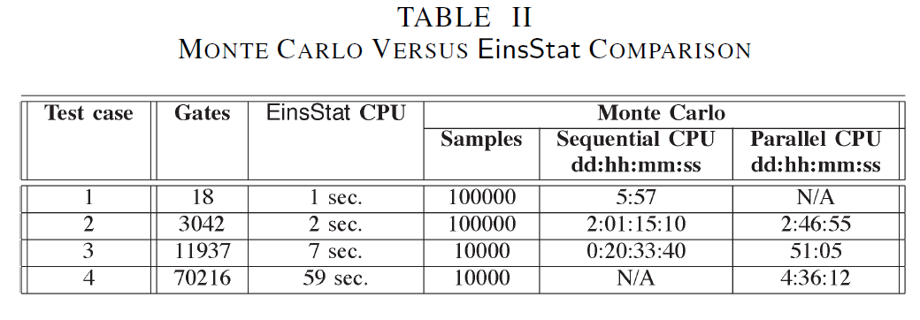
SSTA vs. Monte Carlo Verification Time
Source: IBM, TRCAD 2006

Slide 54
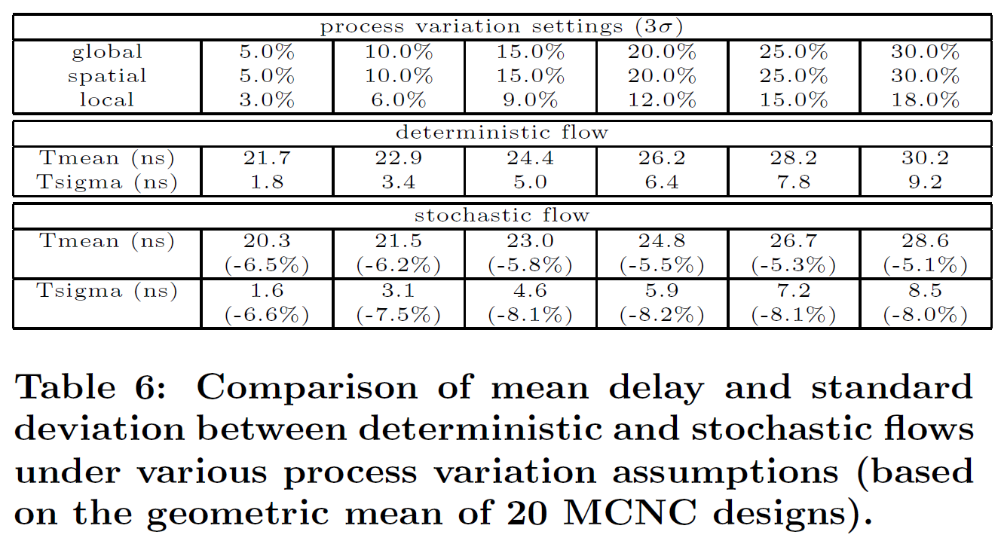
Using SSTA in FPGA CAD
[Slide composed
by Nikil Mehta]
Le Hei
  FPGA2007
  SSTA Synthesis, Place, Route
Kia
  FPGA2007
  Route with SSTA

Slide 55
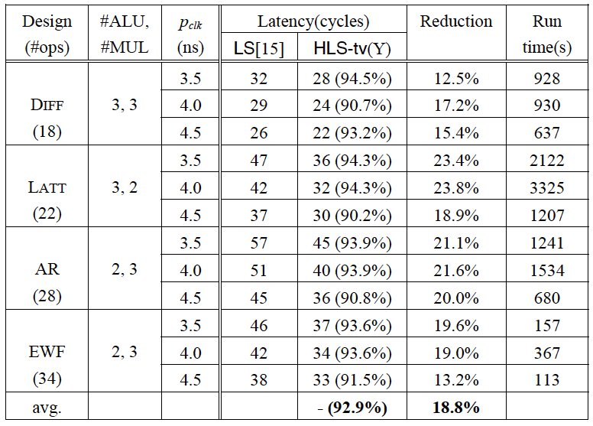
Impact of SSTA in
High-Level Synthesis
Scheduling and provisioning
  ALU/MUL σ=5% t_{nominal}
[Jung&Kim ICCAD2007]

Slide 56
Summary
Nanoscale fabrication is a statistical process
Delays are PDFs
Assuming each device is worst-case delay is too pessimistic
  Wrong prediction about timing
  Leads optimization in wrong direction
Reformulate timing analysis as statistical calculation
Estimate the PDF of circuit delays
Use this to drive optimizations

Slide 57
Big Ideas:
Coping with uncertainty
Statistical Reasoning and Calculation

Slide 58
Admin
Reading for Monday on canvas
Milestone Thursday

