Slide 1

ESE535:
Electronic Design Automation
Day 24: April 15, 2013
Retiming

Slide 2
Today
Behavioral
(C, MATLAB, …)
Arch. Select
Schedule
RTL
FSM assign
Retiming
  Cycle time (clock period)
  Initial states
  Register minimization
Two-level,
Multilevel opt.
Covering
Retiming
Gate Netlist
Placement
Routing
Layout
Masks

Slide 3
Task
Move registers to:
  Preserve semantics
  Minimize path length between registers
    Reduce cycle time
  …while minimizing number of registers required

Slide 4
Example: Same Semantics
Externally: no observable difference

Slide 5
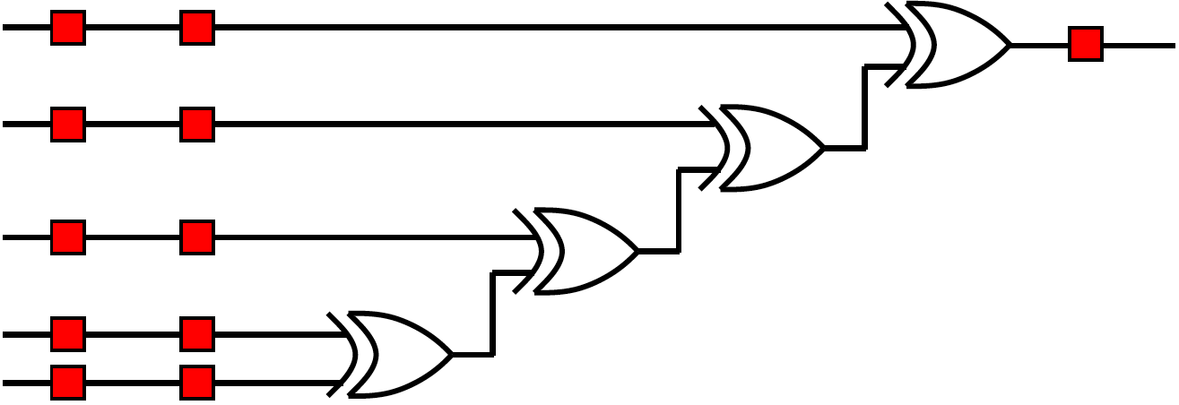
Preclass 1

Slide 6
Problem
Given: clocked circuit
Goal: minimize clock period without changing (observable) behavior
I.e. minimize maximum delay between any pair of registers
Freedom: move placement of internal registers

Slide 7
Other Goals
Minimize number of registers in circuit
Achieve target cycle time
Minimize number of registers while achieving target cycle time
…start talking about minimizing cycle...

Slide 8
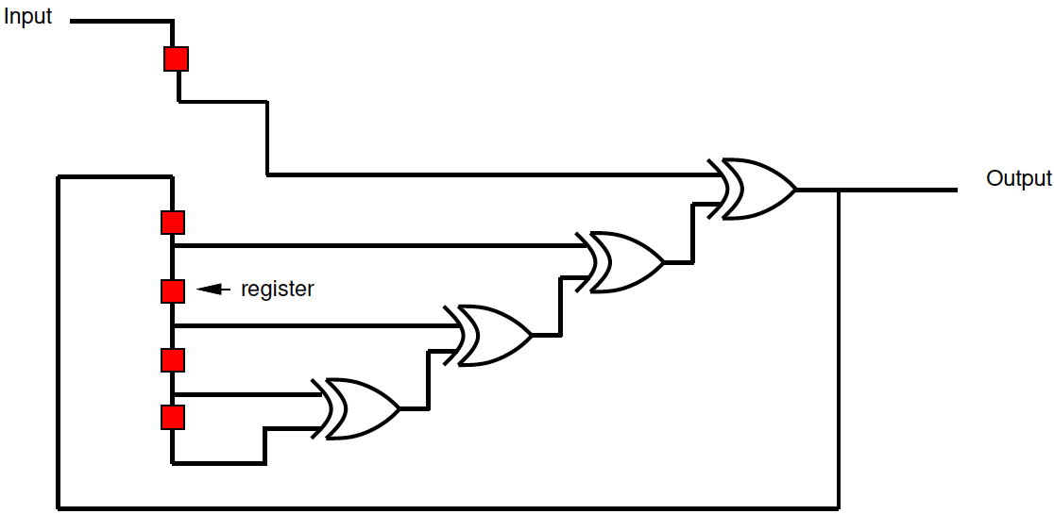
Preclass 2 Example
Path Length (L) ?
Can we do better?

Slide 9
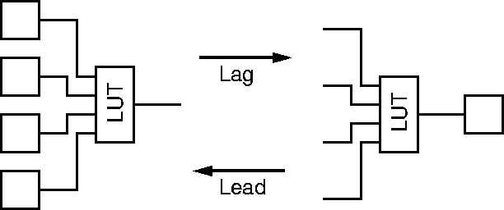
Legal Register Moves
Retiming Lag/Lead

Slide 10
Canonical Graph Representation
1
Separate arc for each path
0
0
0
Weight edges by
number of registers
1
2
(weight nodes by
delay through node)
3
4

Slide 11
Critical Path Length
1
0
0
0
1
2
3
4
Critical Path: Length of longest node path
of zero weight edges

Slide 12
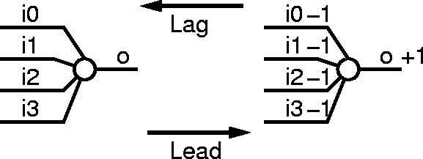
Retiming Lag/Lead
Retiming: Assign a lag to every vertex
weight(e′) = weight(e) + lag(head(e))-lag(tail(e))

Slide 13
Valid Retiming
Retiming is valid as long as:
  ∀e in graph
    weight(e′) = weight(e) + lag(head(e))-lag(tail(e)) ≥ 0
Assuming original circuit was a valid synchronous circuit, this guarantees:
  non-negative register weights on all edges
    no travel backward in time :-)
  all cycles have strictly positive register counts
  propagation delay on each vertex is non-negative (assumed 1 for today)

Slide 14
Retiming Task
Move registers ≡ assign lags to nodes
  lags define all locally legal moves
Preserving non-negative edge weights
  (previous slide)
  guarantees collection of lags remains consistent globally

Slide 15
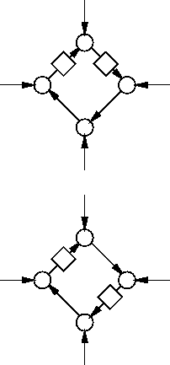
Retiming Transformation
Properties invariant to retiming
  number of registers around a cycle
  delay along a cycle
Cycle of length P must have
  at least P/c registers on it
  to be retimeable to cycle c
  Can be computed from invariant above

Slide 16
Optimal Retiming
There is a retiming of
  graph G
  w/ clock cycle c
  iff G-1/c has no cycles with negative edge weights
G-α ≡ subtract α from each edge weight

Slide 17
G-1/c
1-1/c
0-1/c
0-1/c
0-1/c
1-1/c
2-1/c
3-1/c
4-1/c

Slide 18
1/c Intuition
Want to place a register every c delay units
Each register adds one
Each delay subtracts 1/c
As long as remains more positives than negatives around all cycles
  can move registers to accommodate
  Captures the regs=P/c constraints

Slide 19
Illustrate with Pipeline Case

Slide 20
G-1/c
1-1/c
0-1/c
0-1/c
0-1/c
1-1/c
2-1/c
3-1/c
4-1/c

Slide 21
Compute Retiming
Lag(v) = shortest path to I/O in G-1/c
Compute shortest paths in O(|V||E|)
  Bellman-Ford
  also use to detect negative weight cycles when c too small

Slide 22
Bellman Ford
For I←0 to N
  u_{i} ←∞ (except u_{i}=0 for IO)
For k←0 to N
  for e_{i,j}∈E
    u_{i} ←min(u_{i ,}u_{j}+w(e_{i,j}))
For e_{i,j}∈E //still update→negative cycle
    if u_{i} >u_{j}+w(e_{i,j})
      cycles detected

Slide 23
Apply to Example
1-1/c
0-1/c
0-1/c
0-1/c
1-1/c
2-1/c
3-1/c
4-1/c

Slide 24
Try c=1
1-1/c
0-1/c
0-1/c
0-1/c
1-1/c
2-1/c
3-1/c
0
4-1/c
-1
-1
-1
0
Draw G-1
Negative cycles?
1
2
3

Slide 25
Try c=2
1-1/c
0-1/c
0-1/c
0-1/c
1-1/c
2-1/c
3-1/c
0.5
4-1/c
-0.5
-0.5
-0.5
0.5
Draw G-0.5
Negative cycles?
1.5
2.5
3.5

Slide 26
Apply: Find Lags
0.5
-0.5
-0.5
-0.5
0.5
1.5
2.5
3.5
Shortest paths?

Slide 27
Apply: Lags
0.5
-0.5
-0.5
-0.5
-1.5
-1.0
-0.5
0.5
1.5
2.5
3.5

Slide 28
Apply: Lags
Take ceil
0.5
-0.5
-0.5
-0.5
-1
-1
0
0.5
1.5
2.5
3.5

Slide 29
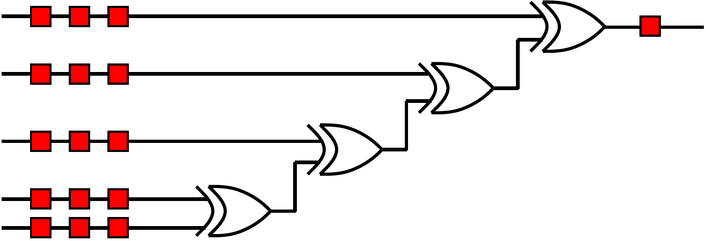
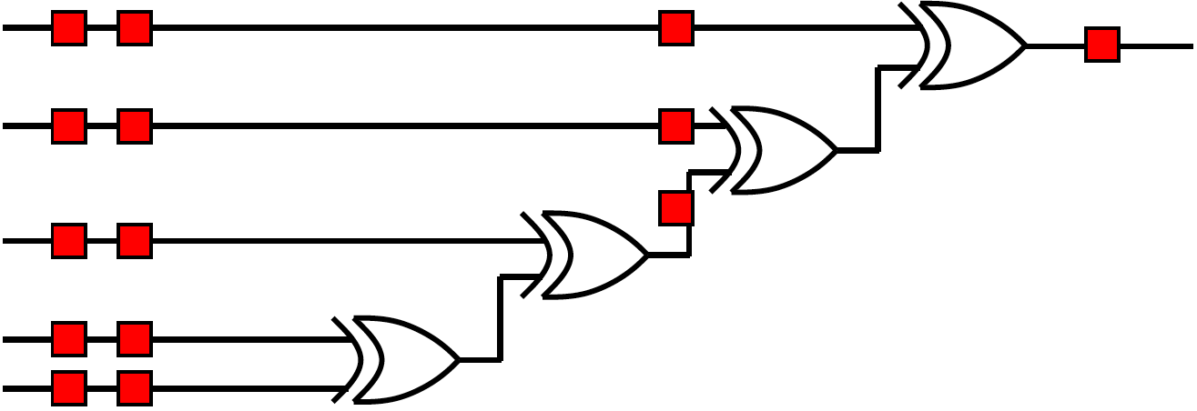
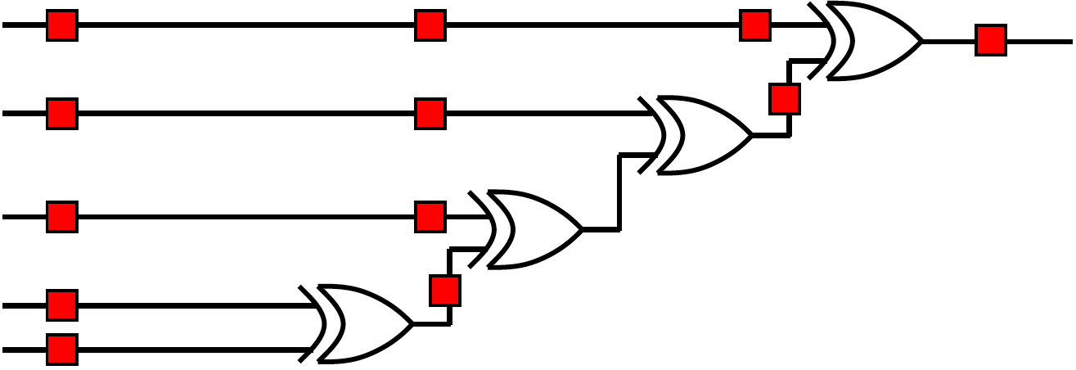
Phase Choice (C=2)

Slide 30
Apply: Move Registers
1
0
0
0
-1
-1
0
Original Graph
weighting
1
2
3
1
4
0
1
0
1
1
2
Compute new weights
3
weight(e′) = weight(e) + lag(head(e))-lag(tail(e))

Slide 31
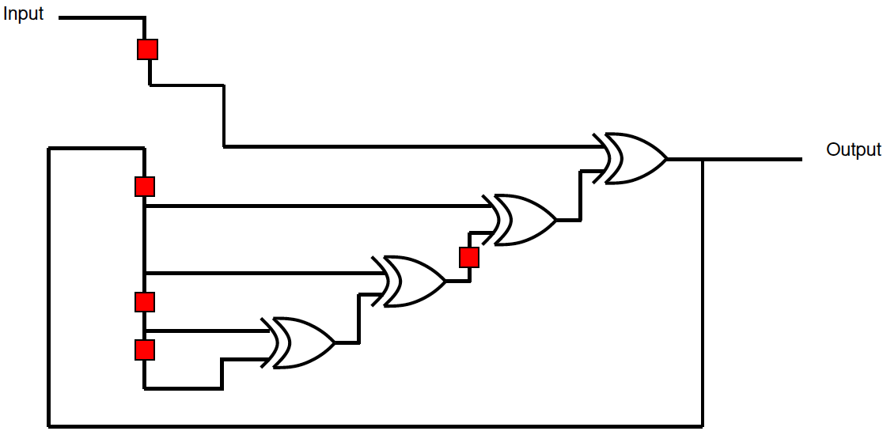
Apply: Retimed Design
1
0
1
0
1
1
2
3

Slide 32
Apply: Lags (alternate)
0.5
-0.5
-0.5
-0.5
Take floor
-1.5
-1.0
-0.5
0.5
1.5
2.5
3.5
0.5
-0.5
-0.5
-0.5
-2
-1
-1
0.5
1.5
2.5
3.5

Slide 33
Apply: Move Registers (floor)
1
0
0
0
-2
-1
-1
Original Graph
weighting
1
2
3
1
4
1
0
1
0
1
1
Compute new weights
2
weight(e′) = weight(e) + lag(head(e))-lag(tail(e))

Slide 34
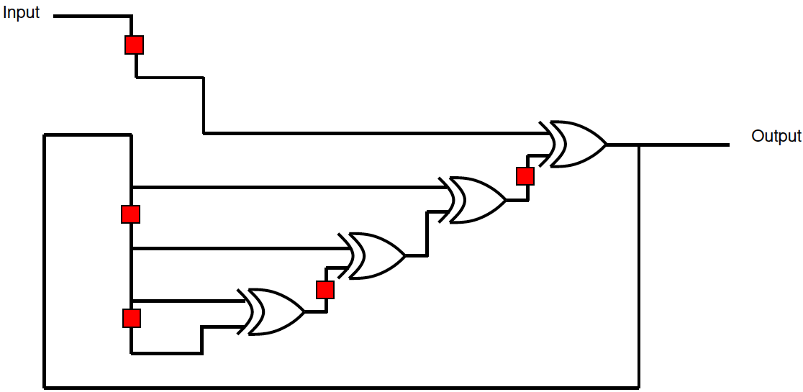
Apply: Retimed Design (floor)
1
1
0
1
0
1
1
2

Slide 35
Summary So Far
Can move registers to minimize cycle time
Formulate as a lag assignment to every node
Optimally solve cycle time in O(|V||E|) time
  Using a shortest path search

Slide 36
Questions?

Slide 37
Note
Algorithm/examples shown
  for special case of unit-delay nodes
For general delay,
  a bit more complicated
  still polynomial
May not achieve P/c lower bound due to indivisible blocks
  Example: blocks of delay 2.1 and 1.9 w c=2
    More general: 0.9, 1.3, 0.8, 1.1

Slide 38
Initial State
What about initial state?
0
1
What should initial value be?

Slide 39
Initial State
0
What should initial value be?

Slide 40
Initial State
0
0
0
1
0
1
1
0
1
What should initial values be?
In general, constraints → satisfiable?

Slide 41
Initial State
0
0
0
0,1?
1
0
0
1
1
What should initial values be?

Slide 42
Initial State
1
Cycle1: 1
Cycle2: /(0*/in)=1
0
?
Cycle1: /init
Cycle2: /(/init*/in)=in+init
init
What should init be?
init=0
Cycle1: 1
Cycle2: /(/init*/in)=in
init=1
Cycle1: 0
Cycle2: /(/init*/in)=1

Slide 43
Initial State
Cannot always get exactly the same initial state behavior on the retimed circuit
  without additional care in the retiming transformation
  sometimes have to modify structure of retiming to preserve initial behavior
Only a problem for startup transient
  if you’re willing to clock to get into initial state, not a limitation

Slide 44
Minimize Registers

Slide 45
Minimize Registers
Number of registers: Σ w(e)
After retime: Σ w(e)+Σ (FI(v)-FO(v))lag(v)
delta only in lags
So want to minimize: Σ (FI(v)-FO(v))lag(v)
  subject to earlier constraints
    non-negative register weights, delays
    positive cycle counts

Slide 46
Minimize Registers → ILP
So want to minimize: Σ (FI(v)-FO(v))lag(v)
  subject to earlier constraints
    non-negative register weights, delays
    positive cycle counts
FI(v)-FO(V) is a constant c_{v}
  Minimize Σ(c_{v}*lag(v))
  w(e_{i})+lag(head(e_{i}))-lag(tail(e_{i})) > 0

Slide 47
Minimize Registers: ILP➔flow
Can be formulated as flow problem
Can add cycle time constraints to flow problem
Time: O(|V||E|log(|V|)log|(|V|²/|E|))

Slide 48
Retiming and Covering
Time Permitting

Slide 49
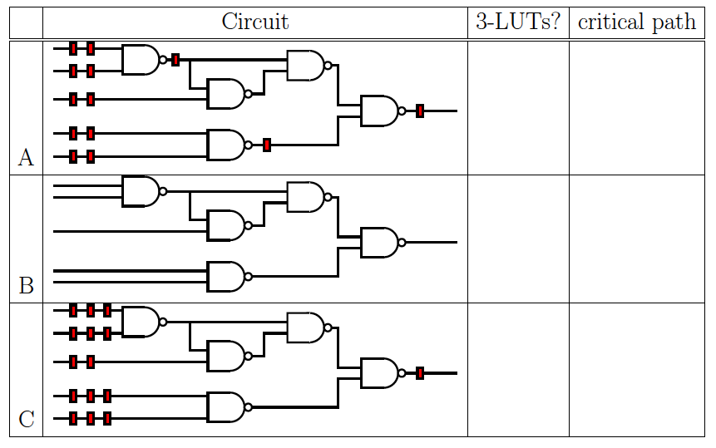
Preclass

Slide 50
Issue
Cover (map) LUTs for minimum delay
  solve optimally for delay → flowmap
Retiming for minimum clock period
  solve optimally
…but, solving cover/retime separately not optimal
We can formulate joint optimization

Slide 51
Phase Ordering Problem
General problem
  don’t know effect of other mapping step
  Have seen this many places
Here
  don’t know delay if retime first
    don’t know what can be packed into LUT
  If we do not retime first
    fragmentation: forced breaks at bad places

Slide 52
Summary
Can move registers to minimize cycle time
Formulate as a lag assignment to every node
Optimally solve cycle time in O(|V||E|) time
Also
  Minimize registers
Watch out for initial values

Slide 53
Big Ideas
Exploit freedom
Formulate transformations (lag assignment)
Express legality constraints
Technique:
  graph algorithms
  network flow

Slide 54
Admin
Reading for Wednesday online
Projects due Wednesday
Need all work in by end-of-finals
  May 12th

