Slide 1

ESE535:
Electronic Design Automation
Day 26: April 29, 2015
Processor Verification

Slide 2
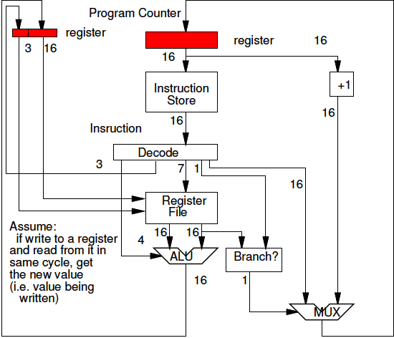
Can we pipeline?

Slide 4
Pipelining: ALU-RF Path
Only a problem when next instruction depends on value written by immediately previous instruction
ADD R3←R1+R2
ADD R4←R2+R4
ADD R5←R4+R3

Slide 5
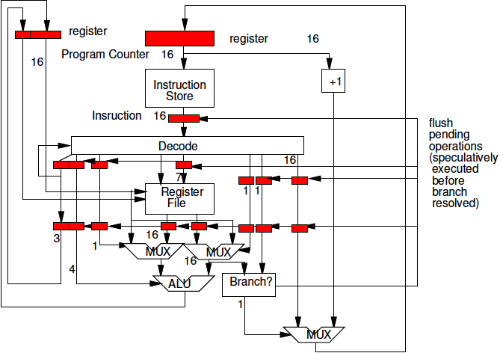
ALU-RF Path
Only a problem when next instruction depends on value written by immediately previous instruction
Solve with Bypass

Slide 6
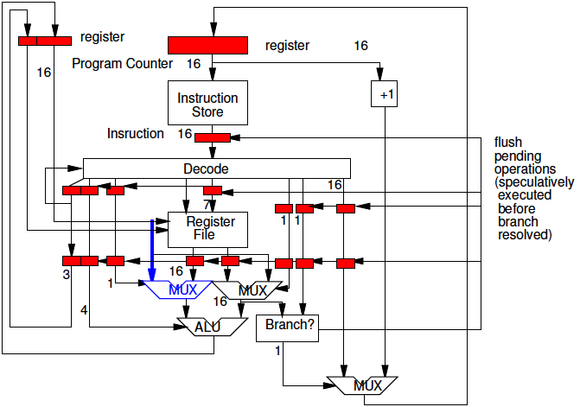
ALU-RF Path
Only a problem when next instruction depends on value written by immediately previous instruction
Solve with Bypass

Slide 7
Branch Path
Only a problem when the instruction is a taken branch

Slide 8
Branch Path
Only a problem when the instruction is a taken branch
Solve by
  Speculating is not a taken branch
  Preventing the speculative instruction from affecting state when branch occurs

Slide 10
Example
Different implementations for same specification

Slide 11
Today
Behavioral
(C, MATLAB, …)
Arch. Select
Schedule
RTL
FSM assign
Specification/Implementation
Abstraction Functions
Correctness Condition
Verification
Self-Consistency
Two-level,
Multilevel opt.
Covering
Retiming
Gate Netlist
Placement
Routing
Layout
Masks

Slide 12
Specification
Abstract from Implementation
Describes observable/correct behavior

Slide 13
Implementation
Some particular embodiment
Should have same observable behavior
  Same with respect to important behavior
Includes many more details than spec.
  How performed
  Auxiliary/intermediate state

Slide 14
Unimportant Behavior?
What behaviors might be unimportant?

Slide 15
“Important” Behavior
Same output sequence for input sequence
  Same output after some time?
Timing?
  Number of clock cycles to/between results?
  Timing w/in bounds?
Ordering?

Slide 16
Abstraction Function
Map from implementation state to specification state
  Use to reason about implementation correctness
  Want to guarantee: AF(Fi(q,i))=Fs(AF(q),i)
    Similar to saying the composite state machines always agree on output (state)
      …but have more general notion of outputs and timing
AF
Fi
Fs
AF

Slide 17
Recall FSM
Equivalent FSMs with different number of states
s0
0/0
1/0
q0
0/0
1/0
s1
s2
1/0
0/0
0/1
1/1
0/1
q1
q2
1/1
0/1
1/1
s3
s4
1/0
0/0
0/0
1/0

Slide 18
Recall FSM
s0
0/0
1/0
q0
0/0
1/0
s1
s2
1/0
0/0
0/1
1/1
0/1
q1
q2
1/1
0/1
1/1
s3
s4
1/0
0/0
0/0
1/0
Maybe right is specification
AF(s1)=q1, AF(s3)=q1
AF(s2)=q2, AF(s4)=q2
AF(s0)=q0
AF
Fi
Fs
AF

Slide 19
Familiar Example
Memory Systems
  Specification:
    W(A,D)
    R(A)→D from last D written to this address
  Specification state: contents of memory
  Implementation:
    Multiple caches, VM, pipelined, Write Buffers…
  Implementation state: much richer…

Slide 20
Memory AF
Maps from
  State of caches/WB/etc.
To
  Abstract state of memory
Guarantee AF(Fi(q,I))==Fs(AF(q),I)
  Guarantee change to state always represents the correct thing

Slide 21
Memory: L1, writeback
Memory with L1 cache
  L1 cache is extra state
    Another L1.capacity words of data
  Check L1 cache first for data on read
  Miss→load into cache
  Writes update mapping for address in L1
  When address evicted form L1
    write-back to main memory

Slide 22
Memory: L1, writeback
Specification State:
  one memory with addr:data mappings
  M(a) = MM[a]
L1 writeback cache implementation
  AF(L1+M): forall a
    If a in L1
    M(a)=L1[a]
    else
    M(a)=MM[a]
AF
Fi
Fs
AF

Slide 23
Memory: L1, writeback
Specification State:
  one memory with addr:data mappings
  M(a) = MM[a]
What are several (different) implementation states that map to same specification state?
  Concrete: M(0x100C)=0xBEC1
AF
Fi
Fs
AF

Slide 24
Abstract Timing
For computer memory system
  Cycle-by-cycle timing not part of specification
  Must abstract out
Solution:
  Way of saying “no response”
    Saying “skip this cycle”
    Marking data presence
      (tagged data presence pattern)
    Example: stall while fetch data into L1 cache

Slide 25
Filter to Abstract Timing
Filter input/output sequence
View computation as: Os(in)→out
FilterStall(Impl_{in}) = in
FilterStall(Impl_{out}) = out
Forall sequences Impl_{in}
  FilterStall(Oi(Impl_{in})) = Os(FilterStall(Impl_{in}))

Slide 26
Filter Example
Address
Data
Valid?
Only one cache + main memory
L1 answers in 1 cycle
4 cycle delay to fetch from main memory into L1
1 cycle
23: 0x10
34: 0x73
4 cycles
.
.
.
23: 0x10
24: 0x27
25: 0x7F
.
.
.
34: 0xF3
.
.

Slide 27
Filter Example
Address
Data
Valid?
Read Sequence:
  23 (request on cycle 0)
  24
  34
Cycle by cycle results?
0:
1:
2:
3:
4:
5:
6:
7:
8:
9:
10:
1 cycle
23: 0x10
34: 0x73
4 cycles
.
.
.
23: 0x10
24: 0x27
25: 0x7F
.
.
.
34: 0xF3
.
.

Slide 28
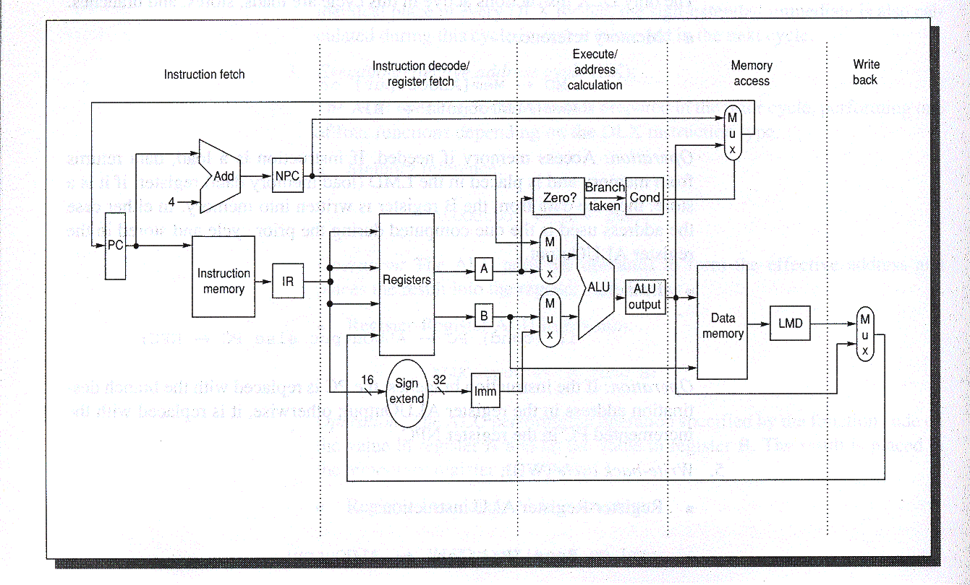
DLX Datapath
DLX unpipelined datapath from H&P (Fig. 3.1 e2, A.17 e3)

Slide 29
Processors
Pipeline is big difference between specification state and implementation state.
What is specification state?

Slide 30
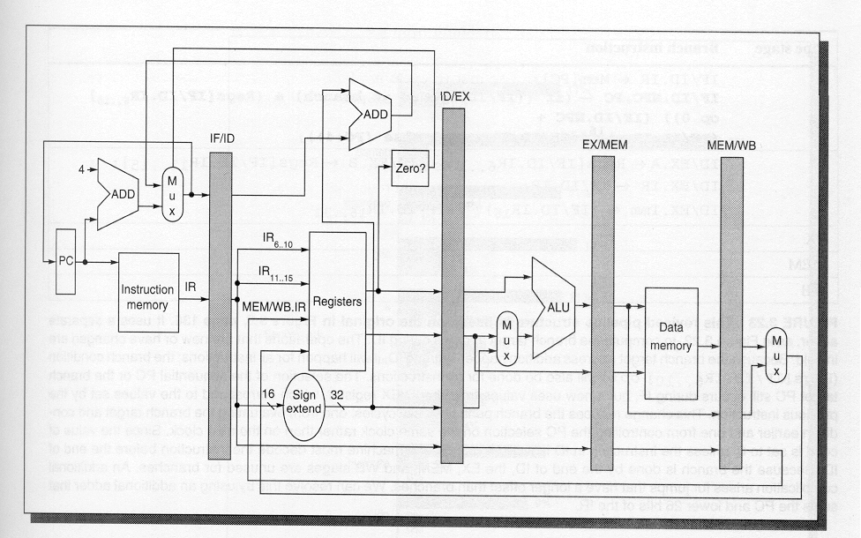
Revised Pipeline
DLX repipelined datapath from H&P (Fig. 3.22 e2, A.24 e3)

Slide 31
Processors
Pipeline is big difference between specification state and implementation state.
Specification State:
  PC, RF, Data Memory
Implementation State:
  Instruction in pipeline
  Lots of bits
    Many more states
    State-space explosion to track

Slide 32
Compare

Slide 33
Return to L1, writeback
How does main memory state relate to specification state after an L1 cache flush?
  L1 cache flush = force writeback on all entries of L1

Slide 34
Compare
How make the shared state the same?

Slide 35
Observation
After flushing pipeline,
  Reduce implementation state to specification state (RF, PC, Data Mem)
Can flush pipeline with series of NOOPs or stall cycles
NOOP “No Operation”
  An instruction that
  does not change
  any state
  (except the PC)

Slide 36
Pipelined Processor Correctness
w = input sequence
w_{f} = flush sequence
  Enough NOOPs to flush pipeline state
Forall states q and prefix w
  Fi(q,w w_{f})→Fs(q,w w_{f})
  Fi(q,w w_{f})→Fs(q,w)
FSM observation
  Finite state in pipeline
  only need to consider finite w

Slide 37
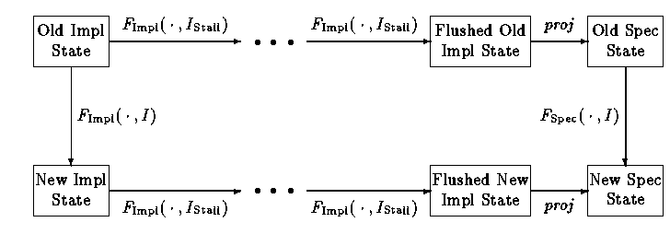
Pipeline Correspondence
[Burch+Dill, CAV’94]

Slide 38
Equivalence
Now have a logical condition for equivalence
Need to show that it always holds
  Is a Tautology
Or find a counter example

Slide 39
Ideas
Extract Transition Function
Segregate datapath
Symbolic simulation on variables
  For q, w’s
Case splitting search
  Generalization of SAT
  Uses implication pruning

Slide 40
Extract Transition Function
From HDL
Similar to what we saw for FSMs

Slide 41
Segregate Datapath
Big state blowup is in size of datapath
  Represent data symbolically/abstractly
    Independent of bitwidth
  Not verify datapath/ALU functions as part of this
    Can verify ALU logic separately using combinational verification techniques
    Abstract/uninterpreted functions for datapath

Slide 42
Burch&Dill Logic
Quantifier-free
Uninterpreted functions (datapath)
Predicates with
  Equality
  Propositional connectives

Slide 43
B&D Logic
Formula = ite(formula, formula, formula)
  (term=term)
  psym(term,…term)
  pvar | true | false
Term = ite(formula,term,term)
  fsym(term,…term)
  tvar

Slide 44
Sample
Regfile:
  (ite stall
  regfile
  (write regfile
  dest
  (alu op
  (read regfile src1)
  (read regfile src2))))

Slide 45
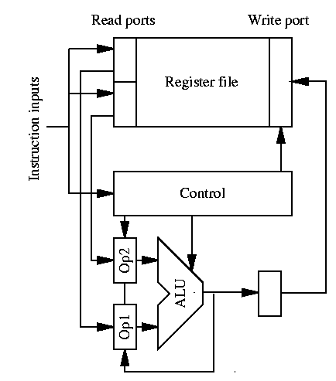
Sample Pipeline

Slide 46
Example Logic
arg1:
  (ite (or bubble-ex
  (not (= src1 dest-ex)))
  (read
  (ite bubble-wb
  regfile
  (write regfile dest-wb result))
  src1)
  (alu op-ex arg1 arg2))

Slide 47
Symbolic Simulation
Create logical expressions for outputs/state
  Taking initial state/inputs as variables
E.g. (ALU op2
(ALU op1 rf-init1 rf-init2)
rf-init3)

Slide 48
Example
After
R1: rf-init1
R2: rf-init2
R3: (ALU add rf-init1 rf-init2)
R4: (ALU add rf-init2 rf-init4)
R5: (ALU add (ALU add rf-init2 rf-init4) (ALU add rf-init1 rf-init2))
ADD R3←R1+R2
ADD R4←R2+R4
ADD R5←R4+R3
This is what checking equivalence on.

Slide 49
Case Splitting Search
Satisfiability Problem
Pick an unresolved variable
  (= src1 dest-ex)
    [relevant to bypass]
  (= 0
  (ALU op2
  (ALU op1 rf-init1 rf-init2)
  rf-init3)
  )
    [relevant to branching]

Slide 50
Case Splitting
Some case-splitting will be
  Ops – explore all combination of op sequences
  Registers – all interactions of registers among ops (ops in pipeline)
  Stalls – all possible timing of stalls
Like picking all output conditions from a state
  Case-splitting – picking cube cases

Slide 51
Case Splitting Search
Satisfiability Problem
Pick an unresolved variable
Branch on true and false
Push implications
Bottom out at consistent specification
Exit on contradiction
Pragmatic: use memoization to reuse work

Slide 52
Case Split Example: Cache
Only three operations: op A D
  R A
  W A D
  NOOP
Two implementations
  One with single memory
  One with cache
Want to be sure all sequences of operations return same results

Slide 53
Specification and Implementation
Specification
(ite (op==R)
(read M A)
(ite (op==W)
(write M A D)
(noop)
)
Cached Implementation
(ite (op==R)
(ite (in L1 A)
(read L1 A)
(seq
(write L1 A (read M A))
(read M A))
(ite (op==W)
(seq
(write M A D)
(ite (in L1 A)
(write L1 A D)))
(noop))))

Slide 54
Sequence
(Op1 A1 D1)
(Op2 A2 D2)
(Op3 A3 D3)
(Op4 A4 D4)
(Op5 A5 D5)
Forall (Op1,Op2,Op3,Op4,Op5, A1,A2,A3,A4,A5,D1,D2,D3,D4,D5)
(Spec ((Op1 A1 D1) ….(Op5 A5 D5))
== (Cache ((Op1 A2 D1) … (Op5 A5 D5))

Slide 55
Case Split
Op1
R
W
Noop
Op2
Op2
Op2
R
W
Noop
R
W
Noop
R
W
Noop
A1=A2
A1≠A2
A1=A2
A1≠A2
A1=A2
A1≠A2

Slide 56
Case Splitting Search
Satisfiability Problem
Pick an unresolved variable
Branch on true and false
Push implications
Bottom out at consistent specification
Exit on contradiction
Pragmatic: use memoization to reuse work

Slide 57
Review: What have we done?
Reduced to simpler problem
  Simple, clean specification
Abstract Simulation
  Explore all possible instruction sequences
Abstracted the simulation
  Focus on control
  Divide and Conquer: control vs. arithmetic
Used Satisfiability for reachability in search in abstract simulation

Slide 58
Achievable
Burch&Dill: Verify 5-stage pipeline DLX
  1 minute in 1994
    On a 40MHz R3400 processor
Modern machines 30+ pipeline stages
  …and many other implementation embellishments

Slide 59
Self Consistency

Slide 60
Self-Consistency
Compare same implementation in two different modes of operation
  (which should not affect result)
Examples of different modes of operation that should behave the same?

Slide 61
Self-Consistency
Compare same implementation in two different modes of operation
  (which should not affect result)
Compare pipelined processor
  To self w/ NOOPs separating instructions
    So only one instruction in pipeline at a time
  Why might this be important?

Slide 62
Self-Consistency
w = instruction sequence
S(w) = w with no-ops
Show: Forall q, w
  F(q,w) = F(q,S(w))

Slide 63
Sample Result
A – stream processor
B – multithread pipeline
[Jones, Seger, Dill/FMCAD 1996]
n.b. Jones&Seger at Intel

Slide 64
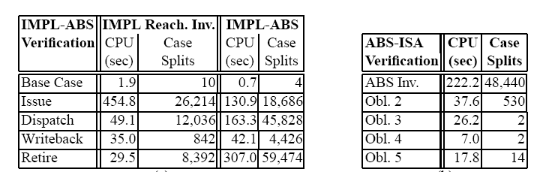
Sample Result: OoO processor
Verification running on P2-200MHz
[Skakkebæk, Jones, and Dill / CAV 1998,
Formal Methods in System Design v20, p139, 2002]

Slide 65
Key Idea Summary
Implementation state reduces to Specification state after finite series of operations
Abstract datapath to avoid dependence on bitwidth
Abstract simulation (reachability)
  Show same outputs for any input sequence
State→state transform
  Can reason about finite sequence of steps

Slide 66
Big Ideas
Proving Invariants
Divide and Conquer
Exploit Structure

Slide 67
Admin
Last Class
Course evaluations online
Traveling next two weeks
  No office hours on Tuesdays
Last day to turnin late assignments:
  May 12th

