Slide 1

ESE535:
Electronic Design Automation
Day 2: January 26, 2015
Covering
Work preclass exercise

Slide 2
Feedback -- Piazza
Last lecture
  Average Pace 4
  everyone agreed was fast
Posted followup on Piazza
Identified a correction on assignment 2 on Piazza
….only 10 people signed up on Piazza

Slide 3
Today:
Covering Problem
Behavioral
(C, MATLAB, …)
Arch. Select
Schedule
RTL
FSM assign
Implement a “gate-level” netlist in terms of some library of primitives
General Formulation
  Make it easy to change technology
  Make it easy to experiment with library requirements
    Evaluate benefits of new cells…
    Evaluate architecture with different primitives
Two-level,
Multilevel opt.
Covering
Retiming
Gate Netlist
Placement
Routing
Layout
Masks

Slide 4
Input
netlist (logical circuit)
library
represent both in normal form:
  nand gate
  inverters

Slide 5
Elements of a library - 1
Element/Area Cost
Tree Representation (normal form)
INVERTER 2
NAND2 3
NAND3 4
NAND4 5
Example: Keutzer

Slide 6
Elements of a library - 2
Element/Area Cost
Tree Representation (normal form)
AOI21 4
AOI22 5

Slide 7
Input Circuit Netlist
``subject DAG’’
Each wire is a network (net).
Each net has a single source (the gate that drives it).
In general, net may have multiple sinks (gates that take as input)

Slide 8
Input Circuit Netlist
``subject DAG’’
5
3
2
1
0
4
6
A list of the nets (netlist) fully describes the circuit
  0 nand 1 6
  1 inv 2
  2 nand 3 4

Slide 9
Problem Statement
Find an ``optimal’’ (in area, delay, power) mapping of this circuit (DAG)
into this library

Slide 10
Why covering now?
Nice/simple cost model
Problem can be solved well
  somewhat clever solution
General/powerful technique
Show off special cases
  harder/easier cases
Show off things that make hard
Show off bounding

Slide 11
What’s the Problem?
Trivial Covering
subject DAG
7 NAND2 (3) = 21
5 INV (2) = 10
Area cost 31

Slide 12
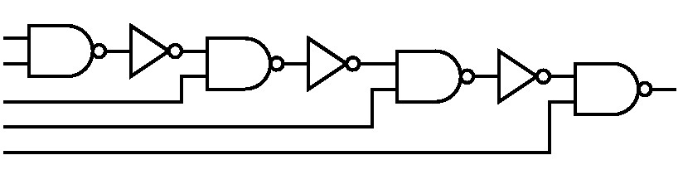
Preclass 1
Direct covering cost?
2
3
4
6

Slide 13
Preclass 3 & 4
Least Area Cover? (associated area?)
  How did you get?
2
3
4
6

Slide 14
Cost Models

Slide 15
Cost Model: Area
Assume: Area in gates
or, at least, can pick an area/gate
  so proportional to gates
e.g.
  Standard Cell design
  Standard Cell/route over cell
  Gate array

Slide 16
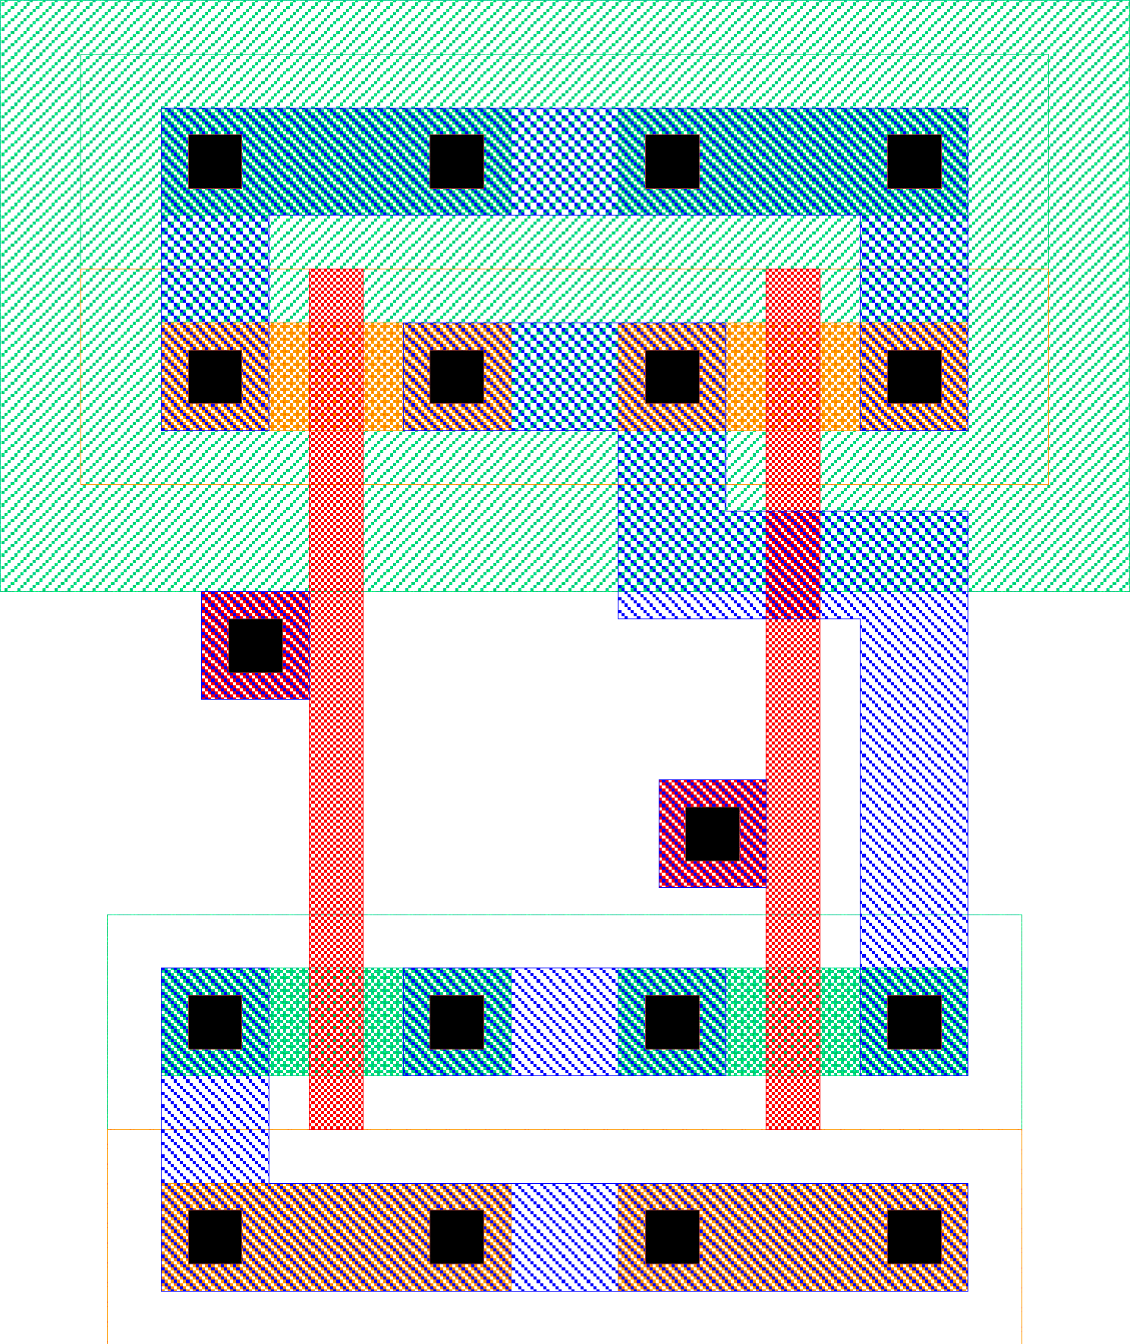
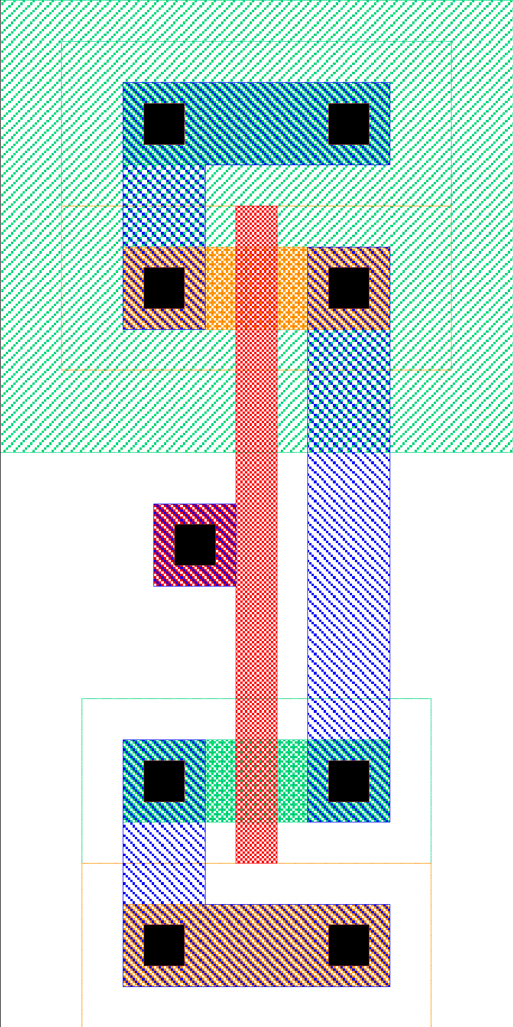
Standard Cells
Lay out gates so that heights match
  Rows of adjacent cells
  Standardized sizes
Motivation: ease place and route
16
Notes:
16

Slide 17
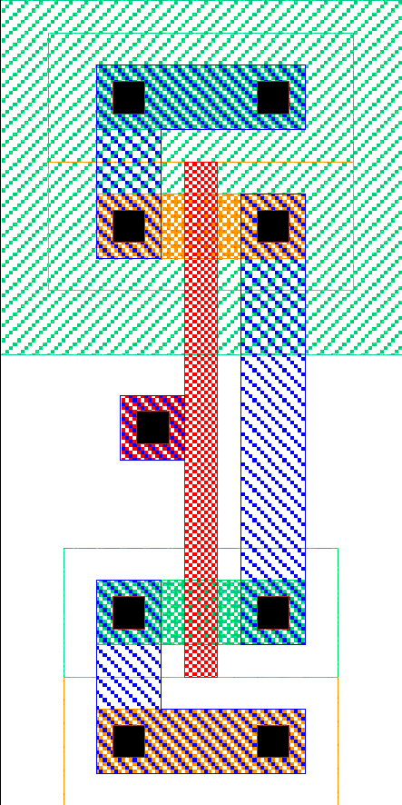

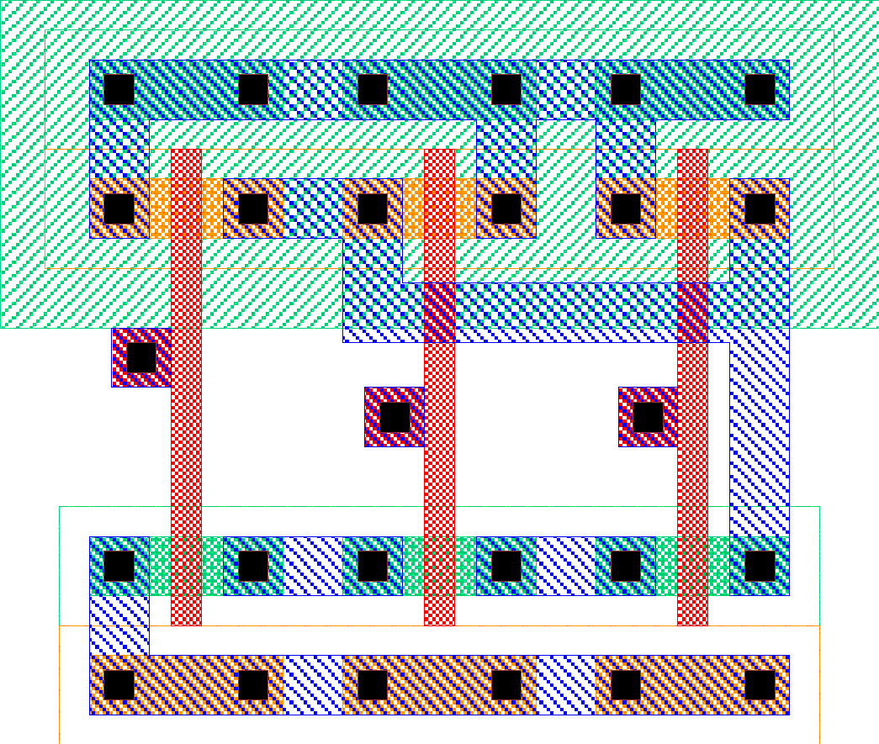
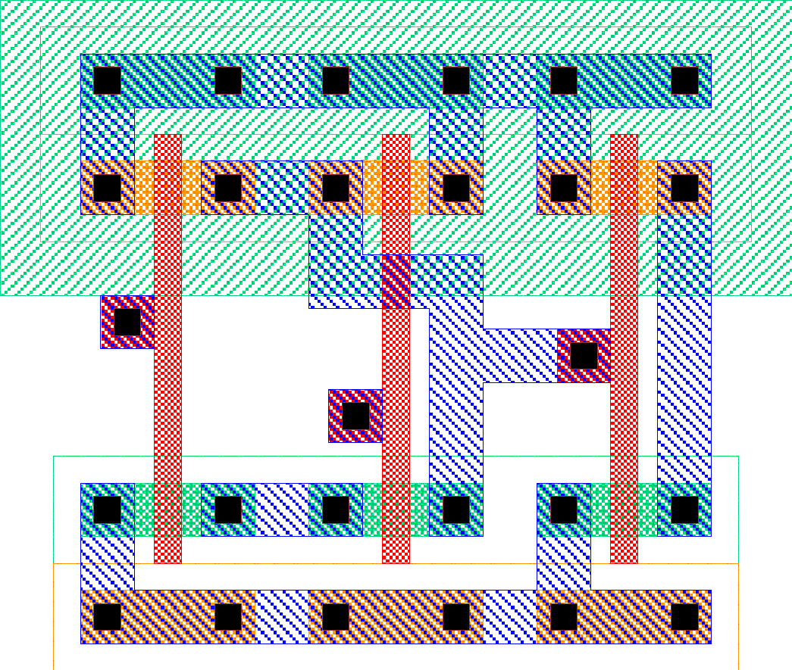
Standard Cell Area
inv
nand3
All cells
uniform
height
Width of
channel
determined
by routing
Cell area
Width of channel
fairly constant?

Slide 18
Cost Model: Delay
Delay in gates
  at least assignable to gates
    T_{wire} << T_{gate}
    T_{wire} ~=constant
  delay exclusively/predominantly in gates
    Gates have C_{out}, C_{in}
    lump capacitance for output drive
    delay ~ T_{gate} + fanout×C_{in}
    C_{wire} << C_{in}
    or C_{wire} can lump with C_{out}/T_{gate}

Slide 19
Logic Delay
How would we calculate delay?

Slide 20
Parasitic Capacitances

Slide 21
Delay of Net

Slide 22
Cost Model: Delay
F=22nm CMOS
T_{gate}(inv drive 4 inv)~=1ps
T_{wire}(300μm)~=1ps
W_{gate}~=0.3μm
Delay in gates
  at least assignable to gates
    T_{wire} << T_{gate}
    T_{wire} ~=constant
  delay exclusively/predominantly in gates
    Gates have C_{out}, C_{in}
    lump capacitance for output drive
    delay ~ T_{gate} + fanout×C_{in}
    C_{wire} << C_{in}
    or C_{wire} can lump with C_{out}/T_{gate}

Slide 23
Cost Models
Why do I show you models?
  not clear there’s one “right” model
  changes over time
  you’re going to encounter many different kinds of problems
  want you to see formulations so can critique and develop own
  simple cost models make problems tractable
    are surprisingly adequate
  simple, at least, help bound solutions
  may be wrong today…need to rethink

Slide 24
Approaches

Slide 25
Greedy work?
Greedy = pick next locally “best” choice
2
3
4
6

Slide 26
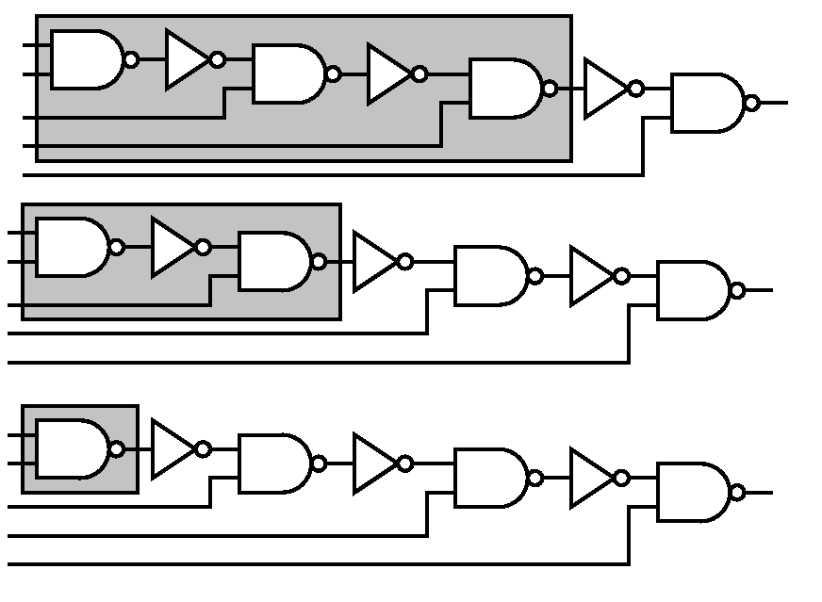
Greedy In→Out
6
4
2

Slide 27
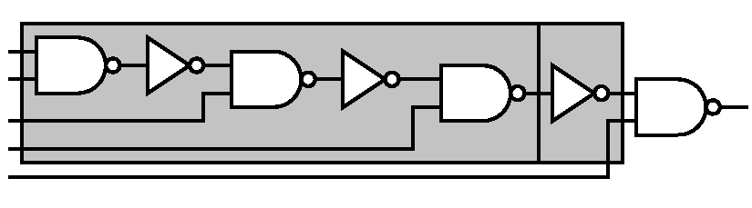
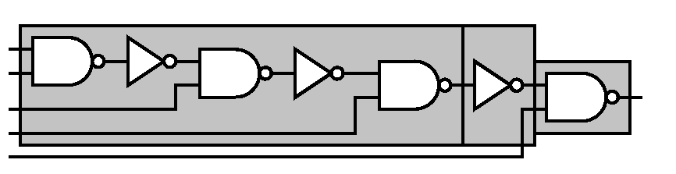
Greedy In→Out
8
11

Slide 28
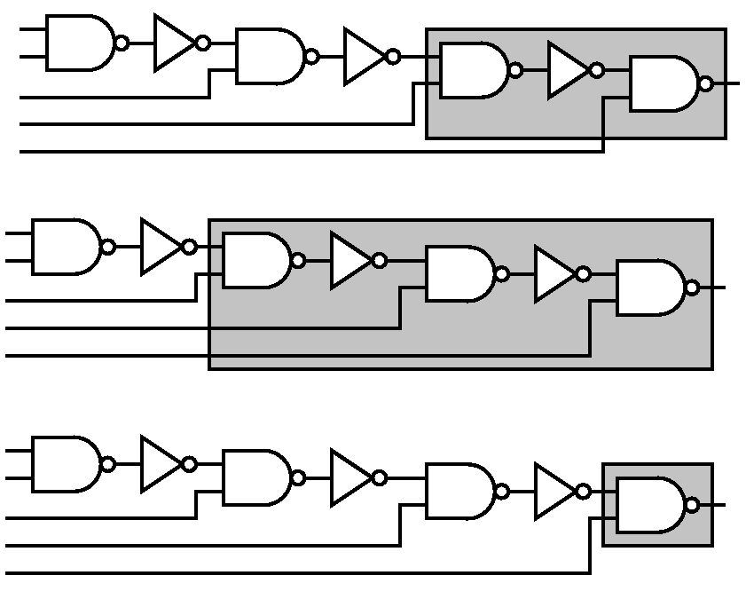
Greedy Out→In
4
6
2

Slide 29
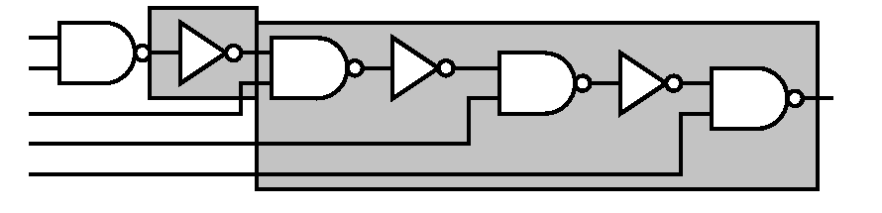
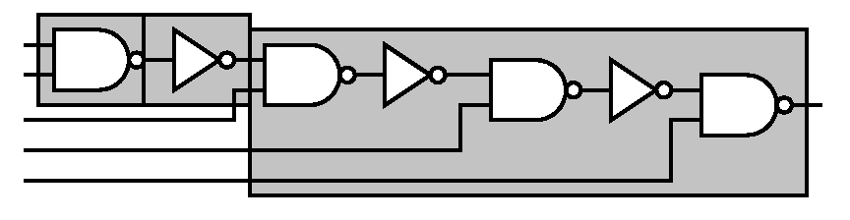
Greedy Out→In
8
11

Slide 30
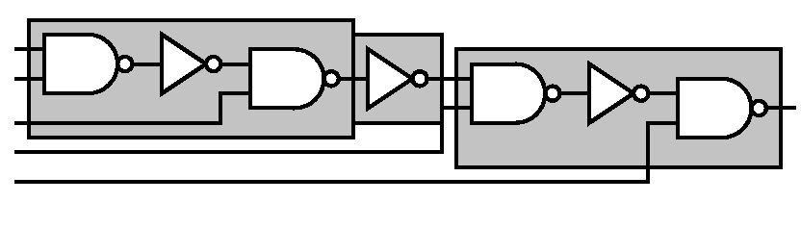
But…
4 2 4 = 10

Slide 31
Greedy Problem
What happens in the future (elsewhere in circuit) will determine what should be done at this point in the circuit.
Can’t just pick best thing for now and be done.

Slide 32
Brute force?
Pick a node (output)
Consider
  all possible gates which may cover that node
  branch on all inputs after cover
  pick least cost node

Slide 33
Pick a Node

Slide 34
Brute force?
Pick a node (output)
Consider
  all possible gates which may cover that node
  recurse on all inputs after cover
  pick least cost node
Explore all possible covers
  can find optimum

Slide 35
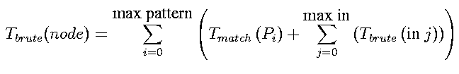
Analyze brute force?
Time?
Say P patterns, constant time to match each
  (if patterns long could be > O(1))
P-way branch at each node…
  How big is tree?
…exponential
  O((P)^{depth})

Slide 36
Structure inherent in problem to exploit?
What structure exists?

Slide 37
Structure inherent in problem to exploit?
There are only N unique nodes to cover!

Slide 38
Structure
If subtree solutions do not depend on what happens outside of its subtree
  separate tree
  farther up tree
Should only have to look at N nodes.
Time(N) = N*P*T(match)
  w/ P fixed/bounded ➔ linear in N
  w/ cleverness work isn’t P*T(match) at every node

Slide 39
Idea Re-iterated
Work from inputs
Optimal solution to subproblem is contained in optimal, global solution
Find optimal cover for each node
Optimal cover:
  examine all gates at this node
  look at cost of gate and its inputs
  pick least

Slide 40
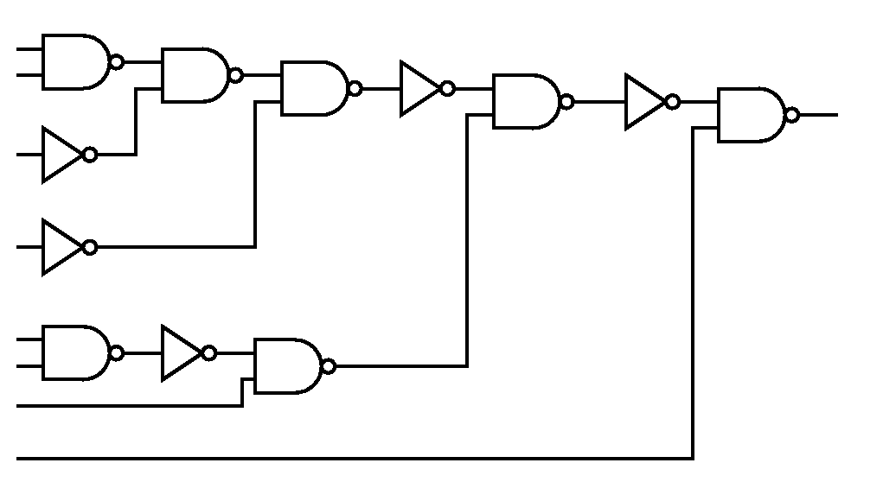
Work front-to-back

Slide 41
Work Example (area)
library
2
3
4
5
4
5

Slide 42
Work Example (area)
3
2
2
3
library
2
3
4
5
4
5

Slide 43
Work Example (area)
3
2
2
3
library
2
3
4
5
4
5

Slide 44
Work Example (area)
Consider all
patterns
3
2
2
3
library
2
3
4
5
4
5

Slide 45
Elements of a library - 1
Element/Area Cost
Tree Representation (normal form)
INVERTER 2
NAND2 3
Copy to
board
NAND3 4
NAND4 5
Example: Keutzer

Slide 46
Elements of a library - 2
Element/Area Cost
Tree Representation (normal form)
AOI21 4
AOI22 5

Slide 47
Work Example (area)
Consider all
patterns
3
2
2
3
library
2
3
4
5
4
5

Slide 48
Work Example (area)
3
3+3+2=8
2
2
3
library
2
3
4
5
4
5

Slide 49
Work Example (area)
3
8
2
2
3
library
2
3
4
5
4
5

Slide 50
Work Example (area)
3
8
2
2
3
library
2
3
4
5
4
5

Slide 51
Work Example (area)
3
8
2
2
3+2=5
3
library
2
3
4
5
4
5

Slide 52
Work Example (area)
3
8
2
2
3
5
library
2
3
4
5
4
5

Slide 53
Work Example (area)
3
8
2
Consider
All patterns
2
3
5
library
2
3
4
5
4
5

Slide 54
Work Example (area)
3
8
2
2
3+5=8
3
5
library
2
3
4
5
4
5

Slide 55
Work Example (area)
3
8
2
2
3
5
4
library
2
3
4
5
4
5

Slide 56
Work Example (area)
3
8
2
2
3
5
4
library
2
3
4
5
4
5

Slide 57
Work Example (area)
3
8+2+3=13
8
2
2
3
5
4
library
2
3
4
5
4
5

Slide 58
Work Example (area)
3
8
13
2
2
3
5
4
library
2
3
4
5
4
5

Slide 59
Work Example (area)
3
13+2=15
8
13
2
2
3
5
4
library
2
3
4
5
4
5

Slide 60
Work Example (area)
3
3+2+4=9
8
13
2
2
3
5
4
library
2
3
4
5
4
5

Slide 61
Work Example (area)
3
8
13
9
2
2
3
5
4
library
2
3
4
5
4
5

Slide 62
Work Example (area)
3
9+4+3=16
8
13
9
2
2
3
5
4
library
2
3
4
5
4
5

Slide 63
Work Example (area)
3
8+2+4+4=18
8
13
9
2
2
3
5
4
library
2
3
4
5
4
5

Slide 64
Work Example (area)
3
8
13
9
16
2
2
3
5
4
library
2
3
4
5
4
5

Slide 65
Work Example (area)
3
16+2=18
8
13
9
16
2
2
3
5
4
library
2
3
4
5
4
5

Slide 66
Work Example (area)
3
8
13+5+4=22
13
9
16
2
2
3
5
4
library
2
3
4
5
4
5

Slide 67
Work Example (area)
3
8
13
9
16
18
2
2
3
5
4
library
2
3
4
5
4
5

Slide 68
Work Example (area)
3
18+3=21
8
13
9
16
18
2
2
3
5
4
library
2
3
4
5
4
5

Slide 69
Work Example (area)
3
9+4+4=17
8
13
9
16
18
2
2
3
5
4
library
2
3
4
5
4
5

Slide 70
Work Example (area)
3
8+2+4+5=19
8
13
9
16
18
2
2
3
5
4
library
2
3
4
5
4
5

Slide 71
Work Example (area)
3
8
13
9
16
18
17
2
2
3
5
4
library
2
3
4
5
4
5

Slide 72
Optimal Cover
3
8
13
9
16
18
17
2
2
3
5
4
library
2
3
4
5
4
5

Slide 73
Optimal Cover
3
8
13
9
16
18
17
2
2
3
5
4
Much better than 31!
library
2
3
4
5
4
5

Slide 74
Note
There are nodes we cover that will not appear in final solution.

Slide 75
“Unused” Nodes
3
8
9
13
16
18
17
2
2
3
5
4
library
2
3
4
5
4
5

Slide 76
Dynamic Programming Solution
Solution described is general instance of dynamic programming
Require:
  optimal solution to subproblems is optimal solution to whole problem
  (all optimal solutions equally good)
  divide-and-conquer gets same (finite/small) number of subproblems
Same technique used for instruction selection in code generation for processors

Slide 77
Delay
Similar
  Delay(node) = Delay(gate)+Max(Delay(input))

Slide 78
DAG
DAG = Directed Acyclic Graph
  Distinguish from tree (tree ⊂ DAG)
  Distinguish from cyclic Graph
  DAG ⊂ Directed Graph (digraph)
tree
DAG
Digraph

Slide 79
Trees vs. DAGs
Optimal for trees
  why?
    Delay
    Area

Slide 80
Not optimal for DAGs
Why?

Slide 81
Not optimal for DAGs
Why?
1+1+1=3
1+1+1=3

Slide 82
Not optimal for DAGs
Why?
1+1+1=3
3+3+1=7 ?
1+1+1=3

Slide 83
Not Optimal for DAGs (area)
Cost(N) = Cost(gate) + Σ Cost(input nodes)
think of sets
cost is magnitude of set union
Problem: minimum cost (magnitude) solution isn’t necessarily the best pick
  get interaction between subproblems
  subproblem optimum not global...

Slide 84
DAG Example
Cover with 3 input gates

Slide 85
DAG Example
Cover with 3 input gates

Slide 86
Not Optimal for DAGs
Delay:
  in fanout model, depends on problem you haven’t already solved (delay of node depends on number of uses)

Slide 87
What do people do?
Cut DAGs at fanout nodes
optimally solve resulting trees
Area
  guarantees covered once
    get accurate costs in covering trees, made “premature” assignment of nodes to trees
Delay
  know where fanout is

Slide 88
Bounding
Tree solution give bounds (esp. for delay)
  single path, optimal covering for delay
  (also make tree by replicating nodes at fanout points)
no fanout cost give lower bounds
  know you can’t do better
delay lower bounds useful, too
  know what you’re giving up for area
  when delay matters

Slide 89
(Multiple Objectives?)
Like to say, get delay, then area
  won’t get minimum area for that delay
  algorithm only keep best delay
  …but best delay on off critical path piece not matter
    …could have accepted more delay there
  don’t know if on critical path while building subtree
  (iterate, keep multiple solutions)

Slide 90
Many more details...
Implement well
Combine criteria
…but now you know the main idea

Slide 91
Big Ideas
simple cost models
problem formulation
identifying structure in the problem
special structure
characteristics that make problems hard
bounding solutions

Slide 92
Admin
Reading for today: canvas
Reading for Wednesday:
  online/ACM DL
  Highly relevant to assignment 3..6
Office Hour: T4:30pm
  Or make an appointment

