Slide 1
ESE535: Electronic Design Automation
Day 4: January 28, 2015
Partitioning
(Intro, KLFM)

Slide 2
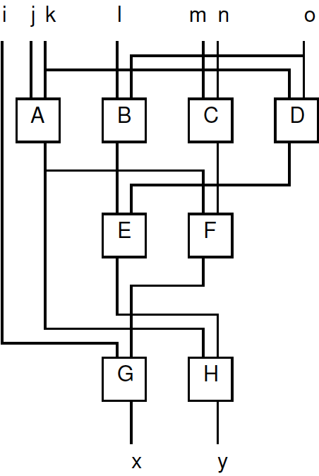
Preclass Warmup
What cut size were you able to achieve?

Slide 3
Today
Behavioral
(C, MATLAB, …)
Arch. Select
Schedule
RTL
FSM assign
Partitioning
why important
Can be used as tool at many levels
practical attack
variations and issues
Two-level,
Multilevel opt.
Covering
Retiming
Gate Netlist
Placement
Routing
Layout
Masks

Slide 4
Motivation (1)
Behavioral
(C, MATLAB, …)
Arch. Select
Schedule
RTL
Cut size (bandwidth) can determine
Area, energy
Minimizing cuts
minimize interconnect requirements
increases signal locality
Chip (board) partitioning
minimize IO
Direct basis for placement
Particularly for our heterogeneous multicontext computing array
FSM assign
Two-level,
Multilevel opt.
Covering
Retiming
Gate Netlist
Placement
Routing
Layout
Masks

Slide 5
Motivation (2)
Divide-and-conquer
trivial case: decomposition
smaller problems easier to solve
net win, if super linear
Part(n) + 2×T(n/2) < T(n)
problems with sparse connections or interactions
Exploit structure
limited cutsize is a common structural property
random graphs would not have as small cuts

Slide 6
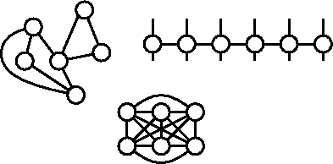
Bisection Width
Partition design into two equal size halves
Minimize wires (nets) with ends in both halves
Number of wires crossing is bisection width
lower bw = more locality
N/2
cutsize
N/2

Slide 7
Interconnect Area
Bisection width is lower-bound on IC width
When wire dominated, may be tight bound
(recursively)

Slide 8
Classic Partitioning Problem
Given: netlist of interconnect cells
Partition into two (roughly) equal halves (A,B)
minimize the number of nets shared by halves
“Roughly Equal”
balance condition: (0.5-δ)N≤|A|≤(0.5+δ)N

Slide 9
Balanced Partitioning
NP-complete for general graphs
[ND17: Minimum Cut into Bounded Sets, Garey and Johnson]
Reduce SIMPLE MAX CUT
Reduce MAXIMUM 2-SAT to SMC
Unbalanced partitioning poly time
Many heuristics/attacks

Slide 10
KL FM Partitioning Heuristic
Greedy, iterative
pick cell that decreases cut and move it
repeat
small amount of non-greediness:
look past moves that make locally worse
randomization

Slide 11
Fiduccia-Mattheyses (Kernighan-Lin refinement)
Start with two halves (random split?)
Repeat until no updates
Start with all cells free
Repeat until no cells free
Move cell with largest gain (balance allows)
Update costs of neighbors
Lock cell in place (record current cost)
Pick least cost point in previous sequence and use as next starting position
Repeat for different random starting points

Slide 12
Efficiency
Tricks to make efficient:
Expend little work picking move candidate
Constant work ≡ O(1)
Means amount of work not dependent on problem size
Update costs on move cheaply [O(1)]
Efficient data structure
update costs cheap
cheap to find next move

Slide 13
Ordering and Cheap Update
Keep track of Net gain on node == delta net crossings to move a node
cut cost after move = cost - gain
Calculate node gain as Σ net gains for all nets at that node
Each node involved in several nets
Sort nodes by gain
Avoid full resort every move
A
C
B

Slide 14
FM Cell Gains
Gain = Delta in number of nets crossing between partitions
= Sum of net deltas for nets on the node
-4
0
+4
1
2
0

Slide 15
After move node?
Update cost
Newcost=cost-gain
Also need to update gains
on all nets attached to moved node
but moves are nodes, so push to
all nodes affected by those nets

Slide 16
Composability of Net Gains
-1
-1
-1+1-0-1 = -1
-1
+1
0

Slide 17
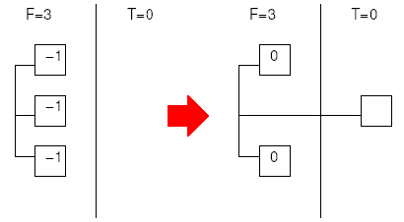
FM Recompute Cell Gain
For each net, keep track of number of cells in each partition [F(net), T(net)]
Move update:(for each net on moved cell)
if T(net)==0, increment gain on F side of net
(think -1 => 0)

Slide 18
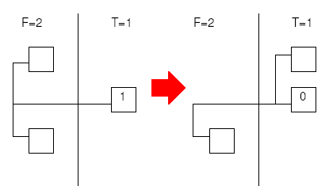
FM Recompute Cell Gain
For each net, keep track of number of cells in each partition [F(net), T(net)]
Move update:(for each net on moved cell)
if T(net)==0, increment gain on F side of net
(think -1 => 0)
if T(net)==1, decrement gain on T side of net
(think 1=>0)

Slide 19
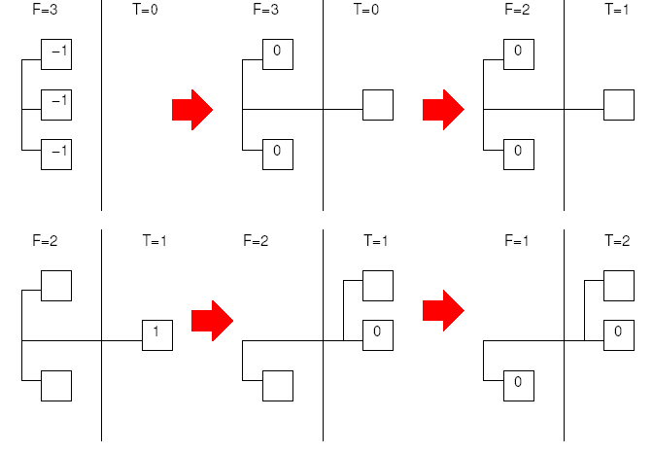
FM Recompute Cell Gain
Move update:(for each net on moved cell)
if T(net)==0, increment gain on F side of net
if T(net)==1, decrement gain on T side of net
decrement F(net), increment T(net)

Slide 20
FM Recompute Cell Gain
Move update:(for each net on moved cell)
if T(net)==0, increment gain on F side of net
if T(net)==1, decrement gain on T side of net
decrement F(net), increment T(net)
if F(net)==1, increment gain on F cell

Slide 21
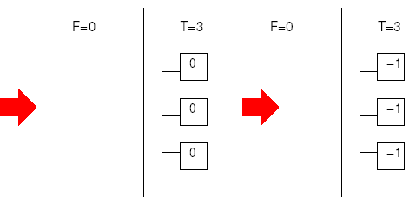
FM Recompute Cell Gain
Move update:(for each net on moved cell)
if T(net)==0, increment gain on F side of net
if T(net)==1, decrement gain on T side of net
decrement F(net), increment T(net)
if F(net)==1, increment gain on F cell
if F(net)==0, decrement gain on all cells (T)

Slide 22
FM Recompute Cell Gain
For each net, keep track of number of cells in each partition [F(net), T(net)]
Move update:(for each net on moved cell)
if T(net)==0, increment gain on F side of net
(think -1 => 0)
if T(net)==1, decrement gain on T side of net
(think 1=>0)
decrement F(net), increment T(net)
if F(net)==1, increment gain on F cell
if F(net)==0, decrement gain on all cells (T)

Slide 23
FM Recompute (example)
[note markings here
are deltas…earlier
pix were absolutes]

Slide 24
FM Recompute (example)
+1
+1
+1
+1
[note markings here
are deltas…earlier
pix were absolutes]

Slide 25
FM Recompute (example)
+1
+1
+1
+1
0
0
0
-1
[note markings here
are deltas…earlier
pix were absolutes]

Slide 26
FM Recompute (example)
+1
+1
+1
+1
0
0
0
-1
0
0
0
0
[note markings here
are deltas…earlier
pix were absolutes]

Slide 27
FM Recompute (example)
+1
+1
+1
+1
0
0
0
-1
0
0
0
0
+1
0
0
0
[note markings here
are deltas…earlier
pix were absolutes]

Slide 28
FM Recompute (example)
+1
+1
+1
+1
0
0
0
-1
0
0
0
0
+1
0
0
0
-1
-1
-1
-1
[note markings here
are deltas…earlier
pix were absolutes]

Slide 29
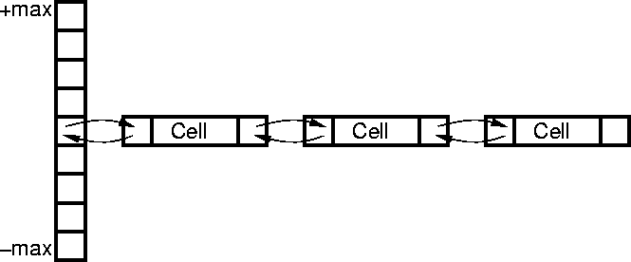
FM Data Structures
Partition Counts A,B
Two gain arrays
One per partition
Key: constant time cell update
Cells
successors (consumers)
inputs
locked status
Binned by cost → constant time update

Slide 30
Use FM to Partition Preclass Example
Allow partition of size 5

Slide 31
Use FM to Partition Preclass Example
Initial Partition
Initial cut size?
Identify Gains?

Slide 32
Use FM to Partition Preclass Example
Initial Partition (cut 6)
Move lists:
Left:
2: A
1: E, G
0: B
Right:
3: D,
1: H
0: F
-1: C
2
0
-1
3
1
0
1
1

Slide 33
Use FM to Partition Preclass Example
Initial Partition
Move D
Cut: 6-3 = 3
Update Gains
2
0
-1
3
1
0
1
1

Slide 34
Use FM to Partition Preclass Example
Initial Partition
Move D
Cut: 6-3 = 3
Update Gains
2→0
0→-2
-1
2
1→-1
0
1
1

Slide 35
Use FM to Partition Preclass Example
Move lists:
Left:
1: G
0: A
-1: E
-2: B
Right:
2:
1: H
0: F
-1: C
0
-2
-1
-2
-1
0
1
1

Slide 36
Use FM to Partition Preclass Example
Move G
Cost: 3-1=2
Update Gains?
0
-2
-1
-2
-1
0
1
1

Slide 37
Use FM to Partition Preclass Example
Move G
Cost: 3-1=2
Update Gains?
0
-2
-1
-2
-1
0→-2
1
1

Slide 38
Use FM to Partition Preclass Example
Move lists:
Left:
0: A
-1: E
-2: B
Right:
2:
1: H
-1: C
-2: F
0
-2
-1
-2
-1
-2
-1
1

Slide 39
Use FM to Partition Preclass Example
Move H
Cost: 2-1=1
Update Gains?
0
-2
-1
-2
-1
-2
-1
1

Slide 40
Use FM to Partition Preclass Example
Move H
Cost: 2-1=1
Update Gains?
0→-1
-2
-1
-2
-1→-3
-2→-1
-1
1

Slide 41
Use FM to Partition Preclass Example
Move lists:
Left:
0:
-1: A
-2: B
-3: E
Right:
2:
-1: C
-2: F
-1
-2
-1
-2
--3
-1
-1
-1

Slide 42
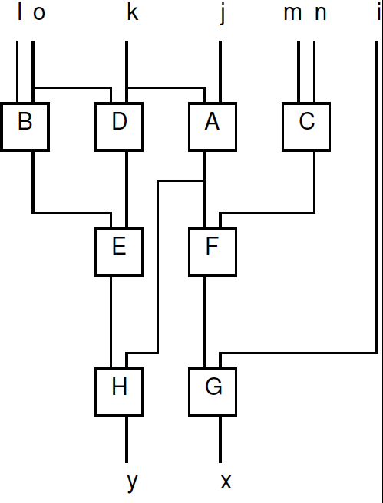
Use FM to Partition Preclass Example
-1
-2
-1
-2
--3
-1
-1
-1

Slide 43
Use FM to Partition Preclass Example
-1
-2
-1
-2
--3
-1
Gain sequence:
+3
+1
+1
(-1)
-1
-1

Slide 44
KLFM
Randomly partition into two halves
Repeat until no updates
Start with all cells free
Repeat until no cells free
Move cell with largest gain
Update costs of neighbors
Lock cell in place (record current cost)
Pick least cost point in previous sequence and use as next starting position
Repeat for different random starting points

Slide 45
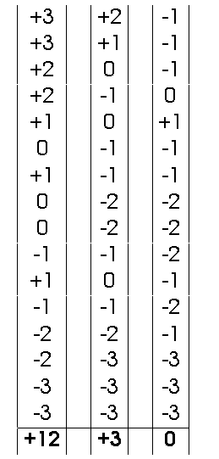
FM Optimization Sequence (ex)

Slide 46
FM Running Time?
Randomly partition into two halves
Repeat until no updates
Start with all cells free
Repeat until no cells free
Move cell with largest gain
Update costs of neighbors
Lock cell in place (record current cost)
Pick least cost point in previous sequence and use as next starting position
Repeat for different random starting points

Slide 47
FM Running Time
Assume:
constant number of passes to converge
constant number of random starts
N cell updates each round (swap)
Updates K + fanout work (avg. fanout K)
assume at most K inputs to each node
For every net attached (K+1)
For every node attached to those nets (O(K))
Maintain ordered list O(1) per move
every io move up/down by 1
Running time: O(K²N)
Algorithm significant for its speed
(more than quality)

Slide 48
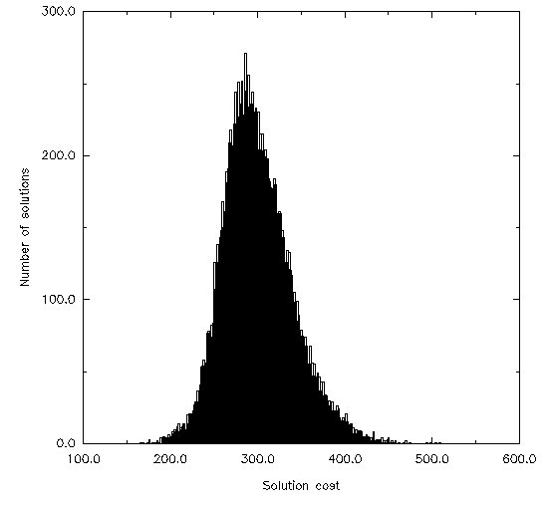
FM Starts?
So, FM gives a not bad solution quickly
21K random starts, 3K network -- Alpert/Kahng

Slide 49
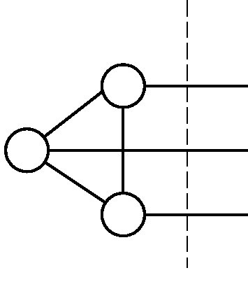
Weaknesses?
Local, incremental moves only
hard to move clusters
no lookahead
Stuck in local minima?
Looks only at local structure

Slide 50
Time Permit

Slide 51
Improving FM
Clustering
Initial partitions
Runs
Partition size freedom
Following comparisons from Hauck and Boriello ‘96

Slide 52
Clustering
Group together several leaf cells into cluster
Run partition on clusters
Uncluster (keep partitions)
iteratively
Run partition again
using prior result as starting point
instead of random start

Slide 53
Clustering Benefits
Catch local connectivity which FM might miss
moving one element at a time, hard to see move whole connected groups across partition
Faster (smaller N)
METIS -- fastest research partitioner exploits heavily

Slide 54
How Cluster?
Random
cheap, some benefits for speed
Greedy “connectivity”
examine in random order
cluster to most highly connected
30% better cut, 16% faster than random
Spectral (next week)
look for clusters in placement
(ratio-cut like)
Brute-force connectivity (can be O(N²))

Slide 55
Initial Partitions?
Random
Pick Random node for one side
start imbalanced
run FM from there
Pick random node and Breadth-first search to fill one half
Pick random node and Depth-first search to fill half
Start with Spectral partition

Slide 56
Initial Partitions
If run several times
pure random tends to win out
more freedom / variety of starts
more variation from run to run
others trapped in local minima

Slide 57
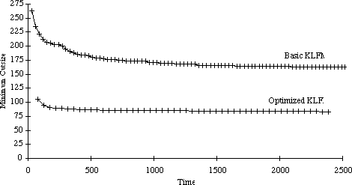
Number of Runs

Slide 58
Number of Runs
2 - 10%
10 - 18%
20 <20%
50 < 22%
…but?
21K random starts, 3K network
Alpert/Kahng

Slide 59
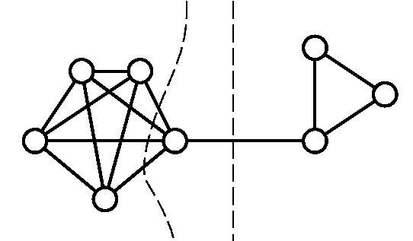
Unbalanced Cuts
Increasing slack in partitions
may allow lower cut size

Slide 60
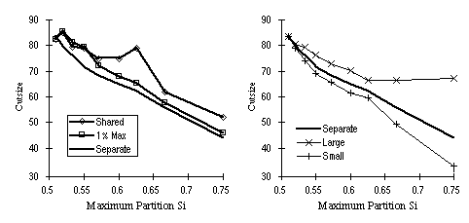
Unbalanced Partitions
Small/large is benchmark size not small/large partition IO.
Following comparisons from Hauck and Boriello ‘96

Slide 61
Partitioning Summary
Decompose problem
Find locality
NP-complete problem
Linear heuristic (KLFM)
Many ways to tweak
Hauck/Boriello, Karypis

Slide 62
Today’s Big Ideas:
Divide-and-Conquer
Exploit Structure
Look for sparsity/locality of interaction
Techniques:
greedy
incremental improvement
randomness avoid bad cases, local minima
incremental cost updates (time cost)
efficient data structures

Slide 63
Admin
Reading for Monday online
Assignment 2 due on tomorrow
Assignment 3 (4, 5, 6) out today

