Slide 1

ESE535:
Electronic Design Automation
Day 5: February 2, 2015
Clustering
(LUT Mapping, Delay)

Slide 2
Today
Behavioral
(C, MATLAB, …)
Arch. Select
Schedule
RTL
How do we map to LUTs?
What happens when
  IO dominates
  Delay dominates?
Lessons…
  for non-LUTs
  for delay-oriented partitioning
FSM assign
Two-level,
Multilevel opt.
Covering
Retiming
Gate Netlist
Placement
Routing
Layout
Masks

Slide 3
LUT Mapping
Problem: Map logic netlist to LUTs
  minimizing area
  minimizing delay
Old problem?
  Technology mapping? (Day 3)
  How big is the library for K-input LUT?
    2^{2K} gates in library

Slide 4
Simplifying Structure
K-LUT can implement any K-input function

Slide 5
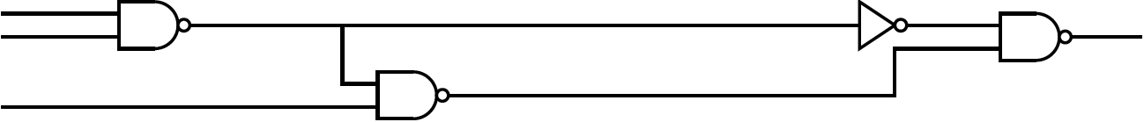
Preclass: Cover in 4-LUT?

Slide 6
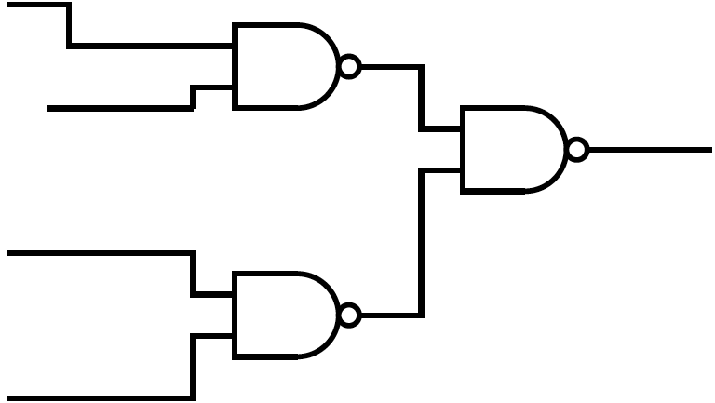
Preclass: Cover in 4-LUT?

Slide 7
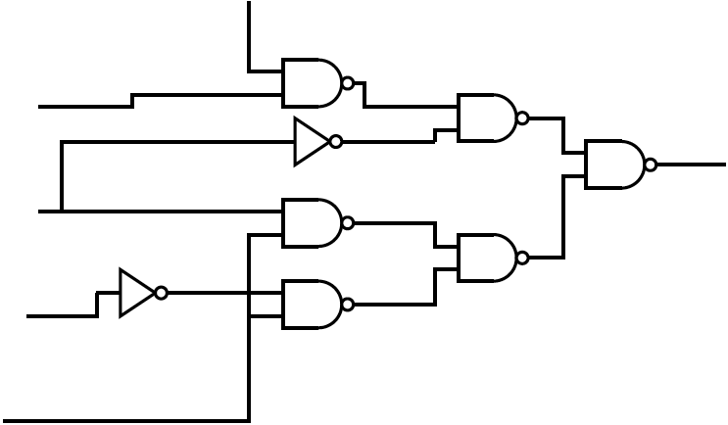
Preclass: Cover in 4-LUT?

Slide 8
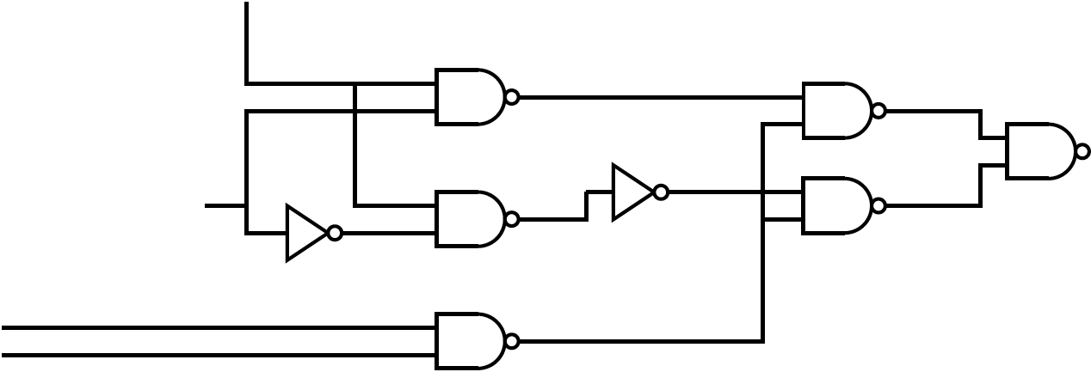
Preclass: Cover in 4-LUT?

Slide 9
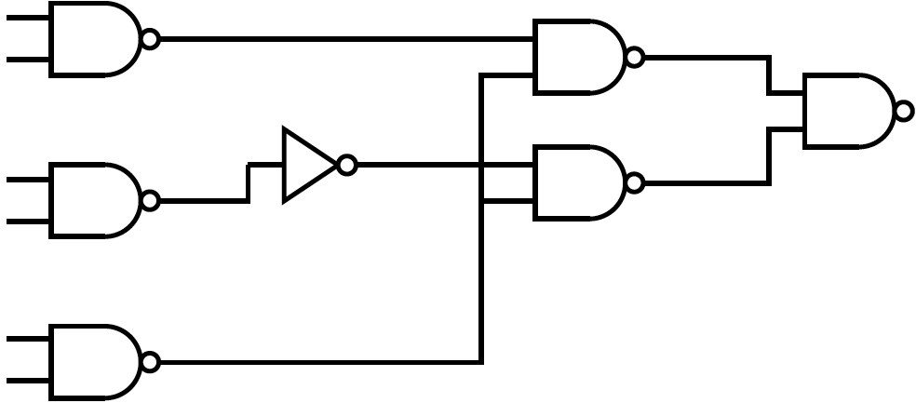
Preclass: Cover in 4-LUT?

Slide 10
Cost Function
Delay: number of LUTs in critical path
  doesn’t say delay in LUTs or in wires
  does assume uniform interconnect delay
Area: number of LUTs
  Assumes adequate interconnect to use LUTs

Slide 11
LUT Mapping
NP-Hard in general
Fanout-free -- can solve optimally given decomposition
  (but which one?)
Delay optimal mapping achievable in Polynomial time
Area w/ fanout NP-complete

Slide 12
Preliminaries
What matters/makes this interesting?
  Area / Delay target
  Decomposition
  Fanout
    replication
    reconvergent

Slide 13
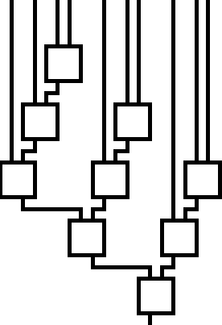
Costs: Area vs. Delay

Slide 14
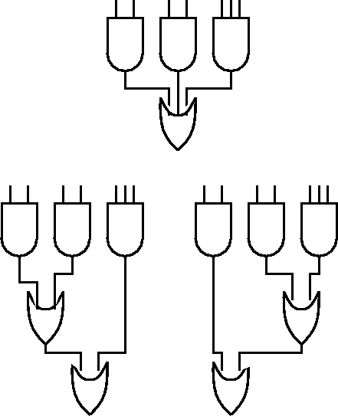
Decomposition

Slide 15
Decomposition

Slide 16
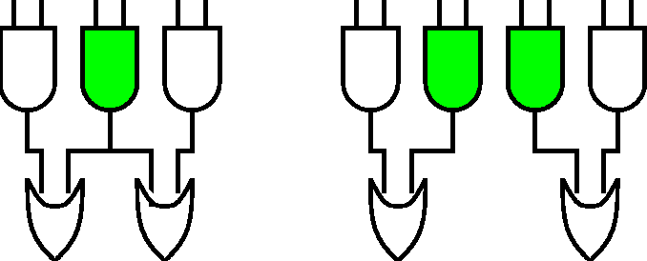
Fanout: Replication

Slide 17
Fanout: Replication

Slide 18
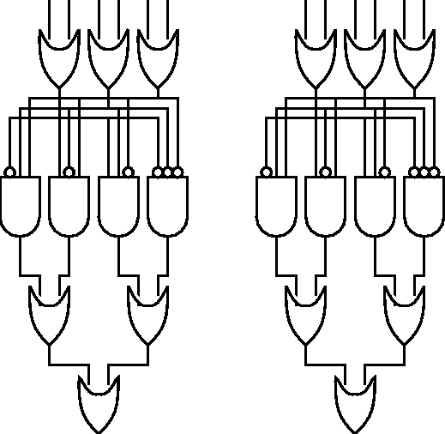
Fanout: Reconvergence

Slide 19
Fanout: Reconvergence

Slide 20
What makes it hard?
Cost does not monotonically increase as cover more of graph.
Not clear when to stop?
We say cost does not have a monotone property

Slide 21
Preclass Revisited

Slide 22
Definition
Cone: set of nodes in the recursive fanin of a node

Slide 23
Example Cones

Slide 24
Delay

Slide 25
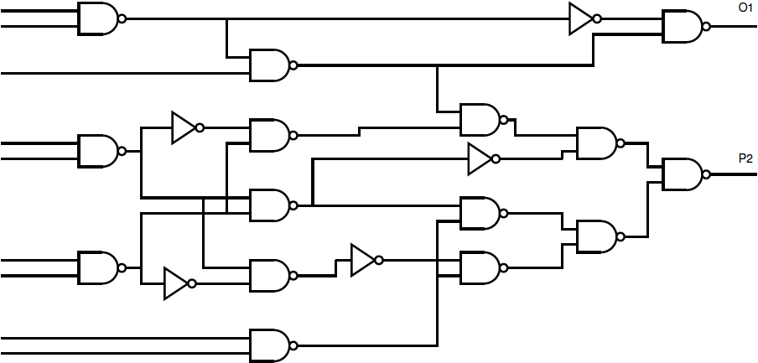
Delay of Preclass Circuit?
Poll: Delay of preclass circuit

Slide 26
Dynamic Programming
Optimal covering of a logic cone is:
  Minimum cost (all possible coverings)
Evaluate costs of each node based on:
  cover node
  cones covering each fanin to node cover
Evaluate node costs in topological order
Key: are calculating optimal solutions to subproblems
  only have to evaluate covering options at each node

Slide 27
Flowmap
Key Idea:
  LUT holds anything with K inputs
  Use network flow to find cuts
    ≡ logic can pack into LUT including reconvergence
    …allows replication
  Optimal depth arise from optimal depth solution to subproblems

Slide 28
Max-Flow / Min-Cut
The maximum flow in a network is equal to the minimum cut
  …the bottleneck
We can find the mincut by computing the maxflow.
Conceptually, how would we determine the maximum flow?

Slide 29
Example Flow cut
s
t

Slide 30
Example Flow cut
Visually, what is min-cut?
s
t

Slide 31
MaxFlow
Set all edge flows to zero
  F[u,v]=0
While there is a path from s,t
  (breadth-first-search)
  for each edge in path f[u,v]=f[u,v]+1
  f[v,u]=-f[u,v]
  When c[v,u]=f[v,u] remove edge from search
O(|E|*cutsize)

Slide 32
Example Flow cut
Find a path?
H
A
s
t
D
F
I
B
E
G
C
J

Slide 33
Example Flow cut
H
A
s
t
D
F
I
B
E
G
C
J

Slide 34
Example Flow cut
Find a path?
H
A
s
t
D
F
I
B
E
G
C
J

Slide 35
Example Flow cut
H
A
s
t
D
F
I
B
E
G
C
J

Slide 36
Example Flow cut
Find a path?
H
A
s
t
D
F
I
B
E
G
C
J

Slide 37
Flowmap
Examples are K=4
Delay objective:
  minimum height, K-feasible cut
  I.e. cut no more than K edges
  start by bounding fanin ≤ K
Height of node will be:
  height of predecessors or
  one greater than height of predecessors
Check shorter first
1
1
1
1
2

Slide 38
Flowmap
Construct flow problem
  sink ← target node being mapped
  source ← start set (primary inputs)
  flow infinite into start set
  flow of one on each link
  to see if height same as predecessors
    collapse all predecessors of maximum height into sink (single node, cut must be above)
    height +1 case is trivially true

Slide 39
Example Subgraph
1
1
1
1
2
Target: K=4
2

Slide 40
Trivial: Height +1
1
1
1
1
2
2
3

Slide 41
Collapse at max height
1
1
1
1
2
2

Slide 42
Collapse at max height
1
1
1
1
2
2
Collapsed
Node

Slide 43
Augmenting Flows
Collapsed
Node

Slide 44
Augmenting Flows
Collapsed
Node

Slide 45
Augmenting Flows
Collapsed
Node

Slide 46
Augmenting Flows
Collapsed
Node

Slide 47
Augmenting Flows
Collapsed
Node
Collapsed
Node

Slide 48
Collapse at max height: works for K=4
1
1
1
1
2
2
Collapsed
Node
2

Slide 49
Collapse not work (K still 4)
(different/larger graph)
1
1
1
1
2
2
Forced to label height+1
2

Slide 50
Reconvergent fanout
(yet different graph)
1
1
1
1
1
2
Can label at height
2

Slide 51
Flowmap
Max-flow Min-cut algorithm to find cut
Use augmenting paths until discover max flow > K
O(K|E|) time to discover K-feasible cut
  (or that does not exist)
Depth identification: O(KN|E|)

Slide 52
Mincut may not be unique
1
1
1
1
2
2
Collapsed
Node
2

Slide 53
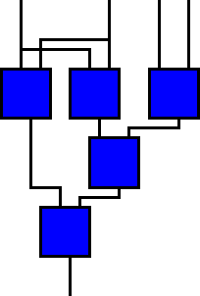
Flowmap
Min-cut may not be unique
To minimize area achieving delay optimum
  find max volume min-cut
    Compute max flow ⇒ find min cut
    remove edges consumed by max flow
    DFS from source
    Compliment set is max volume set

Slide 54
Collapse at max height: works for K=4
1
1
1
1
2
2
Collapsed
Node
2

Slide 55
BFS from Source
1
1
1
1
2
2
Collapsed
Node
2

Slide 56
BFS from Source
1
1
1
1
2
2
Collapsed
Node
2

Slide 57
BFS from Source
1
1
1
1
2
2
Collapsed
Node
2

Slide 58
BFS from Source
1
1
1
1
2
2
Collapsed
Node
2
Does not find rest.

Slide 59
Max-Volume Mincut
1
1
1
1
2
2
Collapsed
Node
2

Slide 60
Flowmap
Covering from labeling is straightforward
  process in reverse topological order
  allocate identified K-feasible cut to LUT
  remove node
  postprocess to minimize LUT count
Notes:
  replication implicit (covered multiple places)
  nodes purely internal to one or more covers may not get their own LUTs

Slide 61
Flowmap Roundup
Label
  Work from inputs to outputs
  Find max label of predecessors
  Collapse new node with all predecessors at this label
  Can find flow cut ≤ K?
    Yes: mark with label (find max-volume cut extent)
    No: mark with label+1
Cover
  Work from outputs to inputs
  Allocate LUT for identified cluster/cover
  Recurse covering selection on inputs to identified LUT

Slide 62
Area
Changing Cost Functions Now
(previous was delay)

Slide 63
DF-Map
Duplication Free Mapping
  can find optimal area under this constraint
  (but optimal area may not be duplication free)
[Cong+Ding, IEEE TR VLSI Sys. V2n2p137]

Slide 64
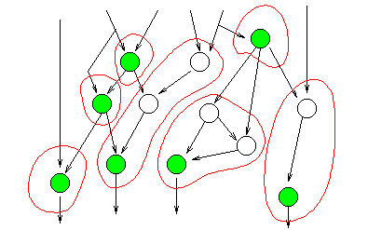
Maximum Fanout Free Cones
MFFC: bit more general than trees

Slide 65
MFFC
Follow cone backward
end at node that fans out (has output) outside the cone

Slide 66
MFFC example
Identify FFC
I
F
G
H
C
D
E
A
B

Slide 67
MFFC example
I
F
G
H
C
D
E
A
B

Slide 68
DF-Map
Partition into graph into MFFCs
Optimally map each MFFC
In dynamic programming
  for each node
    examine each K-feasible cut
      note: this is very different than flowmap where only had to examine a single cut
      Example to follow
    pick cut to minimize cost
      1 + Σ cones for fanins

Slide 69
DF-Map Example
Cones?

Slide 70
DF-Map Example

Slide 71
DF-Map Example

Slide 72
DF-Map Example

Slide 73
DF-Map Example

Slide 74
DF-Map Example

Slide 75
DF-Map Example
Start
mapping
cone

Slide 76
DF-Map Example
1
1
1
1

Slide 77
DF-Map Example
1
1
1
?
1

Slide 78
DF-Map Example
1
1
1
?
1

Slide 79
DF-Map Example
1
1
1
?
1

Slide 80
DF-Map Example
1
1
1
?
1

Slide 81
DF-Map Example
1
1
1
1
1

Slide 82
DF-Map Example
Similar
to
previous
1
1
1
1
1
1
1

Slide 83
DF-Map Example
1
1
1
1
1
1
1
?

Slide 84
DF-Map Example
1
1
1
1
1
1
1
?

Slide 85
DF-Map Example
1
1
1
1
1
1
1
3
?

Slide 86
DF-Map Example
1
1
1
1
1
1
1
?

Slide 87
DF-Map Example
2
1
1
1
1
1
1
1
?

Slide 88
DF-Map Example
1
1
1
1
1
1
1
?

Slide 89
DF-Map Example
3
1
1
1
1
1
1
1
?

Slide 90
DF-Map Example
1
1
1
1
1
1
1
2

Slide 91
DF-Map Example
1
1
1
1
1
1
1
2
?

Slide 92
DF-Map Example
1
1
1
1
1
1
1
2
?

Slide 93
DF-Map Example
1
1
1
1
1
1
1
3
2
?

Slide 94
DF-Map Example
1
1
1
1
1
1
1
3
2
?

Slide 95
DF-Map Example
1
1
3
1
1
1
1
1
3
2
?

Slide 96
DF-Map Example
1
1
3
1
1
1
1
1
3
2
?

Slide 97
DF-Map Example
3
1
1
3
1
1
1
1
1
3
2
?

Slide 98
DF-Map Example
1
1
1
1
1
1
1
2
3

Slide 99
DF-Map Example
1
1
1
1
1
1
1
2
3
?

Slide 100
DF-Map Example
1
1
1
1
1
1
1
2
3
?

Slide 101
DF-Map Example
1
1
1
1
1
1
1
4
2
3
?

Slide 102
DF-Map Example
1
1
1
1
1
1
1
4
2
3
?

Slide 103
DF-Map Example
1
1
3
1
1
1
1
1
4
2
3
?

Slide 104
DF-Map Example
1
1
3
1
1
1
1
1
4
2
3
?

Slide 105
DF-Map Example
1
1
3
3
1
1
1
1
1
4
2
3
?

Slide 106
DF-Map Example
1
1
3
3
1
1
1
1
1
4
2
3
?

Slide 107
DF-Map Example
1
1
3
3
1
1
1
1
1
4
2
3
?
4

Slide 108
DF-Map Example
1
1
3
3
1
1
1
1
1
4
2
3
?
4

Slide 109
DF-Map Example
1
1
3
3
1
1
1
1
1
4
2
3
?
3
4

Slide 110
DF-Map Example
1
1
1
1
1
1
1
2
3
3

Slide 111
DF-Map Example
1
1
1
1
1
1
1
2
3
3
?

Slide 112
DF-Map Example
1
1
1
1
1
1
1
2
3
3
?

Slide 113
DF-Map Example
1
1
1
1
1
1
1
2
3
3
9
?

Slide 114
DF-Map Example
1
1
1
1
1
1
1
2
3
3
9
?

Slide 115
DF-Map Example
1
1
1
1
1
1
1
7
2
3
3
9
?

Slide 116
DF-Map Example
1
1
1
1
1
1
1
7
2
3
3
9
?

Slide 117
DF-Map Example
1
1
1
1
1
1
1
7
2
3
3
5
9
?

Slide 118
DF-Map Example
1
1
1
1
1
1
1
2
3
3
5

Slide 119
DF-Map Example
1
1
1
1
1
1
1
2
3
3
5

Slide 120
Composing
Don’t need minimum delay off the critical path
Don’t always want/need minimum delay
Composite:
  map with flowmap
  Greedy decomposition of “most promising” non-critical nodes
  DF-map these nodes

Slide 121
Variations on a Theme

Slide 122
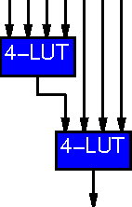
Applicability to Non-LUTs?
E.g. LUT Cascade
  can handle some functions of K inputs
How apply?

Slide 123
Adaptable to Non-LUTs
Sketch:
  Initial decomposition to nodes that will fit
  Find max volume, min-height K-feasible cut
  ask if logic block will cover
    yes ⇒ done
    no ⇒ exclude one (or more) nodes from block and repeat
      exclude == collapse into start set nodes
      this makes heuristic

Slide 124
Partitioning?
Effectively partitioning logic into clusters
  LUT cluster
    unlimited internal “gate” capacity
    limited I/O (K)
    simple delay cost model
      1 cross between clusters
      0 inside cluster

Slide 125
Partitioning
Clustering
  if strongly I/O limited, same basic idea works for partitioning to components
    typically: partitioning onto multiple FPGAs
    assumption: inter-FPGA delay >> intra-FPGA delay
  w/ area constraints
    similar to non-LUT case
      make min-cut
      will it fit?
      Exclude some LUTs and repeat

Slide 126
Clustering for Delay
W/ no IO constraint
area is monotone property
DP-label forward with delays
  grab up largest labels (greatest delays) until fill cluster size
Work backward from outputs creating clusters as needed

Slide 127
Area and IO?
Real problem:
  FPGA/chip partitioning
Doing both optimally is NP-hard
Heuristic around IO cut first should do well
  (e.g. non-LUT slide)
  [Yang and Wong, FPGA’94]

Slide 128
Partitioning
To date:
  primarily used for 2-level hierarchy
    I.e. intra-FPGA, inter-FPGA
Open/promising
  adapt to multi-level for delay-optimized partitioning/placement on fixed-wire schedule
    localize critical paths to smallest subtree possible?

Slide 129
Summary
Optimal LUT mapping NP-hard in general
  fanout, replication, ….
K-LUTs makes delay optimal feasible
  single constraint: IO capacity
  technique: max-flow/min-cut
Heuristic adaptations of basic idea to capacity constrained problem
  promising area for interconnect delay optimization

Slide 130
Today’s Big Ideas:
IO may be a dominant cost
  limiting capacity, delay
Exploit structure: K-LUTs
Mixing dominant modes
  multiple objectives
Define optimally solvable subproblem
  duplication free mapping

Slide 131
Admin
Reading Wednesday on web
Assignment 3 due Thursday

