Slide 1

ESE535:
Electronic Design Automation
Day 6: February 4, 2014
Partitioning 2
(spectral, network flow)

Slide 2
Today
Behavioral
(C, MATLAB, …)
Arch. Select
Schedule
RTL
Alternate views of partitioning
Two things we can solve optimally
  (but don’t exactly solve our original problem)
Techniques
  Linear Placement w/ squared wire lengths
  Network flow MinCut (time permit)
FSM assign
Two-level,
Multilevel opt.
Covering
Retiming
Gate Netlist
Placement
Routing
Layout
Masks

Slide 3
Optimization Target
Place cells
In linear arrangement
Wire length between connected cells:
  distance=X_{i} - X_{j}
  cost is sum of distance squared
Pick X_{i}’s to minimize cost

Slide 4
Why this Target?
Minimize sum of squared wire distances
Prefer:
  Area: minimize channel width
  Delay: minimize critical path length

Slide 5
Why this Target?
Our preferred targets are discontinuous and discrete
Cannot formulate analytically
Not clear how to drive toward solution
  Does reducing the channel width at a non-bottleneck help or not?
  Does reducing a non-critical path help or not?

Slide 6
Preclass: Initial Placement
Metrics:
  Wirelength
  Squared wirelength
  Channel width
  Critical path length

Slide 7
Spectral Ordering
Minimize Squared Wire length -- 1D layout
Start with connection array C (c_{i,j})
“Placement” Vector X for x_{i} placement
Problem:
  Minimize cost =
  cost sum is X^{T}BX
    B = D-C
    D=diagonal matrix, d_{i,i} = Σ(over j) c_{i,j}

Slide 8
Preclass Netlist
Squared wire lengths:
(X_{A} -X_{G} )²
+( X_{B} -X_{G} )²
+( X_{B} -X_{H} )²
+( X_{C} -X_{H} )²
+( X_{G} -X_{O})²
+( X_{H}- X_{O})²

Slide 9
C Matrix
 | A | B | C | G | H | O
A |  |  |  | 1
B |  |  |  | 1 | 1
C |  |  |  |  | 1
G | 1 | 1 |  |  |  | 1
H |  | 1 | 1 |  |  | 1
O |  |  |  | 1 | 1

Slide 10
D Matrix
 | A | B | C | G | H | O
A | 1 |  |  | 1
B |  | 2 |  | 1 | 1
C |  |  | 1 |  | 1
G | 1 | 1 |  | 3 |  | 1
H |  | 1 | 1 |  | 3 | 1
O |  |  |  | 1 | 1 | 2

Slide 11
B=D-C Matrix
 | A | B | C | G | H | O
A | 1 |  |  | -1
B |  | 2 |  | -1 | -1
C |  |  | 1 |  | -1
G | -1 | -1 |  | 3 |  | -1
H |  | -1 | -1 |  | 3 | -1
O |  |  |  | -1 | -1 | 2

Slide 12
BX
 | A | B | C | G | H | O
A | 1 |  |  | -1
B |  | 2 |  | -1 | -1
C |  |  | 1 |  | -1
G | -1 | -1 |  | 3 |  | -1
H |  | -1 | -1 |  | 3 | -1
O |  |  |  | -1 | -1 | 2
X_{A}
X_{B}
X_{C}
X_{G}
X_{H}
X_{O}
X_{A}⁻ X_{G}
2X_{B}⁻ X_{G}⁻ X_{H}
X_{C}⁻ X_{H}
3X_{G}⁻ X_{A}⁻ X_{B}- X_{O}
3X_{H}⁻ X_{B}⁻ X_{C}- X_{O}
2X_{O}⁻ X_{G}⁻ X_{H}
=

Slide 13
X^{T}(BX)
X_{A} | X_{B} | X_{C} | X_{G} | X_{H} | X_{O}
X_{A}⁻ X_{G}
2X_{B}⁻ X_{G}⁻ X_{H}
X_{C}⁻ X_{H}
3X_{G}⁻ X_{A}⁻ X_{B}- X_{O}
3X_{H}⁻ X_{B}⁻ X_{C}- X_{O}
2X_{O}⁻ X_{G}⁻ X_{H}

Slide 14
X^{T}(BX)
X_{A}²⁻ X_{A}X_{G}
+2X_{B}²⁻ X_{B}X_{G}⁻ X_{B}X_{H}
+X_{C}²⁻X_{C} X_{H}
+3X_{G}²⁻ X_{A}X_{G}⁻ X_{B}X_{G}- X_{G}X_{O}
+3X_{H}²⁻ X_{B}X_{H}⁻ X_{C}X_{H}- X_{H}X_{O}
+2X_{O}²⁻ X_{G}X_{O}⁻ X_{H}X_{O}

Slide 15
X^{T}(BX)
X_{A}²- X_{A}X_{G}
+2X_{B}²⁻ X_{B}X_{G}⁻ X_{B}X_{H}
+X_{C}²⁻X_{C} X_{H}
+3X_{G}²⁻ X_{A}X_{G}⁻ X_{B}X_{G}- X_{G}X_{O}
+3X_{H}²⁻ X_{B}X_{H}⁻ X_{C}X_{H}- X_{H}X_{O}
+2X_{O}²⁻ X_{G}X_{O}⁻ X_{H}X_{O}
(X_{A}- X_{G}) ²
+2X_{B}²⁻ X_{B}X_{G}⁻ X_{B}X_{H}
+X_{C}²⁻X_{C} X_{H}
+2X_{G}²⁻ X_{B}X_{G}- X_{G}X_{O}
+3X_{H}²⁻ X_{B}X_{H}⁻ X_{C}X_{H}- X_{H}X_{O}
+2X_{O}²⁻ X_{G}X_{O}⁻ X_{H}X_{O}

Slide 16
X^{T}(BX)
(X_{A}⁻ X_{G}) ²
+2X_{B}²⁻ X_{B}X_{G}⁻ X_{B}X_{H}
+X_{C}²⁻X_{C} X_{H}
+2X_{G}²- X_{B}X_{G}- X_{G}X_{O}
+3X_{H}²⁻ X_{B}X_{H}⁻ X_{C}X_{H}- X_{H}X_{O}
+2X_{O}²⁻ X_{G}X_{O}⁻ X_{H}X_{O}
(X_{A}⁻ X_{G}) ²+ (X_{B}⁻ X_{G}) ²
+X_{B}²⁻ X_{B}X_{H}
+X_{C}²⁻X_{C} X_{H}
+X_{G}²- X_{G}X_{O}
+3X_{H}²⁻ X_{B}X_{H}⁻ X_{C}X_{H}- X_{H}X_{O}
+2X_{O}²⁻ X_{G}X_{O}⁻ X_{H}X_{O}

Slide 17
Can See Will Converage To..
Squared wire lengths:
(X_{A} -X_{G})²
+( X_{B} -X_{G})²
+(X_{B} -X_{H})²
+(X_{C} -X_{H})²
+( X_{G} -X_{O})²
+( X_{H}-X_{O})²
(X_{A}⁻ X_{G}) ²+ (X_{B}⁻ X_{G}) ²
+X_{B}²⁻ X_{B}X_{H}
+X_{C}²⁻X_{C} X_{H}
+X_{G}²- X_{G}X_{O}
+3X_{H}²⁻ X_{B}X_{H}⁻ X_{C}X_{H}- X_{H}X_{O}
+2X_{O}²⁻ X_{G}X_{O}⁻ X_{H}X_{O}

Slide 18
Trying to Minimize
Squared wire lengths:
(X_{A} -X_{G})²
+( X_{B} -X_{G})²
+(X_{B} -X_{H})²
+(X_{C} -X_{H})²
+( X_{G} -X_{O})²
+( X_{H}-X_{O})²
Which we know is also X^{T}BX
Make all X_{i}’s same?
…but, we probably need to be in unique positions.

Slide 19
Spectral Ordering
Add constraint: X^{T}X=1
  prevent trivial solution all x_{i}’s =0
Minimize cost=X^{T}BX w/ constraint
  minimize L=X^{T}BX-λ(X^{T}X-1)
  ∂L/∂X=2BX-2λX=0
  (B-λI)X=0
  What does this tell us about X, λ ?
  X → Eigenvector of B
  cost is Eigenvalue λ

Slide 20
Spectral Solution
Smallest eigenvalue is zero
  Corresponds to case where all x_{i}’s are the same ➔uninteresting
Second smallest eigenvalue (eigenvector) is the solution we want

Slide 21
Eigenvector for B
For this B Matrix
Eigenvector is:
 | A | B | C | G | H | O
A | 1 |  |  | -1
B |  | 2 |  | -1 | -1
C |  |  | 1 |  | -1
G | -1 | -1 |  | 3 |  | -1
H |  | -1 | -1 |  | 3 | -1
O |  |  |  | -1 | -1 | 2
X_{A}
X_{B}
X_{C}
X_{G}
X_{H}
X_{O}
0.6533
1.116E-14
-0.6533
0.2706
-0.2706
1.934E-14
=

Slide 22
Spectral Ordering
X (x_{i}’s) continuous
use to order nodes
  We need at discrete locations
  this is one case where can solve ILP from LP
    Solve LP giving continuous x_{i}’s
    then move back to closest discrete point
Eigenvector is:
X_{A}
X_{B}
X_{C}
X_{G}
X_{H}
X_{O}
0.6533
1.116E-14
-0.6533
0.2706
-0.2706
1.934E-14
=

Slide 23
Eigenvector for B
Eigenvector is:
Order?
X_{A}
X_{B}
X_{C}
X_{G}
X_{H}
X_{O}
0.6533
1.116E-14
-0.6533
0.2706
-0.2706
1.934E-14
=

Slide 24
Order from Eigenvector
Eigenvector is:
A
G
O
B
H
C
Quality of this solution?
all metrics
X_{A}
X_{B}
X_{C}
X_{G}
X_{H}
X_{O}
0.6533
1.116E-14
-0.6533
0.2706
-0.2706
1.934E-14
=
Anyone get a solution
with a better metric?

Slide 25
Spectral Ordering Option
Can encourage “closeness”
  Making some c_{i,j} larger
  Must allow
  some to be
  not close
Could use c_{i,j}
for power opt
  c_{i,j}=P_{switch}
 | A | B | C | G | H | O
A | 1 |  |  | -1
B |  | 2 |  | -1 | -1
C |  |  | 1 |  | -1
G | -1 | -1 |  | 3 |  | -1
H |  | -1 | -1 |  | 3 | -1
O |  |  |  | -1 | -1 | 2

Slide 26
Spectral Ordering Option
With iteration, can reweigh connections to change cost model being optimized
  linear
  (distance)^{1.X}
 | A | B | C | G | H | O
A | 1 |  |  | -1
B |  | 2 |  | -1 | -1
C |  |  | 1 |  | -1
G | -1 | -1 |  | 3 |  | -1
H |  | -1 | -1 |  | 3 | -1
O |  |  |  | -1 | -1 | 2

Slide 27
Spectral Partitioning
Can form a basis for partitioning
Attempts to cluster together connected components
Create partition from ordering
  E.g. Left half of ordering is one half, right half is the other

Slide 28
Spectral Ordering
Midpoint bisect isn’t necessarily best place to cut, consider:
K_{(n/2)}
K_{(n/4)}
K_{(n/4)}

Slide 29
Spectral Partitioning Options
Can bisect by choosing midpoint
  (not strictly optimizing for minimum bisect)
Can relax cut critera
  min cut w/in some δ of balance
Ratio Cut
  Minimize (cut/|A||B|)
    idea tradeoff imbalance for smaller cut
      more imbalance →smaller |A||B|
      so cut must be much smaller to accept
  Easy to explore once have spectral ordering
    Compute at each cut point in O(N) time

Slide 30
Fanout
B
G
H
How do we treat fanout?
As described assumes point-to-point nets
For partitioning, pay price when cut something once
  I.e. the accounting did last time for KLFM
Also a discrete optimization problem
  Hard to model analytically

Slide 31
Spectral Fanout
B
G
H
Typically:
  Treat all nodes on a single net as fully connected
  Model links between all of them
  Weight connections so cutting in half counts as cutting the wire – e.g. 1/(nodes-1)
  Threshold out high fanout nodes
    If connect too many things give no information
B
½
½
G
H
½

Slide 32
Spectral Fanout Cut Approximation
B
B
G
I
G
I
H
H
Weight edges: 1/(4-1)=1/3
B
B
G
I
G
I
H
H

Slide 33
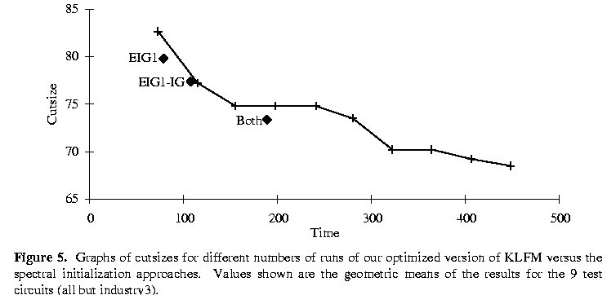
Spectral vs. FM
From Hauck/Boriello ‘96

Slide 34
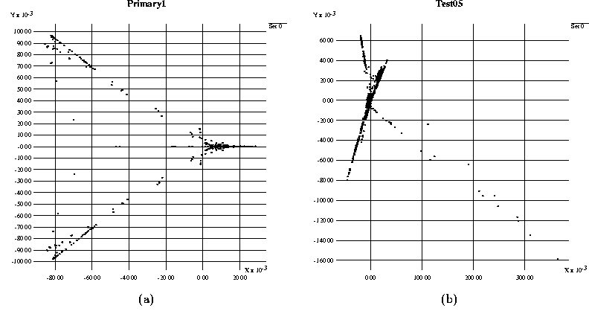
Improving Spectral
More Eigenvalues
  look at clusters in n-d space
    But: 2 eigenvectors is not opt. solution to 2D placement
    Partition cut is plane in this higher-dimensional space
  5--70% improvement over EIG1

Slide 35
Spectral Note
Unlike KLFM, attacks global connectivity characteristics
Good for finding “natural” clusters
  hence use as clustering heuristic for multilevel algorithms
After doing spectral
  Can often improve incrementally using KLFM pass
  Remember spectral optimizing squared wirelength, not directly cut width

Slide 36
If Time Permits

Slide 37
Max Flow
MinCut

Slide 38
MinCut Goal
Find maximum flow (mincut) between a source and a sink
  no balance guarantee

Slide 39
MaxFlow
Set all edge flows to zero
  F[u,v]=0
While there is a path from s,t
  (breadth-first-search)
  for each edge in path f[u,v]=f[u,v]+1
  f[v,u]=-f[u,v]
  When c[v,u]=f[v,u] remove edge from search
O(|E|*cutsize)
[Our problem simpler than general case CLR]

Slide 40
Technical Details
For min-cut in graphs,
  Don’t really care about directionality of cut
  Just want to minimize wire crossings
Fanout
  Want to charge discretely …cut or not cut
Pick start and end nodes?

Slide 41
Directionality
1
10
10
10
10
10
10
10
1
10
For logic net: cutting a net is the same regardless of
which way the signal flows

Slide 42
Directionality Construct
∞
∞
1
∞
∞

Slide 43
Fanout Construct
∞
∞
∞
∞
1
∞
∞

Slide 44
Extend to Balanced Cut
Pick a start node and a finish node
Compute min-cut start to finish
If halves sufficiently balanced, done
else
  collapse all nodes in smaller half into one node
  pick a node adjacent to smaller half
  collapse that node into smaller half
  repeat from min-cut computation
FBB -- Yang/Wong ICCAD’94

Slide 45
Observation
Can use residual flow from previous cut when computing next cuts
Consequently, work of multiple network flows is only O(|E|*final_cut_cost)

Slide 46
Picking Nodes
Optimal:
  would look at all s,t pairs
    Just for first cut is merely N-1 “others”
      …N/2 to guarantee something in second half
    Anything you pick must be in separate halves
    Assuming there is a perfect/ideal bisection
      If pick randomly, probability different halves: 50%
      Few random selections likely to yield s,t in different halves
  would also look at all nodes to collapse into smaller
  could formulate as branching search

Slide 47
Picking Nodes
Randomly pick
  (maybe try several starting points)
With small number of adjacent nodes,
  could afford to branch on all

Slide 48
Big Ideas
Divide-and-Conquer
Techniques
  flow based
  numerical/linear-programming based
  Transformation constructs
Exploit problems we can solve optimally
  Mincut
  Linear ordering

Slide 49
Admin
Assign 3 due on Thursday
Reading for Monday online
Assignment 4 exercise out
  Should be small part
  Most effort on partitioning project

