Slide 1

ESE535:
Electronic Design Automation
Day 7: February 9, 2015
Scheduled Operator Sharing

Slide 2
Today
Behavioral
(C, MATLAB, …)
Arch. Select
Schedule
RTL
Sharing Resources
Area-Time Tradeoffs
Throughput vs. Latency
VLIW Architectures
Scheduling (introduce)
  Maybe start on
FSM assign
Two-level,
Multilevel opt.
Covering
Retiming
Gate Netlist
Placement
Routing
Layout
Masks

Slide 3
Compute Function
Compute:
  y=Ax² +Bx +C
Assume
  D(Mpy) > D(Add)
  A(Mpy) > A(Add)

Slide 4
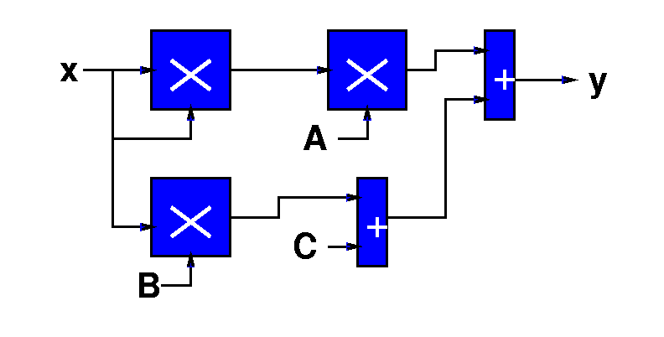
Spatial Quadratic
A(Quad) = 3*A(Mpy) + 2*A(Add)

Slide 5
Latency vs. Throughput
Latency: Delay from inputs to output(s)
Throughput: Rate at which can introduce new set of inputs

Slide 6
Washer/Dryer Example
1 Washer Takes 30 minutes
1 Dryer Takes 45 minutes
How long to do one load of wash?
  → Wash latency
How long to do 5 loads of wash?
Wash Throughput?
W
D
W
D
45m

Slide 7
Pipelining
W
D
Break up the computation graph into stages
  Allowing us to
    reuse portions of the graph for new data,
    while older data is still working its way through the graph
      Before it has exited graph
  Use registers to isolate regions
  Throughput > (1/Latency)
Relate liquid in pipe
  Doesn’t wait for first drop of liquid to exit far end of pipe before accepting second drop

Slide 8
Spatial Quadratic
D(Quad) = 2*D(Mpy)+D(Add) = 21
Throughput 1/(2*D(Mpy)+D(Add)) = 1/21
A(Quad) = 3*A(Mpy) + 2*A(Add) = 32
Latency?

Slide 9
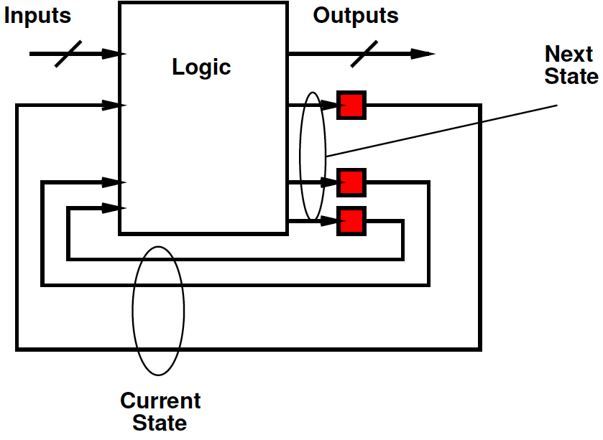
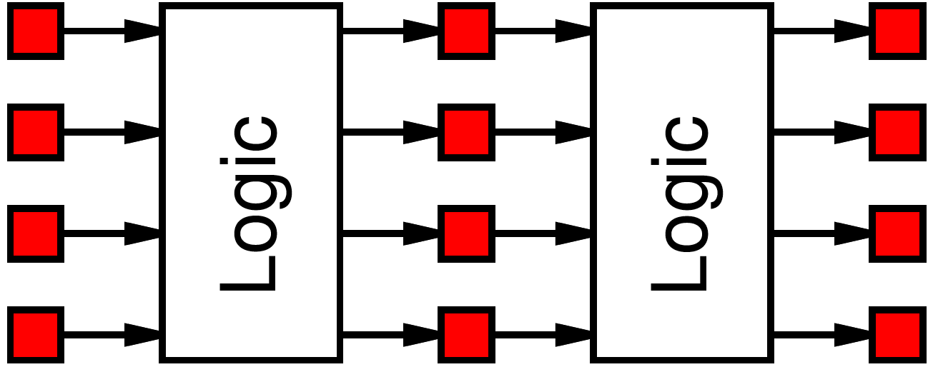
Synchronous Discipline
Compute
  From registers
  Through combinational logic
  To new values for registers
Delay through logic sets a lower bound on the duration of each clock – the clock cycle

Slide 10
Terms
Latency: Delay from inputs to output(s)
Cycle Time:
  Clock period
  Critical path delay between registers
Throughput: Rate at which can introduce new set of inputs
  Typically, inverse of cycle time
Pipelining: how we separate latency from cycle time

Slide 11
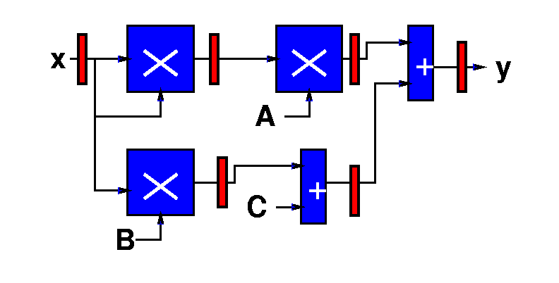
Pipelined Spatial Quadratic
D(Quad) =
  3*D(Mpy) = 30
Throughput =
  1/D(Mpy) = 1/10
A(Quad) =
  3*A(Mpy)+2*A(Add)+6A(Reg) = 35

Slide 12
Quadratic with Single
Multiplier and Adder?
We’ve seen reuse to perform the same operation
  pipelining
We can also reuse a resource in time to perform a different role.
  Here: x*x, A*(x*x), B*x
  also: (Bx)+c, (A*x*x)+(Bx+c)

Slide 13

Quadratic Datapath
Start with one of each operation

Slide 14
Multiplexer
Gate allows us to select data from multiple sources
Mux
  For short
Useful when sharing operators
select
i0
o=i0*/select+
i1*select
i1

Slide 15
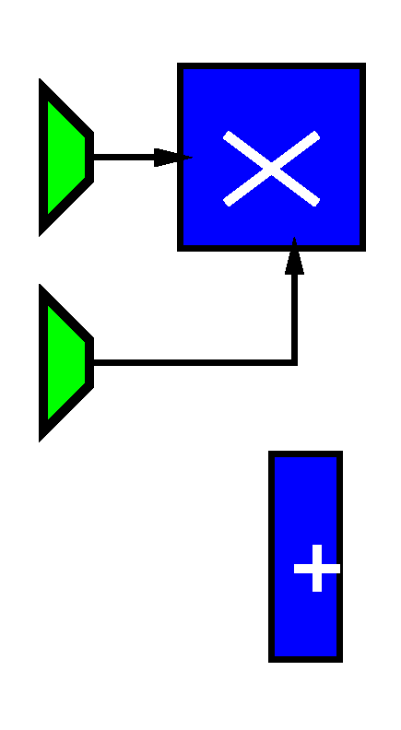
Quadratic Datapath
Multiplier serves multiple roles
  x*x
  A*(x*x)
  B*x
Use multiplexer to steer data (switch interconnections)
  A(mux) < A(multiply)

Slide 16
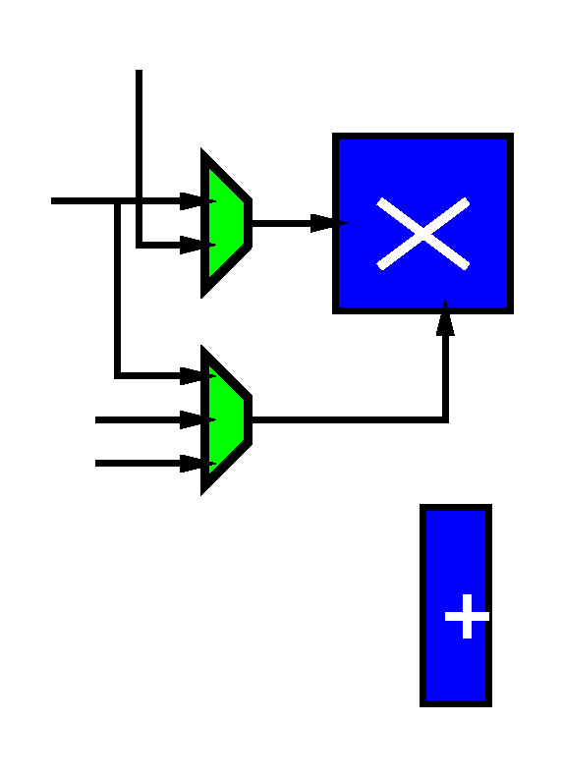
Quadratic Datapath
Multiplier serves multiple roles
  x*x
  A*(x*x)
  B*x
x, x*x
x,A,B

Slide 17
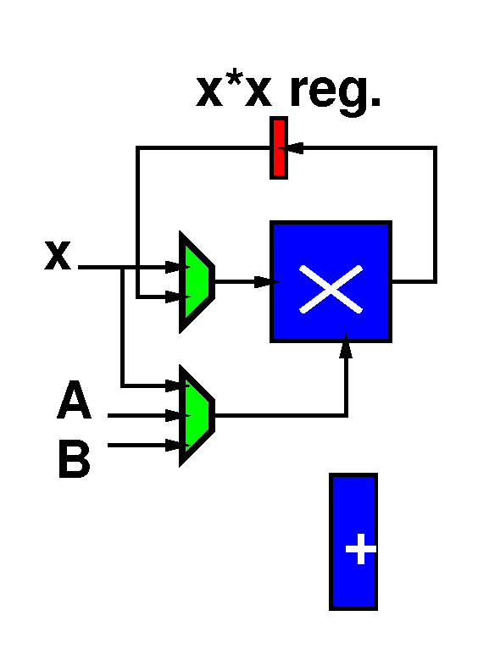
Quadratic Datapath
Multiplier serves multiple roles
  x*x
  A*(x*x)
  B*x
x, x*x
x,A,B

Slide 18
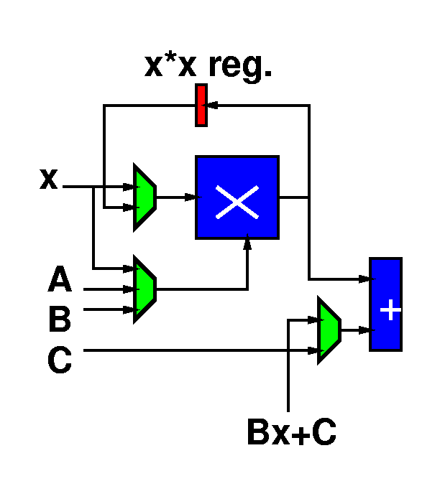
Quadratic Datapath
Adder serves multiple roles
  (Bx)+c
  (A*x*x)+(Bx+c)
one always mpy output
C, Bx+C

Slide 19
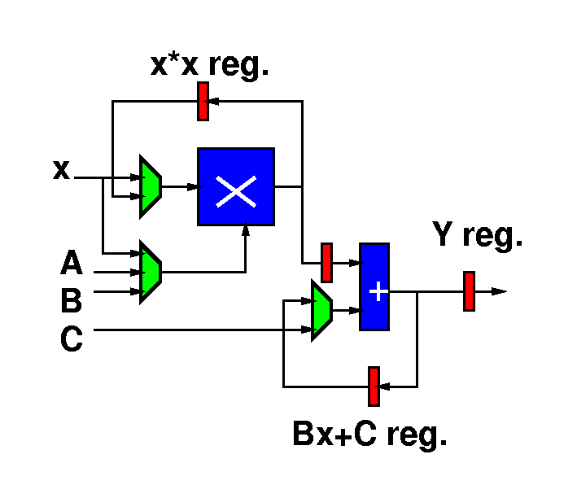
Quadratic Datapath

Slide 20
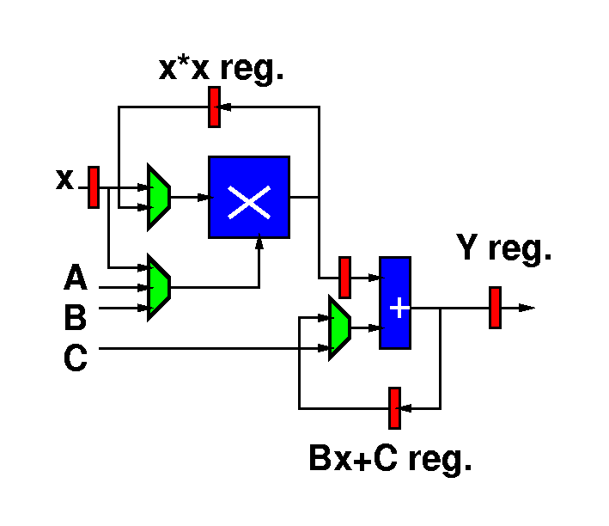
Quadratic Datapath
Add input register for x

Slide 21
Cycle Impact?
Need more cycles
How about the delay of each cycle?
  Add mux delay
  Register setup/hold time, clock skew
  Limited by slowest operation
  Cycle?
    D(Mpy)+2*D(Mux2) = 10.2

Slide 22
Quadratic Control
Now, we just need to control the datapath
What control?
Control:
  LD x
  LD x*x
  MA Select
  MB Select
  AB Select
  LD Bx+C
  LD Y

Slide 23
Quadratic Control
LD_X
MA_SEL=x,MB_SEL[1:0]=x, LD_x*x
MA_SEL=x,MB_SEL[1:0]=B
AB_SEL=C,MA_SEL=x*x, MB_SEL=A, LD_Bx+C
AB_SEL=Bx+C, LD_Y
[Could combine 1 and 5 and
do in 4 cycles; analysis
that follows assume 5 as shown.]

Slide 24
Quadratic Memory Control
LD_X
MA_SEL=x, MB_SEL[1:0]=x, LD_x*x
MA_SEL=x, MB_SEL[1:0]=B
AB_SEL=C, MA_SEL=x*x, MB_SEL=A, LD_Bx+C
AB_SEL=Bx+C, LD_Y

Slide 25
Quadratic Datapath
Latency/Throughput/Area?
Latency: 5*(D(MPY)+D(mux3))=51
Throughput: 1/Latency ~= 0.02
Area: A(Mpy)+A(Add)+5*A(Reg)
+2*A(Mux2)+A(Mux3)+A(Imem)=17.5+A(Imem)

Slide 26
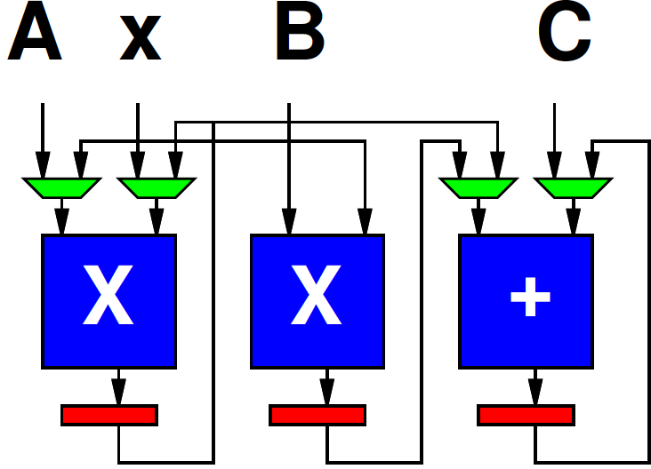
Quadratic with 2 Mult, 1 Add
step | X | X | +
1 | X*X | B*X
2 | A*(X*X) |  | (B*X)+C
3 |  |  | (A*X*X*X)+(B*X+C)
Latency/Throughput/Area?

Slide 27
Quadratic with 2 Mult, 1 Add
step | X | X | +
1 | X*X | B*X
2 | A*(X*X) |  | (B*X)+C
3 |  |  | (A*X*X*X)+(B*X+C)
Latency = 3*(D(Mpy)+D(Mux))=30.3
Throughput = 1/30.3 ~=0.03
Area = 2*A(Mpy)+4*A(Mux2)+A(Add)+3*A(Reg) = 26.5

Slide 28
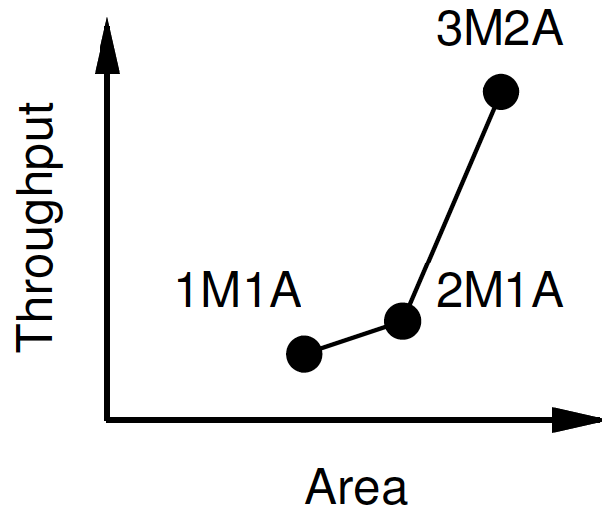
Quadratic: Area-Time Tradeoff
Design | Area | Throughput | Latency
3M2A (pipe) | 35 | 0.1 | 30
2M1A | 26.5 | 0.03 | 30.3
1M1A | 17.5 | 0.02 | 51

Slide 29
Registers→Memory
Generally can see many registers
If # registers >> physical operators
  Only need to access a few at a time
Group registers into memory banks

Slide 30
Memory Bank Quadratic
Store x
x*x
B*x
A*x²; B*x+c
(A*x²)+(B*x+c)
X
+

Slide 31
Memory Bank Quadratic
Store x
x*x
B*x
A*x²; B*x+c
(A*x²)+(B*x+c)
x
x
Bx
c
x²
B
Ax²
Bx+c
A
X
+

Slide 32
Cycle Impact?
How cycle changed?
Add mux delay
Register setup/hold time, clock skew
Memory read/write
  Could pipeline
X
+

Slide 33
Cycle Impact?
Add mux delay
Register setup/hold time, clock skew
Memory read/write
  Could pipeline
  Impact?
    Latency
    Throughput?
X
+

Slide 34
Impact
When have big operators
  Like multiplier
Can share them to reduce area
  At cost of throughput
  Maybe at cost of latency, energy
This gives a rich trade space

Slide 35
Details
At extreme, number of “big” operators is dominant cost
  Total number for area
  Number in path for delay
Does cost additional area, delay to share them
  sometimes a lower order cost

Slide 36
VLIW
Very Long Instruction Word
Set of operators
  Parameterize number, distribution (X, +, sqrt…)
    More operators→ less time, more area
    Fewer operators→ more time, less area
Memories for intermediate state
X
X
+

Slide 37
VLIW
Very Long Instruction Word
Set of operators
  Parameterize number, distribution (X, +, sqrt…)
    More operators→ less time, more area
    Fewer operators→ more time, less area
Memories for intermediate state
Memory for “long” instructions
Instruction
Memory
Address
X
X
+

Slide 38
VLIW
Instruction
Memory
Address
X
X
+

Slide 39
VLIW
Very Long Instruction Word
Set of operators
  Parameterize number, distribution (X, +, sqrt…)
    More operators→ less time, more area
    Fewer operators→ more time, less area
Memories for intermediate state
Memory for “long” instructions
Schedule compute task
General framework for specializing to problem
  Wiring, memories get expensive
  Opportunity for further optimizations
General way to tradeoff area and time

Slide 40
VLIW
Instruction
Memory
Address
X
X
+

Slide 41
Review
Reuse physical operators in time
Share operators in different roles
Allows us to reduce area at expense of increasing time
Area-Time tradeoff
Pay some sharing overhead
  Muxes, memory
VLIW – general formulation for shared datapaths

Slide 42
Design Automation
Behavioral
(C, MATLAB, …)
Arch. Select
Schedule
RTL
Sets up two problems for us:
Provisioning
  (Architecture Selection)
  End of next week (after…)
Scheduling
  Start introducing now
  Next two lectures
FSM assign
Two-level,
Multilevel opt.
Covering
Retiming
Gate Netlist
Placement
Routing
Layout
Masks

Slide 43
Time Permitting

Slide 44
General Problem
Resources are not free
  Wires, io ports
  Functional units
    LUTs, ALUs, Multipliers, ….
  Memory access ports
  State elements
    memory locations
    Registers
      Flip-flop
      loadable master-slave latch
  Multiplexers (mux)
select
i0
o=i0*/select+
i1*select
i1

Slide 45
Trick/Technique
Resources can be shared (reused) in time
Sharing resources can reduce
  instantaneous resource requirements
  total costs (area)
Pattern: scheduled operator sharing

Slide 46
Example

Slide 47
Example
Assume unit delay operators.
How many operators do I need to evaluate this computation
in ~5 time units.

Slide 48
Sharing
Does not have to increase delay
  w/ careful time assignment
  can often reduce peak resource requirements
  while obtaining original (unshared) delay
Alternately: Minimize delay given fixed resources

Slide 49
Schedule Examples
time
resource

Slide 50
More Schedule Examples

Slide 51
Scheduling
Task: assign time slots (and resources) to operations
  time-constrained: minimizing peak resource requirements
    n.b. time-constrained, not always constrained to minimum execution time
  resource-constrained: minimizing execution time

Slide 52
Resource-Time Example
Area
Time Constraint:
<5 → --
5 → 4
6,7 → 2
>7 → 1
Time

Slide 53
Scheduling Use
Very general problem formulation
  HDL/Behavioral → RTL
  Register/Memory allocation/scheduling
  Instruction/Functional Unit scheduling
  Processor tasks
  Time-Switched Routing
    TDMA, bus scheduling, static routing
  Routing (share channel)

Slide 54
Two Types (1)
Data independent
  graph static
  resource requirements and execution time
    independent of data
  schedule staticly
  maybe bounded-time guarantees
  typical ECAD problem

Slide 55
Two Types (2)
Data Dependent
  execution time of operators variable
    depend on data
  flow/requirement of operators data dependent
  if cannot bound range of variation
    must schedule online/dynamically
    cannot guarantee bounded-time
    general case (I.e. halting problem)
  typical “General-Purpose” (non-real-time) OS problem

Slide 56
Unbounded Resource Problem
Easy:
  compute ASAP schedule (next slide)
    I.e. schedule everything as soon as predecessors allow
  will achieve minimum time
  won’t achieve minimum area
    (meet resource bounds)

Slide 57
ASAP Schedule
As Soon As Possible (ASAP)
For each input
  mark input on successor
  if successor has all inputs marked, put in visit queue
While visit queue not empty
  pick node
  update time-slot based on latest input
  mark inputs of all successors, adding to visit queue when all inputs marked

Slide 58
ASAP Example
Work
Example

Slide 59
ASAP Example
1
2
3
4
5
3
2
2

Slide 60
Also Useful to Define ALAP
As Late As Possible
Work backward from outputs of DAG
Also achieve minimum time w/ unbounded resources
Rework
Example

Slide 61
ALAP Example
1
2
3
4
5
4
4
4

Slide 62
ALAP and ASAP
Difference in labeling between ASAP and ALAP is slack of node
  Freedom to select timeslot
  Class theme: exploit freedom to reduce costs
If ASAP=ALAP, no freedom to schedule
1
2
3
4
5
1
2
3
4
5
4
3
4
2
4
2

Slide 63
ASAP, ALAP, Difference
1
2
3
4
5
3
1
2
3
4
5
ASAP
2
4
4
ALAP
2
4
0
0
0
0
0
1
2
2

Slide 64
Big Ideas:
Scheduled Operator Sharing
Area-Time Tradeoffs

Slide 65
Admin
Assignment 2, 3 feedback on canvas
Assignment 4 due Thursday
Reading for Wednesday online

