Slide 1
ESE535: Electronic Design Automation
Day 8: February 11, 2015
Scheduling Introduction

Slide 2
Today
Behavioral
(C, MATLAB, …)
Arch. Select
Schedule
RTL
FSM assign
Scheduling
Basic problem
Variants
List scheduling approximation
Two-level,
Multilevel opt.
Covering
Retiming
Gate Netlist
Placement
Routing
Layout
Masks

Slide 3
General Problem
Resources are not free
Wires, io ports
Functional units
LUTs, ALUs, Multipliers, ….
Memory access ports
State elements
memory locations
Registers
Flip-flop
loadable master-slave latch
Multiplexers (mux)
select
i0
o=i0*/select+
i1*select
i1

Slide 4
Trick/Technique
Resources can be shared (reused) in time
Sharing resources can reduce
instantaneous resource requirements
total costs (area)
Pattern: scheduled operator sharing

Slide 5
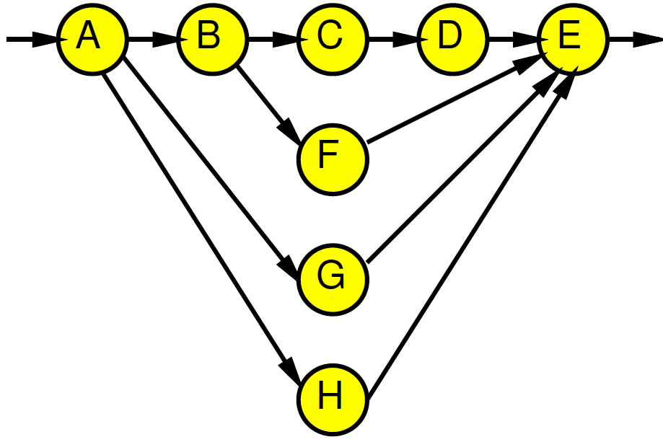
Example
Assume unit delay operators.
How many operators do I need to evaluate this computation
in ~5 time units?

Slide 6
Sharing
Does not have to increase delay
w/ careful time assignment
can often reduce peak resource requirements
while obtaining original (unshared) delay
Alternately: Minimize delay given fixed resources

Slide 7
Schedule Examples
time
resource

Slide 8
More Schedule Examples

Slide 9
Scheduling
Task: assign time slots (and resources) to operations
time-constrained: minimizing peak resource requirements
n.b. time-constrained, not always constrained to minimum execution time
resource-constrained: minimizing execution time

Slide 10
Resource-Time Example
Area
Time Constraint:
<5 → --
5 → 4
6,7 → 2
>7 → 1
Time

Slide 11
Scheduling Use
Very general problem formulation
HDL/Behavioral → RTL
Register/Memory allocation/scheduling
Instruction/Functional Unit scheduling
Processor tasks
Time-Switched Routing
TDMA, bus scheduling, static routing
Routing (share channel)

Slide 12
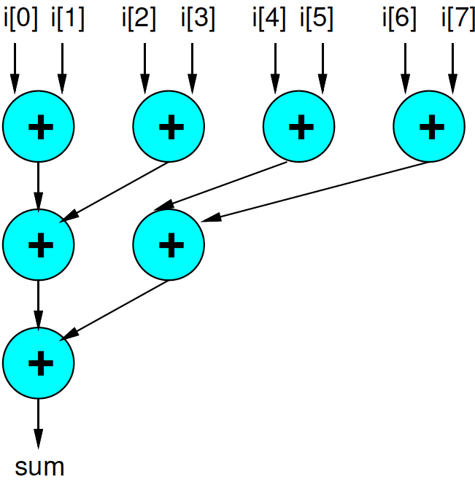
Preclass 2
Schedule onto two adders
Does the number of cycles depend on i[7], i[6], … i[0] ?
How many cycles?

Slide 13
Preclass 3
Schedule onto:
2 adders (+)
2 incrementer (++)
2 comparator (>)
Does the number of cycles depend on i[7], i[6], … i[0] ?
How many cycles?
sum=0; for(j=0;i[j]>0;j++) sum+=i[j];

Slide 14
Two Types (1)
Data independent
graph static
resource requirements and execution time
independent of data
schedule staticly
maybe bounded-time guarantees
typical ECAD problem

Slide 15
Two Types (2)
Data Dependent
execution time of operators variable
depend on data
flow/requirement of operators data dependent
if cannot bound range of variation
must schedule online/dynamically
cannot guarantee bounded-time
general case (I.e. halting problem)
typical “General-Purpose” (non-real-time) OS problem

Slide 16
Unbounded Resource Problem
Easy:
compute ASAP schedule
I.e. schedule everything as soon as predecessors allow
will achieve minimum time
won’t achieve minimum area
(meet resource bounds)

Slide 17
ASAP Schedule As Soon As Possible (ASAP)
For each input
mark input on successor
if successor has all inputs marked, put in visit queue
While visit queue not empty
pick node
update time-slot based on latest input
Time-slot = max(time-slot-of-inputs)+1
mark inputs of all successors, adding to visit queue when all inputs marked

Slide 18
ASAP Example
Work
Example

Slide 19
ASAP Example
1
2
3
4
5
3
2
2

Slide 20
Also Useful to Define ALAP
As Late As Possible
Work backward from outputs of DAG
Also achieve minimum time w/ unbounded resources
Rework
Example

Slide 21
ALAP Example
1
2
3
4
5
4
4
4

Slide 22
ALAP and ASAP
Difference in labeling between ASAP and ALAP is slack of node
Freedom to select timeslot
Class theme: exploit freedom to reduce costs
If ASAP=ALAP, no freedom to schedule
1
2
3
4
5
1
2
3
4
5
4
3
4
2
4
Compute
Slack
2

Slide 23
ASAP, ALAP, Difference
1
2
3
4
5
3
1
2
3
4
5
ASAP
2
4
4
ALAP
2
4
0
0
0
0
0
1
2
2

Slide 24
Two Bounds

Slide 25
Bounds
Useful to have bounds on solution
Two:
CP: Critical Path
Sometimes call it “Latency Bound”
RB: Resource Bound
Sometimes call it “Throughput Bound” or “Compute Bound”

Slide 26
Critical Path Lower Bound
ASAP schedule ignoring resource constraints
(look at length of remaining critical path)
Certainly cannot finish any faster than that

Slide 27
Resource Capacity Lower Bound
Sum up all capacity required per resource
Divide by total resource (for type)
Lower bound on remaining schedule time
(best can do is pack all use densely)
Ignores schedule constraints

Slide 28
Example
Critical Path
Resource Bound (2 resources)
Resource Bound (4 resources)

Slide 29
Example
Critical Path
3
7/2=4
7/4=2
Resource Bound (2 resources)
Resource Bound (4 resources)

Slide 30
Why hard?
3 units
Start with Critical Path?
Schedule on:
1 Red Resource
1 Green Resource

Slide 31
General
3 units
When selecting, don’t know
need to tackle critical path
need to run task to enable work (parallelism)
Can generalize example to single resource case

Slide 32
Single Resource Hard (1)
A1
A3
A5
A7
A8
A9
A10
A11
A12
A13
Crit. Path:
A1 A2
A3 A4
A5 A6
A7 B1
A8 B2
A9 B3
A10 B4
A11 B5
A12 B6
A13 B7
B8 B9
B10
B11
A2
A4
A6
B2
B1
B3
B10
B11
B4
B5
B6
B7
B8
B9

Slide 33
Single Resource Hard (2)
PFirst
A1 B1
B2 B3
B4 B5
B6 B7
B8 B9
A2 B10
A3 A4
A5 A6
A7 B11
A8
A9
A10
A11
A12
A13
A1
A3
A5
A7
A8
A9
A10
A11
A12
A13
A2
A4
A6
B2
B1
B3
B10
B11
B4
B5
B6
B7
B8
B9

Slide 34
Single Resource Hard (4)
A1
A3
A5
A7
A8
A9
A10
A11
A12
A13
Balance1
A1 B1
A2 B2
A3 B3
A4 B4
A5 B5
A6 B6
A7 B7
A8 B8
A9 B9
A10 B10
B11 B11
A12
A13
A2
A4
A6
B2
B1
B3
B10
B11
B4
B5
B6
B7
B8
B9

Slide 35
List Scheduling
Greedy Algorithm → Approximation

Slide 36
List Scheduling (basic algorithm flow)
Keep a ready list of “available” nodes
(one whose predecessors have already been scheduled)
Like ASAP queue
But won’t necessary process in FIFO order
While there are unscheduled tasks
Pick an unscheduled task and schedule on first available resource after its predecessors
Put any tasks enabled by this one on ready list

Slide 37
List Scheduling
Greedy heuristic
Key Question: How prioritize ready list?
What is dominant constraint?
least slack (worst critical path) → LPT
LPT = Longest Processing Time first
enables work
utilize most precious (limited) resource
So far:
seen that no single priority scheme would be optimal

Slide 38
List Schedule by LPT
A1
A3
A5
A7
A8
A9
A10
A11
A12
A13
A2
A4
A6
B2
B1
B3
B10
B11
B4
B5
B6
Work example
compute ALAP
then use to order
ReadyQ
B7
B8
B9

Slide 39
LPT Schedule
A1
A3
A5
A7
A8
A9
A10
A11
A12
A13
LPT:
A1 A2
A3 A4
A5 A6
A7 B1
A8 B2
A9 B3
A10 B4
A11 B5
B6 B7
B8 B9
A12 B10
A13 B11
A2
A4
A6
B2
B1
B3
B10
B11
B4
B5
B6
B7
B8
B9

Slide 40
List Scheduling
Use for
resource constrained
time-constrained
give resource target and search for minimum resource set
Fast: O(N) →O(Nlog(N)) depending on prioritization
Simple, general
Good for upper bound – results is achievable
Not always optimal
How good?

Slide 41
Approximation
Can we say how close an algorithm comes to achieving the optimal result?
Technically:
If can show
Heuristic(Prob)/Optimal(Prob)≤α ∀ Prob
Then the Heuristic is an α-approximation

Slide 42
Scheduled Example Without Precedence
resource
How bad is this
schedule?
time

Slide 43
Observe
∃ optimal length L
No idle time up to start of last job to finish
start time of last job ≤ L
last job length ≤ L
Total LS length ≤ 2L
What can say about optimality?
Algorithm is within factor of 2 of optimum

Slide 44
Results
Scheduling of identical parallel machines has a 2-approximation
i.e. we have a polynomial time algorithm which is guaranteed to achieve a result within a factor of two of the optimal solution.
In fact, for precedence unconstrained there is a 4/3-approximation
i.e. schedule Longest Processing Time first

Slide 45
Recover Precedence
With precedence we may have idle times, so need to generalize
Work back from last completed job
two cases:
entire machine busy
some predecessor in critical path is running
Divide into two sets
whole machine busy times
critical path chain for this operator

Slide 46
Precedence
RB
RB
RB
CP
CP
CP
CP

Slide 47
Precedence Constrained
Optimal Length > All busy times
Optimal Length ≥ Resource Bound
Resource Bound ≥ All busy
Optimal Length>This Path
Optimal Length ≥ Critical Path
Critical Path ≥ This Path
List Schedule = This path + All busy times
List Schedule ≤ 2 *(Optimal Length)

Slide 48
Conclude
Scheduling of identical parallel machines with precedence constraints has a 2-approximation.

Slide 49
Tightening
How could we do better?
What is particularly pessimistic about the previous cases?
List Schedule = This path + All busy times
List Schedule ≤ 2 *(Optimal Length)

Slide 50
Tighten
LS schedule ≤ Critical Path+Resource Bound
LS schedule ≤ Min(CP,RB)+Max(CP,RB)
Optimal schedule ≥ Max(CP,RB)
LS/Opt ≤ 1+Min(CP,RB)/Max(CP,RB)
The more one constraint dominates
the closer the approximate solution to optimal
(EEs think about 3dB point in frequency response)

Slide 51
Tightening
Example of
More information about problem
More internal variables
…allow us to state a tighter result
2-approx for any graph
Since CP may = RB
Tighter approx as CP and RB diverge

Slide 52
Multiple Resource
Previous result for homogeneous functional units
For heterogeneous resources:
also a 2-approximation
Lenstra+Shmoys+Tardos, Math. Programming v46p259
(not online, no precedence constraints)

Slide 53
Bounds
Precedence case, Identical machines
no polynomial approximation algorithm can achieve better than 4/3 bound
(unless P=NP)
Heterogeneous machines (no precedence)
no polynomial approximation algorithm can achieve better than 3/2 bound

Slide 54
Summary
Resource sharing saves area
allows us to fit in fixed area
Requires that we schedule tasks onto resources
General kind of problem arises
We can, sometimes, bound the “badness” of a heuristic
get a tighter result based on gross properties of the problem
approximation algorithms often a viable alternative to finding optimum
play role in knowing “goodness” of solution

Slide 55
Relate HMC
How does this relate to our mapping for Heterogeneous multicontext computing array?

Slide 56
Big Ideas:
Exploit freedom in problem to reduce costs
(slack in schedules)
Use dominating effects
(constrained resources)
the more an effect dominates, the “easier” the problem
Technique: Approximation

Slide 57
Admin
Reading on web for Monday
Same reading for today and Monday
Assignment 4 Due Thursday

