Slide 1
ECE 252 / CPS 220 Advanced Computer Architecture I Lecture 6 Pipelining – Part 1
Benjamin Lee
Electrical and Computer Engineering
Duke University
www.duke.edu/~bcl15
www.duke.edu/~bcl15/class/class_ece252fall11.html

Slide 2
ECE252 Administrivia
29 September – Homework #2 Due
Use blackboard forum for questions
Attend office hours with questions
Email for separate meetings
4 October – Class Discussion
Roughly one reading per class. Do not wait until the day before!
Srinivasan et al. “Optimizing pipelines for power and performance”
Mahlke et al. “A comparison of full and partial predicated execution support for ILP processors”
Palacharla et al. “Complexity-effective superscalar processors”
Yeh et al. “Two-level adaptive training branch prediction”

Slide 3
Pipelining
Latency = (Instructions / Program) x (Cycles / Instruction) x (Seconds / Cycle)
Performance Enhancement
- Increases number of cycles per instruction
- Reduces number of seconds per cycle
Instruction-Level Parallelism
- Begin with multi-cycle design
- When one instruction advances from stage-1 to stage=2, allow next instruction to enter stage-1.
- Individual instructions require the same number of stages
- Multiple instructions in-flight, entering and leaving at faster rate
Multi-cycle
insn0.fetch
insn0.dec
insn0.exec
insn1.fetch
insn1.dec
insn1.exec
Pipelined
insn0.fetch
insn0.dec
insn0.exec
insn1.fetch
insn1.dec
insn1.exec

Slide 4
Ideal Pipelining
stage
1
stage
2
stage
3
stage
4
All objects go through the same stages
No resources shared between any two stages
Equal propagation delay through all pipeline stages
An object entering the pipeline is not affected by objects in other stages
These conditions generally hold for industrial assembly lines
But can an instruction pipeline satisfy the last condition?
Technology Assumptions
Small, very fast memory (caches) backed by large, slower memory
Multi-ported register file, which is slower than a single-ported one
Consider 5-stage pipelined Harvard architecture

Slide 5
Practical Pipelining
stage
1
stage
2
stage
3
stage
4
Pipeline Overheads
Each stage requires registers, which hold state/data communicated from one stage to next, incurring hardware and delay overheads
Each stage requires partitioning logic into “equal” lengths
Introduces diminishing marginal returns from deeper pipelines
Pipeline Hazards
Instructions do not execute independently
Instructions entering the pipeline depend on in-flight instructions or contend for shared hardware resources

Slide 6
Pipelining MIPS
First, build MIPS without pipelining
- Single-cycle MIPS datapath
Then, pipeline into multiple stages
- Multi-cycle MIPS datapath
- Add pipeline registers to separate logic into stages
- MIPS partitions into 5 stages
- 1: Instruction Fetch (IF)
- 2: Instruction Decode (ID)
- 3: Execute (EX)
- 4: Memory (MEM )
- 5: Write Back (WB)

Slide 7
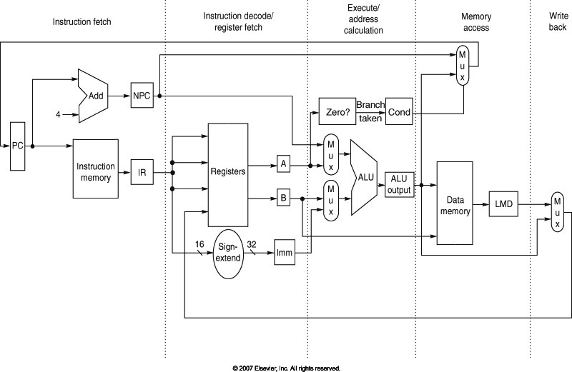
5-Stage Pipelined Datapath (MIPS)
Figure A.17, Page A-29
IF/ID
ID/EX
EX/MEM
MEM/WB
IR ← mem[PC]; PC ← PC + 4; Reg[IR_{rd}] ← Reg[IR_{rs}] op_{IRop} Reg[IR_{rt}]

Slide 8
5-Stage Pipelined Datapath (MIPS)
Figure A.17, Page A-29
IF/ID
ID/EX
EX/MEM
MEM/WB
A ← Reg[IR_{rs}]; B ← Reg[IR_{rt}]; Result ← A op_{IRop} B;
WB ← Result; Reg[IR_{rd}] ← WB

Slide 9
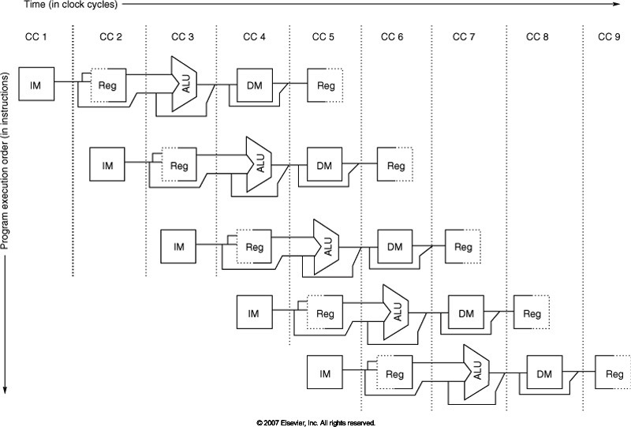
Visualizing the Pipeline
Figure A.2, Page A-8

Slide 10
Hazards and Limits to Pipelining
Hazards prevent next instruction from executing during its designated clock cycle
Structural Hazards
Hardware cannot support this combination of instructions.
Example: Limited resources required by multiple instructions (e.g. FPU)
Data Hazards
Instruction depends on result of prior instruction still in pipeline
Example: An integer operation is waiting for value loaded from memory
Control Hazards
Instruction fetch depends on decision about control flow
Example: Branches and jumps change PC

Slide 11
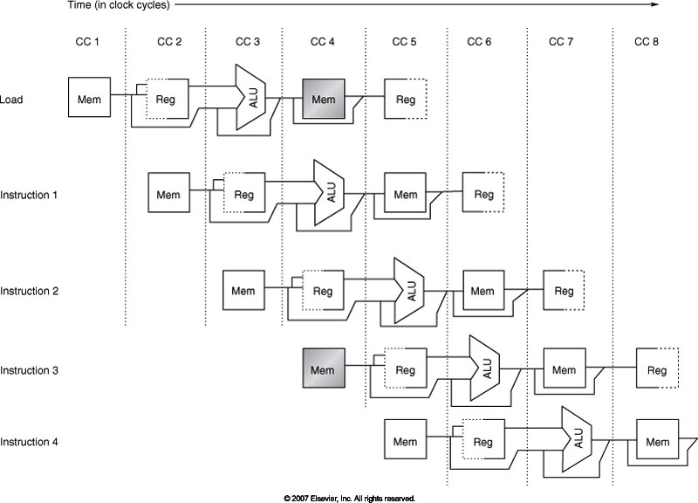
Structural Hazards
Figure A.4, A-14
A single memory port causes structural hazard during data load, instr fetch

Slide 12
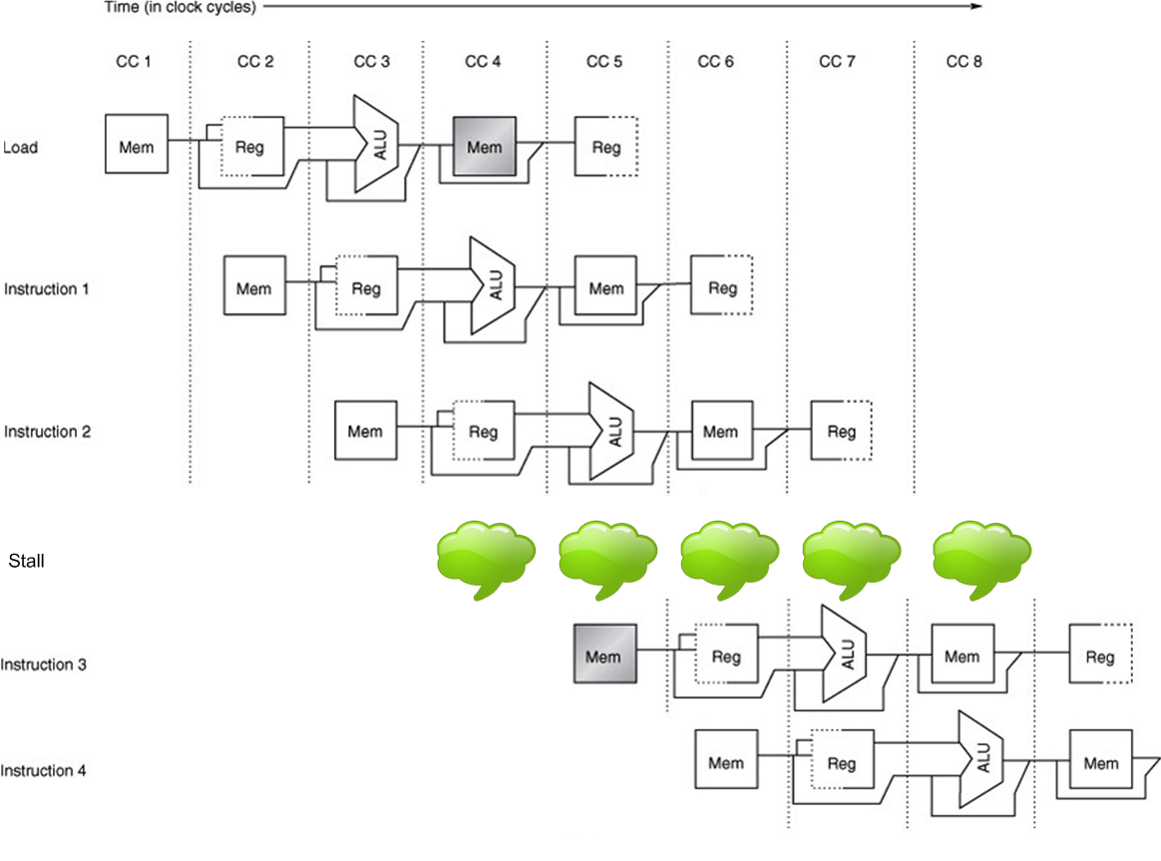
Structural Hazards
Figure A.4, A-14
Stall the pipeline, creating bubbles, by freezing earlier stages → interlocks
Use Harvard Architecture (separate instruction, data memories)

Slide 13
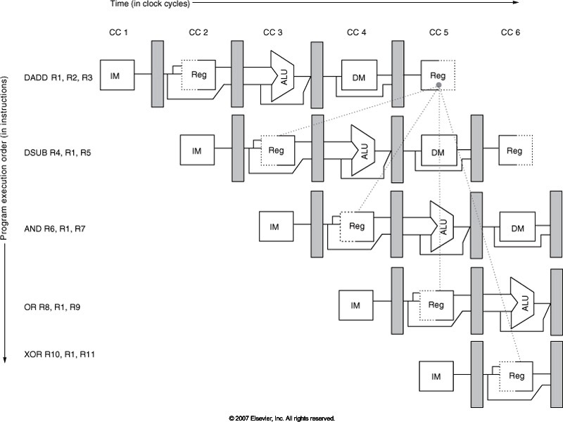
Data Hazards
Figure A.6, A-16
Instruction depends on result of prior instruction still in pipeline

Slide 14
Data Hazards
Read After Write (RAW)
Caused by a dependence, need for communication
Instr-j tries to read operand before Instr-I writes it
i: add r1, r2, r3
j: sub r4, r1, 43
Write After Read (WAR)
Caused by an anti-dependence and the re-use of the name “r1”
Instr-j writes operand (r1) before Instr-I reads it
i: add r4, r1, r3
j: add r1, r2, r3
k: mul r6, r1, r7
Write After Write (WAW)
Caused by an output dependence and the re-use of the name “r1”
Instr-j writes operand (r1) before Instr-I writes it
i: sub r1, r4, r3
j: add r1, r2, r3
k: mul r6, r1, r7

Slide 15
Resolving Data Hazards
FB₁
FB₂
FB₃
FB₄
stage
1
stage
2
stage
3
stage
4
Strategy 1 – Interlocks and Pipeline Stalls
Later stages provide dependence information to earlier stages, which can stall or kill instructions
Works as long as instruction at stage i+1 can complete without any interference from instructions In stages 1 through I (otherwise, deadlocks may occur)

Slide 16
Interlocks & Pipeline Stalls
time
t0 t1 t2 t3 t4 t5 t6 t7 . . . .
(I₁) r1 ← (r0) + 10 IF₁ ID₁ EX₁ MA₁ WB₁
(I₂) r4 ← (r1) + 17 IF₂ ID₂ ID₂ ID₂ ID₂ EX₂ MA₂ WB₂
(I₃) IF₃ IF₃ IF₃ IF₃ ID₃ EX₃ MA₃ WB₃
(I₄) IF₄ ID₄ EX₄ MA₄ WB₄
(I₅) IF₅ ID₅ EX₅ MA₅ WB₅
stalled stages
time
t0 t1 t2 t3 t4 t5 t6 t7 . . . .
IF I₁ I₂ I₃ I₃ I₃ I₃ I₄ I₅
ID I₁ I₂ I₂ I₂ I₂ I₃ I₄ I₅
EX I₁ nop nop nop I₂ I₃ I₄ I₅
MA I₁ nop nop nop I₂ I₃ I₄ I₅
WB I₁ nop nop nop I₂ I₃ I₄ I₅
Resource
Usage

Slide 17
Interlocks & Pipeline Stalls
Example Dependence
r1 ← r0 + 10
r4 ← r1 + 17
Stall Condition
0x4
nop
IR
IR
IR
Add
31
we
rs1
addr
rs2
A
PC
ws
rd1
we
inst
IR
wd
rd2
ALU
Y
addr
Inst
Memory
GPRs
B
rdata
Data
Memory
R
Imm
Ext
wdata
wdata
MD1
MD2

Slide 18
Interlock Control Logic
Compare the source registers of instruction in decode stage with the destination registers of uncommitted instructions
Stall if a source register in decode matches some destination register?
No, not every instruction writes to a register
No, not every instruction reads from a register
Derive stall signal from conditions in the pipeline

Slide 19
Interlock Control Logic
stall
ws
C_{stall}
rs
?
rt
0x4
nop
IR
IR
IR
Add
31
we
rs1
addr
rs2
A
PC
ws
rd1
we
inst
IR
wd
rd2
ALU
Y
addr
Inst
Memory
GPRs
B
rdata
Data
Memory
R
Imm
Ext
wdata
wdata
MD1
MD2
Compare the source registers of the instruction in the decode stage with the destination register of the uncommitted instructions.

Slide 20
Interlock Control Logic
stall
ws
C_{stall}
we
rs
?
rt
we
ws
we
ws
re1
re2
C_{dest}
C_{dest}
C_{re}
0x4
nop
IR
IR
IR
Add
31
C_{dest}
we
rs1
addr
rs2
A
PC
ws
rd1
we
inst
IR
wd
rd2
ALU
Y
addr
Inst
Memory
GPRs
B
rdata
Data
Memory
R
Imm
Ext
wdata
wdata
MD1
MD2
Should we always stall if RS/RT matches some RD? No, because not every instruction writes/reads a register. Introduce write/read enable signals (we/re)

Slide 21
Source and Destination Registers
R-type: op rs rt rd func
I-type: op rs rt immediate16
J-type: op immediate26
instruction source(s) destination
ALU rd ← (rs) func (rt) rs, rt rd
ALUi rt ← (rs) op imm rs rt
LW rt ← M[(rs) + imm] rs rt
SW M [(rs) + imm] ← (rt) rs, rt
BZ cond (rs)
true: PC ← (PC) + imm rs
false: PC ← (PC) + 4 rs
J PC ← (PC) + imm
JAL r31 ← (PC), PC ← (PC) + imm R31
JR PC ← (rs) rs
JALR r31 ← (PC), PC ← (rs) rs R31

Slide 22
Interlock Control Logic
stall
ws
C_{stall}
we
rs
?
rt
we
ws
we
ws
re1
re2
C_{dest}
C_{dest}
C_{re}
0x4
nop
IR
IR
IR
Add
31
C_{dest}
we
rs1
addr
rs2
A
PC
ws
rd1
we
inst
IR
wd
rd2
ALU
Y
addr
Inst
Memory
GPRs
B
rdata
Data
Memory
R
Imm
Ext
wdata
wdata
MD1
MD2
Should we always stall if RS/RT matches some RD? No, because not every instruction writes/reads a register. Introduce write/read enable signals (we/re)

Slide 23
Deriving the Stall Signal
Cdest ws Case(opcode)
ALU: ws ← rd
ALUi: ws ← rt
JAL, JALR: ws ← R31
we Case(opcode)
ALU, ALUi, LW we ← (ws != 0)
JAL, JALR we ← 1
otherwise we ← 0
Cre re1 Case(opcode)
ALU, ALUi re1 ← 1
LW, SW, BZ re1 ← 1
JR, JALR re1 ← 1
J, JAL re1 ← 0
re2 Case(opcode)
<< same as re1 but for register rt>>

Slide 24
Deriving the Stall Signal
Xrs denote register rs for instruction in pipeline stage X
Xrt denote register rt for instruction in pipeline stage X
Xws denote destination register for instruction in pipeline stage X
Cstall stall-1 ← ( (Drs == Ews) & Ewe |
(Drs == Mws) & Mwe |
(Drs == Wws) & Wwe
) & Dre1
stall-2 ← ( (Drt == Ews) & Ewe |
(Drt == Mws) & Mwe |
(Drt == Wws) & Wwe
) & Dre2
stall ← stall-1 | stall-2

Slide 25
Load/Store Data Hazards
M[(r1)+7] ← (r2)
r4 ← M[(r3)+5]
What is the problem here?
What if (r1)+7 == (r3+5)?
Load/Store hazards may be resolved in the pipeline or may be resolved in the memory system. More later.

Slide 26
Resolving Data Hazards
Strategy 2 – Forwarding (aka Bypasses)
Route data as soon as possible to earlier stages in the pipeline
Example: forward ALU output to its input
t0 t1 t2 t3 t4 t5 t6 t7 . . . .
(I₁) r1 ← r0 + 10 IF₁ ID₁ EX₁ MA₁ WB₁
(I₂) r4 ← r1 + 17 IF₂ ID₂ ID₂ ID₂ ID₂ EX₂ MA₂ WB₂
(I₃) IF₃ IF₃ IF₃ IF₃ ID₃ EX₃ MA₃
(I₄) stalled stages IF₄ ID₄ EX₄
(I₅) IF₅ ID₅
time t0 t1 t2 t3 t4 t5 t6 t7 . . . .
(I₁) r1 ← r0 + 10 IF₁ ID₁ EX₁ MA₁ WB₁
(I₂) r4 ← r1 + 17 IF₂ ID₂ EX₂ MA₂ WB₂
(I₃) IF₃ ID₃ EX₃ MA₃ WB₃
(I₄) IF₄ ID₄ EX₄ MA₄ WB₄
(I₅) IF₅ ID₅ EX₅ MA₅ WB₅

Slide 27
Example Forwarding Path
stall
E
M
W
0x4
nop
IR
IR
IR
Add
31
ASrc
we
rs1
addr
D
rs2
A
PC
ws
rd1
we
inst
IR
wd
rd2
ALU
Y
addr
Inst
Memory
GPRs
B
rdata
Data
Memory
R
Imm
Ext
wdata
wdata
MD1
MD2

Slide 28
Deriving Forwarding Signals
This forwarding path only applies to the ALU operations…
Eforward Case(Eopcode)
ALU, ALUi Eforward ← (ws != 0)
otherwise Eforward ← 0
…and all other operations will need to stall as before
Estall Case(Eopcode)
LW Estall ← (ws != 0)
JAL, JALR Estall ← 1
otherwise Estall ← 0
Asrc ← (Drs == Ews) & Dre1 & Eforward
Remember to update stall signal, removing case covered
by this forwarding path

Slide 29
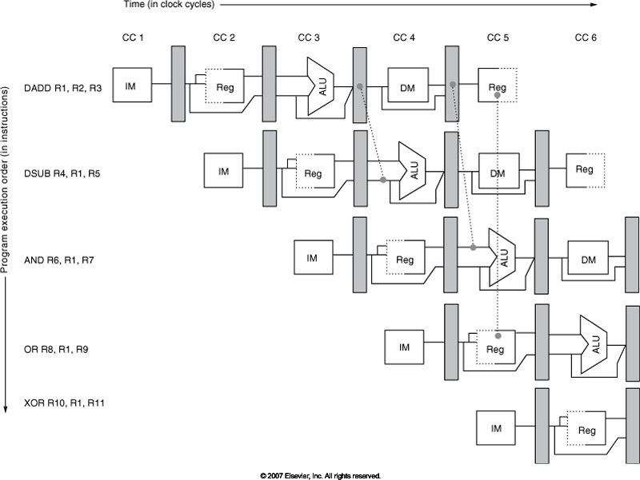
Multiple Forwarding Paths
Figure A.7, Page A-18

Slide 30
Multiple Forwarding Paths
stall
PC for JAL, ...
E
M
W
0x4
nop
IR
IR
IR
Add
ASrc
31
we
rs1
addr
D
rs2
A
PC
ws
rd1
we
inst
IR
wd
rd2
ALU
Y
addr
Inst
Memory
GPRs
B
rdata
Data
Memory
R
Imm
Ext
wdata
BSrc
wdata
MD1
MD2

Slide 31
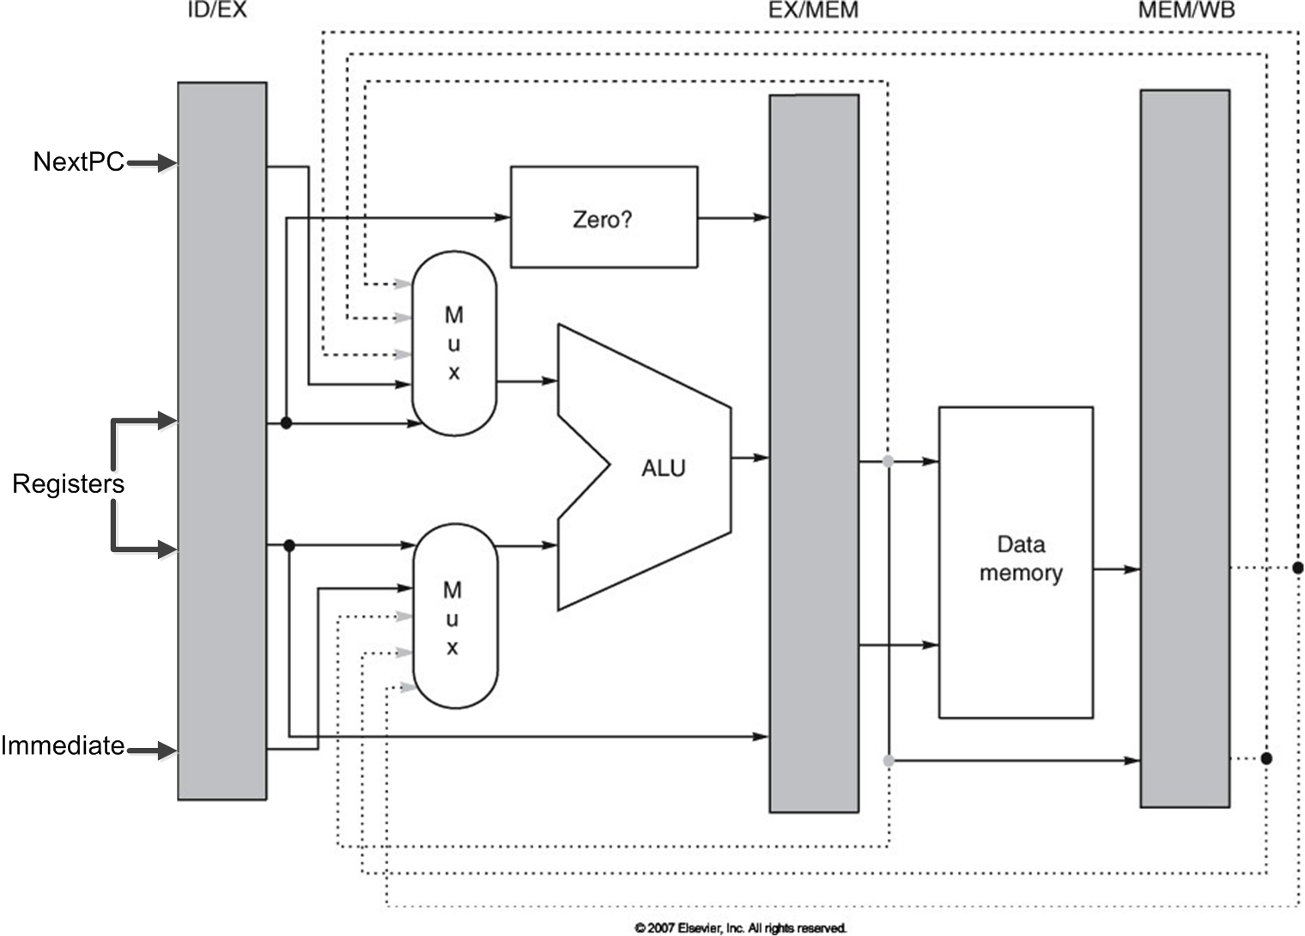
Forwarding Hardware
Figure A.23, Page A-37

Slide 32
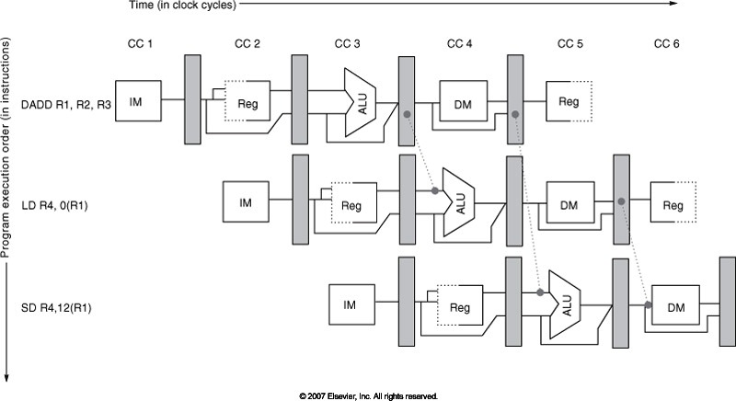
Forwarding Loads/Stores
Figure A.8, Page A-19

Slide 33
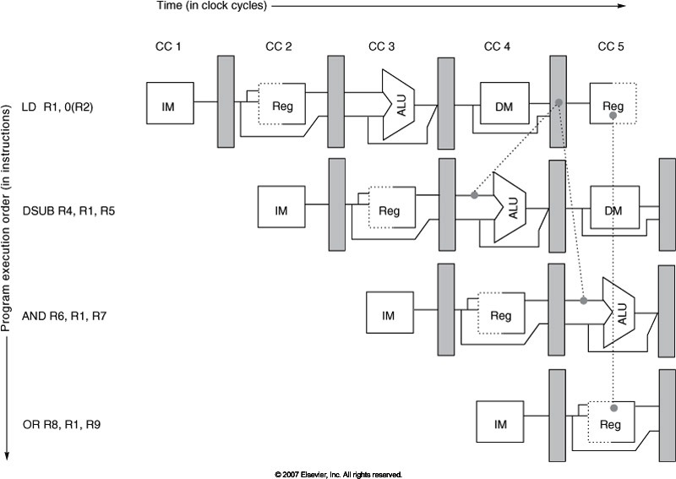
Data Hazard Despite Forwarding
Figure A.9, Page A-20
LD cannot forward (backwards in time) to DSUB. What is the solution?

Slide 34
Data Hazards and Scheduling
Try producing faster code for
A = B + C; D = E – F;
Assume A, B, C, D, E, and F are in memory
Assume pipelined processor
Slow Code
LW Rb, b
LW Rc, c
ADD Ra, Rb, Rc
SW a, Ra
LW Re e
LW Rf, f
SUB Rd, Re, Rf
SW d, RD
Fast Code
LW Rb, b
LW Rc, c
LW Re, e
ADD Ra, Rb, Rc
LW Rf, f
SW a, Ra
SUB Rd, Re, Rf
SW d, RD

Slide 35
Acknowledgements
These slides contain material developed and copyright by
Arvind (MIT)
Krste Asanovic (MIT/UCB)
Joel Emer (Intel/MIT)
James Hoe (CMU)
John Kubiatowicz (UCB)
Alvin Lebeck (Duke)
David Patterson (UCB)
Daniel Sorin (Duke)

