Slide 1
ECE 252 / CPS 220
Advanced Computer Architecture I
Lecture 13
Memory – Part 2
Benjamin Lee
Electrical and Computer Engineering
Duke University
www.duke.edu/~bcl15
www.duke.edu/~bcl15/class/class_ece252fall11.html

Slide 2

ECE252 Administrivia
20 October – Project Proposals Due
  One page proposal
  What question are you asking?
  How are you going to answer that question?
  Talk to me if you are looking for project ideas.
25 October – Homework #3 Due
25 October – Class Discussion
Roughly one reading per class. Do not wait until the day before!
  Jouppi. “Improving direct-mapped cache performance by the addition of a small fully-associative cache and prefetch buffers.”
  Kim et al. “An adaptive, non-uniform cache structure for wire-delay dominated on-chip caches.”
  Fromm et al. “The energy efficiency of IRAM architectures”
  Lee et al. “Phase change memory architecture and the quest for scalability”

Slide 3
Last Time
History of Memory
  Williams tubes were unreliable. Core memory reliable but slow
  Semiconductor memory competitive in 1970s.
DRAM Operation
  DRAM accesses require (1) activates, (2) reads/writes, (3) precharges
  Performance gap between processor and memory is growing.
Managing the Memory Hierarchy
  Predictable patterns provide (1) temporal and (2) spatial locality
  Exploit predictable patterns with small, fast caches.
  Cache data placement policies include (1) fully-associative, (2) set-associative, and direct-mapped. Choice of policy determines cache effectiveness.

Slide 4
Datapath – Cache Interaction
0x4
Add
E
Decode,
Register
Fetch
M
A
we
Y
addr
nop
ALU
Y
IR
B
Primary
Data
Cache
rdata
PC
addr
inst
D
R
wdata
hit?
hit?
wdata
Primary
Instruction
Cache
MD1
MD2
Stall entire CPU on data cache miss
To Memory Control
Cache Refill Data from Lower Levels of Memory Hierarchy

Slide 5
Average Memory Access Time
AMAT = [Hit Time] + [Miss Prob.] x [Miss Penalty]
  Miss Penalty equals AMAT of next cache/memory/storage level.
  AMAT is recursively defined
To improve performance
  Reduce the hit time (e.g., smaller cache)
  Reduce the miss rate (e.g., larger cache)
  Reduce the miss penalty (e.g., optimize the next level)
Simple design strategy
  Observe that hit time increases with cache size
  Design the largest possible cache with a hit time of 1-2 cycles.
  For example, design 8-32KB of cache in modern technology
  Design trade-offs are more complex with superscalar architectures and multi-ported memories

Slide 6
Example: Serial vs Parallel Access
Serial Access
  Check cache for addressed data. If miss (probability 1-p), go to memory
  AMAT = Tcache + (1-p) x Tmem
Parallel Access
  Check cache and memory for addressed data.
  AMAT = p x Tcache + (1-p) x Tmem
  AMAT reductions from parallel access often small. Tmem >> Tcache and p is high. Parallel access consumes memory bandwidth Parallel access increases cache complexity and Tcache.
Addr
Addr
CACHE
Main
Memory
Processor
Data
Data
Addr
CACHE
Main
Memory
Processor
Data
Data

Slide 7
Cache Misses and Causes (3C’s)
Compulsory
  First reference to a block. May be caused by “cold” caches as application begins execution.
  Compulsory misses would occur even with infinitely sized cache
Capacity
    Cache is too small and cannot hold all data needed by the program.
    Capacity misses would occur even under perfect replacement policy.
Conflict
    Cache line replacement policy causes collisions
    Conflict misses would not occur with full associativity

Slide 8
Cache Performance
Larger Cache Size
  Benefit: reduces capacity and conflict misses
  Cost: increases hit time
Higher Associativity
    Benefit: reduces conflict misses
    Cost: increases hit time
Larger Line Size
    Benefit: reduces compulsory and capacity misses
    Cost: increases conflict misses and increases miss penalty

Slide 9
Cache Write Policy Alternatives
What happens when a cache line is written?
If write hits in cache (i.e., line already cached)
  Write-Through: Write data to both cache and memory. Increases memory traffic but allows simpler datapath and cache controllers.
  Write-Back: Write data to cache only. Write data to memory only when cache line is replaced (e.g., conflict).
  Write-Back Optimization: Insert “dirty bit” per cache line, which indicates whether line is modified. Write-back only if replaced cache line is dirty.
If write misses in cache
    No Write Allocate: Write data to memory only.
    Write Allocate: Fetch data into cache. Write data into cache. Also known as fetch-on-write.
Common combinations
    Write-through and no-write allocate
    Write-back and write allocate.

Slide 10
Write Performance
Tag
Index
Block
Offset
b
t
k
V
Tag
Data
2^{k}
lines
t
  Writes must (1) check for HIT and (2) perform write only after HIT signal resolves. Steps are serial, which harms performance.
=
WE
HIT
Data Word or Byte

Slide 11
Reducing Write Time
Problem: Writes take two cycles in memory
  Access cache and compare tags to generate HIT signal (1 cycle)
  Perform cache write if HIT enables a write (1 cycle)
Solutions
    Design data SRAM that can perform read/write in one cycle, restoring old value if HIT is false.
    Design content-addressable data SRAM (CAM), which enables word line only if HIT is true.
    Pipeline writes with a write buffer. Write the cache for j-th store instruction during the tag check for (j+1)-th store instruction

Slide 12
Pipelining Cache Writes
Address and Store Data From CPU
Tag
Index
Store Data
Delayed Write Addr.
Delayed Write Data
Load/Store
=?
Tags
S
Data
L
=?
1
0
Load Data to CPU
Hit?
  Introduce buffers for delayed write address, write data. Write cache for j-th store during tag check for (j+1)-th store. Note that loads must check buffers for latest data.

Slide 13
Buffering Writes
With buffers, writes do not stall datapath
  Introduce a write buffer between adjacent levels in cache hierarchy.
  After writes enter buffer, computation proceeds.
  For example: Reads bypass writes.
Problem
      Write buffer may hold latest value for a read instruction’s address
Solutions
    Option 1: If a read misses in cache, wait for the write buffer to empty
    Option 2: Compare read address with write buffer addresses. If no match, allow read to bypass writes. Else, return value in write buffer.

Slide 14
Cache Hierarchy
Problem
  Memory technology imposes trade-off between speed and size.
  A memory cannot be both large and fast.
Solution
      Introduce a multi-level cache hierarchy.
      As distance from datapath increases, increase cache size.
DRAM
CPU
L2$
L1$

Slide 15
L1-L2 Cache Interactions
Use smaller L1 cache if L2 cache is present
  Reduce L1 hit time, but increase L1 miss rate.
  L2 mitigates higher L1 miss rate by reducing L1 miss penalty
  May reduce average time (AMAT) and energy (AMAE)
Use write-through L1 if write-back L2 cache is present
      Write-through L1 simplifies pipeline, cache controller.
      No write-backs for dirty lines reduces complexity.
      Write-back L2 absorbs write traffic. Writes do not go off-chip to DRAM.
Inclusion Policies
      Inclusive Multi-level Cache: Smaller cache (e.g., L1) holds copies of data in larger cache (e.g., L2). Simpler policies.
      Exclusive Multi-level Cache: Smaller cache (e.g., L1) holds data not in larger cache (e.g., L2). Example: AMD Athlon with 64KB primary and 256KB secondary. Reduces duplication.

Slide 16
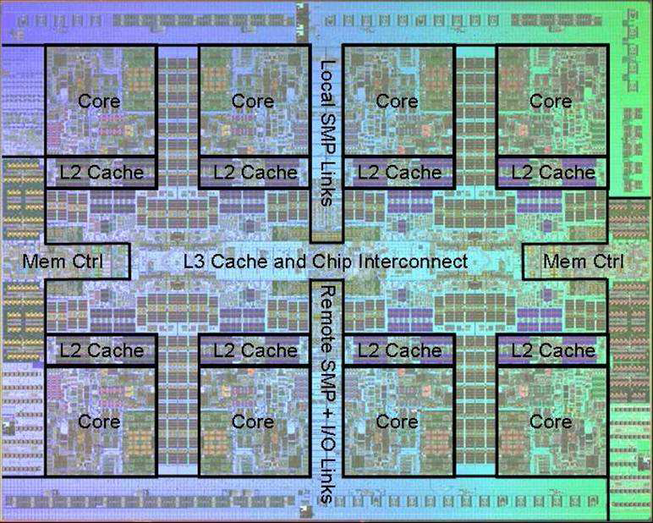
Power7 On-Chip Caches (2009)
32KB L1 I$/core
32KB L1 D$/core
3-cycle latency
256KB Unified L2$/core
8-cycle latency
32MB Unified Shared L3$
Embedded DRAM
25-cycle latency to local slice

Slide 17
Prefetching
Speculate about future memory accesses
  Predict likely instruction and data accesses.
  Pre-emptively fetch instructions and data into caches.
  Instructions accesses likely easier to predict than data accesses.
  Mechanisms might be implemented in HW, SW or both.
  What type of misses does prefetching affect?
Challenges in Prefetching
      Prefetching should be useful. Prefetches should reduce misses.
      Prefetching should be timely. Prefetches will pollute the cache if too early and will be useless if too late.
      Prefetching may pollute caches and consume memory bandwidth.

Slide 18
Hardware Instruction Prefetching
Example: Alpha AXP 21064
  Prefetch instructions
  Fetch two lines on a cache miss. Fetch the requested line (i) and the next consecutive line (i+1).
  Place requested line in instruction L1 cache. Place next line in an instruction stream buffer.
  If an instruction fetch misses in L1 cache but hits in stream buffer, move stream buffer line into L1 cache. And prefetch next line (i+2)
Prefetched
instruction block
Req
block
Stream
Buffer
CPU
Unified L2 Cache
L1 Instruction
RF
Req
block

Slide 19
Hardware Data Prefetching
Prefetch after a cache miss
  Prefetch line (i+1) if an access for line (i) misses in the cache
One Block Look-ahead (OBL)
      Blocks also known as lines.
      Initiate prefetch for block (i+1) when block (i) is accessed.
      Generalizes to N-block look-ahead
      How is this different from increasing the block or line size by N times?
Strided Prefetch
      Observe sequence of accesses to cache lines.
      Suppose a sequence (i), (i+N), (i+2N) is observed. Prefetch (i+3N).
      N is the stride.
      Example: IBM Power 5 (2003) supports eight independent streams of strided prefetches per processor, prefetching 12 lines ahead of the current access.

Slide 20
Software Prefetching
  for(i=0; i < N; i++) {
  prefetch( &a[i + P] );
  prefetch( &b[i + P] );
  SUM = SUM + a[i] * b[i];
  }
Challenges in Software Prefetching
      Timing is the biggest difficulty, not predictability.
      Prefetch too late if prefetch instruction too close to data use.
      Prefetch too early and cause cache/bandwidth pollution.
      Requires estimating prefetch latency: time from issuing prefetch to filling L1 cache line.
      Why is this hard to do? What is the correct value of P above?

Slide 21
Caches and Code
Restructuring code affects data access sequences
  Group data accesses together to improve spatial locality
  Re-order data accesses to improve temporal locality
Prevent data from entering the cache
      Useful for variables that are only accessed once
      Requires SW to communicate hints to HW.
      Example: “no-allocate” instruction hints
Kill data that will never be used again
      Streaming data provides spatial locality but not temporal locality
      If particular lines contain dead data, use them in replacement policy.
      Toward software-managed caches

Slide 22
Loop Interchange
  for(j=0; j < N; j++) {
  for(i=0; i < M; i++) {
  x[i][j] = 2 * x[i][j];
  }
  }
  for(i=0; i < M; i++) {
  for(j=0; j < N; j++) {
  x[i][j] = 2 * x[i][j];
  }
  }
What type of locality does this improve?
What does it assume about x?

Slide 23
Loop Fusion
  for(i=0; i < N; i++)
  a[i] = b[i] * c[i];
  for(i=0; i < N; i++)
  d[i] = a[i] * c[i];
  for(i=0; i < N; i++)
  {
  a[i] = b[i] * c[i];
  d[i] = a[i] * c[i];
  }
What type of locality does this improve?

Slide 24
Matrix Multiply (X=YZ) – Naïve
  for(i=0; i < N; i++)
  for(j=0; j < N; j++) {
  r = 0;
  for(k=0; k < N; k++)
  r = r + y[i][k] * z[k][j];
  x[i][j] = r;
  }
z
j
k
Notes
Iterate through matrix (y) by row.
Iterate through matrix (z) by col.
Update matrix (x) by col.
y
k
x
j
i
i
Not touched
Old access
New access

Slide 25
Matrix Multiply (X=YZ) – Blocked
  for(jj=0; jj < N; jj=jj+B)
  for(kk=0; kk < N; kk=kk+B)
  for(i=0; i < N; i++)
  for(j=jj; j < min(jj+B,N); j++) {
  r = 0;
  for(k=kk; k < min(kk+B,N); k++)
  r = r + y[i][k] * z[k][j];
  x[i][j] = x[i][j] + r;
  }
z
j
k
Notes
Organize matrix into BxB sub-matrices.
Iterate through blocks (jj, kk).
For each block, iterate through its elements (i, j).
What type of locality does this improve? Hint: Track the re-use of matrix elements during computation.
y
k
x
j
i
i
Not touched
Old access
New access

Slide 26
Summary
Caches
  Quantify cache/memory hierarchy performance with AMAT
  Three types of cache misses: (1) compulsory, (2) capacity, (3) conflict
  Cache structure and data placement policies determine miss rates
  Write buffers improve performance.
Prefetching
  Identify and exploit spatial locality
  Prefetchers can be implemented in hardware, software, or both
Caches and Code
  Restructuring SW code can improve HW cache performance
  Data re-use can improve with code structure (e.g., matrix-multiply)

Slide 27
Acknowledgements
    These slides contain material developed and copyright by
    Arvind (MIT)
    Krste Asanovic (MIT/UCB)
    Joel Emer (Intel/MIT)
    James Hoe (CMU)
    John Kubiatowicz (UCB)
    Alvin Lebeck (Duke)
    David Patterson (UCB)
    Daniel Sorin (Duke)

