Slide 1
ECE 252 / CPS 220 Advanced Computer Architecture I Lecture 17 Vectors
Benjamin Lee
Electrical and Computer Engineering
Duke University
www.duke.edu/~bcl15
www.duke.edu/~bcl15/class/class_ece252fall11.html

Slide 2
ECE252 Administrivia
15 November – Homework #4 Due
Project Status
Plan on having preliminary data or infrastructure
ECE 299 – Energy-Efficient Computer Systems
www.duke.edu/~bcl15/class/class_ece299fall10.html
Technology, architectures, systems, applications
Seminar for Spring 2012.
Class is paper reading, discussion, research project
In Fall 2010, students read >35 research papers.
In Spring 2012, read research papers.
In Spring 2012, also considering textbook “The Datacenter as a Computer: An Introduction to the Design of Warehouse-scale Machines.”

Slide 3
Last Time
Simultaneous
Multithreading
Superscalar
Fine-Grained
Coarse-Grained
Multiprocessing
Time (processor cycle)
Thread 1
Thread 3
Thread 5
Thread 2
Thread 4
Idle slot

Slide 4
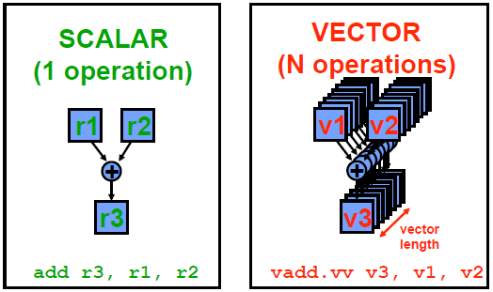
Vector Processors

Slide 5
Data-level Parallelism
Vectors effective for data-level parallelism (DLP)
-- Vectors are most efficient way to exploit DLP
-- Superscalar (e.g., DLP as instruction-level parallelism) is less efficient
-- Multiprocessor (e.g., DLP as thread-level parallelism) is less efficient
Scientific Computing
-- Weather forecasting, car-crash simulation, biological modeling
-- Vector processors were invented for supercomputing, but fell out of favor after the advent of multiprocessors
Multimedia Computing
-- Identical ops on streams or arrays of sound samples, pixels, video frames
-- Vector processors were revived for multimedia computing

Slide 6
Vector Processor History
Vectors widely used for supercomputing (1970s-1990s)
-- Cray, CDC, Convex, TI, IBM
Transition away from vectors (1980s-1990s)
-- Fitting a vector processor into a single chip was difficult
-- Building supercomputers from commodity components was easier
Vectors are re-emerging as SIMD
-- SIMD – single instruction multiple data
-- SIMD provides short vectors in all ISAs
-- Provides multimedia acceleration

Slide 7
Parts of a Vector Processor
Scalar processor
-- Scalar register file (e.g., 32 registers)
-- Scalar functional units (arithmetic, load/store, etc…)
Vector register file
-- Each register is an array of elements
-- Example: 32 registers, each with 32 64-bit elements
-- MVL – maximum vector length = max # of elements per register
Vector functional units
-- Integer, floating-point, load/store, etc…
-- Some datapaths (e.g., ALUs) shared by vector, scalar units

Slide 8
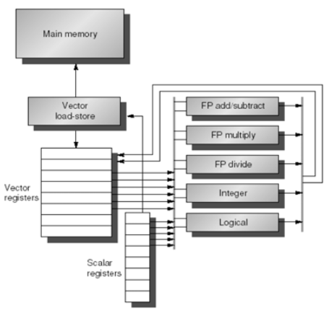
Parts of a Vector Processor

Slide 9
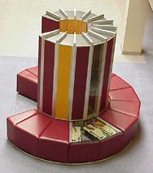
Vector Supercomputers
Cray-1, 1976
Scalar Unit
- Load/Store architecture
Vector Extension
- Vector registers
- Vector instructions
Implementation
- Hardwired control (no microcode)
- Pipelined functional units
- Interleaved memory system
- No data caches
- No virtual memory

Slide 10
Cray-1 (1976)
V0
V_{i}
V. Mask
V1
V_{j}
Single Port
Memory
16 banks of 64-bit words
+
8-bit SECDED
80MW/sec data load/store
320MW/sec instruction
buffer refill
64 Element Vector Registers
V2
V. Length
V3
V_{k}
V4
V5
V6
V7
FP Add
S0
S_{j}
FP Mul
( (A_{h}) + j k m )
S1
S2
S_{k}
FP Recip
64
T Regs
S_{i}
S3
(A₀)
S4
S_{i}
Int Add
T_{jk}
S5
S6
Int Logic
S7
Int Shift
( (A_{h}) + j k m )
A0
Pop Cnt
A1
A_{i}
A2
A_{j}
(A₀)
64
B Regs
A3
A_{k}
Addr Add
B_{jk}
A4
A5
A_{i}
Addr Mul
A6
A7
64-bitx16
NIP
CIP
4 Instruction Buffers
LIP

Slide 11
Vector Programming Model
Scalar Registers
Vector Registers
r15
v15
r0
v0
[0]
[1]
[2]
[VLRMAX-1]
Vector Length Register
VLR
Vector Arithmetic Instructions
ADDV v3, v1, v2
v1
v2
+
+
+
+
+
+
v3
[0]
[1]
[VLR-1]
Vector Load and Store Instructions
LV v1, r1, r2
Vector Register
v1
Base, r1
Stride, r2
Memory

Slide 12
Vector ISA Benefits
Compact – single instruction defines N operations
-- also fewer branches
Parallel – N operations are (data) parallel
-- no dependencies between vector elements
-- like VLIW, no complex hardware for dynamic scheduling
-- scalable; additional functional units give additional performance
Expressive – memory ops describe access patterns
-- vector memory ops exhibit continuous or regular access patterns
-- vector memory ops can prefetch and/or effectively use memory banks
-- amortize high latency for 1st element over large sequential pattern (bursts of data transfer…1st element incurs a long latency….subsequent elements are pipelined to produce a new element per cycle)

Slide 13
Basic Vector Instructions
Suppose 64-element vectors
Instr Operands Operation Comment
VADD.VV V1, V2, V3 V1 = V2 + V3 vector + vector
VADD.SV V1, R0, V2 V1 = R0 + V2 scalar + vector
VMUL.VV V1, V2, V3 V1 = V2 * V3 vector x vector
VMUL.SV V1, R0, V2 V1 = R0 * V2 scalar x vector
VLD V1, R1 V1 = M[R1,…R1+63] load, stride=1
VLDS V1, R1, R2 V1 = M[R1,…R1+63*R2] load, stride=R2
VLDX V1, R1, V2 V1 = M[R1+V2(i), i=0 to 63] indexed gather
VST V1, R1 M[R1…R1+63] = V1 store, stride=1
VLDS V1, R1, R2 M[R1,…R1+63*R2] = V1 store, stride=R2
VLDX V1, R1, V2 M[R1+V2(i), i=0 to 63] = V1 indexed scatter

Slide 14
Vector Code Example
# C code # Scalar Code # Vector Code
for (i=0 ; i<64 ; i++) LI R4, 64 LI VLR, 64
C[i] = A[i] + B[i]; loop: VLD V1, R1
L.D F0, 0 (R1) VLD V2, R2
L.D F2, 0 (R2) ADD.VV V3, V1, V2
ADD.D F4, F2, F0 VST V3, R3
S.D F4, 0 (R3)
DADDIU R1, 8
DADDIU R2, 8
DADDIU R3, 8
DSUBIU R4, 1
BNEZ R4, loop
-- Load immediate (LI) with length of vector (64)
-- Vector length register (VLR)

Slide 15
Vector Length
Vector register holds a max number of elements
-- MVL: Maximum vector length (e.g., 64)
-- But application vectors may not match MVL
Vector length register
-- VL: controls length of any vector operation (add, multiply, load, store)
-- Example: vadd.vv with VL10 is equivalent to:
for(i=0; i<10; i++) {V1[i] = V2[i] + V3[i]}
-- Before vector instructions, VL is set to number less than or equal to MVL
How can we code applications where the vector length is not known until run-time?

Slide 16
Strip Mining
Strip Mining
-- Suppose application VL > MVL
-- Generate loop that handles MVL elements per iteration
-- Translate each loop iteration into a single vector instruction
Example: AX+Y
-- First loop for (N mod MVL) elements. Remaining loops for MVL elements
VL = (N mod MVL); # set VL to be a smaller vector
for (i=0 ; i<VL ; i++) # 1st-loop translates into a single set
Y[i] = A*X[i] + Y[i]; # of vector instructions
low = (N mod MVL) # low – strips off beginning elements
VL = MVL # set VL to be max vector length
for (i=low ; i<N ; i++); # 2nd-loop translates into N/MVL sets
Y[i] = A * X[i] + Y[i]; # of vector instructions

Slide 17
Vector Instruction Execution
Use deep pipeline (fast clock) to execute operations for each vector element.
Simplify pipeline control because elements in vector are independent → no hazards.
V1
V2
V3
Six stage multiply pipeline
V3 ← V1 * V2

Slide 18
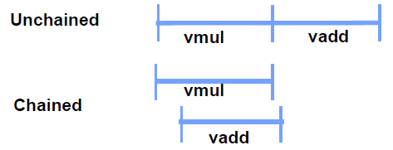
Opt 1 – Chaining
Consider the following code with vector length of 32
vmul.vv V1, V2, V3
vadd.vv V4, V1, V5 # very long RAW hazard
Chaining
-- V1 is not a single entity, but a vector of individual elements
-- Pipeline forwarding can work for individual elements
Flexible Chaining
-- Chain any vector to any other active vector operation
-- Requires more read/write ports in the vector register file

Slide 19
Opt 2 – Multiple Datapaths
ADDV C,A,B
Execution using one pipelined datapath
Execution using four pipelined datapaths
A[5]
B[5]
A[20]
B[20]
A[21]
B[21]
A[22]
B[22]
A[23]
B[23]
A[4]
B[4]
A[16]
B[16]
A[17]
B[17]
A[18]
B[18]
A[19]
B[19]
A[3]
B[3]
A[12]
B[12]
A[13]
B[13]
A[14]
B[14]
A[15]
B[15]
C[2]
C[8]
C[9]
C[10]
C[11]
C[1]
C[4]
C[5]
C[6]
C[7]
C[0]
C[0]
C[1]
C[2]
C[3]
1 adder → 1 element / cycle
N cycles
4 adders → 4 elements / cycle
N/4 cycles

Slide 20
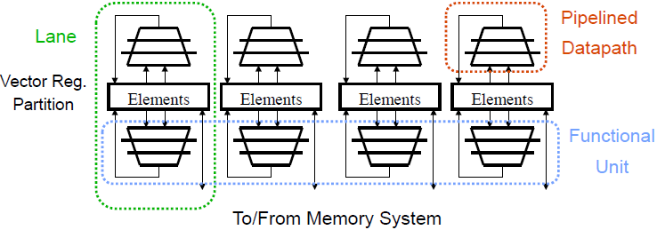
Opt 2+: Multiple Lanes
-- Vector elements interleaved across lanes
-- Example: V[0, 4, 8, …] on Lane 1, V[1, 5, 9,…] on Lane 2, etc.
-- Compute for multiple elements per cycle
-- Example: Lane 1 computes on V[0] and V[4] in one cycle
-- Modular, scalable design
-- No inter-lane communication needed for most vector instructions

Slide 21
Opt 3 – Conditional Execution
Suppose you want to vectorize this code:
for (i=0 ; i<N ; i++) {
if(A[i] != B[i]) {A[i] -= B[i]; } }
Solution: vector conditional execution
-- Add vector flag registers, single-bit mask per vector element
-- Use vector-compare to set the vector flag register
-- Use vector flag register to control vector-sub
-- Vector op executed only if corresponding flag element is set
vld V1, Ra
vld V2, Rb
vcmp.neq.vv M0, V1, V2 # vector compare for mask
vsub.vv V3, V2, V1, M0 # conditional vadd
vst V3, Ra

Slide 22
Vector Memory
Multiple, interleaved memory banks (16)
Bank busy time (e.g., 4 cycles) is time before bank ready to accept next request
Base
Stride
Vector Registers
Address Generator
+
0
1
2
3
4
5
6
7
8
9
A
B
C
D
E
F
Memory Banks

Slide 23
Supercomputing to Multimedia
Support narrow data types
-- Allow each vector registers to store 16-, 32-, or 64-bit elements
-- Use a control register to indicate width of register elements
Support saturated and fixed-point arithmetic
-- Minor modification to functional units
Support element permutations for vector reductions
-- for(i=0 ; i<N ; i++) {S += A[i]}
-- Rewrite as:
for(i=0 ; i<N ; i+=VL) {S[0:VL-1]+=A[i:i+VL-1];} # S[…], A[…] are
for(i=0 ; i<VL ; i++) {S+=[S[i];} # vectors of VL elements
-- First loop trivially vectorizable
-- Second loop vectorizable by splitting vector register S into two vector registers. Take a binary-tree approach to reduction

Slide 24
SIMD in Superscalar Processors
SIMD extends conventional ISA
-- SIMD – single instruction, multiple data
-- MMX, SSE, SSE-2, SSE-3, 3D-Now, Altivec, VIS
Objective: Accelerate multimedia processing
-- Define vectors of 16-, 32-bit elements in regular registers
-- Apply SIMD arithmetic on these vectors
Advantages
-- No vector register file, which would require additional area
-- Simple extensions (new opcodes, modified datapath)

Slide 25
SIMD Challenges
SIMD Vectors are short with fixed size
-- Cannot capture data parallelism wider than 64 bits
-- Recent shift from 64-bit to 128-bit vectors (SSE, Altivec)
SIMD does not support vector memory accesses
-- Strided or indexed access require equivalent multi-instruction sequences
-- With vector memory accesses, much lower benefits in performance and code density

Slide 26
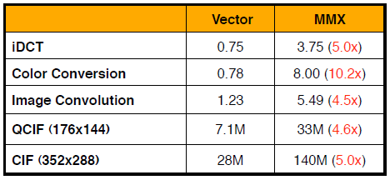
SIMD versus Vectors
-- QCIF and CIF numbers are in clock cycles per frame
-- All other numbers are in clock cycles per pixel
-- MMX results assume no first-level cache misses
-- Courtesy: Christos Kozyrakis, Stanford

Slide 27
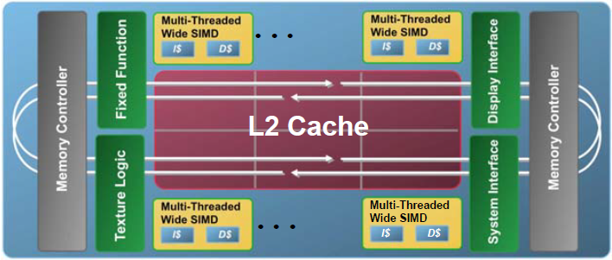
Intel Larrabee
Vector Multiprocessor
-- 2-way superscalar, 4-way multi-threaded, in-order cores with vectors
-- Cores communicate on a wide ring bus
-- L2 cache is partitioned among the cores
-- Provides high aggregate bandwidth
-- Allows data replication and sharing

Slide 28
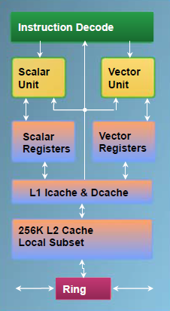
Larrabee x86 Core
-- separate scalar, vector units with separate registers
-- scalar unit: in-order x86 core
-- vector unit: 16 32-bit ops/clock
-- short execution pipelines
-- fast access to L1 cache
-- direct connection to L2 cache subset
-- instructions support prefetch into L1 and L2 caches

Slide 29
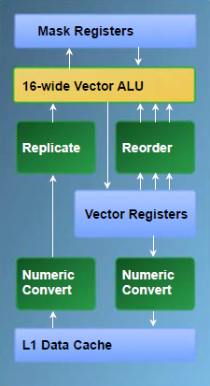
Larrabee Vector Unit
Vector Instruction Set
-- 32 vector registers (512 bits each)
-- vector load/store with scatter/gather
-- 8 mask registers for conditional exec.
-- mask registers select lanes for an instruction
-- mask registers allow separate execution kernels in each lane
Vector Instruction Support
-- Fast read from L1 cache
-- Numeric type conversion and replication in memory path

Slide 30
Vector Power Efficiency
Power and Parallelism
-- Power(1-lane) = [capacitance] x [voltage]^2 x [frequency]
-- If we double number of lanes, we double peak performance
-- Then, if we halve frequency, we return to original peak performance.
-- But, halving frequency allows us to halve voltage
-- Power (2-lane) = [2 x capacitance] x [voltage/2]^2 x [frequency/2]
-- Power (2-lane) = Power(1-lane)/4 @ same peak performance
Simpler Logic
-- Replicate control logic for all lanes
-- Avoid logic for multiple instruction issue or dynamic out-of-order execution
Clock Gating
-- Turn-off clock when hardware is unused
-- Vector of given length uses specific resources for specific # of cycles -- Conditional execution (masks) further exposes unused resources

Slide 31
Summary
Vector Processors
-- Express and exploit data-level parallelism (DLP)
SIMD Extensions
-- Extensions for short vectors in superscalar (ILP) processors
-- Provide some advantages of vector processing at less cost

