Slide 1
ECE 252 / CPS 220 Advanced Computer Architecture I Lecture 19 Summary
Benjamin Lee
Electrical and Computer Engineering
Duke University
www.duke.edu/~bcl15
www.duke.edu/~bcl15/class/class_ece252fall11.html

Slide 2
ECE252 Administrivia
1 December 2011
Project Status
Please submit project reports to Blackboard by midnight
Final Exam
Wednesday, Dec 14, 2-5pm
Closed book, closed notes exam
Cumulative, with emphasis on latter half.
6-7 Questions
1/3 on earlier material, 2/3 on later material
1/3 extended design questions
2/3 short answer

Slide 3
Architecture: Abstractions/Metrics
Computer architecture defines HW/SW interface
Evaluate architectures quantitatively

Slide 4
Computer Architecture
Application
Gap too large to bridge in one step
Physics
Computer architecture is the design of abstraction layers,
which allow efficient implementations of computational applications on available technologies

Slide 5
Abstraction Layers
Application
Algorithm
Programming Language
Operating System/Virtual Machines
Domain of early computer architecture
(‘50s-’80s)
Instruction Set Architecture (ISA)
Domain of recent computer architecture
(since ‘90s)
Microarchitecture
Gates/Register-Transfer Level (RTL)
Circuits
Devices
Physics

Slide 6
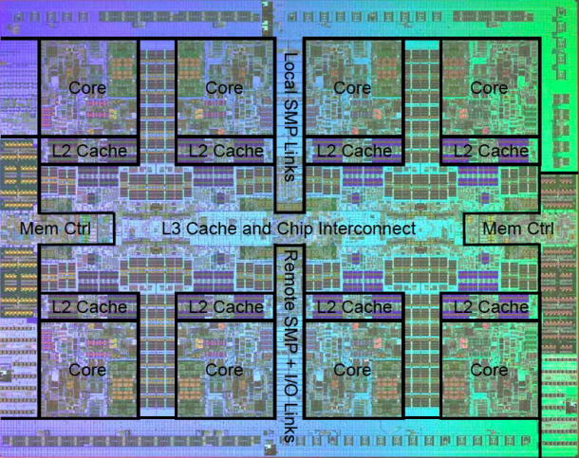
ECE 252 Executive Summary
In-order Datapath
(built, ECE152)
Chip Multiprocessors
(understand, experiment ECE252)

Slide 7
Performance Factors
Latency = (Instructions / Program) x (Cycles / Instruction) x (Seconds / Cycle)
Seconds / Cycle
- Technology and architecture
- Transistor scaling
- Processor microarchitecture
Cycles / Instruction (CPI)
- Architecture and systems
- Processor microarchitecture
- System balance (processor, memory, network, storage)
Instructions / Program
- Algorithm and applications
- Compiler transformations, optimizations
- Instruction set architecture

Slide 8
Power and Energy
Definitions
- Energy (Joules) = a x C x V²
- Power (Watts) = a x C x V² x f
Power Factors and Trends
- activity (a): function of application resource usage
- capacitance (C): function of design; scales with area
- voltage (V): constrained by leakage, which increases as V falls
- frequency (f): varies with pipelining and transistor speeds
- Models in cycle-accurate simulators (e.g., Princeton Wattch)
Dynamic Voltage and Frequency Scaling (DVFS)
- P-states: move between operational modes with different V, f
- Intel TurboBoost: increase V, f for short durations without violating thermal design point (TDP)

Slide 9
Datapath: CISC versus RISC
Complex Instruction Set Computing
- microprogramming
- motivated by technology (slow instruction fetch)
Reduced Instruction Set Computing
- hard-wired datapath
- motivated by technology (caches, fast memory)
- complex instructions rarely used

Slide 10
CISC Microprograms
instr fetch: MA ← PC # fetch current instr
A ← PC # next PC calculation
IR ← Memory
PC ← A + 4
dispatch on Opcode # start microcode
ALU: A ← Reg[rs]
B ← Reg[rt]
Reg[rd] ← func(A,B)
do instruction fetch
ALUi: A ← Reg[rs]
B ← Imm # sign extension
Reg[rt] ← Opcode(A,B)
do instruction fetch

Slide 11
CISC Bus-Based MIPS Datapath
Opcode
zero?
busy
ldIR
OpSel
ldA
ldB
32(PC)
ldMA
31(Link)
rd
2
rt
rs
RegSel
MA
rd
3
IR
rt
A
B
addr
addr
rs
32 GPRs
+ PC ...
32-bit Reg
ExtSel
Memory
MemWrt
Imm
Ext
ALU
control
RegWrt
2
ALU
enReg
enImm
enALU
data
data
enMem
Bus
32
Microinstruction: register to register transfer (17 control signals)
MA ← PC means RegSel = PC; enReg=yes; ldMA= yes
B ← Reg[rt] means RegSel = rt; enReg=yes; ldB = yes

Slide 12
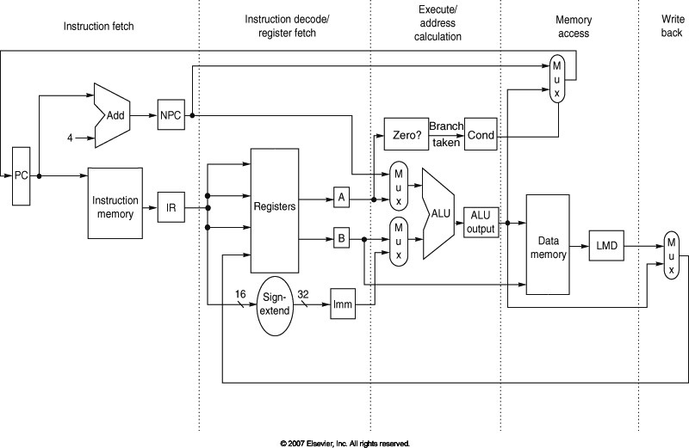
RISC Hard-wired MIPS Datapath
Figure A.17, Page A-29
IF/ID
ID/EX
EX/MEM
MEM/WB

Slide 13
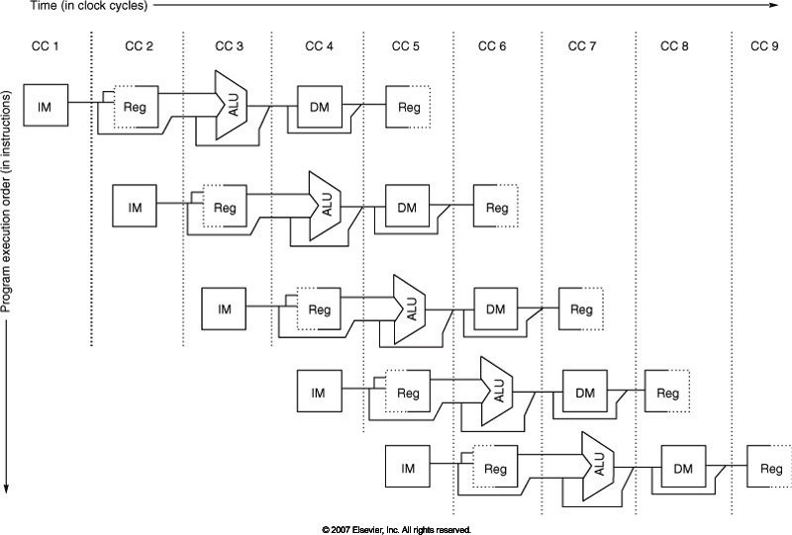
Visualizing the Pipeline
Figure A.2, Page A-8

Slide 14
Hazards and Limits to Pipelining
Structural Hazards
Hardware cannot support this combination of instructions.
Solution: stall pipeline (interlocks)
Data Hazards
Instruction depends on result of prior instruction still in pipeline
Solution: forward data, stall pipeline
Control Hazards
Instruction fetch depends on decision about control flow
Example: compute branches early in pipeline, predict branches

Slide 15
Tomasulo & Out-of-order
Out-of-order Execution
Dynamically schedule instructions
Execute instructions when dependences resolved
Tomasulo’s Algorithm
Queue instructions until operands ready (reservation stations, ROB)
Rename to eliminate write hazards (rename table, physical registers)
Precise Interrupts/Exceptions
Instructions execute/complete out-of-order
Instructions commit in-order via reorder buffer
Check for exceptions when committing instruction

Slide 16
Memory
Big, Slow Memory
(DRAM)
A
Small,
Fast Memory
(RF, SRAM)
B
CPU
holds frequently used data
DRAM – access dense array of slow memory with a command protocol
SRAM – access smaller array of fast memory on processor die
Virtual Memory – translate applications’ virtual addresses into physical addresses, providing better memory management and protection

Slide 17
DRAM
-- Chip organized into 4-8 logical banks, which can be accessed in parallel
-- Access DRAM with activate , read/write, precharge commands
Bank 1
bit lines
Col.
1
Col. 2^{M}
word lines
Row 1
N
Row Address Decoder
Row 2^{N}
Memory cell (one bit)
N+M
M
Column Decoder & Sense Amplifiers
Data
D

Slide 18
Caches
Caches exploit predictable patterns
Temporal Locality
Caches remember the contents of recently accessed locations
Spatial Locality
Caches fetch blocks of data nearby recently accessed locations

Slide 19
Placement Policy
Line Number
1 1 1 1 1 1 1 1 1 1 0 1 2 3 4 5 6 7 8 9
2 2 2 2 2 2 2 2 2 2 0 1 2 3 4 5 6 7 8 9
3 3
0 1
0 1 2 3 4 5 6 7 8 9
Memory
Set Number
0 1 2 3
0 1 2 3 4 5 6 7
Cache
Fully (2-way) Set Direct
Associative Associative Mapped
anywhere anywhere in only into
set 0 block 4
(12 mod 4) (12 mod 8)
Line 12
can be placed

Slide 20
Direct-Mapped Cache
Tag
Index
Line
Offset
t
k
b
V
Tag
Data Line
2^{k}
lines
t
=
HIT
Data Word or Byte

Slide 21
Average Memory Access Time
AMAT = [Hit Time] + [Miss Prob.] x [Miss Penalty]
Miss Penalty equals AMAT of next cache/memory/storage level.
AMAT is recursively defined
To improve performance
Reduce the hit time (e.g., smaller cache)
Reduce the miss rate (e.g., larger cache)
Reduce the miss penalty (e.g., optimize the next level)
Simple design strategy
Observe that hit time increases with cache size
Design the largest possible cache with a hit time of 1-2 cycles.
For example, design 8-32KB of cache in modern technology
Design trade-offs are more complex with superscalar architectures and multi-ported memories

Slide 22
Caches and Code
Restructuring code affects data access sequences
Group data accesses together to improve spatial locality
Re-order data accesses to improve temporal locality
Prevent data from entering the cache
Useful for variables that are only accessed once
Requires SW to communicate hints to HW.
Example: “no-allocate” instruction hints
Kill data that will never be used again
Streaming data provides spatial locality but not temporal locality
If particular lines contain dead data, use them in replacement policy.
Toward software-managed caches

Slide 23
Caches and Code
for(i=0; i < N; i++) a[i] = b[i] * c[i];
for(i=0; i < N; i++)
d[i] = a[i] * c[i];
for(i=0; i < N; i++) { a[i] = b[i] * c[i]; d[i] = a[i] * c[i];
}
What type of locality does this improve?

Slide 24
Virtual Memory
Page Fault?
Protection violation?
Page Fault?
Protection violation?
Virtual Address
Virtual Address
Physical Address
Physical Address
PC
Inst. TLB
D
Decode
E
M
Data TLB
W
Inst. Cache
Data Cache
+
Miss?
Miss?
Page-Table Base Register
Hardware Page Table Walker
Physical Address
Memory Controller
Physical Address
Physical Address
Main Memory (DRAM)

Slide 25
Parallelism
Instruction-level Parallelism (ILP)
- multiple instructions in-flight
- hardware-scheduled: (1) pipelining, (2) out-of-order execution
- software-scheduled: (3) VLIW
Data-level Parallelism (DLP)
- multiple, identical operations on data arrrays/streams
- (1) vector processors, (2) GPUs
- (3) single-instruction, multiple-data (SIMD) extensions
Thread-level Parallelism (TLP)
- multiple threads of control
- if a thread stalls, issue instructions from other threads
- (1) multi-threading, (2) multiprocessors

Slide 26
VLIW and ILP (SW-managed)
Int Op 1
Int Op 2
Mem Op 1
Mem Op 2
FP Op 1
FP Op 2
Two Integer Units,
Single Cycle Latency
Two Load/Store Units,
Three Cycle Latency
Two Floating-Point Units,
Four Cycle Latency
Multiple operations packed into one instruction format
Instruction format is fixed, each slot supports particular instruction type
Constant operation latencies are specified (e.g., 1 cycle integer op)
Software schedules operations into instruction format, guaranteeing
Parallelism within an instruction – no RAW checks between ops
No data use before ready – no data interlocks/stalls

Slide 27
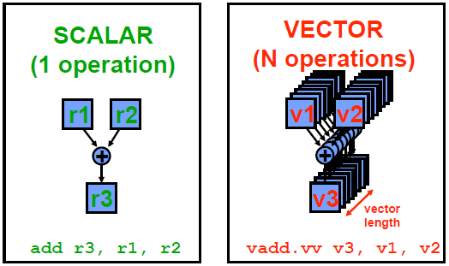
Vectors and DLP

Slide 28
Multithreading and TLP
Simultaneous
Multithreading
Superscalar
Fine-Grained
Coarse-Grained
Multiprocessing
Time (processor cycle)
Thread 1
Thread 3
Thread 5
Thread 2
Thread 4
Idle slot

Slide 29
Multiprocessors
Shared-memory Multiprocessors
Provide a shared-memory abstraction
Enables familiar and efficient programmer interface
P₁
P₂
P₃
P₄
Memory System

Slide 30
Multiprocessors
Shared-memory Multiprocessors
Provide a shared-memory abstraction
Enables familiar and efficient programmer interface
P₁
P₂
P₃
P₄
M₁
M₂
M₃
M₄
Cache
Cache
Cache
Cache
Interface
Interface
Interface
Interface
Interconnection Network

Slide 31
Multiprocessors
Shared-memory Multiprocessors
Provide a shared-memory abstraction
Enables familiar and efficient programmer interface
P₁
P₂
P₃
P₄
M₁
M₂
M₃
M₄
Cache
Cache
Cache
Cache
Interface
Interface
Interface
Interface
Interconnection Network

Slide 32
Challenges in Shared Memory
Cache Coherence
“Common Sense”
P1-Read[X] → P1-Write[X] → P1-Read[X] Read returns X
P1-Write[X] → P2-Read[X] Read returns value written by P1
P1-Write[X] → P2-Write[X] Writes serialized
All P’s see writes in same order
Synchronization
Atomic read/write operations
Memory Consistency
What behavior should programmers expect from shared memory?
Provide a formal definition of memory behavior to programmer
Example: When will a written value be seen?
Example: P1-Write[X] <<10ps>> P2-Read[X]. What happens?

Slide 33
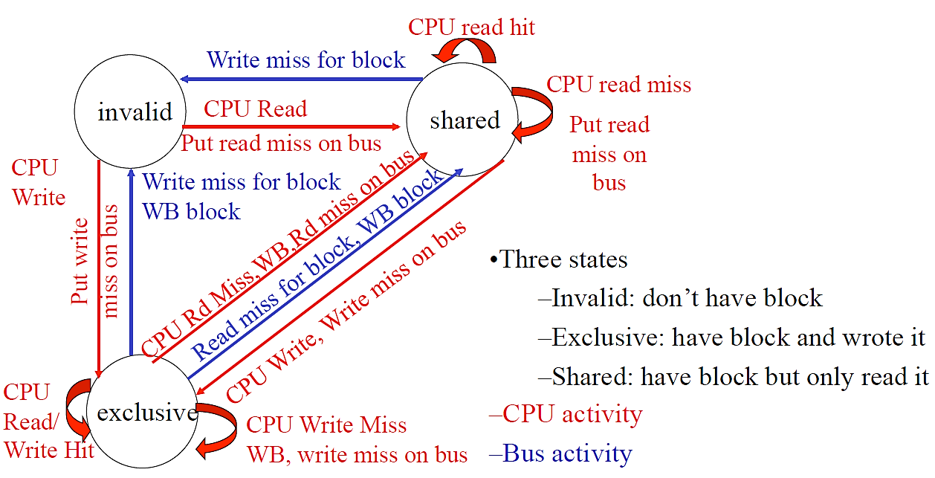
Coherence Protocols
Implement protocol for every cache line.
Compare, contrast snoopy and directory protocols [[Stanford Dash]]

Slide 34
Synchronization and Atomicity
Solution: Test-and-set instruction
Add single instruction for load-test-store (t&s R1, lock)
- Test-and-set atomically executes
ld R1, lock; # load previous lock value
st 1, lock; # store 1 to set/acquire
If lock initially free (0), t&s acquires lock (sets to 1)
If lock initially busy (1), t&s does not change it
Instruction is un-interruptible/atomic by definition
Inst-0 t&s R1, lock # atomically load, check, and set lock=1
Inst-1 bnez R1 # if previous value of R1 not 0,
…. acquire unsuccessful
Inst-n stw R1, 0 # atomically release lock

Slide 35
Sequential Consistency (SC)
Definition of Sequential Consistency
Formal definition of programmers’ expected view of memory
Each processor P sees its own loads/stores in program order
(2) Each processor P sees !P loads/stores in program order
(3) All processors see same global load/store ordering.
P and !P loads/stores may be interleaved into some order.
But all processors see the same interleaving/ordering.
Definition of Multiprocessor Ordering [Lamport]
Multi-processor ordering corresponds to some sequential interleaving of uni-processor orderings. Multiprocessor ordering should be indistinguishable from multi-programmed uni-processor

Slide 36
For More
ECE 259 (Spring 2012)
Advanced Computer Architecture II
Parallel computer architecture design and evaluation
Parallel programming, coherence, synchronization, consistency
ECE 299-01 (Spring 2012)
Energy Efficient Computer Systems
Technology, architecture, application strategies for energy efficiency
Datacenter computing
ECE 254 (tbd)
Fault-Tolerant and Testable Computer Systems
Fault models, redundancy, recovery, testing
Computer architecture is HW/SW interface.
Consider classes on both sides of this interface.

Slide 37
Looking Forward
Energy-efficiency
Technology limitations motivate new architectures for efficiency
Ex: specialization, heterogeneity, management
Technology
Emerging technologies motivate new architectures for capability
Ex: memory (phase change), networks (optical),
Reliability and Security
Variations in fabrication, design process motivate new safeguards
Ex: tunable structures, trusted bases
Multiprocessors
Abundant transistors, performance goals motivate parallel computing
Ex: parallel programming, coherence/consistency, management

