Slide 1
ECE552 / CPS550
Advanced Computer Architecture I
Lecture 1
Introduction
Benjamin Lee
Electrical and Computer Engineering
Duke University
www.duke.edu/~bcl15
www.duke.edu/~bcl15/class/class_ece552fall12.html

Slide 2

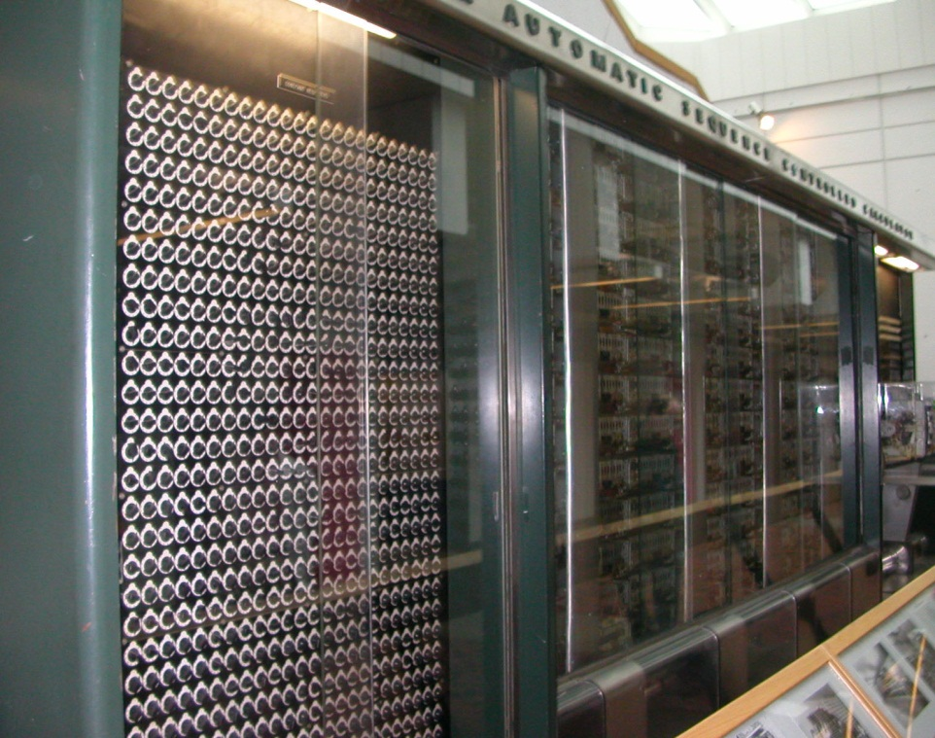
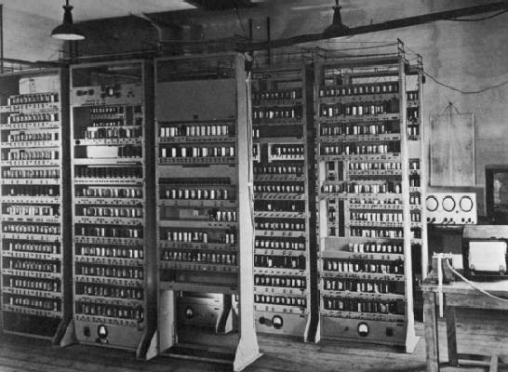
Computing Devices (Then)
Mark I
Harvard University, 1944
EDSAC
University of Cambridge, 1949

Slide 3
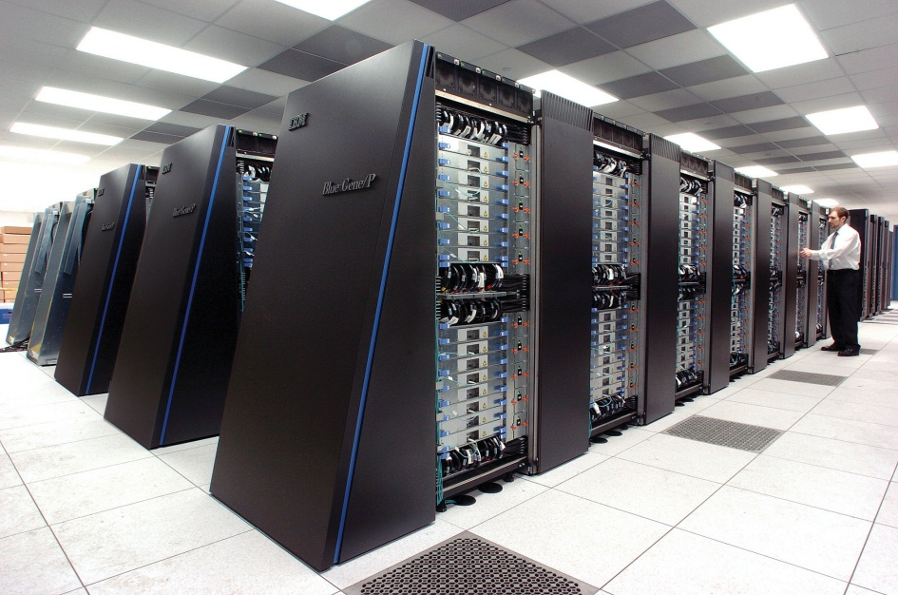

Computing Devices (Now)
iPad
Apple/ARM, 2010
Blue Gene/P
IBM, 2007

Slide 4
Computer Architecture
Application
Gap too large to bridge in one step
Physics
Computer architecture is the design of abstraction layers,
which allow efficient implementations of computational applications on available technologies

Slide 5
Abstraction Layers
Application
Algorithm
Programming Language
Operating System/Virtual Machines
Domain of early computer architecture
(‘50s-’80s)
Instruction Set Architecture (ISA)
Domain of recent computer architecture
(since ‘90s)
Microarchitecture
Gates/Register-Transfer Level (RTL)
Circuits
Devices
Physics

Slide 6
An Integrated Approach
Architect Systems
- Coordinate technology, hardware, run-time software, compilers, apps
- Responsible for end-to-end functionality
Design and Analyze
- Search the space of possible designs at all levels in computer system
- Evaluate designs with quantitative metrics (performance, power, cost)
Navigate Computing Landscape
- Architects work at the hardware-software interface
- Technologies are emerging
- Applications are demanding
- Systems are scaling

Slide 7
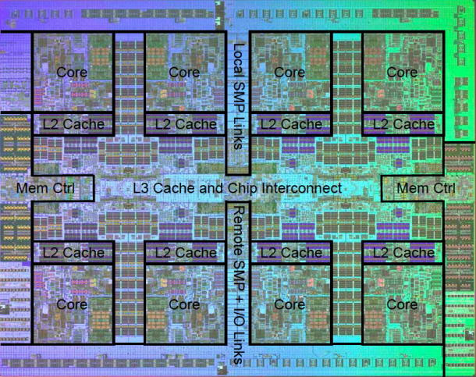
ECE 552 Executive Summary
In-order Datapath
(built, ECE152)
Chip Multiprocessors
(understand, experiment ECE552)

Slide 8
ECE 552 Administrivia
Instructor Prof. Benjamin Lee
benjamin.c.lee@duke.edu
Office Hours: Tu 4-5pm, Fr 4-5pm, 210 Hudson
Teaching Marisabel Guevara, mg@cs.duke.edu
Assistants Office Hours: Tu 12:25-1:25pm, W 4-5pm, TBD
Weidan Wu, ww53@duke.edu
Office Hours: M 4-5pm, Th 2:40-3:40pm, TBD
Lectures Tu/Th 1:25-2:40PM, 208 Hudson
Text Computer Architecture: A Quantitative Approach,
5th Edition (2012). Do not use earlier editions
Web http://www.duke.edu/~BCL15/class/class_ece552fall12.html

Slide 9
ECE 552 Prerequisites
Participation
- Electrical and Computer Engineering, Computer Science
- PhD, MS, Undergraduates
Prerequisites
- Introduction to computer architecture (CPS 104, ECE 152, or equiv.)
- Programming (homework/projects in C, C++)
Background Knowledge
- Instruction sets, computer arithmetic, assembly programming
    D.A. Patterson and J.L. Hennessy. Computer Organization and Design: The Hardware/Software Interface, 5th Edition.
Dropping the Course
- if you are going to drop, please do so early

Slide 10
ECE 552 Syllabus
Design Metrics
  Performance
  Power
  Early machines
Simple Pipelining
  Multi-cycle machines
  Branch Prediction
  In-order Superscalar
  Optimizations
Complex Pipelining
  Score-boarding, Tomasulo Algorithm
  Out-of-order Superscalar
Midterm Exam
Fall Break
Memory Systems
  Caches
  DRAM
  Virtual Memory
Explicitly Parallel Architectures
  VLIW
  Vector machines
  Multi-threading
Multiprocessors
  Memory Models
  Coherence Protocols
Advanced Topics
  Emerging Technologies
  Specialized Architectures
  Datacenter Architectures

Slide 11
ECE 552 Components
30% Homework and Readings
- Homework done in teams of 3
- 5 classes dedicated to paper discussions
15% Midterm exam
- 75 minutes (in class), closed book
25% Final exam
- 3 hours, closed-book
- based on lectures, problem sets, readings
30% Term project/paper
- Project done in teams of 3
Academic Policy
University policy as codified by Duke Undergraduate Honor Code will be strictly enforced. Zero tolerance for cheating and/or plagiarism.

Slide 12
ECE 552 Academic Policy
University policy as codified by the Duke Undergraduate Honor Code will be strictly enforced. Zero tolerance for cheating and/or plagiarism.
If a student is suspect of academic dishonesty (e.g., cheating on an exam, copying a lab report, collaborating inappropriately on an assignment), faculty are required to report the matter to the Office of Student Conduct.
A student found responsible for academic dishonesty faces formal disciplinary action, which may include suspension. A student suspended twice for academic dishonesty automatically faces a minimum 5-year separation from Duke University.

Slide 13
ECE 552 Term Project
Scope
- Semester-long research project
- Teams of 3
- Students propose project ideas (Oct 14)
Final Paper
- 6-12 page research paper
- Evaluate research idea quantitatively
- Survey and cite related work

Slide 14
ECE 552 Upcoming Deadlines
11 September – Homework #1 Due
Assignment on web page. Teams of 2-3.
Submit hard copy in class. Email code to TA’s
11 September – Class Discussion
Roughly one reading per class. Do not wait until the day before!
  Hill et al. “Classic machines: Technology, implementation, and economics”
  Moore. “Cramming more components onto integrated circuits”
  Radin. “The 801 minicomputer”
  Patterson et al. “The case for the reduced instruction set computer”
  Colwell et al. “Instruction sets and beyond: Computers, complexity, controversy”

Slide 15
Performance
Definitions
- Latency: time to finish given task (a.k.a. execution time)
- Throughput: number of tasks in given time (a.k.a. bandwidth)
- Throughput can exploit parallelism while latency cannot
Example: Move people from Duke to UNC, 10 miles
- Car: capacity = 5, speed = 60 miles/hour
- Bus: capacity = 60, speed = 20 miles/hour
- Latency(car) = (10 miles @ 60 miles/hour )= 10 minutes
- Latency(bus) = (10 miles @ 20 miles/hour) = 30 minutes
- Throughput(car) = (3 trips @ 60 miles per hour) = 15 people/hour
- Throughput(bus) = (1 trip @ 20 miles per hour) = 60 people/hour

Slide 16
Benchmarking
Measuring Performance
- Target Workload: accurate but not portable
- Representative Benchmark: portable but not accurate
- Microbenchmark: small, fast code sequences but incomplete
Representative Benchmarks
- SPEC (Standard Performance Evaluation Corporation, www.spec.org)
- Collects, standardizes, distributes benchmark programs
- Parallel Benchmarks
- Scientific and commercial computing
- SPLASH-2, NAS, SPEC OpenMP, SPECjbb
- Transaction Processing Council (TPC)
- Online transaction processing (OLTP) with heavy I/O, memory
- TPC-C, TPC-H, TPC-W

Slide 17
Aggregating Performance
Addition
- Latency is additive but throughput is not
- Example: Consider applications A1 and A2 on processor P
- Latency(A1,A2) = Latency(A1) + Latency(A2)
- Throughput (A1,A2) = 1/[1/Throughput(A1) + 1/Throughput(A2)]
Averages
  - Arithmetic Mean: (1/N) * ∑_{P=1..N} Latency(P)
  - For measures that are proportional to time (e.g., latency)
  - Harmonic Mean: N / ∑_{P=1..N} 1/Throughput(P)
- For measures that are inversely proportional to time (e.g., throughput)
  - Geometric Mean: (∏_{P=1..N} Speedup(P))^(1/N)
  - For ratios (e.g., speed-ups)

Slide 18
Processor Performance
SPECint Benchmarks. Hennessy and Patterson, Computer Architecture: A Quantitative Approach, 4th Edition, 2006.

Slide 19
Performance Factors
Latency = (Instructions / Program) x (Cycles / Instruction) x (Seconds / Cycle)
Seconds / Cycle
  - Technology and architecture
  - Transistor scaling
  - Processor microarchitecture
Cycles / Instruction (CPI)
  - Architecture and systems
  - Processor microarchitecture
  - System balance (processor, memory, network, storage)
Instructions / Program
- Algorithm and applications
- Compiler transformations, optimizations
- Instruction set architecture

Slide 20
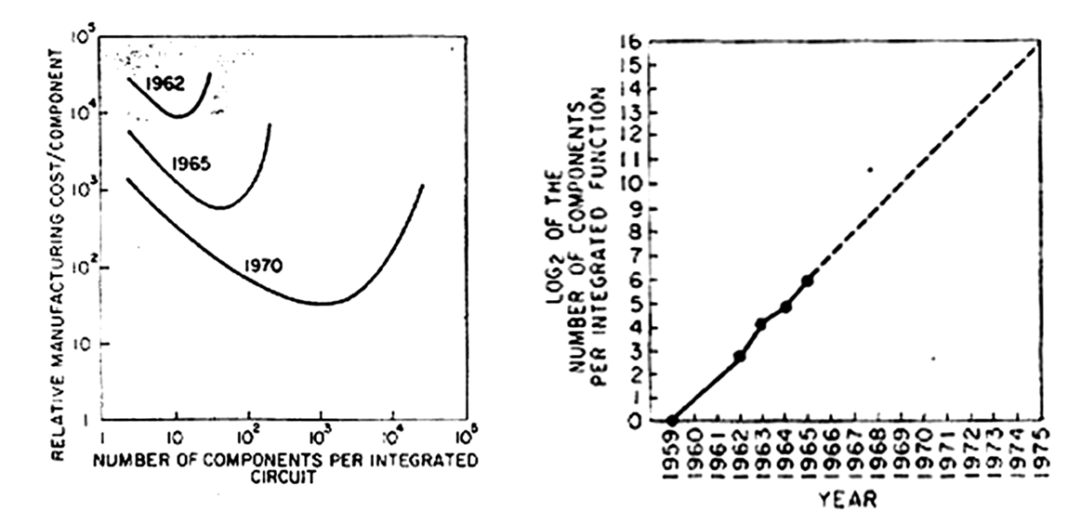
Moore’s Law
    Moore. “Cramming more components onto integrated circuits.” Electronics, Vol 38, No. 8, 1965.
    As integration increases and packaging cost decrease
    How does Moore’s Law impact performance?

Slide 21
Field-Effect Transistors
MOSFET
MOS: metal-oxide semiconductor
FET: field-effect transistor
Charge carriers flow between source-drain
Flow controlled by gate voltage
Abstract MOSFET as electrical switch
Gate
Drain
Drain
Source
Gate
Width
Channel
Bulk
Source
Length

Slide 22
Complementary MOS (CMOS)
Voltages map to logical values (Vdd=1, Gnd=0)
Implement complementary Boolean logic
nFET: conduct charge when Vg = Vdd, used in pull-down network
pFET: conduct charge when Vg = Gnd, used in pull-up network
Examples: Inverter, NAND (universal, any logic function via De Morgan’s Law)
Vdd
pFET
A
B
!(AB)
A
!A
A
nFET
B
Gnd

Slide 23
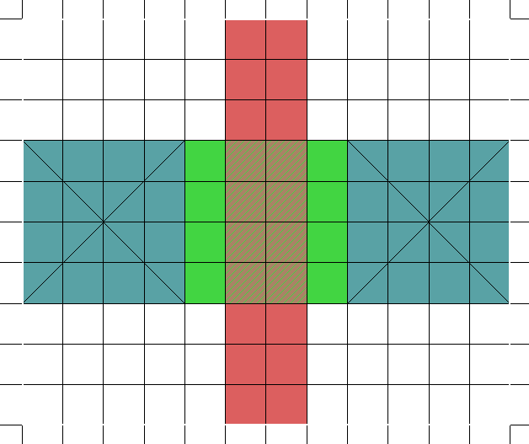
Transistor Dimensions
Process defined by feature size (F), layout design (λ = F/2)
Example: F=2λ =45nm process technology
Transistor dimensions determine technology performance
Transistor drive strength (i.e., performance) increases as channel length shrinks
Minimum Length=2λ
Gate
Drain
Source
Gate
Width
Source
Drain
Width=4λ
Bulk
Length

Slide 24
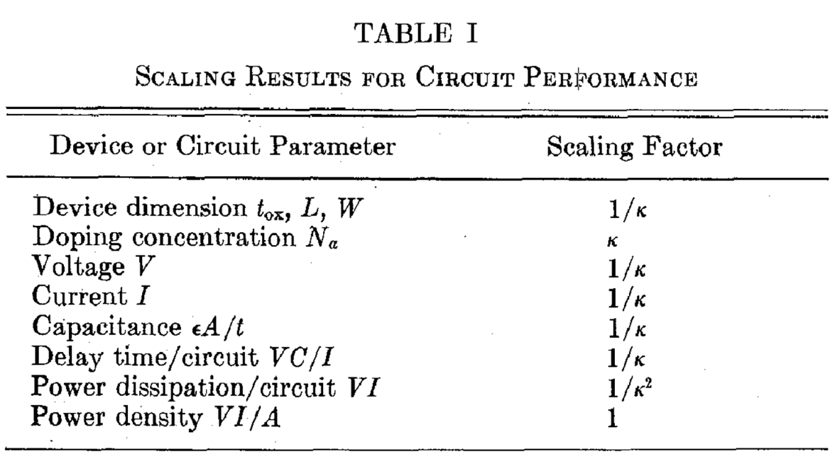
Dennard Scaling
    Dennard et al. “Design of ion-implanted MOSFETs with very small physical dimensions,” Journal Solid State Circuits, 1974.
Scale not only dimensions but also doping concentration and voltage
Transistors become faster (1.4x)
Applied to Moore’s Law: k=1.4, 1/k = 0.7 every 18-24 months
Gate
Drain
Source
Width
Bulk
Length

Slide 25

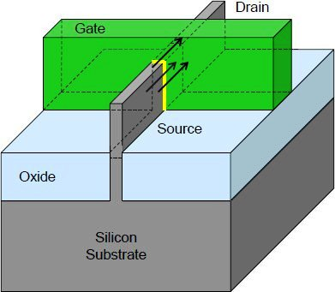
Dennard Scaling Limits
    Horowitz et al. “Scaling, power, and the future of CMOS.” IEDM, 2005.
    Classical Dennard scaling ended at 130nm in 2000-2001.
    Oxide Thickness: How to manage increasing leakage? Use high-K dielectrics
    Channel Length: How to manage increasing leakage? Stop scaling L
    Doping Concentration: How to handle imprecise doping? Manage variability
    Voltage: How to manage increasing leakage? Stop scaling V
    Current: How to increase current with shrinking channels? Stress silicon
    Example: Intel 22nm process technology with FinFET
    Image: Courtesy Intel Corp.

Slide 26
Processor Performance
SPECint Benchmarks. Hennessy and Patterson, Computer Architecture: A Quantitative Approach, 4th Edition, 2006.

Slide 27
Performance Factors
Latency = (Instructions / Program) x (Cycles / Instruction) x (Seconds / Cycle)
Seconds / Cycle
  - Technology and architecture
  - Transistor scaling
  - Processor microarchitecture
Cycles / Instruction (CPI)
  - Architecture and systems
  - Processor microarchitecture
  - System balance (processor, memory, network, storage)
Instructions / Program
- Algorithm and applications
- Compiler transformations, optimizations
- Instruction set architecture

Slide 28
Cycles per Instruction (CPI)
Average Instruction Latency
  - Examine instruction frequency
  - Different instructions require different number of cycles
  - Example: Integer instructions (1 cy), Floating-point instruction (>10 cy)
  - CPI is slightly easier to calculate than IPC (time versus rate)
Example
  - Instruction frequency: 1/3 INT, 1/3 FP, 1/3 MEM operations
  - Instruction cycles: 1cy INT, 3cy FP, 2cy MEM
  - CPI = (1/3 x 1) + (1/3 x 3) + (1/3 x 2)
  Caveat
  - CPI provides high-level, quick estimates of performance
  - Does not account for details (e.g., instruction dependences)

Slide 29
CPI and Design
Baseline Processor / Application
  - Integer ALU: 50%, 1 cycle
  - Load: 20%, 5 cycle
  - Store: 10%, 1 cycle
  - Branch: 20%, 2 cycle
Possible Enhancements
  - Option 1: Branch prediction to reduce branch cost to 1 cycle
  - Option 2: Bigger data cache to reduce load cost to 3 cycles
  - Which enhancement would we prefer?
  Cycles Per Instruction
  - Base = (0.5 x 1) + (0.2 x 5) + (0.1 x 1) + (0.2 x 2) = 2 cycles
  - Option 1 = (0.5 x 1) + (0.2 x 5) + (0.1 x 1) + (0.2 x 1) = 1.8 cycles
  - Option 1 = (0.5 x 1) + (0.2 x 3) + (0.1 x 1) + (0.2 x 2) = 1.6 cycles

Slide 30
Measuring CPI
Physical Measurements
  - Measure wall clock time as application runs
  - Multiply time by clock frequency to get cycles
  - Profile application with hardware counters (e.g., Intel VTune)
Simulated Measurements
  - Cycle-level, microarchitectural simulation (e.g., SimpleScalar)
  - Run applications on simulated hardware
  - Track instructions as they progress through the design

Slide 31
Pitfall: Partial Performance Metrics
Ignoring Instructions per Program
- Neglect dynamic instruction count
- Misleading if working in algorithms, compilers, or ISA
Using Instructions per Second
- MIPS = (Instructions / Cycle) x (Cycles / Second) x 1E-6
- FLOPS: considers only floating-point instructions
- Example: CPI = 2, clock frequency = 500MHz, 250 MIPS
- Example: compiler removes instructions, latency falls, MIPS increases
Using Clock Frequency
- Cannot equate clock frequency with performance
- Proc A: CPI = 2, f = 500MHz
- Proc B: CPI = 1, f = 300MHz
- Given the same ISA and compiler, B is faster

Slide 32
Pitfall & Amdahl’s Law
Amdahl. “Validity of the single-processor approach…” AFIPS, 1967.
Make Common Case Fast
    Consider improving fraction F of system with a speedup S.
    T(new) = T(base) x (1-F) + T(base) x F / S
    = T(base) x [(1-F) + F/S]
    Speedup = 1 / [(1-F) + F/S] = T(base)/T(new)
    Max Speedup = 1 / (1 – F)
Example
    Suppose FP computation is 1/4 of an application’s execution time
    Maximum benefit from optimizing FP unit is 1.3x (=1/0.75)
    Multiprocessor systems were original application of this law
    Accounts for diminishing marginal returns

Slide 33
Processor Power
SPECint Benchmarks. Hennessy and Patterson, Computer Architecture: A Quantitative Approach, 4th Edition, 2006.

Slide 34
Power and Energy
Definitions
- Energy (Joules) = a x C x V²
- Power (Watts) = a x C x V² x f
Power Factors and Trends
- activity (a): function of application resource usage
- capacitance (C): function of design; scales with area
    - voltage (V): constrained by leakage, which increases as V falls
- frequency (f): varies with pipelining and transistor speeds
- Models in cycle-accurate simulators (e.g., Princeton Wattch)
Dynamic Voltage and Frequency Scaling (DVFS)
- P-states: move between operational modes with different V, f
    - Intel TurboBoost: increase V, f for short durations without violating thermal design point (TDP)

Slide 35
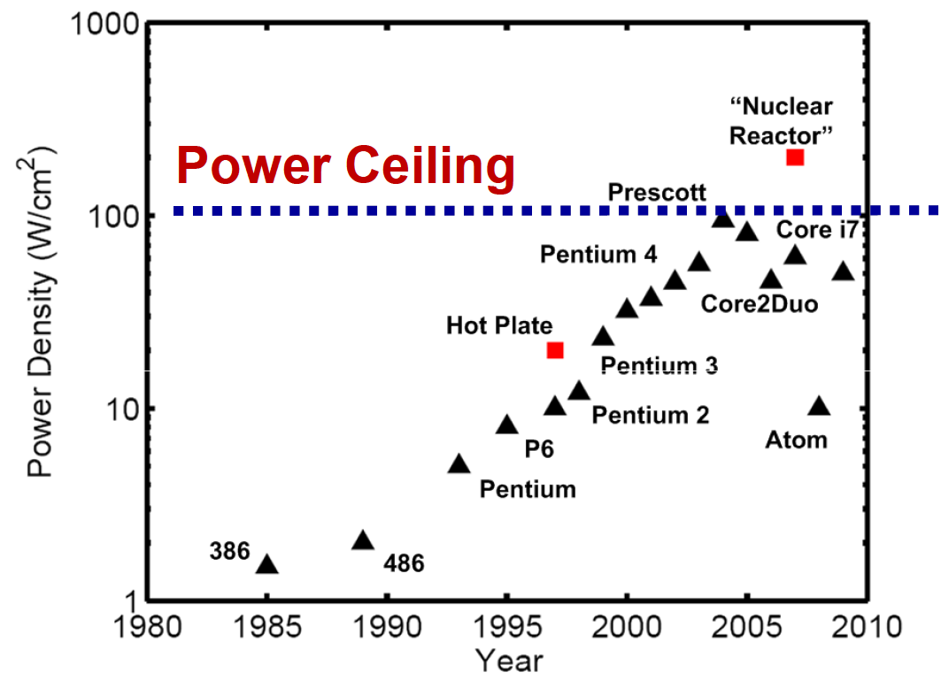
Power and Temperature
Temperature
Power density (Watts / sq-mm) is proxy for thermal effects
- Estimate thermal conductivity and resistance to understand processor hot spots (e.g., University of Virginia, HotSpot simulator)
Power Budgets
Higher power budgets increase packaging cost
130W servers, 65W desktops, 10-30W laptops, 1-2W hand-held

Slide 36
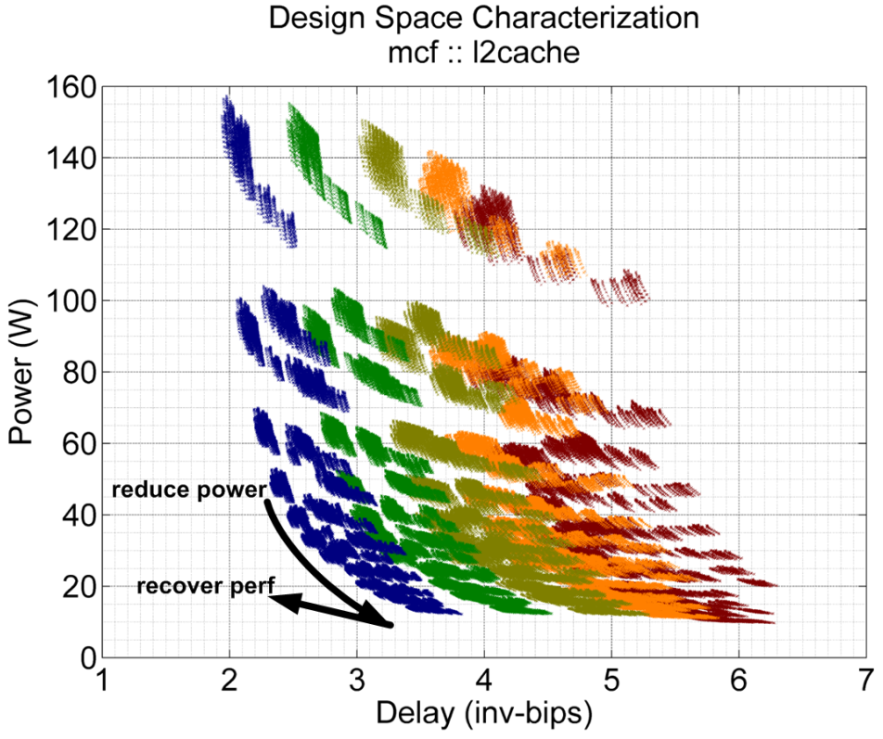
Power and Chip-Multiprocessors
Definitions
Historically, multiprocessors use multiple packages (e.g., IBM Power 3)
Chip multi-processor integrates multiple cores on the same die
Multiprocessor Efficiency
Reduce power with simpler cores
Recover lost performance with many core parallelism (e.g., IBM Power 4)

Slide 37
Power and Chip-Multiprocessors
Lower voltages, frequencies
Voltage, frequency scale together (approximately)
Power proportional to V², f (falls cubically)
Performance proportional to f (falls linearly)
Example
Baseline: 1-core at V, f
Multiprocessor: 4-cores at 0.85V, 0.85f; program is 75% parallel
1-Core Power 0.61x =0.85³
1-Core Performance 0.85x
- Power impact 2.44x = 0.61x 4
- Performance adjusted for parallelism 2.28x = 1/[0.25 + (0.75 / 4)]
Performance adjusted for freq slowdown 1.94x = 2.28 x 0.85
Multiprocessor: 1.5% power per 1% performance (=144%/94%)
Higher V, f: 3% power per 1% performance (=(1.01³-1)/(1.01-1))

Slide 38
Cost
Non-recurring Engineering (NRE)
- Dominated by engineer-years ($200K per engineer-year)
- Mask costs (>$1M per spin)
Chip Cost
- Depends on wafer and chip size, process maturity
Packaging Cost
- Depends on number of pins (e.g., signal + power/ground)
    Depends on thermal design point (e.g., heat sink)
Total Cost of Ownership
- Capital costs (e.g., server procurement cost)
    Operating costs (e.g., electricity)

Slide 39
Yield
Wafers
- Integrated circuits built with multi-step chemical process on wafers
- Cost per wafer depends on wafer size, number of steps
Chip (a.k.a. Die)
- If chips are large, fewer chips per wafer
- Larger chips have lower yield
    Uniform defect density
    Chip cost is proportional to area²⁻³
Process Variability
- Yield is non-binary
    Binning for speed grades
    Binning for core count
    Post-fabrication tuning with spares

Slide 40
Acknowledgements
    These slides contain material developed and copyright by
    Arvind (MIT)
    Krste Asanovic (MIT/UCB)
    Joel Emer (Intel/MIT)
    James Hoe (CMU)
    John Kubiatowicz (UCB)
    Alvin Lebeck (Duke)
    David Patterson (UCB)
    Daniel Sorin (Duke)

