Slide 1
ECE 552 / CPS 550
Advanced Computer Architecture I
Lecture 7
Pipelining – Part 2
Benjamin Lee
Electrical and Computer Engineering
Duke University
www.duke.edu/~bcl15
www.duke.edu/~bcl15/class/class_ece252fall12.html

Slide 2

ECE252 Administrivia
27 September – Homework #2 Due
  Use blackboard forum for questions
  Attend office hours with questions
  Email for separate meetings
2 October – Class Discussion
Roughly one reading per class. Do not wait until the day before!
  Srinivasan et al. “Optimizing pipelines for power and performance”
  Mahlke et al. “A comparison of full and partial predicated execution support for ILP processors”
  Palacharla et al. “Complexity-effective superscalar processors”
  Yeh et al. “Two-level adaptive training branch prediction”

Slide 3
Data Hazards and Scheduling
Try producing faster code for
  A = B + C; D = E – F;
  Assume A, B, C, D, E, and F are in memory
  Assume pipelined processor
Slow Code
LW Rb, b
LW Rc, c
ADD Ra, Rb, Rc
SW a, Ra
LW Re e
LW Rf, f
SUB Rd, Re, Rf
SW d, RD
Fast Code
LW Rb, b
LW Rc, c
LW Re, e
ADD Ra, Rb, Rc
LW Rf, f
SW a, Ra
SUB Rd, Re, Rf
SW d, RD

Slide 4
Compiler Scheduling
Reduce stalls by moving instructions
  Basic pipeline scheduling eliminates back-to-back load-use pairs
  What are the limitations of scheduling?
Scheduling Scope
  Requires an independent instruction to place between load-use pairs
  Little scope for scheduling, 1-add, 3-ld/st
Slow Code Fast Code
ld r2, 4(sp) ld r2, 4(sp)
ld r3, 8(sp) ld r3, 8(sp)
add r3, r2, r1 add r3, r2, r1
st r1, 0(sp) st r1, 0(sp)

Slide 5
Compiler Scheduling
Number of registers
  Registers hold “live” values
  Example code contains 7 different values, including sp
  Before: max 3 values live → 3 registers sufficient
  After: max 4 values live → 3 registers insufficient
  Original code re-uses r1 and r2, re-scheduling causes WAR violations
Before After
ld r2, 4 (sp) ld r2, 4 (sp)
ld r1, 8 (sp) ld r1, 8 (sp)
add r1, r2, r1 #stall ld r2, 16 (sp)
st r1, 0 (sp) add r1, r2, r1 #WAR
ld r2, 16 (sp) ld r1, 20 (sp)
ld r1, 20 (sp) st r1, 0 (sp) #WAR
sub r2, r1, r1 #stall sub r2, r1, r1
st r1, 12 (sp) st r1, 12 (sp)

Slide 6
Compiler Scheduling
Alias Analysis
  Determine whether load/stores reference same memory locations
  Determines if loads/stores can be re-ordered
  Previous Examples: easy, all loads/stores use the same base register (sp)
  New Example: Can compiler tell that r8 == sp?
Before After
ld r2, 4 (sp) ld r2, 4 (sp)
ld r3, 8 (sp) ld r3, 8 (sp)
add r3, r2, r1 #stall ld r5, 0 (r8)
st r1, 0 (sp) add r3, r2, r1
ld r5, 0 (r8) ld r6, 4 (r8)
ld r6, 4 (r8) st r1, 0 (sp)
sub r5, r6, r4 #stall sub r5, r6, r4
st r4, 8 (r8) st r4, 8 (r8)

Slide 7
Control Hazards
Arises when calculating next program counter (PC)
  Pipeline stalls if required values not yet available
Jumps
  Jump (immediate) requires opcode, offset, current PC
  Jump (register) requires opcode, register value
Conditional Branches
  Requires opcode, current PC, register (for condition), offset
Sequential Successor Instructions
  Requires opcode, current PC

Slide 8
Program Counter Calculations
Identify change in control flow during decode
Determine whether I₁ changes control flow before fetching I₂? No.
      Time
      t0 t1 t2 t3 t4 t5 t6 t7 . . . .
(I₁) r1 ←(r0) + 10 IF₁ ID₁ EX₁ MA₁ WB₁
(I₂) r3 ←(r2) + 17 IF₂ IF₂ ID₂ EX₂ MA₂ WB₂
(I₃) IF₃ IF₃ ID₃ EX₃ MA₃ WB₃
(I₄) IF₄ IF₄ ID₄ EX₄ MA₄ WB₄
Resource Usage
  time
  t0 t1 t2 t3 t4 t5 t6 t7 . . . .
IF I₁ nop I₂ nop I₃ nop I₄
ID I₁ nop I₂ nop I₃ nop I₄
EX I₁ nop I₂ nop I₃ nop I₄
MA I₁ nop I₂ nop I₃ nop I₄
WB I₁ nop I₂ nop I₃ nop I₄

Slide 9
Speculate PC ← PC + 4
PCSrc (pc+4 / jabs / rind/ br)
stall
Add
E
M
0x4
nop
IR
Add
IR
Jump?
I₁
PC
addr
inst
IR
104
Inst
Memory
I₂
addr instr
I₁ 096 ADD
I₂ 100 J 304
I₃ 104 ADD
I₄ 304 ADD
A jump instruction kills (not stalls)
the following instruction. How?
kill

Slide 10
Pipelining Jumps
PCSrc (pc+4 / jabs / rind/ br)
stall
Add
E
M
0x4
nop
IR
Add
IR
Jump?
I₂
I₁
I₁
IRSrc_{D}
PC
addr
nop
inst
IR
304
Inst
Memory
104
nop
I₂
To kill a fetched instruction, add mux before IR to insert “nops”
case(opcodeD)
J, JAL: IR ← nop
otherwise: IR ← inst
addr instr
I₁ 096 ADD
I₂ 100 J 304
I₃ 104 ADD
I₄ 304 ADD
kill

Slide 11
Pipelining Jumps
      time
      t0 t1 t2 t3 t4 t5 t6 t7 . . . .
(I₁) 096: ADD IF₁ ID₁ EX₁ MA₁ WB₁
(I₂) 100: J 304 IF₂ ID₂ EX₂ MA₂ WB₂
(I₃) 104: ADD IF₃ nop nop nop nop
(I₄) 304: ADD IF₄ ID₄ EX₄ MA₄ WB₄
  time
  t0 t1 t2 t3 t4 t5 t6 t7 . . . .
IF I₁ I₂ I₃ I₄ I₅
ID I₁ I₂ nop I₄ I₅
EX I₁ I₂ nop I₄ I₅
MA I₁ I₂ nop I₄ I₅
WB I₁ I₂ nop I₄ I₅
Resource
Usage

Slide 12
Pipelining Conditional Branches
PCSrc (pc+4 / jabs / rind / br)
stall
Add
E
M
0x4
nop
IR
Add
IR
Jump?
I₁
zero?
IRSrc_{D}
PC
addr
nop
A
inst
IR
ALU
Y
104
Inst
Memory
I₂
addr instr
I₁ 096 ADD
I₂ 100 BEQZ r1 200
I₃ 104 ADD
I₄ 304 ADD
Branch condition computed in execute stage. What should be done in decode stage?

Slide 13
Pipelining Conditional Branches
PCSrc (pc+4/jabs/rind/br)
stall
Add
E
BEQZ?
M
IRSrc_{E}
0x4
nop
IR
Add
IR
Jump?
I₂
I₁
zero?
PC
IRSrc_{D}
A
PC
addr
nop
inst
IR
ALU
Y
108
Inst
Memory
I₃
addr instr
I₁ 096 ADD
I₂ 100 BEQZ r1 200
I₃ 104 ADD
I₄ 304 ADD
If branch is taken, kill two following instructions. And because instruction in decode stage is invalid, update stall signal.

Slide 14
Update Stall Signal
Stall ← <<original stall signal>>
& !( (opcodeE == BEQZ) & zero? # branch condition true
+ (opcodeE == BNEZ) & !zero? # branch condition true
)
Do not stall if branch is taken. Why?
Instruction in the decode stage is invalid.
Kill instruction instead.

Slide 15
Pipelining Conditional Branches
PCSrc (pc+4/jabs/rind/br)
stall
Add
E
BEQZ?
M
IRSrc_{E}
0x4
nop
IR
Add
IR
Jump?
I₂
I₁
zero?
PC
IRSrc_{D}
A
PC
addr
nop
inst
IR
ALU
Y
108
Inst
Memory
I₃
addr instr
I₁ 096 ADD
I₂ 100 BEQZ r1 200
I₃ 104 ADD
I₄ 304 ADD
If branch is taken, kill two following instructions. And because instruction in decode stage is invalid, update stall signal.

Slide 16
Derive PCSrc Signal
Derive mux control signal for PCSrc.
if( (opcodeE == BEQZ & z) + (opcodeE == BNEZ & !z) ), PCSrc ← br
else if ((opcodeD == J) + (opcodeD == JAL)), PCSrc ← jabs
else if ((opcodeD == JR) + (opcodeD == JALR)), PCSrc ← rind
otherwise, PCSrc ← PC + 4
Derive mux control signal for IRSrcD.
if( (opcodeE == BEQZ & z) + (opcodeE == BNEZ & !z) ), ICSrcD ← nop
else if( (opcodeD==J) + (opcodeD==JAL) +
(opcodeD==JAR) + (opcodeD==JALR) ), ICSrcD ← nop
otherwise, ICSrcD ← Instr
Derive mux control signal for IRSrcE.
if( (opcodeE == BEQZ & z) + (opcodeE == BNEZ & !z) ), ICSrcE ← nop
otherwise, IRSrcE ← (stall & nop) + (!stall & IRD)

Slide 17
Pipelining Conditional Branches
PCSrc (pc+4/jabs/rind/br)
stall
Add
E
BEQZ?
M
IRSrc_{E}
0x4
nop
IR
Add
IR
Jump?
I₂
I₁
zero?
PC
IRSrc_{D}
A
PC
addr
nop
inst
IR
ALU
Y
108
Inst
Memory
I₃
addr instr
I₁ 096 ADD
I₂ 100 BEQZ r1 200
I₃ 104 ADD
I₄ 304 ADD
If branch is taken, kill two following instructions. And because instruction in decode stage is invalid, update stall signal.

Slide 18
Derive IRSrcD Signal
Derive mux control signal for PCSrc.
if( (opcodeE == BEQZ & z) + (opcodeE == BNEZ & !z) ), PCSrc ← br
else if ((opcodeD == J) + (opcodeD == JAL)), PCSrc ← jabs
else if ((opcodeD == JR) + (opcodeD == JALR)), PCSrc ← rind
otherwise, PCSrc ← PC + 4
Derive mux control signal for IRSrcD.
if( (opcodeE == BEQZ & z) + (opcodeE == BNEZ & !z) ), ICSrcD ← nop
else if( (opcodeD==J) + (opcodeD==JAL) +
(opcodeD==JAR) + (opcodeD==JALR) ), ICSrcD ← nop
otherwise, ICSrcD ← Instr
Derive mux control signal for IRSrcE.
if( (opcodeE == BEQZ & z) + (opcodeE == BNEZ & !z) ), ICSrcE ← nop
otherwise, IRSrcE ← (stall & nop) + (!stall & IRD)

Slide 19
Pipelining Conditional Branches
PCSrc (pc+4/jabs/rind/br)
stall
Add
E
BEQZ?
M
IRSrc_{E}
0x4
nop
IR
Add
IR
Jump?
I₂
I₁
zero?
PC
IRSrc_{D}
A
PC
addr
nop
inst
IR
ALU
Y
108
Inst
Memory
I₃
addr instr
I₁ 096 ADD
I₂ 100 BEQZ r1 200
I₃ 104 ADD
I₄ 304 ADD
If branch is taken, kill two following instructions. And because instruction in decode stage is invalid, update stall signal.

Slide 20
Derive IRSrcE Signal
Derive mux control signal for PCSrc.
if( (opcodeE == BEQZ & z) + (opcodeE == BNEZ & !z) ), PCSrc ← br
else if ((opcodeD == J) + (opcodeD == JAL)), PCSrc ← jabs
else if ((opcodeD == JR) + (opcodeD == JALR)), PCSrc ← rind
otherwise, PCSrc ← PC + 4
Derive mux control signal for IRSrcD.
if( (opcodeE == BEQZ & z) + (opcodeE == BNEZ & !z) ), IRSrcD ← nop
else if( (opcodeD==J) + (opcodeD==JAL) +
(opcodeD==JAR) + (opcodeD==JALR) ), IRSrcD ← nop
otherwise, IRSrcD ← Instr
Derive mux control signal for IRSrcE.
if( (opcodeE == BEQZ & z) + (opcodeE == BNEZ & !z) ), IRSrcE ← nop
otherwise, IRSrcE ← (stall & nop) + (!stall & IRD)

Slide 21
Pipelining Branches
      time
      t0 t1 t2 t3 t4 t5 t6 t7 . . . .
(I₁) 096: ADD IF₁ ID₁ EX₁ MA₁ WB₁
(I₂) 100: BEQZ 200 IF₂ ID₂ EX₂ MA₂ WB₂
(I₃) 104: ADD IF₃ ID₃ nop nop nop
(I₄) 108: IF₄ nop nop nop nop
(I₅) 304: ADD IF₅ ID₅ EX₅ MA₅ WB₅
  time
  t0 t1 t2 t3 t4 t5 t6 t7 . . . .
IF I₁ I₂ I₃ I₄ I₅
ID I₁ I₂ I₃ nop I₅
EX I₁ I₂ nop nop I₅
MA I₁ I₂ nop nop I₅
WB I₁ I₂ nop nop I₅
Resource
Usage

Slide 22
Resolving Branch Conditions
beq r1, r3, 36
Ifetch
Reg
ALU
DMem
Reg
and r2, r3, r5
Ifetch
Reg
ALU
DMem
Reg
or r6, r1, r7
Ifetch
Reg
ALU
DMem
Reg
add r8, r1, r9
Ifetch
Reg
ALU
DMem
Reg
xor r10,r1,r11
Ifetch
Reg
ALU
DMem
Reg
Three stage stall. What about the 3 instructions in between? Attempt to reduce.
Stall/Kill signals in decode stage, reduces stalls from 3 to 2 stages.

Slide 23
Solution 1: Resolve Earlier
Large performance impact
  Suppose CPI = 1, 30% branch
  If branch stalls for 2 cycles, new CPI is 1.6
Solution – Branch Computation
  Determine whether branch is taken or not earlier in pipeline (e.g,. beq)
  Compute target branch address earlier (e.g., PC addition)
Solution – MIPS
  MIPS branch tests if a register is equal to zero (e.g., beq)
  Move zero test to ID/RF stage
  Introduce adder to calculate new PC in ID/RF stage
  With early branch resolution and kill/stall signals in decode, branches stall for 1 cycle

Slide 24
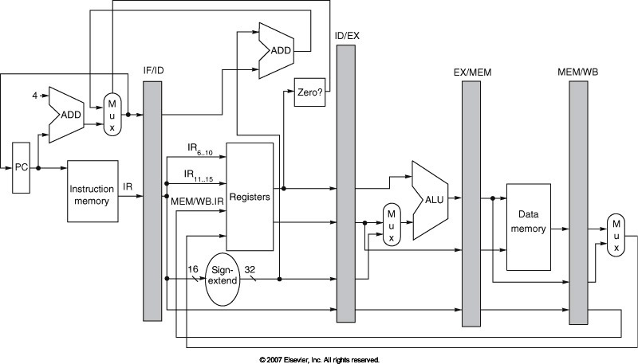
Pipelined MIPS Datapath
Add sufficient logic in decode stage to generate “zero?” signal
Branch is resolved in ID stage instead of EX stage, eliminating one stall cycle

Slide 25
Solution 2: Predict Condition
Stall until branch direction is clear
Predict Branch Not Taken
  Execute successor instructions in sequence
  “Squash” instructions in pipeline if branch taken
  Advantage: 47% of MIPS branches not taken
  Advantage: PC+4 already calculated for instruction fetch
Predict Branch Taken
  Advantage: 53% of MIPS branches taken
  Disadvantage: Target address not yet calculated, 1-cycle penalty
More sophisticated branch prediction later…

Slide 26
Solution 3: Change ISA Semantics
Delayed Branch
  Change ISA semantics: Instruction after jump/branch always executed.
  Define branch to take place after a following instruction
  Gives compiler flexibility to schedule useful instructions into a branch-induced stall
  Branch delay of length n
    Branch instruction
    Sequential successor 1
    Sequential successor 2
    …
    Sequential successor n
    Branch target if taken
  MIPS uses n=1 delay slot to calculate branch outcome, target address

Slide 27
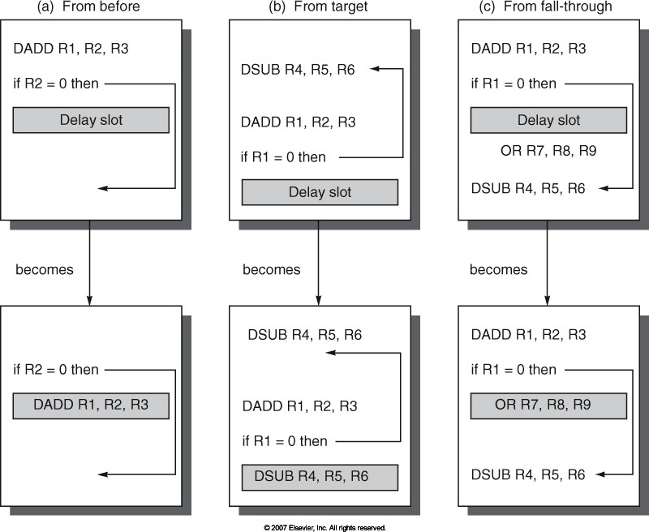
Scheduling Delay Slots
(a) Fills delay slot and reduces instruction count, (b) DSUB needs copying and increases instruction count, (c) OR executes if branch fails so issue speculatively

Slide 28
Delayed Branches
Compiler Effectiveness (n=1 branch delay slot)
  Fill about 60% of branch delay slots
  About 80% of instructions executed are useful computation
Disadvantages of Delayed Branches
  As pipelines deepen, branch delay grows and requires more slots
  Less popular than dynamic approaches (e.g., branch prediction)

Slide 29
Pipelining in Practice
Why is IPC < 1?
Full forwarding may be too expensive to implement
  Implement only frequently used forwarding paths
  Implementing infrequently used forwarding paths might impact length of pipeline stage, increase clock period, and reduce IPC forwarding gains
Multi-cycle Instructions (e.g., loads)
  Instruction following a multi-cycle instruction cannot use its results
  MIPS-I defined load-delay slots, a software-visible pipeline hazard.
  Rely on compiler to schedule useful instructions, nops
Conditional Branches
  Without delay slots, kill following instructions
  With delay slots, rely on compiler to schedule useful instructions, nops

Slide 30
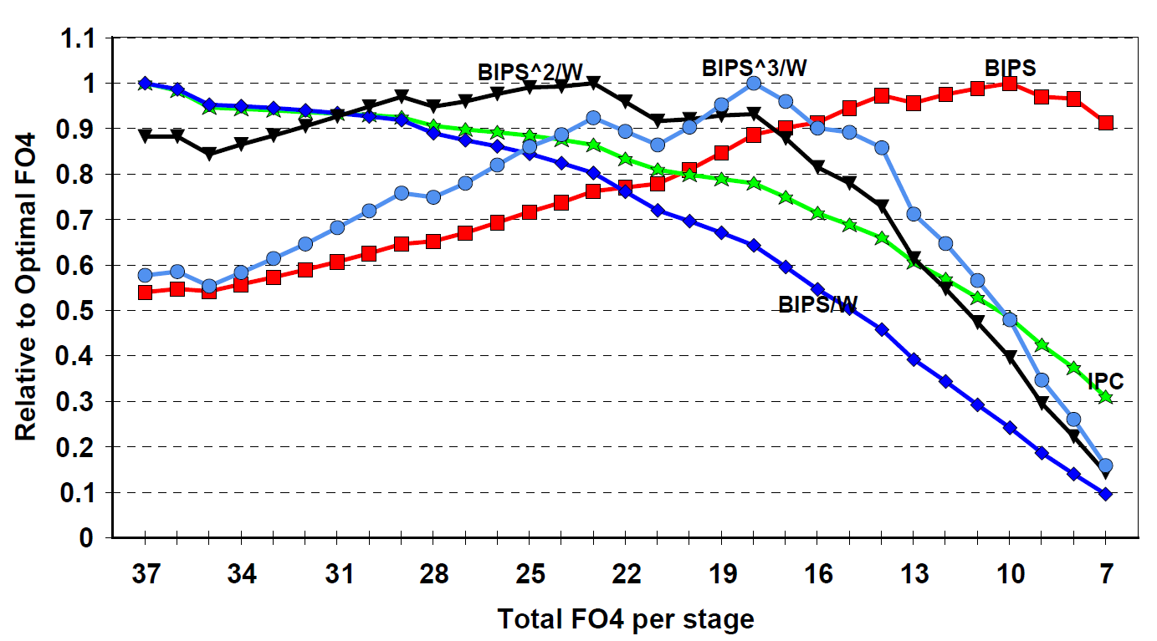
Optimal Pipeline Depth
  Srinivasan et al. “Optimizing pipelines for power and performance,” 2002.
  Performance (BIPS) versus Power (W)
  FO4 is measure of delay: Delay of inverter that is driven by inverter 4x smaller and that is driving inverter 4x larger.
  Quantify amount of logic per pipeline stage in FO4 delays
  (shorter delays → deeper pipelines)

Slide 31
Interrupts and Exceptions
Interrupts alter normal control flow
  Event that needs to be processed by another (system) program
  Event is considered unexpected or rare from program’s perspective
I_{i-1}
HI₁
interrupt
handler
program
I_{i}
HI₂
I_{i+1}
HI_{n}

Slide 32
Causes of Interrupts
Interrupt
  An event that requests the attention of the processor
Asynchronous Interrupt – External Event
  Input/output device service-request
  Timer expiration
  Power disruptions, hardware failure
Synchronous Interrupt – Internal Event
  Undefined opcode, privileged instruction
  Arithmetic overflow, FPU exception
  Misaligned memory access
  Virtual memory exceptions – page faults, TLB misses, protection violations
  Traps – system calls, jumps into kernel
  Also known as exceptions

Slide 33
Asynchronous Interrupts
Service Request
  An I/O device requests attention by asserting one of the prioritized interrupt request lines
Invoking Interrupt Handler
  Processor decides to process interrupt
  Stops current program at instruction j, completing all instructions up to j-1. Defines a precise interrupt.
  Saves PC of instruction j in a special register (e.g., EPC)
  Disables interrupts and transfers control to designated interrupt handler running in kernel mode.

Slide 34
Interrupt Handler
PC Processing
  Save EPC before re-enabling interrupts, thereby allowing nested interrupts
  Need an instruction to move EPC into general-purpose registers
  Need a way to mask further interrupts until EPC saved
Status Register
  Read status register to determine cause of interrupt
  Executes handler code
Exiting Interrupt Handler
  Use special indirect jump instruction RFE (return-from-exception)
  Enables interrupts
  Restores processor to user mode
  Restores hardware status and control state

Slide 35
Synchronous Interrupts
Exceptions
  A synchronous interrupt (exception) is caused by a particular instruction
Instruction Re-start
  Generally, instruction cannot be completed without handler
  Instruction needs re-start after exception has been handled
  Processor must undo the effect of partially executed instructions
System Calls
  If the interrupt arises from a system calls (traps), trapping instruction considered complete
  System calls require a special jump instruction and changing into privileged kernel mode

Slide 36
Pipelining and Interrupt Handling
PC
Inst. Mem
D
Decode
E
M
Data Mem
W
+
PC address Exception
Illegal Opcode
Data address Exceptions
Overflow
Asynchronous Interrupts
Synchronous: How does the processor handle multiple, simultaneous exceptions in different pipeline stages?
Asynchronous: How does the processor handle external interrupts?

Slide 37
Pipelining and Interrupt Handling
Commit Point
PC
Inst. Mem
D
Decode
E
M
Data Mem
W
+
Illegal Opcode
Overflow
Data address Exceptions
PC address Exception
Exc
D
Exc
E
Exc
M
Cause
PC
D
PC
E
PC
M
EPC
Select Handler PC
Asynchronous
Interrupts
Kill F Stage
Kill D Stage
Kill E Stage
Kill Writeback

Slide 38
Pipelining and Interrupt Handling
Propagate exception flags through pipeline until commit point
Internal Interrupts
  An instruction might generate multiple exception flags
  For a given instruction, exceptions in earlier pipe stages over-ride those in later pipe stages, thereby prioritizing exceptions earlier in time
Inject external interrupts at commit point
  External interrupts over-ride internal interrupts
Check exception flags at commit point
  If exception flagged, update cause and EPC register
  Kill instructions in all pipeline stages
  Inject handler PC into fetch stage

Slide 39
Speculating about Exceptions
Predict
  Exceptions are rare. Predicting that no exceptions occurred is accurate.
Check Prediction
  Exceptions detected at end of pipeline (commit point). Invoke special hardware for various exception types
Recovery Mechanism
  Architectural state modified at end of pipeline (commit point).
  Discard partially executed instructions after an exception
  Launch exception handler after flushing pipeline

Slide 40
Pipelining and Exceptions
      time
      t0 t1 t2 t3 t4 t5 t6 t7 . . . .
(I₁) 096: ADD IF₁ ID₁ EX₁ MA₁ nop overflow!
(I₂) 100: XOR IF₂ ID₂ EX₂ nop nop
(I₃) 104: SUB IF₃ ID₃ nop nop nop
(I₄) 108: ADD IF₄ nop nop nop nop
(I₅) Exc. Handler code IF₅ ID₅ EX₅ MA₅ WB₅
  time
  t0 t1 t2 t3 t4 t5 t6 t7 . . . .
IF I₁ I₂ I₃ I₄ I₅
ID I₁ I₂ I₃ nop I₅
EX I₁ I₂ nop nop I₅
MA I₁ nop nop nop I₅
WB nop nop nop nop I₅
Resource
Usage

Slide 41
Acknowledgements
    These slides contain material developed and copyright by
    Arvind (MIT)
    Krste Asanovic (MIT/UCB)
    Joel Emer (Intel/MIT)
    James Hoe (CMU)
    John Kubiatowicz (UCB)
    Alvin Lebeck (Duke)
    David Patterson (UCB)
    Daniel Sorin (Duke)

