Slide 1
ECE 552 / CPS 550
Advanced Computer Architecture I
Lecture 12
Memory – Part 1
Benjamin Lee
Electrical and Computer Engineering
Duke University
www.duke.edu/~bcl15
www.duke.edu/~bcl15/class/class_ece252fall12.html

Slide 2

ECE552 Administrivia
19 October – Homework #3 Due
19 October – Project Proposals Due
  One page proposal
  What question are you asking?
  How are you going to answer that question?
  Talk to me if you are looking for project ideas.
23 October – Class Discussion
Roughly one reading per class. Do not wait until the day before!
  Jouppi. “Improving direct-mapped cache performance by the addition of a small fully-associative cache and prefetch buffers.”
  Kim et al. “An adaptive, non-uniform cache structure for wire-delay dominated on-chip caches.”
  Fromm et al. “The energy efficiency of IRAM architectures”
  Lee et al. “Phase change memory architecture and the quest for scalability”

Slide 3
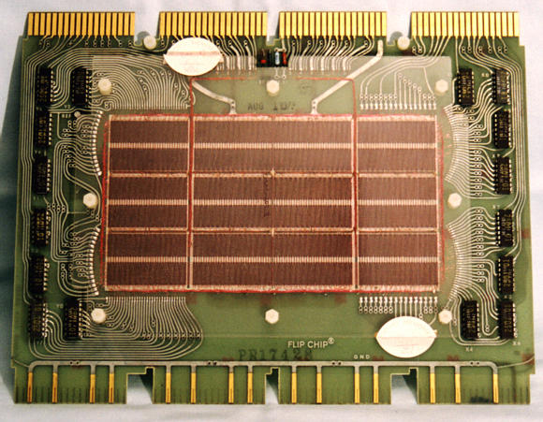
History of Memory
Core Memory
  Williams Tube in Manchester Mark I (1947) unreliable.
  Forrester invented core memory for MIT Whirlwind (1940-50s) in response
  First large-scale, reliable main memory
Magnetic Technology
  Core memory stores bits using magnetic polarity on ferrite cores
  Ferrite cores threaded onto 2D grid of wires
  Current pulses on X- and Y-axis could read and write cells
Performance
  Robust, non-volatile storage
  1 microsecond core access time
DEC PDP-8/E Board,
4K words x 12 bits, (1968)

Slide 4
Semiconductor Memory
Semiconductor Memory
  Static RAM (SRAM): cross-coupled inverters latch value
  Dynamic RAM (DRAM): charge stored on a capacitor
Advent of Semiconductor Memory
  Technology became competitive in early 1970s
  Intel founded to exploit market for semiconductor memory
Dynamic Random Access Memory (DRAM)
  Charge on a capacitor maps to logical value
  Intel 1103 was first commercial DRAM
  Semiconductor memory quickly replaced core memory in 1970’s

Slide 5
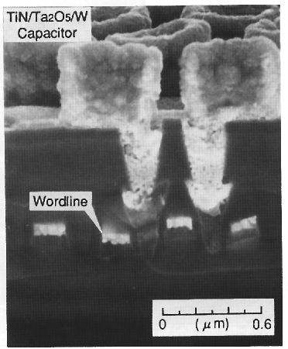
DRAM – Dennard 1968
1T DRAM Cell
access transistor
word
TiN top electrode (V_{REF})
Ta₂O₅ dielectric
V_{REF}
bit
Storage
capacitor (FET gate, trench, stack)
poly
word
line
W bottom
electrode
access transistor

Slide 6
DRAM Chip Architecture
-- Chip organized into 4-8 logical banks, which can be accessed in parallel
-- Each bank implements 2-D array of bits
Bank 1
bit lines
Col.
1
Col.
2^{M}
word lines
Row 1
N
Row Address Decoder
Row 2^{N}
Memory cell
(one bit)
N+M
M
Column Decoder & Sense Amplifiers
Data
D

Slide 7
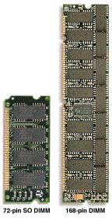
Packaging & Memory Channel
~7
Clock and control signals
DRAM chip
Address lines multiplexed row/column address
~12
Data bus
(x4, x8, x16, x32)
DIMM (Dual Inline Memory Module): Multiple chips sharing the same clock, control, and address signals.
Data pins collectively supply wide data bus. For example, four x16 chips supply 64b data bus.

Slide 8
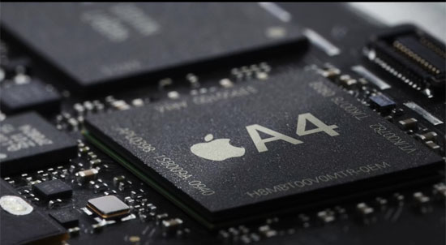
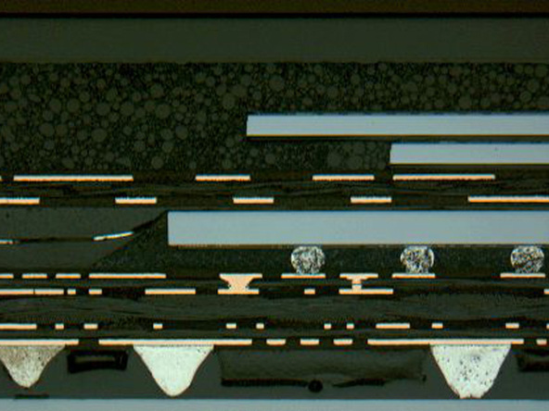
Packaging & 3D Stacking
[ Apple A4 package on circuit board ]
Two stacked DRAM die
Processor plus logic die
[ Apple A4 package cross-section, iFixit 2010 ]

Slide 9
DRAM Operation
Activate (ACT)
- Decode row address (RAS). Enable the addressed row (e.g., 4Kb)
- Bitline and capacitor share charge
- Sense amplifiers detect small change in voltage.
- Latch row contents (a.k.a. row buffer)
2. Read or Write
- Decode column address (CAS). Select subset of row (e.g., 16b)
- If read, send latched bits to chip pins
- If write, modify latched bits and charge capacitor
- Can perform multiple CAS on same row without RAS (i.e., buffer hit)
3. Precharge
- Charge bit lines to buffer to prepare for next row access

Slide 10
DRAM Chip Architecture
-- Activate: Latch row in sense amplifiers
-- Read/Write: Access specific columns in the row.
-- Precharge: Prepare for next row
Bank 1
bit lines
Col.
1
Col.
2^{M}
word lines
Row 1
N
Row Address Decoder
Row 2^{N}
Memory cell
(one bit)
N+M
M
Column Decoder & Sense Amplifiers
Data
D

Slide 11
DRAM Controller
1. Interfaces to Processor Datapath
- Processor issues a load/store instruction
- Memory address maps to particular chips, rows, columns
2. Implements Control Protocol
- (1) Activate a row, (2) Read/write the row, (3) Precharge
- Enforces timing parameters between commands
- Latency of each step is approximately 15-20ns
- Various DRAM standards (DDR, RDRAM) have different signals

Slide 12
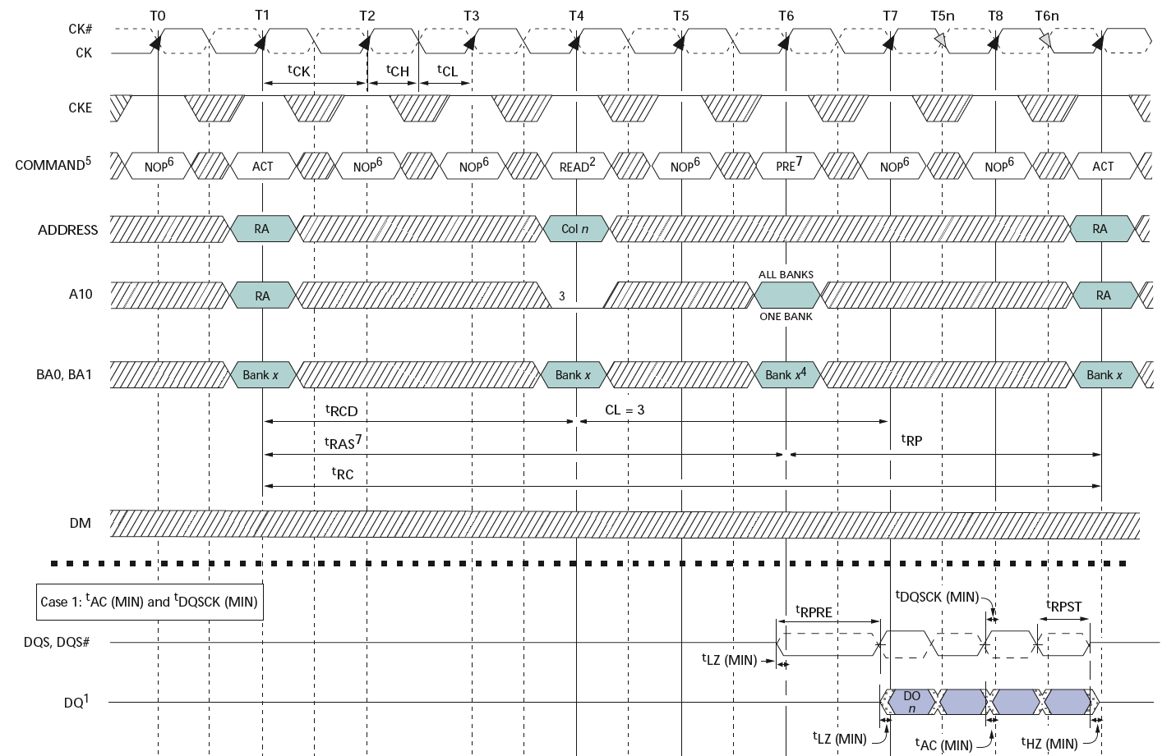
Double Data Rate (DDR*) DRAM
200MHz Clock
Row
Column
Precharge
Row’
Data
400Mb/s Data Rate
[ Micron, 256Mb DDR2 SDRAM datasheet ]

Slide 13
Processor-Memory Bottleneck
Memory is usually a performance bottleneck
- Processor limited by memory bandwidth and latency
Latency (time for single transfer)
- Memory access time >> Processor cycle time
- Example: 60ns latency translates into 60 cycles for 1GHz processor
Bandwidth (number of transfers per unit time)
- Every instruction is fetched from memory
- Suppose M is fraction of loads/stores in a program
- On average,1+M memory references per instruction
- For CPI = 1, system must supply 1+M memory transfers per cycle.

Slide 14
Processor-Memory Latency
µProc 60%/year
1000
CPU
Processor-Memory
Performance Gap:
(growing 50%/yr)
100
Performance
10
DRAM
7%/year
DRAM
1
1986
1988
1987
1989
1990
1991
1992
1993
1994
1995
1980
1996
1981
1982
1983
1984
1985
1997
1998
1999
2000
Time
Consider processor. Four-way superscalar. 3GHz clock. In 100ns required to access DRAM once, processor could execute 1,200 instructions

Slide 15
Distance Increases Latency
CPU
Big Memory
CPU
Small Memory

Slide 16
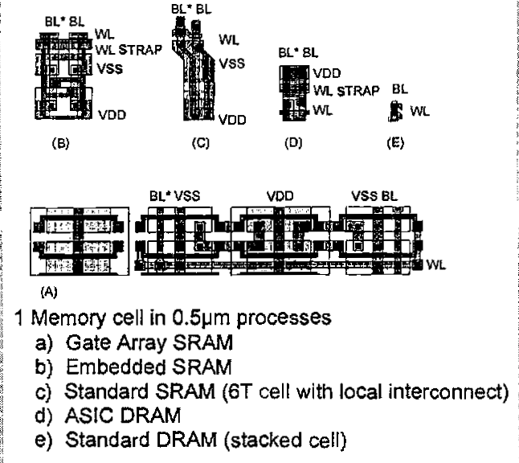
Memory Cell Size
On-Chip SRAM in logic chip
DRAM on memory chip
Off-chip DRAM has higher density than on-chip SRAM.
[ Foss, “Implementing Application-Specific Memory”, ISSCC 1996 ]

Slide 17
Memory Hierarchy
Big, Slow Memory
(DRAM)
A
Small,
Fast Memory
(RF, SRAM)
B
CPU
holds frequently used data
Capacity Register (RF) << SRAM << DRAM
Latency Register (RF) << SRAM << DRAM
Bandwidth on-chip >> off-chip
Consider a data access.
If data is located in fast memory, latency is low (e.g., SRAM).
If data is not located in fast memory, latency is high (e.g., DRAM).

Slide 18
Memory Hierarchy Management
Small & Fast (Registers)
- Instruction specifies address (e.g., R5)
- Implemented directly as register file
- Hardware might dynamically manage register usage
- Examples: stack management, register renaming
Large & Slow (SRAM and DRAM)
- Address usually computed from values in registers (e.g., ld R1, x(R2))
- Implemented directly as hardware-managed cache hierarchy
- Hardware decides what data is kept in faster memory
- Software may provide hints

Slide 19
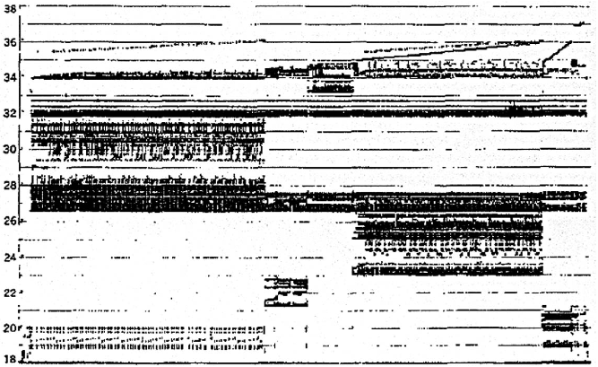
Real Memory Reference Patterns
Memory Address (one dot per access)
Donald J. Hatfield, Jeanette Gerald: Program Restructuring for Virtual Memory. IBM Systems Journal 10(3): 168-192 (1971)
Time

Slide 20
Predictable Patterns
Temporal Locality
If a location is referenced once,
the same location is likely to referenced again in the near future.
Spatial Locality
If a location is referenced once,
nearby locations are likely to be referenced in the near future.

Slide 21
Real Memory Reference Patterns
Temporal
Locality
Memory Address (one dot per access)
Spatial
Locality
Donald J. Hatfield, Jeanette Gerald: Program Restructuring for Virtual Memory. IBM Systems Journal 10(3): 168-192 (1971)
Time

Slide 22
Caches
Caches exploit predictable patterns
Temporal Locality
Caches remember the contents of recently accessed locations
Spatial Locality
Caches fetch blocks of data nearby recently accessed locations

Slide 23
Caches
Address
Address
Processor
Cache
Main
Memory
Data
Data
copy of main
memory
location 100
copy of main
memory
location 101
100
Data
Byte
Data
Byte
Line
304
Data
Byte
Address
Tag
6848
416
Data Block

Slide 24
Cache Controller
Controller examines address from datapath and searches cache for matching tags.
Cache Hit – address found in cache
- Return copy of data from cache
Cache Miss – address not found in cache
- Read block of data from main memory.
- Wait for main memory
- Return data to processor and update cache
- What is the update policy?

Slide 25
Data Placement Policy
Fully Associative
- Update – place data in any cache line (a.k.a. block)
- Access – search entire cache for matching tag
Set Associative
    - Update – place data within set of lines determined by address
    - Access – identify set from address, search set for matching tag
Direct Mapped
    - Update – place data in specific line determined by address
    - Access – identify line from address, check for matching tag

Slide 26
Placement Policy
Line Number
1 1 1 1 1 1 1 1 1 1 0 1 2 3 4 5 6 7 8 9
2 2 2 2 2 2 2 2 2 2 0 1 2 3 4 5 6 7 8 9
3 3
0 1
0 1 2 3 4 5 6 7 8 9
Memory
Set Number
0 1 2 3
0 1 2 3 4 5 6 7
Cache
Fully (2-way) Set Direct
Associative Associative Mapped
anywhere anywhere in only into
set 0 block 4
(12 mod 4) (12 mod 8)
Line 12
can be placed

Slide 27
Direct-Mapped Cache
Tag
Index
Line
Offset
t
k
b
V
Tag
Data Line
2^{k}
lines
t
=
HIT
Data Word or Byte

Slide 28
Fully Associative Cache
V
Tag
Data Line
t
=
Tag
t
=
HIT
Line
Offset
Data
Word
or Byte
=
b

Slide 29
Update/Replacement Policy
In an associative cache, which cache line in a set should be evicted when the set becomes full?
Random
Least Recently Used (LRU)
- LRU cache state must be updated on every access
- True implementation only feasible for small sets (e.g., 2-way)
- Approximation algorithms exist for larger sets
First-In, First-Out (FIFO)
- Used in highly associative caches
Not Most Recently Used (NMRU)
- Implements FIFO with an exception for most recently used blocks

Slide 30
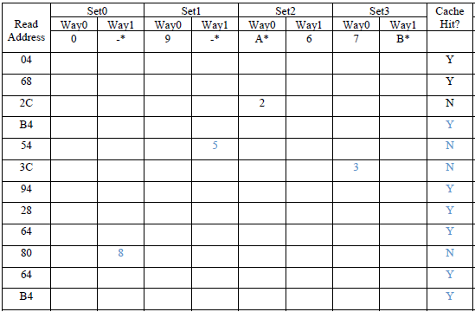
Cache Example
Given memory accesses (read address), complete table for cache.
Cache is two-way set associative with four lines (a.k.a. sets)
Each entry contains the {tag, index} for that line.

Slide 31
Line Size and Spatial Locality
Line is unit of transfer between the cache and memory
Tag
Word0
Word1
Word2
Word3
4 word line, b=2
Split CPU
address
Line address offset_{b}
32-b bits
b bits
2^{b} = line size a.k.a block size (in bytes)
Larger line size has distinct hardware advantages
-- less tag overhead
-- exploit fast burst transfers from DRAM
-- exploit fast burst transfers over wide bus
What are the disadvantages of increasing block size?
  -- fewer lines, more line conflicts
  -- can waste bandwidth depending on application’s spatial locality

Slide 32
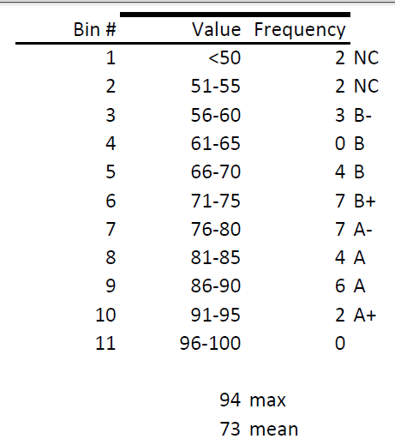
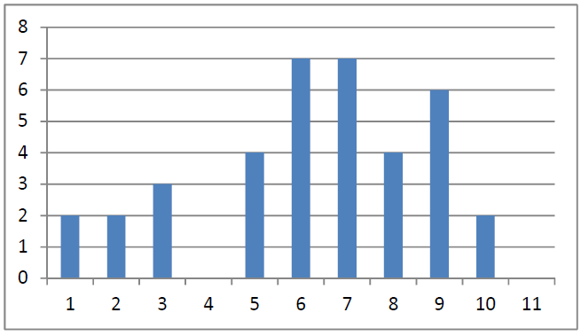
Midterm

Slide 33
Acknowledgements
    These slides contain material developed and copyright by
    Arvind (MIT)
    Krste Asanovic (MIT/UCB)
    Joel Emer (Intel/MIT)
    James Hoe (CMU)
    John Kubiatowicz (UCB)
    Alvin Lebeck (Duke)
    David Patterson (UCB)
    Daniel Sorin (Duke)

