Slide 1
ECE 552 / CPS 550
Advanced Computer Architecture I
Lecture 14
Virtual Memory
Benjamin Lee
Electrical and Computer Engineering
Duke University
www.duke.edu/~bcl15
www.duke.edu/~bcl15/class/class_ece252fall12.html

Slide 2

ECE552 Administrivia
19 October – Homework #3 Due
19 October – Project Proposals Due
  One page proposal
  What question are you asking?
  How are you going to answer that question?
  Talk to me if you are looking for project ideas.
23 October – Class Discussion
Roughly one reading per class. Do not wait until the day before!
  Jouppi. “Improving direct-mapped cache performance by the addition of a small fully-associative cache and prefetch buffers.”
  Kim et al. “An adaptive, non-uniform cache structure for wire-delay dominated on-chip caches.”
  Fromm et al. “The energy efficiency of IRAM architectures”
  Lee et al. “Phase change memory architecture and the quest for scalability”

Slide 3
Last Time
Caches
  Quantify cache/memory hierarchy with AMAT
  Three types of cache misses: (1) compulsory, (2) capacity, (3) conflict
  Cache structure and data placement policies determine miss rates
  Write buffers improve performance
Prefetching
  Identify and exploit spatial locality
  Prefetchers can be implemented in hardware, software, both
Caches and Code
  Restructuring SW code can improve HW cache performance
  Data re-use can improve with code structure (e.g., matrix multiply)

Slide 4
Physical Addresses
Physical addresses determined when program is loaded into memory.
But programmers do not think about memory addresses when writing sub-routines…
  Location Independence – How do we write programs without knowing physical addresses
  For code, addresses determined by Loader/Linker
  (1) loads sub-routines into memory, determines physical addresses,
  (2) links multiple sub-routines,
  (3) resolves physical addresses so jumps to sub-routines go to correct memory locations

Slide 5
Machine with Physical Addresses
PC
Physical Address
Inst. Cache
D
Decode
E
M
Physical Address
Data Cache
W
+
Memory Controller
Physical Address
Physical Address
Physical Address
Main Memory (DRAM)
With unrestricted access to a machine, program uses physical addresses.

Slide 6
Translated Addresses
Motivation
In early machines, I/O is slow and requires processor support
Slow I/O: Mitigate by over-lapping I/O from different programs
Processor Support: Mitigate with DMAs
Direct Memory Accesses (DMAs)
Processor invokes DMA controller to perform I/O
Processor does other operations during transfer
Processor interrupted by DMA controller when transfer complete
Multi-programming Support
  Overlapped I/O and DMAs require multi-programming support
  Supervisor schedules programs, manage context switches
  Address translation provides location-independent programs.
  Address translation provides isolated memory spaces.
prog1
Physical Memory
prog2
OS

Slide 7
Virtual and Physical Memory
Physical Memory
Virtual Memory
Programs are allocated physical memory at physical addresses.
Program operates in virtual memory with virtual addresses.
We require address translation to map virtual addresses to physical addresses.
This lecture provides 4 increasingly sophisticated translation techniques

Slide 8
1 - Base & Bound
Segment Length
≤
Bounds
Violation?
Bound Register
Physical
Address
segment
Physical Memory
Virtual Address
+
Base Register
Base Physical Address
Virtual Memory
Program Address Space
Base register – Identifies start of program’s allocation in physical memory.
Bound register – Provides protection and isolation between programs
Base, Bound registers visible only when processor is running in “supervisor” mode

Slide 9
Machine with Virtual Addresses
Prog. Bound Register
Data Bound Register
Bounds Violation?
Bounds Violation?
≤
≤
Virtual
Address
Virtual
Address
PC
D
Decode
E
M
W
Inst. Cache
Data Cache
+
+
+
Physical Address
Physical Address
Program Base Register
Data Base Register
Physical Address
Physical Address
Memory Controller
Physical Address
Main Memory (DRAM)
Every memory access translates virtual addresses to physical addresses.
Efficient adder implementations are possible for (base+offset).

Slide 10
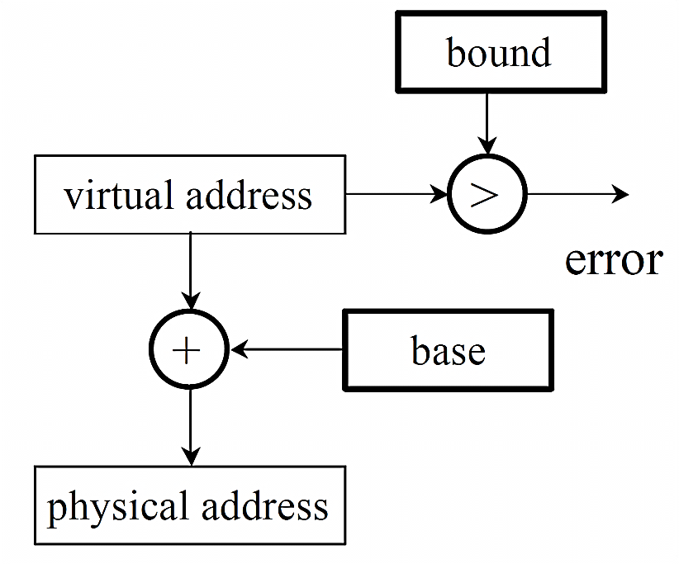
Base & Bounds Implementation
Hardware Cost
Two registers, adder, comparator
Fast logic
Context Switch
Switch between programs
Save/restore base, bound registers

Slide 11
2 - Segmentation
Motivation
  Base&Bounds assumes one contiguous memory segment per program.
  Segmentation separates address space into several segments.
  Each segment is contiguous but multiple segments may be required.
Idea
  Generalize Base&Bounds
  Implement a table of base-bound pairs
  (Base) (Bound)
  Virtual Segment # Physical Segment Base Segment Size
  Code (00) 0x4000 0x700
  Data (01) 0x0000 0x500
  - (10) 0 0
  Stack (11) 0x2000 0x1000

Slide 12
Data & Program Segments
Data Bound Register
≤
Bounds
Violation?
Logical Address
data
segment
Mem. Address Register
Data Base Register
+
Physical Address
Main Memory
Virtual Memory
Program Address
Space
Program Bound Register
≤
Bounds
Violation?
Logical Address
program
segment
Program Counter
Program Base Register
+
Physical Address
What is the advantage of this separation?

Slide 13
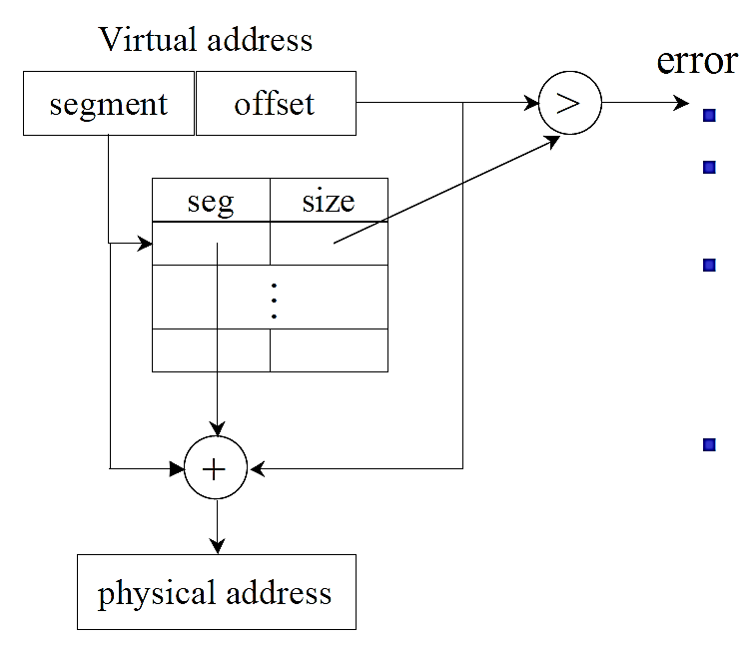
Segmentation Implementation
Virtual Address
Partition into segment and offset
Segment – Specifies segment number, which indexes table
Offset – Specifies offset within a segment
Segment Table
Segment – Provides segment base
Size – Provides segment bound
Translation
Compute physical address from segment base, offset, and bound

Slide 14
Fragmentation
free
OS
Space
user 1
16K
user 2
24K
24K
user 3
32K
24K
As programs enter and leave the system, physical memory is fragmented.
Fragmentation occurs because segments are variable size

Slide 15
Fragmentation
Users 4 & 5
arrive
free
OS
Space
OS
Space
user 1
16K
user 1
16K
user 2
24K
user 2
24K
user 4
16K
24K
8K
user 3
32K
user 3
32K
24K
user 5
24K
As programs enter and leave the system, physical memory is fragmented.
Fragmentation occurs because segments are variable size

Slide 16
Fragmentation
Users 4 & 5
arrive
Users 2 & 5
leave
free
OS
Space
OS
Space
OS
Space
user 1
16K
user 1
16K
user 1
16K
user 2
24K
user 2
24K
24K
user 4
16K
24K
user 4
16K
8K
8K
user 3
32K
user 3
32K
user 3
32K
24K
user 5
24K
24K
As programs enter and leave the system, physical memory is fragmented.
Fragmentation occurs because segments are variable size

Slide 17
Fragmentation
Users 4 & 5
arrive
Users 2 & 5
leave
free
OS
Space
OS
Space
OS
Space
user 1
16K
user 1
16K
user 1
16K
user 2
24K
user 2
24K
24K
user 4
16K
24K
user 4
16K
8K
8K
user 3
32K
user 3
32K
user 3
32K
24K
user 5
24K
24K
As programs enter and leave the system, physical memory is fragmented.
Fragmentation occurs because segments are variable size

Slide 18
3 - Paging
Motivation
  Branch&Bounds, Segmentation require fancy memory management
  Example: What mechanism coalesces free fragments?
Idea
  Constrain segmentation with fixed-size segments (e.g., pages)
  Paging simplifies memory management
  Example: free page management is a simple bitmap
  00111111100000011100
  Each bit represents a page of physical memory
  1 means allocated, 0 means free

Slide 19
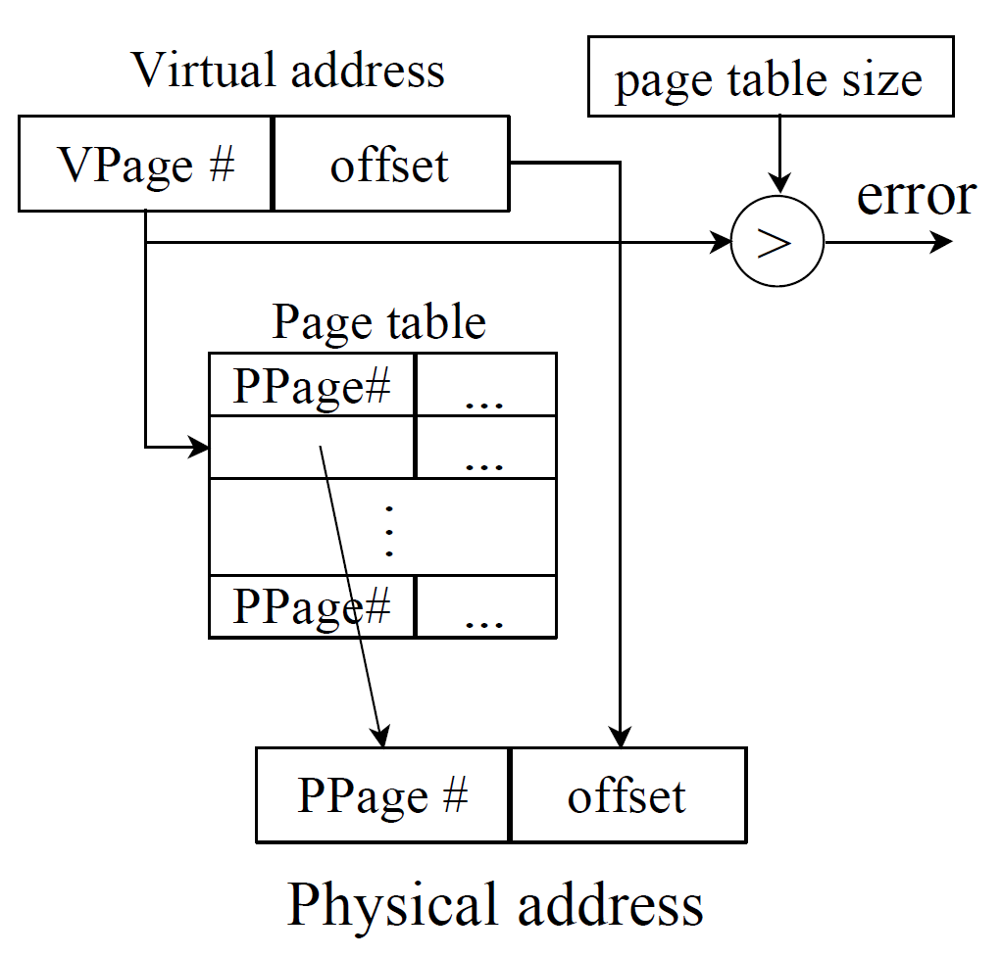
Paging Implementation
Virtual Address
Partition into page and offset
Page – Specifies virtual page number, which indexes table
Offset – Specifies offset within a page
Page Table
Page – Provides a physical page number
Size – Not required, pages equal size (e.g., 4KB)
Translation
Compute physical address from physical page number, offset

Slide 20
4 – Segmentation & Paging
Motivation
  Page tables can be very large.
  Assume 32-bit virtual addresses, 4KB page size
  4KB = 4096 bytes = 2¹² bytes per page => 12-bit offset
  Remaining address bits for page number => 20-bit page number
  Each page requires a page table entry
  With 20-bit page number, 2²⁰ pages addressed
  Each program in multi-programmed machine requires its own page table
  Total size of page tables = [# of programs] x 2²⁰ entries
Idea
  Page tables reside in memory
  Segmentation with paging and indirection to reduce page table size
  (Alternatively use indirect page tables, which hashes VPN to PPN)

Slide 21
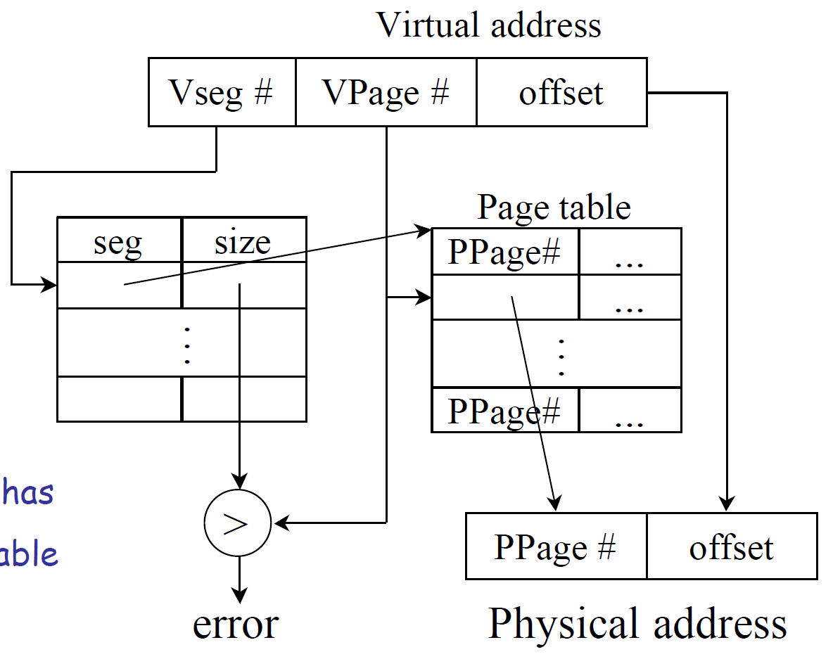
Segmented Page Tables
Virtual Address
Partition into segment, page, offset
Segment –Specifies segment#, which indexes Table 1
Page – Specifies virtual page # number, which indexes Table 2
Offset – Specifies offset in page
Table 1
Segment – Points to a page table
Size – Specifies number of pages in segment
Table 2
Page – Provides a physical page#
Translation
Compute physical address from physical page number, offset
What about paged page tables?

Slide 22
Address Translation & Protection
Virtual Address
Virtual Page No. (VPN)
offset
Kernel/User Mode
Read/Write
Protection
Check
Address
Translation
Exception?
Physical Address
Physical Page No. (PPN)
offset
  Every access to memory requires
  (1) address translation
  (2) protection check
  A good virtual memory system must be fast (e.g., 1 cycle), space efficient

Slide 23
Translation Lookaside Buffer (TLB)
Address Translation is Expensive
  In a two-level page table, reference requires several memory accesses
Solution
    Cache translations. We use a data structure called a TLB.
    TLB Hit – single cycle translation
    TLB Miss – walk page table to translate, update TLB
virtual address
VPN offset
tag PPN
(VPN = virtual page number)
(PPN = physical page number)
physical address
hit?
PPN offset

Slide 24
TLB Design
32-128 entries, fully associative
  Each entry maps a large page.
  Little spatial locality across 4KB pages so associative caches preferred.
  Larger TLBs (e.g., 256-512 entries) may be 4-8 way set-associative
  Even larger systems may have multi-level TLBs
Random or FIFO replacement policies
Definition – TLB Reach
    Size of largest virtual address space that can be simultaneously mapped
    64 entries, 4KB pages, 1 page per TLB entry
    TLB Reach = [64 entries] x [4KB] = 256KB (if pages contiguous in memory)

Slide 25
TLB Misses
Software (MIPS, Alpha)
  TLB miss causes an exception
  Operating system walks page table and reloads TLB
  Requires privileged processor mode. Why?
Hardware (SPARC v8, x86, PowerPC)
    Memory management unit (MMU) walks page table and reloads TLB
    If MMU encounters page fault (missing page), MMU causes an exception
    Operating system handles page fault, transferring page from disk to memory.

Slide 26
Machine with Virtual Memory
Page Fault?
Protection violation?
Page Fault?
Protection violation?
Virtual Address
Virtual Address
Physical Address
Physical Address
PC
Inst. TLB
D
Decode
E
M
Data TLB
W
Inst. Cache
Data Cache
+
Miss?
Miss?
Page-Table Base Register
Hardware Page Table Walker
Physical Address
Memory Controller
Physical Address
Physical Address
Main Memory (DRAM)

Slide 27
Address Translation Summary
virtual address
hardware
hardware or software
software
TLB
Lookup
miss
hit
Page Table
Walk
Protection
Check
page not
in mem
page
in mem
denied
permitted
page fault
(OS loads page)
update TLB
protection
fault
physical address
(use to access L1 cache)
exception
handler
seg fault

Slide 28
Summary
Virtual Memory
  Enables multi-programming
  Programs operate in virtual memory space
  Programs are protected from each other
Virtual to Physical Address Translation
  Base&Bound
  Segmentation
  Paging
  Multi-level Translation (segmented paging, paged paging)
Translation Lookaside Buffer
  Accelerates virtual memory, address translation

Slide 29
Acknowledgements
    These slides contain material developed and copyright by
    Arvind (MIT)
    Krste Asanovic (MIT/UCB)
    Joel Emer (Intel/MIT)
    James Hoe (CMU)
    Arvind Krishnamurthy (U. Washington)
    John Kubiatowicz (UCB)
    Alvin Lebeck (Duke)
    David Patterson (UCB)
    Daniel Sorin (Duke)

