Slide 1
ECE 552 / CPS 550 Advanced Computer Architecture I Lecture 16 Multi-threading
Benjamin Lee
Electrical and Computer Engineering
Duke University
www.duke.edu/~bcl15
www.duke.edu/~bcl15/class/class_ece252fall12.html

Slide 2
ECE552 Administrivia
13 November – Homework #4 Due
Project Status
Plan on having preliminary data or infrastructure
8 November – Class Discussion
Roughly one reading per class. Do not wait until the day before!
Mudge, “Power: A first-class architectural design constraint”
Lamport, “How to make a multiprocessor computer that correctly executes multiprocess programs”
Lenoski et al. “The Stanford DASH Multiprocessor”
Tullsen et al. “Simultaneous multithreading: Maximizing on-chip parallelism”

Slide 3
Last Time
Out-of-order Superscalar
Hardware complexity increases super-linearly with issue width
Very Long Instruction Word (VLIW)
Compiler explicitly schedules parallel instructions
Simple hardware, complex compiler
Later VLIWs added more dynamic interlocks
Compiler Analysis
Use loop unrolling and software pipelining for loops, trace scheduling for more irregular code
Static compiler scheduling is difficult in presence of unpredictable branches and variable memory latency

Slide 4
Multi-threading
Instruction-level Parallelism
Objective: Extract instruction-level parallelism (ILP)
Difficulty: Limited ILP from sequential thread of control
Multi-threaded Processor
Processor fetches instructions from multiple threads of control
If instructions from one thread stalls, issue instructions from other threads
Thread-level Parallelism
Thread-level parallelism (TLP) provides independent threads
Multi-programming – run multiple, independent, sequential jobs
Multi-threading – run single job faster using multiple, parallel threads

Slide 5
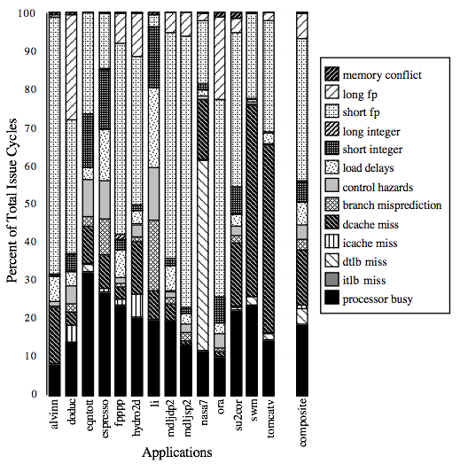
Increasing Pipeline Utilization
In an out-of-order superscalar processor, many apps cannot fully use execution units
Consider percentage of issue cycles in which processor is busy.
Tullsen, Eggers and Levy. “Simultaneous multi-threading,” ISCA 1995.

Slide 6
Superscalar (In)Efficiency
Issue width
Instruction issue
Completely idle cycle (vertical waste)
Time
Partially filled cycle, i.e., IPC < 4
(horizontal waste)

Slide 7
Pipeline Hazards
t0
t1
t2
t3
t4
t5
t6
t7
t8
t9
t10
t11
t12
t13
t14
LW r1, 0(r2)
LW r5, 12(r1)
ADDI r5, r5, #12
SW 12(r1), r5
F
D
X
M
W
F
D
D
D
D
X
M
W
F
F
F
F
D
D
D
D
X
M
W
F
F
F
F
D
D
D
D
Data Dependencies
Dependencies exist between instructions
Example: LW-LW (via r1), LW-ADDI (via r5), ADDI-SW (via r5)
Solutions
Interlocks stall the pipeline (slow)
Forwarding paths (requires hardware, limited applicability)

Slide 8
Vertical Multithreading
Issue width
Instruction issue
Second thread interleaved cycle-by-cycle
Time
Partially filled cycle, i.e., IPC < 4
(horizontal waste)
With cycle-by-cycle interleaving, remove vertical waste

Slide 9
Multithreading
t0
t1
t2
t3
t4
t5
t6
t7
t8
t9
T1: LW r1, 0(r2)
T2: ADD r7, r1, r4
T3: XORI r5, r4, #12
T4: SW 0(r7), r5
T1: LW r5, 12(r1)
F
D
X
M
W
F
D
X
M
W
F
D
X
M
W
F
D
X
M
W
F
D
X
M
W
Interleave instructions from multiple threads in pipeline
Example: Interleave threads (T1, T2, T3, T4) in 5-stage pipeline
For a given thread, earlier instruction writes-back (W) before later instruction reads register file (D).
Example: [T1: LW r1, 0(r2)] writes back before [T1: LW r5, 12(r1)] decodes

Slide 10
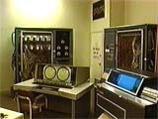
CDC 6600 Peripheral Processors
Cray (1964) built first multithreaded hardware architecture
Pipeline with100ns clock period
10 “virtual” I/O processors → provides thread-level parallelism
Each virtual processor executes one instruction every 1000ns (= 1ms)
Minimize processor state with accumulator-based instruction set

Slide 11
Simple Multithreaded Pipeline
X
PC
1
GPR1
PC
1
I$
IR
GPR1
PC
1
GPR1
PC
1
GPR1
D$
Y
+1
2
Thread select
2
Additional State: One copy of architected state per thread (e.g., PC, GPR)
Thread Select: Round-robin logic; Propagate thread ID down pipeline to access correct state (e.g., GPR1 versus GPR2)
Software (e.g., OS) perceives multiple, slower CPUs

Slide 12
Multithreading Costs
User State (per thread)
Program counters
Physical register files
System State (per thread)
Page table base register
Exception handling registers
Overheads and Contention
Threads contend for shared caches, TLB
Alternatively, threads require additional cache, TLB capacity
Scheduler (OS or HW) manages threads

Slide 13
Fine-Grain Multithreading
Switch threads at instruction-granularity
Fixed Interleave (CDC 6600 PPUs, 1964)
PPU – peripheral processing unit
Given N threads, each thread executes one instruction every N cycles
Insert pipeline bubble (e.g., NOP) if thread not ready for its slot
Software-controlled Interleave (TI ASC PPUs, 1971)
PPU – peripheral processing unit
OS explicitly controls thread interleaving
Example: blue thread scheduled 2x as often as orange, purple thread
Why was thread scheduling introduced for peripheral processing units first?

Slide 14
Coarse-Grain Multithreading
Switch threads on long-latency operation
Tera MTA designed for supercomputing applications with large data sets and little locality
Little locality → no data cache
Many parallel threads needed to hide long memory latency
If one thread accesses memory, schedule another thread in its place
Other applications may be more cache friendly
Good locality → data cache hits
Provide small number of threads to hide cache miss penalty
If one thread misses cache, schedule another thread in its place

Slide 15
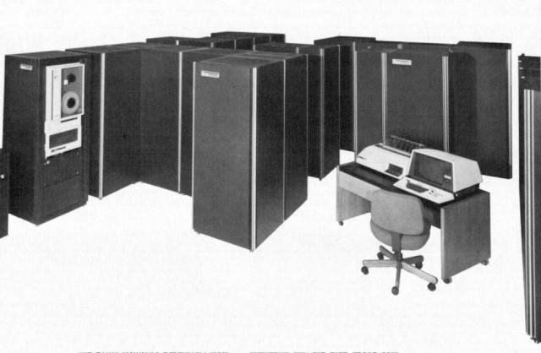
Denelcor HEP (1982)
First commercial hardware-threading for main CPU
Architected by Burton Smith
Multithreading previously used to hide long I/O, memory latencies in PPUs
Up to 8 processors, 10 MHz Clock
120 threads per processor
Precursor to Tera MTA

Slide 16
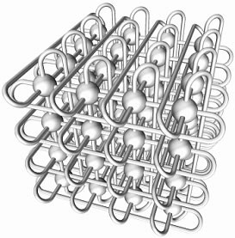
Tera MTA (1990)
Up to 256 processors
Up to 128 threads per processor
Processors and memories communicate via a 3D torus interconnect
Nodes linked to nearest 6 neighbors
Main memory is flat and shared
Flat memory → no data cache
Memory supports one memory access per cycle per processor
Why does this make sense for a multi-threaded machine?

Slide 17
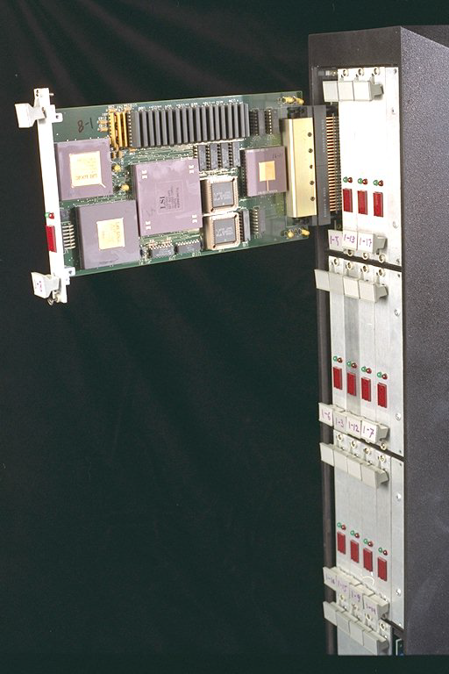
MIT Alewife (1990)
Anant Agarwal at MIT
SPARC
RISC instruction set architecture from Sun Microsystems
Alewife modifies SPARC processor
Multithreading
Up to 4 threads per processor
Threads switch on cache miss

Slide 18
Multithreading & “Simple” Cores
IBM PowerPC RS64-IV (2000)
RISC instruction set architecture from IBM
Implements in-order, quad-issue, 5-stage pipeline
Up to 2 threads per processor
Oracle/Sun Niagara Processors (2004-2009)
Targets datacenter web and database servers.
SPARC instruction set architecture from Sun
Implements simple, in-order core
Niagara-1 (2004) – 8 cores, 4 threads/core
Niagara-2 (2007) – 8 cores, 8 threads/core
Niagara-3 (2009) – 16 cores, 8 threads/core

Slide 19
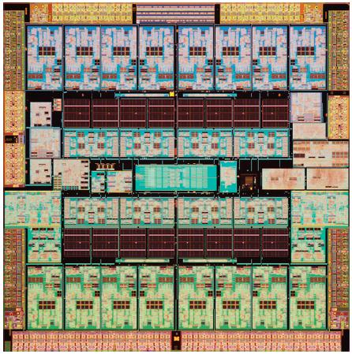
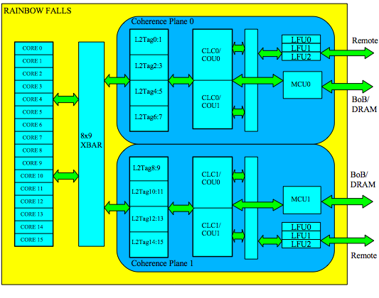
Oracle/Sun Niagara-3 (2009)

Slide 20
Why Simple Cores?
Switch threads on cache miss
If a thread accesses memory, flush pipeline switch to another thread
Simple Core Advantages
Minimize flush penalty with short pipeline (4 cycles in 5-stage pipeline)
Reduce energy cost per op (out-of-order execution consumes energy)
Simple Core Trade-off
Lower single-thread performance
Higher multi-thread performance and energy efficiency

Slide 21
Superscalar (In)Efficiency
Issue width
Instruction issue
Completely idle cycle (vertical waste)
Time
Partially filled cycle, i.e., IPC < 4
(horizontal waste)

Slide 22
Vertical Multithreading
Issue width
Instruction issue
Second thread interleaved cycle-by-cycle
Time
Partially filled cycle, i.e., IPC < 4
(horizontal waste)
Vertical multithreading reduces vertical waste with cycle-by-cycle interleaving.
However, horizontal waste remains.

Slide 23
Chip Multiprocessing (CMP)
Issue width
Completely idle cycle (vertical waste)
Time
Partially filled cycle, i.e., IPC < 4
(horizontal waste)
Chip multiprocessing reduces horizontal waste with simple (narrower) cores.
However, (1) vertical waste remains and (2) ILP is bounded.

Slide 24
Simultaneous Multithreading (SMT)
Issue width
Time
Interleave multi-threaded instructions with no restrictions.
Tullsen, Eggers, Levy. University of Washington, 1995.

Slide 25
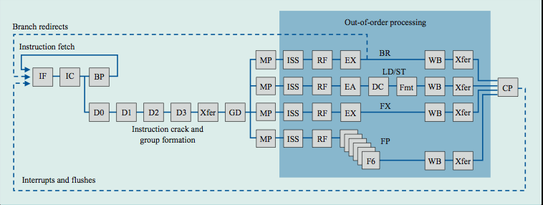
IBM Power4 → IBM Power5
Power4
- Single-threaded processor
- Out-of-order execution, superscalar (8 execution units)

Slide 26
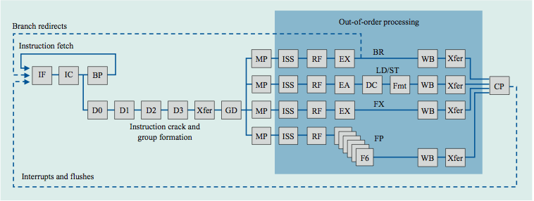
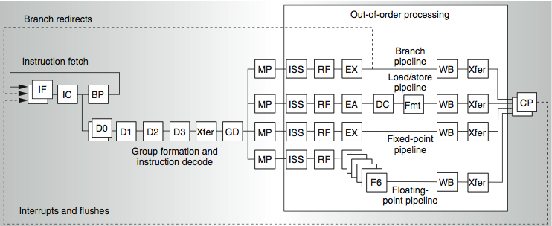
IBM Power4 → IBM Power5
Power4 – single-threaded processor, 8 execution units
Power5 – dual-threaded processor, 8 execution units

Slide 27
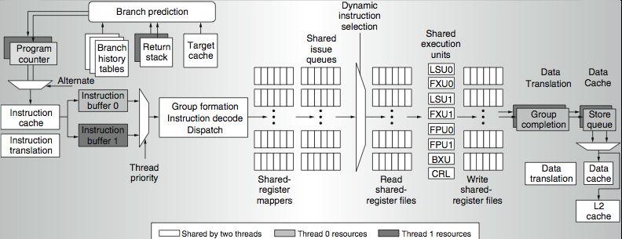
IBM Power5 Data Flow
Program Counter: duplicate and alternate fetch between two threads
Return Stack: duplicate since different threads call different sub-routines
Instruction Buffer: queue instructions separately
Decode: de-queue instructions depending on thread priority

Slide 28
IBM Power4 → IBM Power5
Support multiple instruction streams
- Increase L1 instruction cache associativity
- Increase instruction TLB associativity
- Mitigate cache contention from instruction streams
- Separate instruction prefetch and buffering per thread
- Allow thread prioritization
Support more instructions in-flight
- Increase the number of physical registers (e.g., 152 to 240)
- Mitigate register renaming bottleneck
Support larger cache footprints
- Increase L2 cache size (e.g., 1.44MB to 1.92MB)
- Increase L3 cache size
- Mitigate cache contention from data footprints
Power5 core is 24% larger than Power4 core

Slide 29
Instruction Scheduling
ICOUNT: Schedule thread with fewest instructions in flight
(1) prevents one thread from filling issue queue
(2) prioritizes threads that efficiently move instructions through datapath
(3) provides an even mix of threads, maximizing parallelism

Slide 30
SMT Performance
Intel Pentium4 Extreme SMT
- Single program
- 1.01x speedup for SPECint and 1.07x speedup for SPECfp
- Multiprogram (pairs of SPEC workloads)
- 0.9-1.6x for various pairs
IBM Power 5
- Single program
- 1.23x speedup for SPECint and 1.16x speedup for SPECfp
- Multiprogram (pairs of SPEC workloads)
- 0.89-1.41x for various pairs
Intuition
- SPECint has complex control flow, idles processor, benefits from SMT
- SPECfp has large data sets, cache conflicts, fewer benefits from SMT

Slide 31
SMT Flexibility
For SW regions with high thread level parallelism (TLP), share machine width across all threads
For SW regions with low thread level parallelism (TLP), reserve machine width for single thread instruction level parallelism (ILP)
Issue width
Issue width
Time
Time

Slide 32
Types of Multithreading
Simultaneous
Multithreading
Superscalar
Fine-Grained
Coarse-Grained
Multiprocessing
Time (processor cycle)
Thread 1
Thread 3
Thread 5
Thread 2
Thread 4
Idle slot

Slide 33
Summary
Out-of-order Superscalar
Processor pipeline is under-utilized due to data dependencies
Thread-level Parallelism
Independent threads more fully use processor resources
Multithreading
Reduce vertical waste by scheduling threads to hide long latency operations (e.g., cache misses)
Reduce horizontal waste by scheduling threads to more fully use superscalar issue width

Slide 34
Acknowledgements
These slides contain material developed and copyright by
Arvind (MIT)
Krste Asanovic (MIT/UCB)
Joel Emer (Intel/MIT)
James Hoe (CMU)
Arvind Krishnamurthy (U. Washington)
John Kubiatowicz (UCB)
Alvin Lebeck (Duke)
David Patterson (UCB)
Daniel Sorin (Duke)

