Slide 1
ECE 552 / CPS 550
Advanced Computer Architecture I
Lecture 18
Multiprocessors
Benjamin Lee
Electrical and Computer Engineering
Duke University
www.duke.edu/~bcl15
www.duke.edu/~bcl15/class/class_ece252fall12.html

Slide 2

ECE552 Administrivia
13 November – Homework #4 Due
Project Status
  Plan on having preliminary data or infrastructure
8 November – Class Discussion
Roughly one reading per class. Do not wait until the day before!
  Mudge, “Power: A first-class architectural design constraint”
  Lamport, “How to make a multiprocessor computer that correctly executes multiprocess programs”
  Lenoski et al. “The Stanford DASH Multiprocessor”
  Tullsen et al. “Simultaneous multithreading: Maximizing on-chip parallelism”

Slide 3
Multiprocessors
Shared-memory Multiprocessors
  Provide a shared-memory abstraction
  Enables familiar and efficient programmer interface
P₁
P₂
P₃
P₄
Memory System

Slide 4
Multiprocessors
Shared-memory Multiprocessors
  Provide a shared-memory abstraction
  Enables familiar and efficient programmer interface
P₁
P₂
P₃
P₄
M₁
M₂
M₃
M₄
Cache
Cache
Cache
Cache
Interface
Interface
Interface
Interface
Interconnection Network

Slide 5
Processors and Memory – UMA
Uniform Memory Access (UMA)
  Access all memory locations with same latency
  Pros: Simplifies software. Data placement does not matter
  Cons: Lowers peak performance. Latency defined by worst case
  Implementation: Bus-based UMA for symmetric multiprocessor (SMP)
CPU($)
CPU($)
CPU($)
CPU($)
Mem
Mem
Mem
Mem

Slide 6
Processors and Memory – NUMA
Non-Uniform Memory Access (NUMA)
  Access local memory locations faster
  Pros: Increases peak performance.
  Cons: Increases software complexity, data placement.
  Implementation: Network-based NUMA with various network topologies, which require routers (R).
CPU($)
CPU($)
CPU($)
CPU($)
Mem
R
Mem
R
Mem
R
Mem
R

Slide 7
Networks and Topologies
Shared Networks
Every CPU can communicate with every other CPU via bus or crossbar
Pros: lower latency
Cons: lower bandwidth and more difficult to scale with processor count (e.g., 16)
Point-to-Point Networks
Every CPU can talk to specific neighbors (depending on topology).
Pros: higher bandwidth and easier to scale with processor count (e.g., 100s)
Cons: higher multi-hop latencies
CPU($)
CPU($)
CPU($)
CPU($)
CPU($)
CPU($)
Mem
R
R
Mem
Mem
R
Mem
R
Mem
R
Mem
R
Mem
R
R
Mem
CPU($)
CPU($)

Slide 8
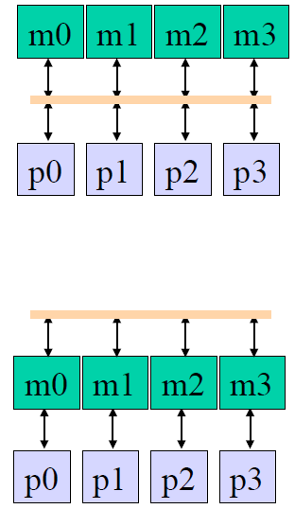
Topology 1 – Bus
Network Topology
Defines organization of network nodes
Topologies differ in connectivity, latency, bandwidth, and cost.
Notation: f(1) denotes constant independent of p, f(p) denotes linearly increasing cost with p, etc…
Bus
Direct interconnect style
Latency: f(1) wire delay
Bandwidth: f(1/p) and not scalable (p<=4)
Cost: f(1) wire cost
Supports ordered broadcast only

Slide 9
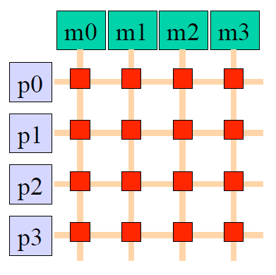
Topology 2 – Crossbar Switch
Network Topology
Defines organization of network nodes
Topologies differ in connectivity, latency, bandwidth, and cost.
Notation: f(1) denotes constant independent of p, f(p) denotes linearly increasing cost with p, etc…
Crossbar Switch
Indirect interconnect.
Switches implemented as big multiplexors
Latency: f(1) constant latency
Bandwidth: f(1)
Cost: f(2P) wires, f(P²) switches

Slide 10
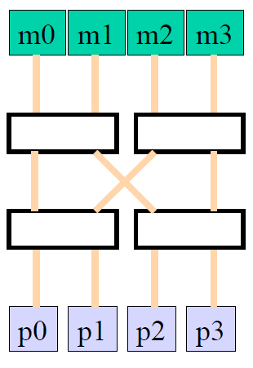
Topology 3 – Multistage Network
Network Topology
Defines organization of network nodes
Topologies differ in connectivity, latency, bandwidth, and cost.
Notation: f(1) denotes constant independent of p, f(p) denotes linearly increasing cost with p, etc…
Crossbar Switch
Indirect interconnect.
Routing done by address decoding
k: switch arity (#inputs or #outputs)
d: number of network stages = log_{k}P
Latency: f(d)
Bandwidth: f(1)
Cost: f(d*P/k) switches, f(P*d) wires
Commonly used in large UMA systems

Slide 11
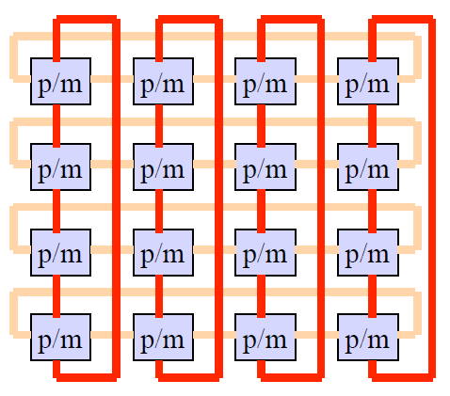
Topology 4 – 2D Torus
Network Topology
Defines organization of network nodes
Topologies differ in connectivity, latency, bandwidth, and cost.
Notation: f(1) denotes constant independent of p, f(p) denotes linearly increasing cost with p, etc…
2D Torus
Direct interconnect
Latency: f(P^{1/2})
Bandwidth: f(1)
Cost: f(2P) wires
Scalable and widely used.
Variants: 1D torus, 2D mesh, 3D torus

Slide 12
Challenges in Shared Memory
Cache Coherence
“Common Sense”
P1-Read[X] → P1-Write[X] → P1-Read[X] Read returns X
P1-Write[X] → P2-Read[X] Read returns value written by P1
P1-Write[X] → P2-Write[X] Writes serialized
All P’s see writes in same order
Synchronization
Atomic read/write operations
Memory Consistency
What behavior should programmers expect from shared memory?
Provide a formal definition of memory behavior to programmer
Example: When will a written value be seen?
Example: P1-Write[X] <<10ps>> P2-Read[X]. What happens?

Slide 13
Example Execution
Processor 0 Processor 1
0: addi r1, accts, r3
1: ld 0(r3), r4
2: blt r4, r2, 6
3: sub r4, r2, r4
4: st r4, 0 (r3)
5: call give-cash 0: addi r1, accts, r3 # get addr for account
1: ld 0(r3), r4 # load balance into r4
2: blt r4, r2, 6 # check for sufficient funds
3: sub r4, r2, r4 # withdraw
4: st r4, 0(r3) #store new balance
5: call give-cash
CPU0
CPU1
Mem
Two withdrawals from one account. Two ATMs
Withdraw value: r2 (e.g., $100)
Account memory address: accts+r1
Account balance: r4

Slide 14
Scenario 1 – No Caches
P0
P1
Mem
Processor 0 Processor 1
0: addi r1, accts, r3
1: ld 0(r3), r4
2: blt r4, r2, 6
3: sub r4, r2, r4
4: st r4, 0 (r3)
5: call give-cash 0: addi r1, accts, r3
1: ld 0(r3), r4
2: blt r4, r2, 6
3: sub r4, r2, r4
4: st r4, 0(r3)
5: call give-cash
500
500
400
400
300
Processors have no caches
Withdrawals update balance without a problem

Slide 15
Scenario 2a – Cache Incoherence
P0
P1
Mem
Processor 0 Processor 1
0: addi r1, accts, r3
1: ld 0(r3), r4
2: blt r4, r2, 6
3: sub r4, r2, r4
4: st r4, 0 (r3)
5: call give-cash 0: addi r1, accts, r3
1: ld 0(r3), r4
2: blt r4, r2, 6
3: sub r4, r2, r4
4: st r4, 0(r3)
5: call give-cash
500
V:500
500
D:400
500
D:400
V:500
500
D:400
D:400
500
Processors have write-back caches
Processor 0 updates balance in cache, but does not write-back to memory
Multiple copies of memory location [accts+r1]
Copies may get inconsistent

Slide 16
Scenario 2b – Cache Incoherence
P0
P1
Mem
Processor 0 Processor 1
0: addi r1, accts, r3
1: ld 0(r3), r4
2: blt r4, r2, 6
3: sub r4, r2, r4
4: st r4, 0 (r3)
5: call give-cash 0: addi r1, accts, r3
1: ld 0(r3), r4
2: blt r4, r2, 6
3: sub r4, r2, r4
4: st r4, 0(r3)
5: call give-cash
500
V:500
500
V:400
400
V:400
V:400
400
V:400
V:300
300
Processors have write-through caches
What happens if processor 0 performs another withdrawal?

Slide 17
Hardware Coherence Protocols
Absolute Coherence
  All cached copies have same data at same time. Slow and hard to implement
Relative Coherence
  Temporary incoherence is ok (e.g., write-back caches) as long as no load reads incoherent data.
Coherence Protocol
  Finite state machine that runs for every cache line
  Define states per cache line
  Define state transitions based on bus activity
  Requires coherence controller to examine bus traffic (address, data)
  (4) Invalidates, updates cache lines
CPU
D$ data
CC
D$ tags
bus

Slide 18
Protocol 1 – Write Invalidate
Mechanics
  Process P performs write, broadcasts address on bus
  !P snoop the bus. If address is locally cached, !P invalidates local copy
  Process P performs read, broadcasts address on bus
  !P snoop the bus. If address is locally cached, !P writes back local copy
Example
Data in Data in Data in
Processor-Activity Bus-Activity Cache-A Cache-B Mem[X]
0
CPU-A reads X Cache miss for X 0 0
CPU-B reads X Cache miss for X 0 0 0
CPU-A writes 1 to X Invalidation for X 1 0
CPU-B reads X Cache miss for X 1 1 1

Slide 19
Protocol 2 – Write Update
Mechanics – processor P performs write
  Do not invalidate !P cache line.
  Instead update !P cache line and memory
  Pro: !P gets data faster
  Con: Requires significant bandwidth
Data in Data in Data in
Processor-Activity Bus-Activity Cache-A Cache-B Mem[X]
0
CPU-A reads X Cache miss for X 0 0
CPU-B reads X Cache miss for X 0 0 0
CPU-A writes 1 to X Write Broadcast X 1 1 1
CPU-B reads X Cache hit for X 1 1 1

Slide 20
Cache Coherent Systems
Provide Coherence Protocol
  States
  State transition diagram
  Actions
Implement Coherence Protocol
  (0) Determine when to invoke coherence protocol
  Find state of cache line to determine action
  Locate other cached copies
  Communicate with other cached copies (invalidate, update)
Implementation Variants
  (0) is done in the same way for all systems. Maintain additional state per cache line. Invoke protocol based on state
  (1-3) have different approaches

Slide 21
Implementation 1 – Snooping
Bus-based Snooping
  All cache/coherence controllers observe/react to all bus events.
  Protocol relies on globally visible events
    i.e., all processors see all events
  Protocol relies on globally ordered events
      i.e., all processors see all events in same sequence
Bus Events
  Processor (events initiated by own processor P)
    read (R), write (W), write-back (WB)
  Bus (events initiated by other processors !P)
        bus read (BR), bus write (BW)

Slide 22
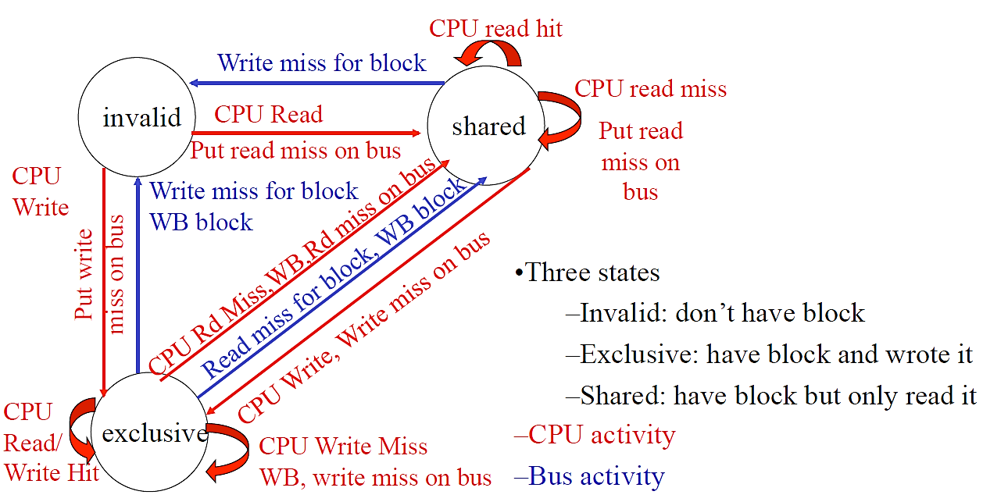
Three-State Invalidate Protocol
Implement protocol for every cache line.
Add state bits to every cache to indicate (1) invalid, (2) shared, (3) exclusive

Slide 23
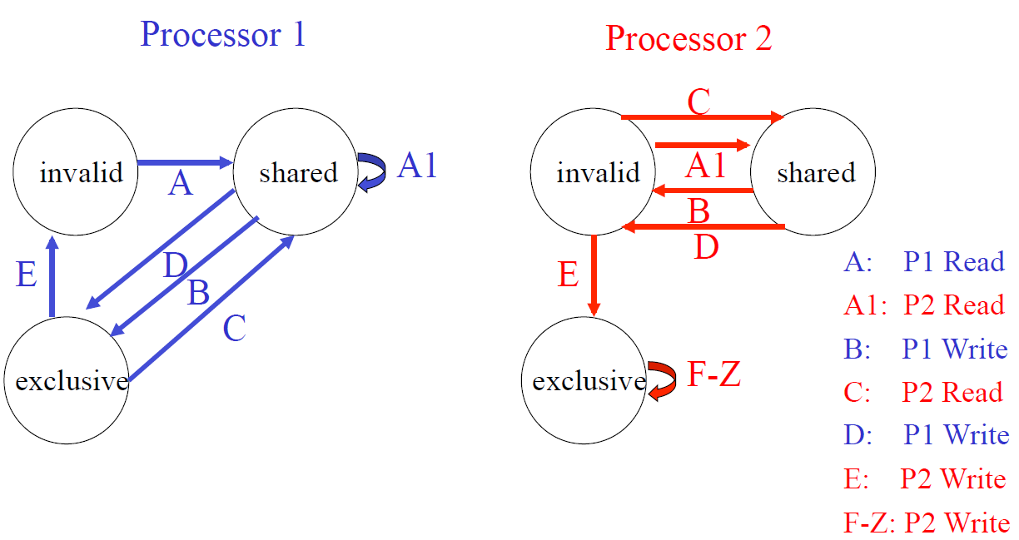
Example
P1 read (A)
P2 read (A1)
P1 write (B)
P2 read (C)
P1 write (D)
P2 write (E)
P2 write (F-Z)

Slide 24
Implementation 2 – Directory
Bus-based Snooping – Limitations
  Snooping scalability is limited
  Bus has insufficient data bandwidth for coherence traffic
  Processor has insufficient snooping bandwidth for coherence traffic
Directory-based Coherence – Scalable Alternative
  Directory contains state for every cache line
  Directory identifies processors with cached copies and their states
  In contrast to snoopy protocols, processors observe/act only on relevant memory events. Directory determines whether a processor is involved.

Slide 25
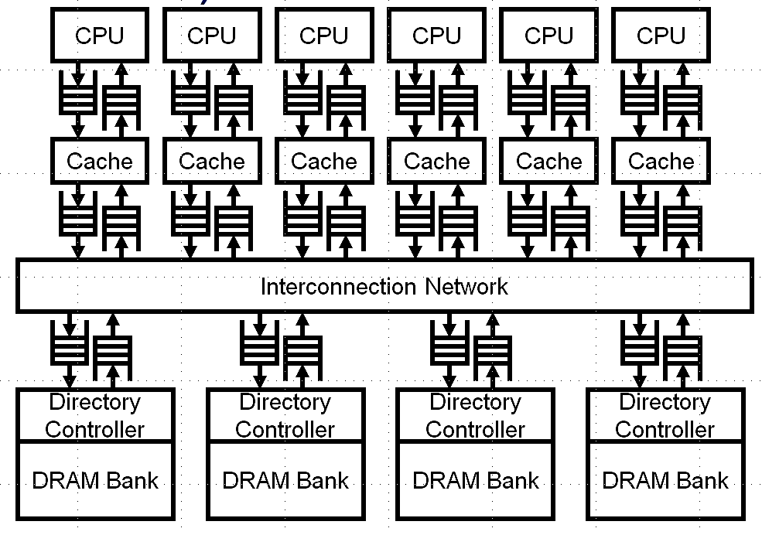
Directory Communication
Processor sends coherence events to directory
    Find directory entry
    Identify processors with copies
    Communicate with processors, if necessary

Slide 26
Challenges in Shared Memory
Cache Coherence
“Common Sense”
P1-Read[X] → P1-Write[X] → P1-Read[X] Read returns X
P1-Write[X] → P2-Read[X] Read returns value written by P1
P1-Write[X] → P2-Write[X] Writes serialized
All P’s see writes in same order
Synchronization
Atomic read/write operations
Memory Consistency
What behavior should programmers expect from shared memory?
Provide a formal definition of memory behavior to programmer
Example: When will a written value be seen?
Example: P1-Write[X] <<10ps>> P2-Read[X]. What happens?

Slide 27
Synchronization
Regulate access to data shared by processors
  Synchronization primitive is a lock
  Critical section is a code segment that accesses shared data
  Processor must acquire lock before entering critical section.
  Processor should release lock when exiting critical section
Spin Locks – Broken Implementation
  acquire (lock) # if lock=0, then set lock = 1, else spin
  critical section
  release (lock) # lock = 0
  Inst-0: ldw R1, lock # load lock into R1
  Inst-1: bnez R1, Inst-0 # check lock, if lock!=0, go back to Inst-0
  Inst-2: stw 1, lock # acquire lock, set to 1
  << critical section>>> # access shared data
  Inst-n: stw 0, lock # release lock, set to 0

Slide 28
Implementing Spin Locks
  Processor 0 Processor 1
  Inst-0: ldw R1, lock
  Inst-1: bnez R1,Inst-0 # P0 sees lock is free
  Inst-0: ldw R1, lock
  Inst-1: bnez R1, Inst-0 # P1 sees lock is free
  Inst-2: stw 1, lock # P0 acquires lock
  Inst-2: stw 1, lock # P1 acquires lock
  …..
  …. # P0/P1 in critical section
  …. # at the same time
  Inst-n: stw 0, lock
Problem: Lock acquire not atomic
  A set of atomic operations either all complete or all fail. During a set of atomic operations, no other processor can interject.
  Spin lock requires atomic load-test-store sequence

Slide 29
Implementing Spin Locks
Solution: Test-and-set instruction
  Add single instruction for load-test-store (t&s R1, lock)
  - Test-and-set atomically executes
    ld R1, lock; # load previous lock value
    st 1, lock; # store 1 to set/acquire
  If lock initially free (0), t&s acquires lock (sets to 1)
  If lock initially busy (1), t&s does not change it
  Instruction is un-interruptible/atomic by definition
  Inst-0 t&s R1, lock # atomically load, check, and set lock=1
  Inst-1 bnez R1 # if previous value of R1 not 0,
  …. acquire unsuccessful
  Inst-n stw R1, 0 # atomically release lock

Slide 30
Test-and-Set Inefficiency
Test-and-set works…
  Processor 0 Processor 1
  Inst-0: t&s R1, lock
  Inst-1: bnez R1,Inst-0 Inst-0: t&s R1, lock # P0 sees lock is free
  Inst-1: bnez R1, Inst-0 # P1 does not acquire
…but performs poorly
  Suppose Processor 2 (not shown) has the lock
  Processors 0/1 must…
    Execute a loop of t&s instructions
    Issue multiple store instructions
    Generate useless interconnection traffic

Slide 31
Test-and-Test-and-Set Locks
Solution: Test-and-test-and-set
  Inst-0 ld R1, lock # test with a load, see if lock changed
  Inst-1 bnez R1, Inst-0 # if lock=1, spin
  Inst-2 t&s R1, lock # if lock=1, test-and-set
  Inst-4 bnez R1, Inst-0 # if can not acquire, spin
Advantages
  Spins locally without stores
  Reduces interconnect traffic
  Not a new instruction, simply new software (lock implementation)

Slide 32
Semaphores
Semaphore (semaphore S, integer N)
  Allows N parallel threads to access shared variable
  If N = 1, equivalent to lock
  Requires atomic fetch-and-add
  Function Init (semaphore S, integer N) {
  s = N;
  }
  Function P (semaphore S) { # “Proberen” to test
  while (S == 0) { };
  s = s -1 ;
  }
  Function V (semaphore S) { # “Verhogen” to increment
  s = s + 1;
  }

Slide 33
Challenges in Shared Memory
Cache Coherence
“Common Sense”
P1-Read[X] → P1-Write[X] → P1-Read[X] Read returns X
P1-Write[X] → P2-Read[X] Read returns value written by P1
P1-Write[X] → P2-Write[X] Writes serialized
All P’s see writes in same order
Synchronization
Atomic read/write operations
Memory Consistency
What behavior should programmers expect from shared memory?
Provide a formal definition of memory behavior to programmer
Example: When will a written value be seen?
Example: P1-Write[X] <<10ps>> P2-Read[X]. What happens?

Slide 34
Memory Consistency
Execution Example
  A = Flag = 0
  Processor 0 Processor 1
  A = 1 while (!Flag)
  Flag = 1 print A
Intuition – P1 should print A=1
Coherence – Makes no guarantees!

Slide 35
Consistency and Caches
Execution Example
  A = Flag = 0
  Processor 0 Processor 1
  A = 1 while (!Flag)
  Flag = 1 print A
Caching Scenario
1. P0 writes A=1. Misses in cache. Puts write into a store buffer.
2. P0 continues execution.
3. P0 writes Flag=1. Hits in cache. Completes write (with coherence)
4. P1 reads Flag=1.
5. P1 exits spin loop.
6. P1 prints A=0
Caches, buffering, and other performance mechanisms can cause strange behavior.

Slide 36
Sequential Consistency (SC)
Definition of Sequential Consistency
Formal definition of programmers’ expected view of memory
Each processor P sees its own loads/stores in program order
(2) Each processor P sees !P loads/stores in program order
(3) All processors see same global load/store ordering.
P and !P loads/stores may be interleaved into some order.
But all processors see the same interleaving/ordering.
Definition of Multiprocessor Ordering [Lamport]
Multi-processor ordering corresponds to some sequential interleaving of uni-processor orderings. Multiprocessor ordering should be indistinguishable from multi-programmed uni-purocessor

Slide 37
Enforcing SC
Consistency and Coherence
- SC Definition: loads/stores globally ordered
- SC Implications: coherence events of all load/stores globally ordered
Implementing Sequential Consistency
All loads/stores commit in-order
Delay completion of memory access until all invalidations that are caused by access are complete
Delay a memory access until previous memory access is complete
Delay memory read until previous write completes. Cannot place writes in a buffer and continue with reads.
Simple for programmer but constraints HW/SW performance optimizations

Slide 38
Weaker Consistency Models
Assume programs are synchronized
- SC required only for lock variables
Other variables are either (1) in critical section and cannot be accessed in parallel or (2) not shared
Use fences to restrict re-ordering
Increases opportunity for HW optimization but increases programmer effort
Memory fences stall execution until write buffers empty
Allows load/store reordering in critical section.
Slows lock acquire, release
acquire
memory fence
critical section
memory fence # ensures all writes from critical section
release # are cleared from buffer

Slide 39
Summary
Shared Memory Multiprocessors
  Provides efficient and familiar abstraction to programmer
  Much, much more in ECE259
Cache Coherence
  Coordinate accesses to shared, writeable data
  Coherence protocol defines cache line states, state transitions, actions
  Snooping implementation – bus and broadcast
  Directory implementation – directory and
Synchronization
  Locks and ISA support for atomicity
Memory Consistency
  Defines programmers’ expected view of memory
  Sequential consistency imposes ordering on loads/stores

