Slide 1
weHelp: A Reference Architecture for Social Recommender Systems
Swapneel Sheth, Nipun Arora, Christian Murphy, Gail Kaiser
Department of Computer Science, Columbia University
New York, NY 10027
{swapneel, nipun, cmurphy, kaiser}@cs.columbia.edu

Slide 2
Introduction
Recommender systems have been increasingly popular and ubiquitous – Amazon, Netflix, Facebook, Pandora
Most of the research has focused on aspects such as algorithms [Netb, ZP07], social network implications [ZC08], and security/privacy issues [BEKR07, MA07]
Very little research in the area of system architectures for recommendation systems
Work such as [GNOT92] has focused on their own implementations, without aiming to propose a general purpose reference architecture

Slide 3
Introduction
We introduce weHelp – A Reference Architecture for Social Recommender Systems
Targeted towards community-driven recommender systems – systems where recommendations are derived automatically from the aggregate of logged activities conducted by the system’s users
Designed to be generic and domain agnostic
Intended to provide a template for designing a well-modularized system

Slide 4
Background and Motivation
We are working on three otherwise unrelated research projects that share a similar theme: providing suggestions aimed to help users employ particular software tools in some better way
These systems were designed independently, and were not intended to exhibit a common architecture, but we realized that their architectures are very similar
Distilled a common architecture and the best practices that we discovered along the way into our reference architecture

Slide 5
genSpace [MSKW08]
Plugin for geWorkbench [CFKW], an open-source Java-based system for integrated genomics targeted toward biomedical researchers
geWorkbench includes more than 50 tools for genomics data analysis and visualizations
Can be very daunting for users who don’t know which tools to use, the order of using the tools, etc.
genSpace provides recommendations such as the most frequently occuring workflows including a given tool or starting with the sequence of tools the user has already executed

Slide 6
Retina [MKLH09]
Community-driven recommendations targeted towards CS1 (intro to programming) courses
Students have little prior programming experience – may not be able to estimate the time required or understand the cryptic compiler error messages
Retina provides recommendations such as the time expected to spend on an assignment given the distribution of students' work on the same assignment in previous semesters and the user's standing within the current class

Slide 7
COMPASS [SAG⁺09]
“Community Driven Parallelization Advisor for Sequential Software” – targeted towards programmers
Parallelizing sequential code is hard
COMPASS provides recommendations on potential optimizations, based on previous optimizations performed by expert users
Uses a code matching and ranking algorithm for the recommendations

Slide 8
Reference Architecture
Collection of best practices for a domain [HH00]
Blueprint and design template for building applications
Defines a common vocabulary with the goal of standardizing different independent implementations
Usually defines different modules and specifies the functionality of each module along with the interaction and interfaces between the different modules
Creates the potential for future components to be reused across systems
E.g., scientific workflow management [LLF⁺09] and web servers [HH00]

Slide 9
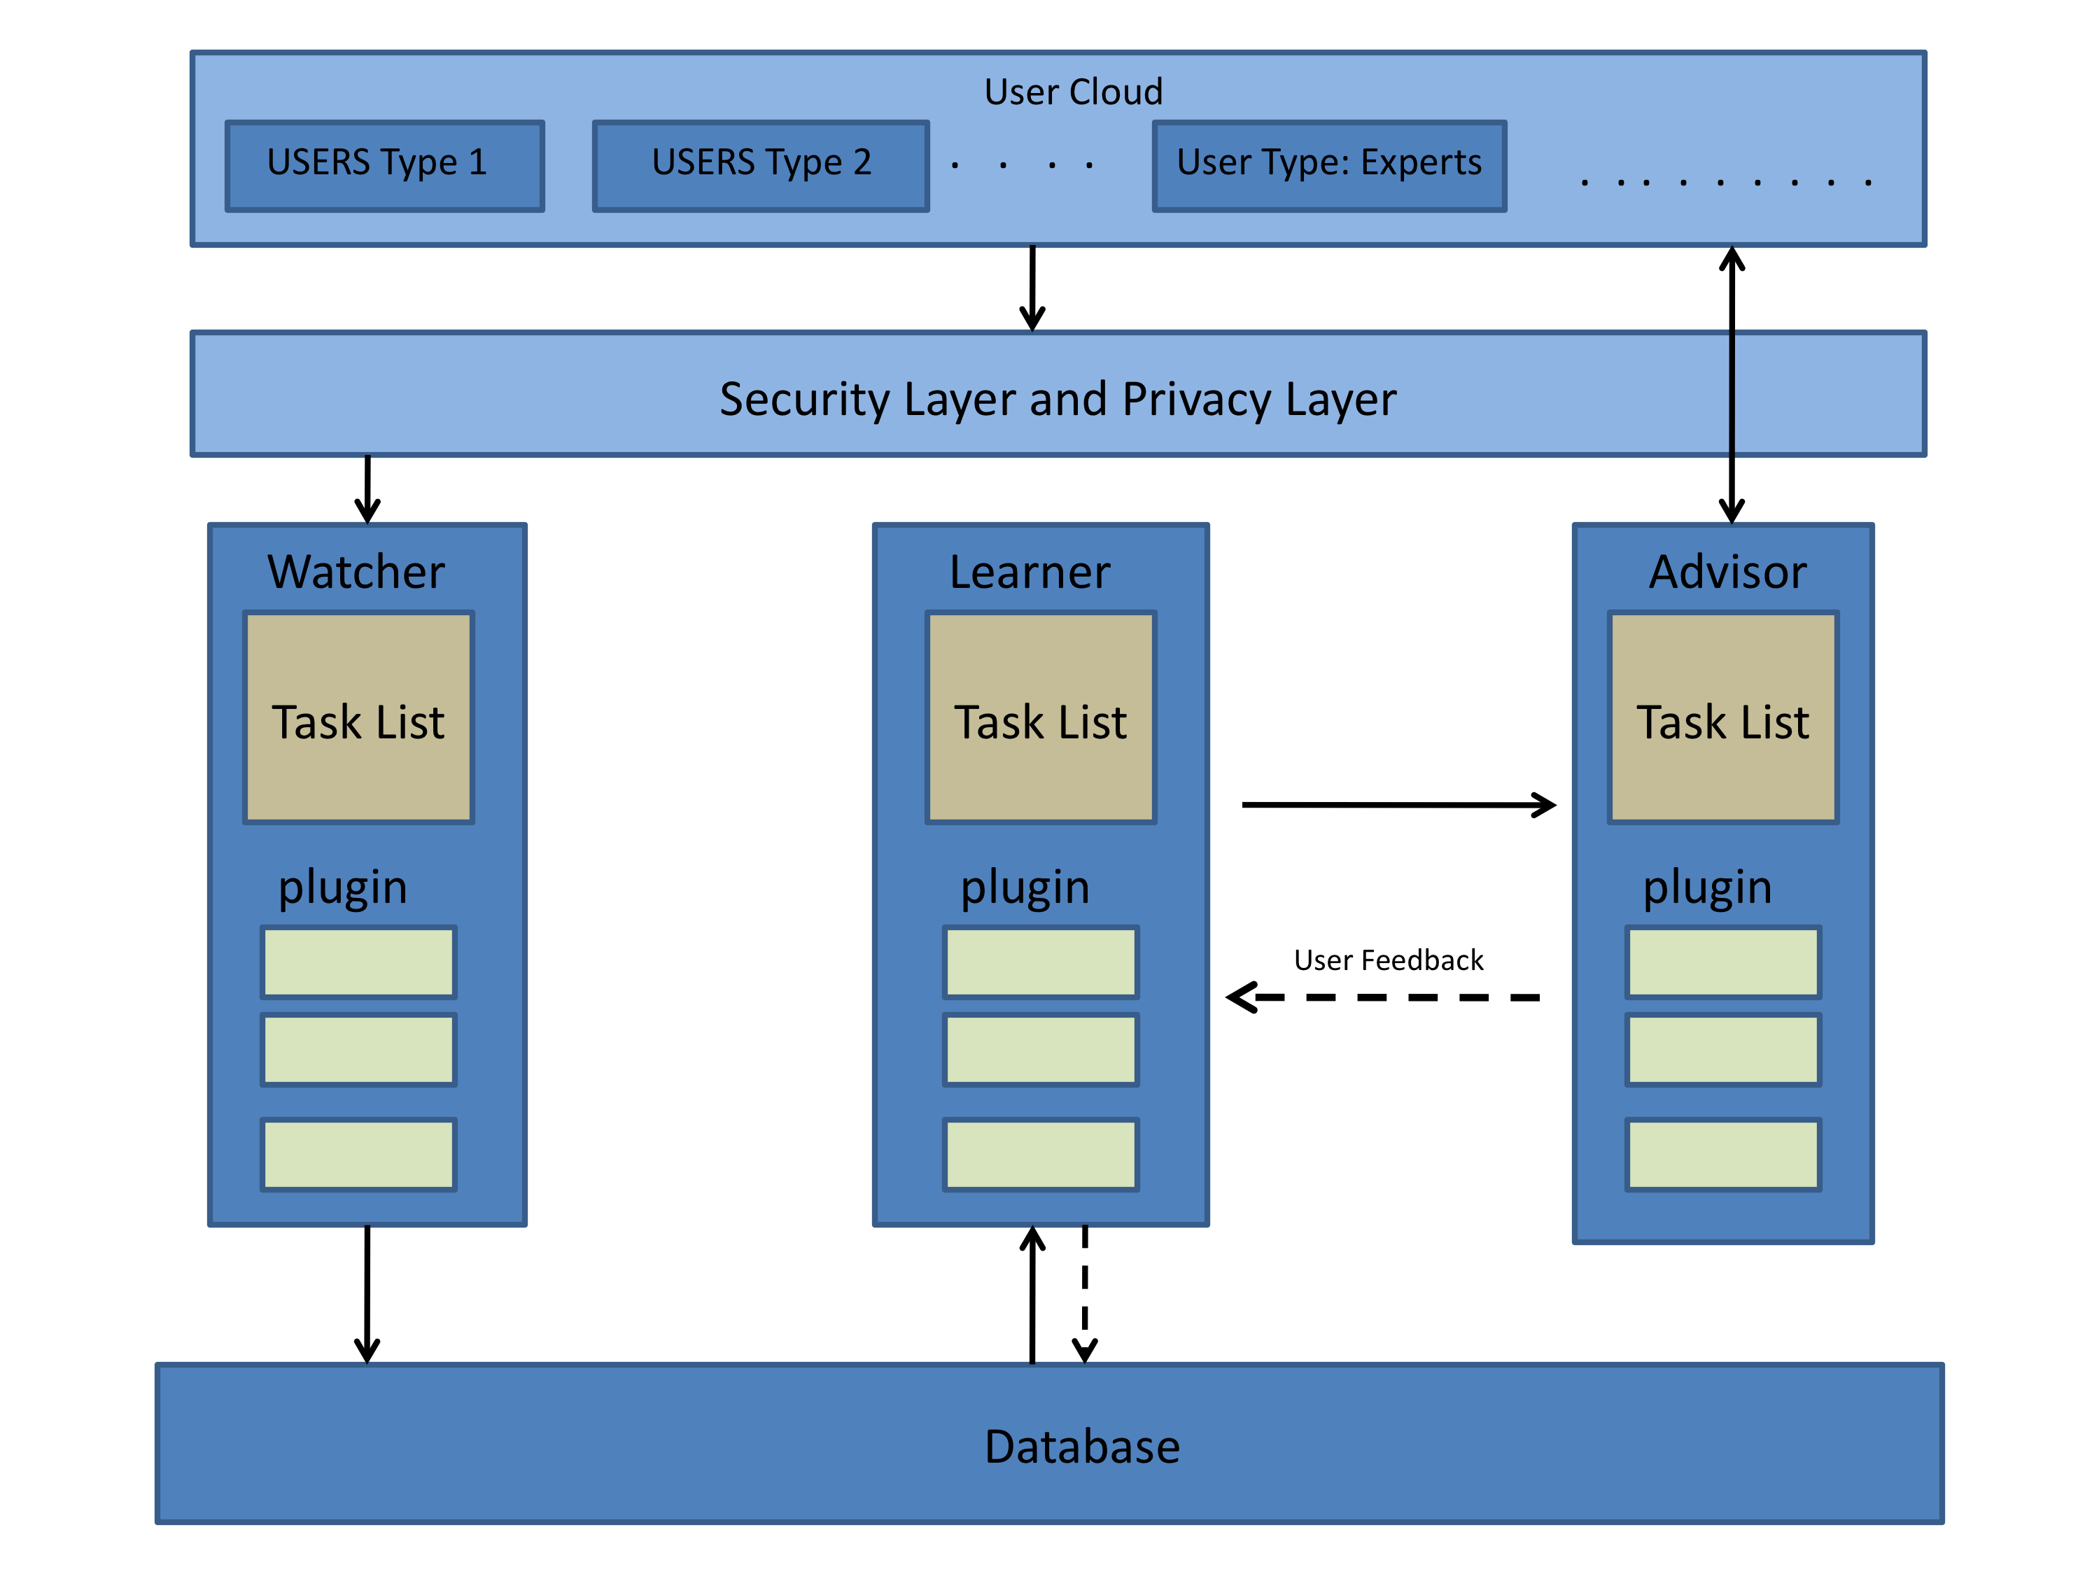
weHelp Reference Architecture

Slide 10
The Watcher Module
Observer of User Activities
“Watches” what the user does and logs it
Explicit Observations
  Users can annotate/tag the data and activities
Implicit Observations
  Usually a better option – unobtrusive, no effort for users
  E.g., counting the number of times a link was clicked
Generate a parseable representation of user activities

Slide 11
The Watcher Module
Optional Functionality
  Users can provide extra domain specific information
  Users can rate certain activities

Slide 12
The Watcher Module - Amazon
Observes the pages visited by a user
E.g., if a user wants to buy an MP3 player, the Watcher can keep track of different MP3 players looked at and details such as vendor, color, etc.
Users can provide explicit information such as rating of products and reviews

Slide 13
The Watcher Module - genSpace
Observe the users’ activities as they use geWorkbench
Log information such as type of analysis, name of dataset, and the current time
Data can be logged with user names, anonymously, or not at all
All users are treated equally – no differentiation between “novice users” and “expert users”

Slide 14
The Watcher Module – Retina
Observe and record students’ compilation attempts and compiler errors
Log information such as type of error, file name, and line number
Data can be logged with user names, anonymously, or not at all
All users are treated equally – no differentiation between “novice users” and “expert users”

Slide 15
The Watcher Module – COMPASS
COMPASS does differentiate between “novice users” and “expert users”
Watcher module targeted towards expert users
Users select “hot-spots” for parallelization and then write the corresponding parallel program
Watcher module stores both versions
Users can provide extra domain information such as target architecture and additional comments

Slide 16
The Learner Module
Infers patterns and/or recommendations
Uses the data provided by the Watcher module
Can use a simple rule-based system, data aggregation, or complex data mining algorithms

Slide 17
The Learner Module
Optional Functionality
  Use different Ranking Algorithms
  Weigh user data in different ways such as weighing data from experts more than data novice users
  Generate overall system statistics
  Include optimizations such as caching of data and results

Slide 18
The Learner Module - Amazon
Uses the information recorded by the Watcher module to infer patterns and recommendations
E.g., suggest alternate products to buy depending on the products viewed by the user
Generates statistics such as the highest rated products and the most popular products in different categories

Slide 19
The Learner Module - genSpace
Uses data aggregation to provide recommendations
E.g., the next best tool to use, based on popular workflows and the tools used by the user so far
Uses an exponential time decay formula [CS03] to weigh recent user data more heavily
Generates statistics such as the most popular tools and the most popular workflows

Slide 20
The Learner Module - Retina
Uses a rule-based system to provide recommendations
E.g., the amount of time a student can expect to spend on an assignment, based on the student’s past performance and the time taken by others for the same assignment in the past
Generates statistics such as the most common compilation errors and the average time spent on the assignment for all students, which can be useful for instructors to gauge the difficulty of an assignment
Retina also helps instructors by providing a picture of particular difficulties faced by the current class, to help them refine their lectures

Slide 21
The Learner Module - COMPASS
Uses a code matching and ranking algorithm to provide recommendations
E.g., code parallelizations, based on the serial code under consideration and past parallelizations performed by users
COMPASS uses a code matching algorithm on the key “before” entries in its knowledge base and then a ranking algorithm to prioritize the corresponding value “after” entries

Slide 22
The Advisor Module
Provides recommendations to the users
Uses the data from the Learner module
Implemented using a variety of different UI options
Pulled Recommendations
  Users can ask for recommendations when needed most
Pushed Recommendations
  More dynamic, can take into account users’ current activities

Slide 23
The Advisor Module
Care should be taken to avoid the “Clippy Effect” [Gal06]
Optional Functionality
  Allow the user to rate the suggestions
  Users can provide feedback to the recommender system and to other users

Slide 24
The Advisor Module - Amazon
Provides recommendations using HTML pages as UI
E.g., other similar products viewed by users who viewed this product

Slide 25
The Advisor Module - genSpace
Provides recommendations using Java Swing as UI
Provides both pushed and pulled recommendations
Users can ask for recommendations such as workflows that start with a certain tool
Real-time suggestions such as what’s the next best tool to use, based on the users’ current activities
Users can provide feedback by rating tools and workflows and by writing comments on an affiliated web portal

Slide 26
The Advisor Module - Retina
Provides recommendations using Instant Messaging Applications as UI
Provides both pushed and pulled recommendations
Users can ask for recommendations such as the amount of time needed for the assignment
Real-time recommendations based on the students’ current activities such as if a student is taking too long on a particular assignment

Slide 27
The Advisor Module - COMPASS
Provides recommendations as stylized templates known as ‘sketches’
Sketches are shown as graphical overlays on the existing source code
Users can chose whether to accept the recommendation as is, or modify it to suit their needs - this can be used as indirect feedback to the system

Slide 28
Other Components
Database
  Used as a data store for user activities
Security and Privacy Layer
  Recommendations provided by the system may be used to invade the privacy of users by inferring how a particular user uses the system
  This layer provides the functionality to ensure that the users’ privacy is maintained and security threats are mitigated
User Cloud
  Can be used to differentiate users into groups

Slide 29
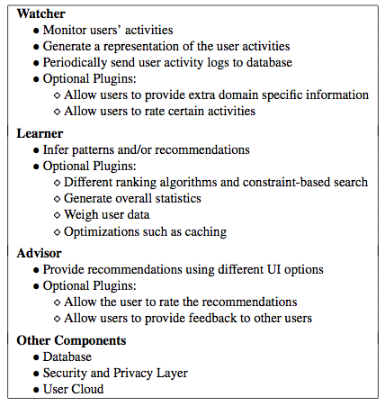
weHelp Reference Architecture

Slide 30
Limitations and Future Work
Knowledge-based Recommendation Systems
  Use domain knowledge to provide recommendations
  Similar to Expert Systems, may not utilize any aspects of social networking
  E.g., ACE [Mei98] and [MFS09]
  Cannot be mapped to the weHelp Reference Architecture
Security and Privacy Layer
  Expand on and provide more concrete modules

Slide 31
Conclusion
weHelp: A Reference Architecture for Social Recommender Systems
Designed to be generic and domain agnostic
Provides a template for designing modularized recommender systems
Could lead to standard interfaces and interoperability among recommender system components

Slide 32
Acknowledgements
Aris Floratos and Kiran Keshav - genSpace
Sahar Hasan - Retina
Simha Sethumadhavan – COMPASS
Lauren Wilcox
The authors are members of the Programming Systems Lab, funded in part by NSF CNS-0905246, CNS-0717544, CNS-0627473 and CNS-0426623, and NIH 1 U54 CA121852-01A1

Slide 33
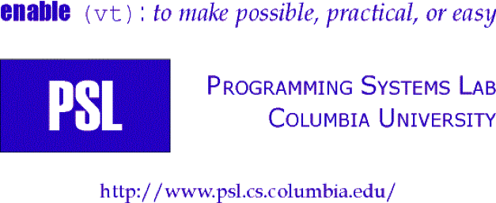
weHelp: A Reference Architecture for Social Recommender Systems
Swapneel Sheth, Nipun Arora, Christian Murphy, Gail Kaiser
Department of Computer Science, Columbia University
New York, NY 10027
{swapneel, nipun, cmurphy, kaiser}@cs.columbia.edu

